Slide 1
Interest Based Problem Solving
Hedy Eischeid
Hedy.Eischeid@neaalaska.org

Slide 2

Honoring This Space
We would like to acknowledge that this meeting is being hosted on Dena’ina Land. We want to thank the Stewards and Keepers of this land who have taken care of and nurtured it for generations.
We extend gratitude to the Dena’ina people who continue to work and live with settlers of the land, despite the continued adversity that Alaska Native peoples continue to face due to Western influence in land, climate, and subsistence.
Let us acknowledge our own places in which we learn, work, and live, and do our collective best to lift up Native communities and voices, as well as consider the hardships continuing to face marginalized communities through the extension of colonization of Western culture.
Notes:
Gina

Slide 3
Getting Started
Agenda Overview
Materials Overview
Introductions and your why

Slide 4
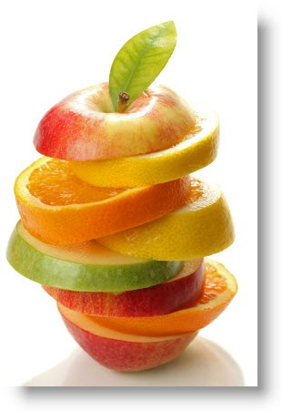
An interest-based strategy is a principled process that relies on a series of steps, commitments and behaviors that help groups seek a good solution, not just an agreement. The ultimate outcome is improved relationships.

Slide 5
Entry Point- Convene – Pg. 2
Why are you here?
What is our purpose?
Who are you as a stakeholders?
What is our Outcome/Charge?

Slide 6
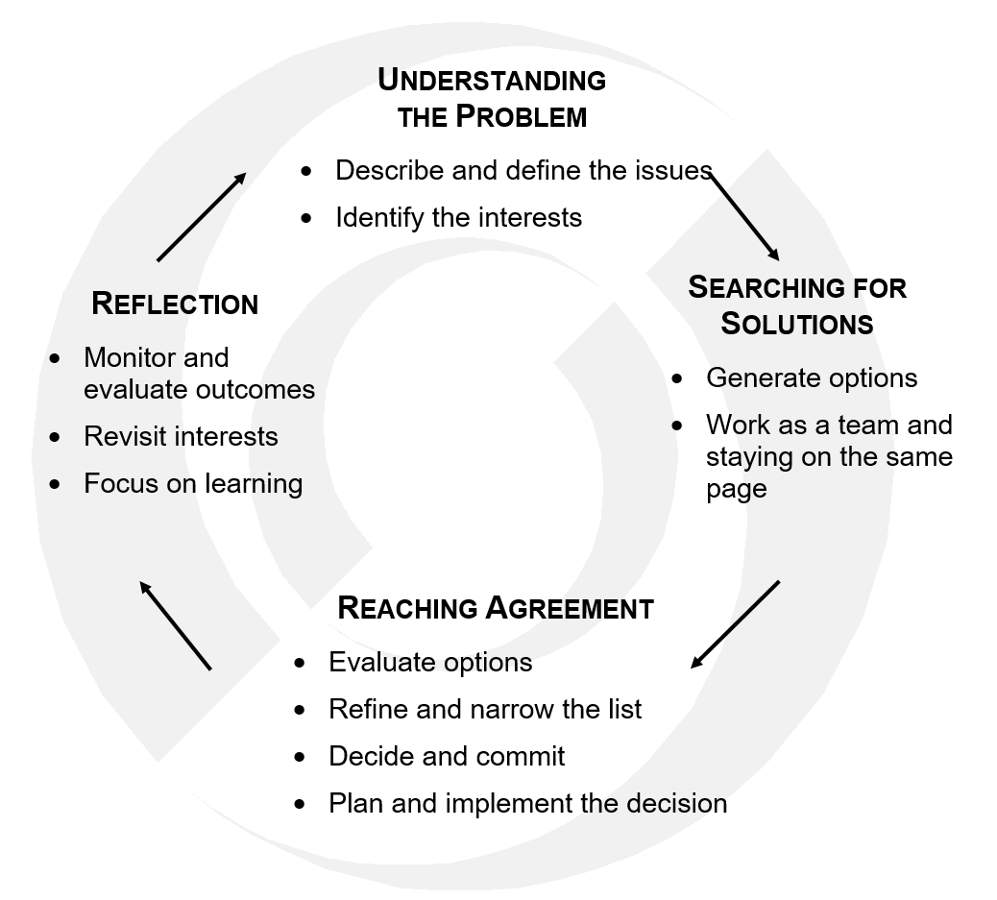

Slide 7
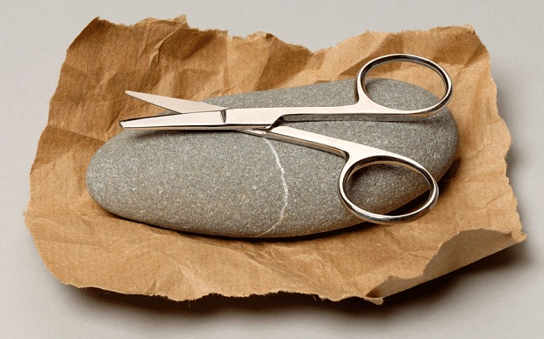
What are some examples of problem-solving or negotiating in your everyday life? Pg. 4

Slide 8
What are some examples?
Which Position do you use?

Slide 9
Position Based Approach
Interest Based Approach
Pgs. 5-7

Slide 10
Why Focus on Interests? Pg. 8
We Are
Happy Zone
Interest Based Zone Increased Options for Solutions that Maximize the Overall Interests
Middle Ground
No One is Thrilled Zone
Maximize Our Interests (we want)
No One is Happy Zone
They Are
Happy Zone
Maximize Their Interests (they want)

Slide 11
Elements of Interest Based Process Pg. 9 -15
DEFINE the issues
IDENTIFY stakeholders & interests
CREATE options
EVALUATE options
COMMIT to solutions
AGREE on a plan of action

Slide 12
Principles of Interest Based Process Pg. 17 and Pg. 29
Attack the problem not the people
Use reason to make decisions not power
Focus on interests not positions

Slide 13
It’s a Principled Process

Slide 14
Why Focus on Interests?
When we do, we find that many of our interests are held in common with the other parties at the table.
Common interests draw us together and allow us to focus on creative solutions.
It allows us to acknowledge when interests diverge.

Slide 15


Slide 16
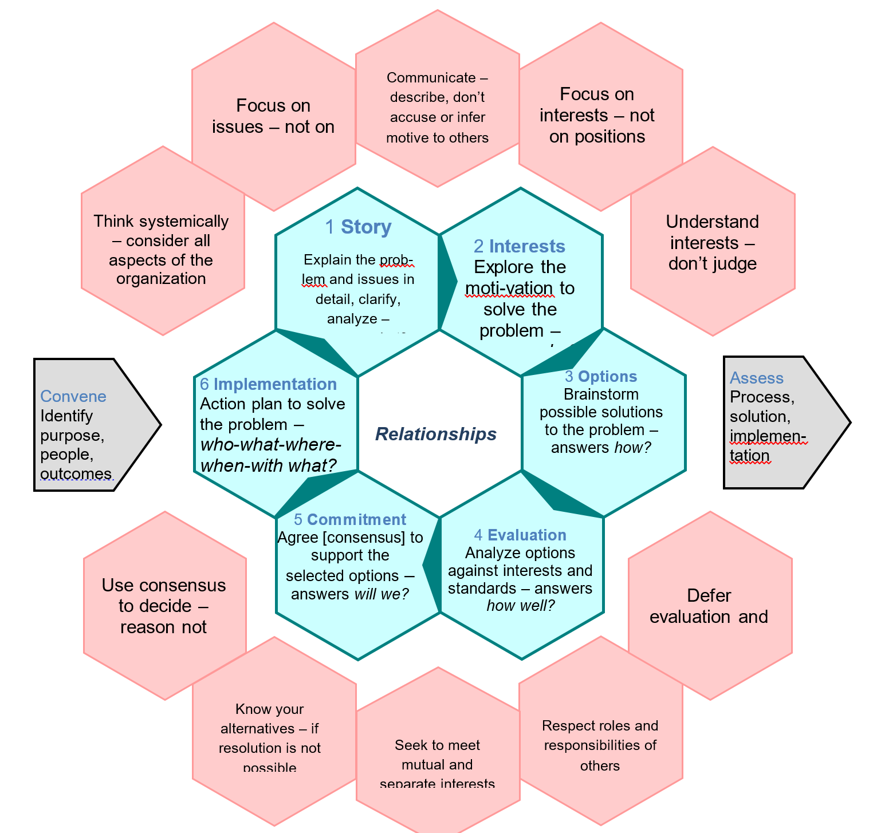
Pg. 15

Slide 17
Key Roles
Facilitator
Recorder
Group Memory Pg. 17

Slide 18
How do we build relationships?
Develop Norms
  Decide how to treat each other and capture those norms in written agreements.
Reflect as a Group
  What worked, what needs improvement and what did we learn? Entry and exit check-ins.
Surface Relationship Issues
  Raise issues as they occur, describe what happened without ascribing intent to another person or group.

Slide 19
Consensus Pg. 38
When each member of the group can honestly say:
  I believe that you understand my point of view
  I believe that I understand your point of view
  Whether or not I prefer this decision, I support it because …
    It was reached openly and fairly
    It is the best solution for us at this time

Slide 20



Thumbing
Up - I think this option adequately meets all interests
Side - I think this option might work because it may meet all interests, but I have concerns I need to discuss.
Down - I think this option does not meet the interests of the parties.

Slide 21


Tale of Two Thumbs
If you put your thumb sideways or down, explain which interests you think the option does not meet.
Note: When checking for consensus and commitment in the final step, a sideways thumb means, “I can live with the decision or solution.”

Slide 22
Recording the Thumbing
Interest Statement: Some teachers need additional funds to meet student needs. | Thumbing 1/7/2020 Up Side Down
The establishment of a fund accessible by teachers who work in high needs schools and have a documented need for more supplies. | 20 4 1
The development of a grant application system that allows any teacher to apply for small grants in the amount of $250 once a year. | 0 5 20

Slide 23
Let’s Agree to Some Norms
Pg. 18

Slide 24
Recording the Thumbing
Interest Statement: Some teachers need additional funds to meet student needs. | Thumbing 1/7/2020 Up Side Down
The establishment of a fund accessible by teachers who work in high needs schools and have a documented need for more supplies. | 20 4 1
The development of a grant application system that allows any teacher to apply for small grants in the amount of $250 once a year. | 0 5 20

Slide 25
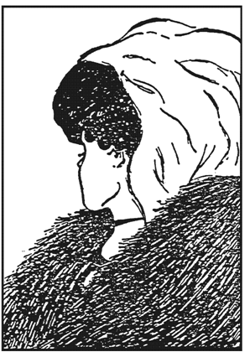
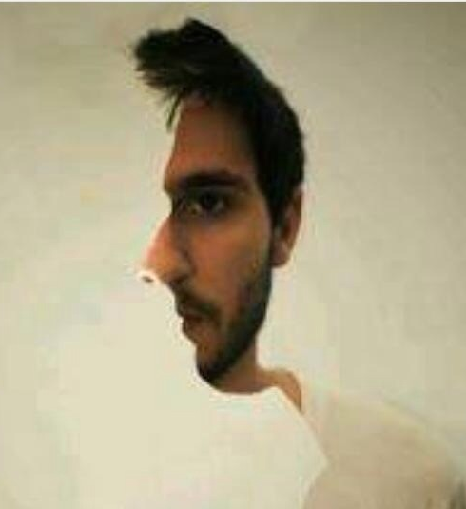
Our Perceptions Matter pg. 20 & 21

Slide 26
Principles of this Process
Attack the problem not the people
Use reason to make decisions not power
Focus on interests not positions

Slide 27
Attack the Problem
Not the People
Focus on issues, not personalities
See the other party as a partner not and opponent
Devote time to explaining, exploring and understanding the problem = TELL THE STORY

Slide 28
Reason and Principles,
not Power
Be guided by values and principles rather than position or power
It is not about maximizing individual gain or securing personal advantage
Recognize that all parties have certain interests in common

Slide 29
Focus on Interests not Positions
Interests are our concerns, needs, reasons for taking certain positions.
Positions are our demands, postures and pre-formed solutions

Slide 30
BLUE/GREEN Game Pg. 22
Find a Partner
Decide who is blue and who is green
Objective:
Win as many points as you can.
Notes:
Don

Slide 31
Step 1 – Blue Makes an X on one half or the other
BLUE EXCHANGE #1
B G +9 +9 | B G +10 -10
B G -10 +10 | B G -9 -9

Slide 32
Step 2 – Green Makes an X on what is left
BLUE EXCHANGE #1
B G +9 +9 | B G +10 -10
B G -10 +10 | B G -9 -9

Slide 33
Step 3 – Record the Points that are Left
BLUE EXCHANGE #1
B G +9 +9 | B G +10 -10
B G -10 +10 | B G -9 -9
SCORECARD
 | BLUE | GREEN
#1 | +10 | -10
#2

Slide 34
Blue Green Game
Rules:
Take two minutes to read the rules.
Blue goes first in the first box, then take turns going first. After crossing off your boxes, remember to record your scores
There is no talking.

Slide 35
Two Views of Self-Interest Pg. 24
2 Views of Self-Interest
Independent
Interdependent
In each relationship, we need to realistically assess whether we are inherently interdependent or not.
If we are, we should act like it.

Slide 36
Trusting Positive Intent
Whether between or among individuals or organizations TRUST is a dependent variable. The level of trust depends on four aspects of the relationships between and among individuals.
Predictability Can we predict what they will do in similar situations? | Reliability Do they do what they say they will do?
Accountability Do they take responsibility for what they do? | Honesty Do they have the same values about trust that we do?

Slide 37
What are you reading into this? Pg. 25
The message at the top of the screen is yours.
Scenario 1: You sent it to someone who you don’t trust very well. The response on the bottom is from them. How do you feel?

Slide 38
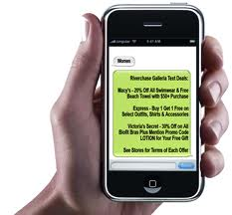
Thank you for your feedback on my meeting. I am sorry you did not get to see the whole thing. Let’s talk more about this.
Sure. I saw enough.

Slide 39
What are you reading into this?
The message at the top of the screen is yours.
Scenario 2: You sent the same message to someone you know well and trust. The response on the bottom of the screen is from them. How do you feel?

Slide 40
Thank you for your feedback on my meeting. I am sorry you did not get to see the whole thing. Let’s talk more about this.
Sure. I saw enough.

Slide 41
Ladder of Inference Pg. 26
The automatic and unconscious process of forming beliefs
 | Take action |  | We make decisions and take actions based on the rapid, unconscious reasoning process that just occurred. Our actions are visible to others — our reasoning behind them is not.
 | Adopt or support beliefs |  | We adopt beliefs based on our generalizations. These beliefs influence influence the data we select. We tend to select data to support our beliefs and ignore other data.
 | Make generalizations |  | We make generalizations about things we have not directly observed based on our conclusions about the person or event.
 | Draw conclusions |  | We reach conclusions based on the meanings we have added.
 | Add meaning |  | We attach meaning to the data we have selected based on our cultural and personal history.
 | Select data |  | We selectively acknowledge only certain data. This selection is influenced by our belief systems.
 | Observe event |  | The actual event — visible to any observer.
Based on original work by Chris Argyris, Robert Putnam and Peter Senge

Slide 42
Three Tools for the Ladder Pg. 27
Reflecting
Asking
Telling

Slide 43
Attitudes for Principled Relationships Pg. 29-31
1 Be wholly trustworthy, not wholly trusting
2 Always consult before deciding
3 Accept the other person
4 Separate relationship issues from process and content issues
5 Choose rather than react in kind
6 Describe rather than characterize
7 Assume the other person's good will
8 Be unconditionally constructive

Slide 44
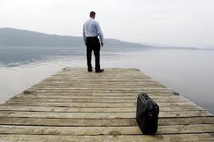
What’s the story… Pg. 32

Slide 45
Developing The Story Pg. 34
Explain the Issue: A subject of discussion, negotiation or problem-solving – the what, the problem to be solved – the story of the parties’ involvement with the issue
Develop the issues in detail
  What is the current situation?
  Why is this an issue?
  What is working or not working?
  What is causing these results?
  How does it affect us?
  What assumptions do we need to test?
  What other information do we need to fully understand the situation?
  What perspectives are not in the room that we might seek to understand?
Notes:
Carol

Slide 46
We spend a lot of time and attention on the story.

Slide 47
Defining the Problem Pg. 33
Moving from the issue and the full story to identifying problems, allows you to begin considering options more tightly aligned to key facets of the issue.

Slide 48
Defining the Problem Statement Pg. 33
Discuss the problem and develop a question that…
Includes the subject (What is the problem about?)
Identifies the issue regarding the subject (What is the issue?)
Seeks information (How might we? How can we? What shall we?)
  Cannot be answered with Yes or No
  Contains no solutions
  Contains no accusations or inflammatory wording
  Reach consensus on the form, wording and substance of the question

Slide 49
Why do you want to solve this?

Slide 50
Review of Interests
Interests are not actions, activities or programs
Interests are driven by values and needs
In an interest-based agreement process the parties always have the ability to say “no” to an option – but they have the responsibility to explain the objection in terms of their interests.
Notes:
Malethia

Slide 51
Interests
The parties’ concerns, needs or desires underlying the issue – why the issue is being raised
  Look for underlying motivations
  Discover your interests and their interests
  Use a framework of interests, not positions
  Challenge assumptions
  Prioritize
Notes:
Malethia

Slide 52
Interests are Key
Our interests- deeply held, stable concerns – underlie our more surface “positions”
Interests are driven by values and needs
Interests can be tangible or psychological

Slide 53
Why Focus on Interests?
Because when we do, we find that many of our interests are held in common with the other parties at the table.
Common interests draw us together and allow us to focus on creative solutions
It allows us to acknowledge when interests diverge

Slide 54
Why are you here? Pg. 35
Look for underlying motivations
Ask yourself: Why is this important?
What conditions will be addressed?

Slide 55
Types of Interests
  Shared Interests
  Complementary Interests
  Divergent Interests
Notes:
Malethia

Slide 56
Alternatives Pg. 36
What you can do on your own if there is no agreement or involvement with the other party
Best Alternative To a Negotiated Agreement (BATNA)
Your baseline measure of success
Protects against:
  Accepting an unfavorable agreement
  Rejecting an agreement which might be in your interest
Notes:
Don

Slide 57
Use of Standards or Criteria Pg. 44
Agreed upon qualities of an acceptable solution – how well an option solves the problem
  Propose possible standards
  Clarify the meaning of each proposed standard
  Reach consensus on the standards
  Evaluate each option against the standards

Slide 58
Sample Standards
Fair - ?
Equitable
Consistent with area/industry practice
Cost-effective / affordable
Legal
Feasible (possible/practical)
Ratifiable/Saleable
Workable – can it be done?
Notes:
Don

Slide 59
Options Pg. 10
• Options are possible solutions
• Options should be future oriented
• Options answer the question "How?"

Slide 60
Creating Options
• Separate inventing from judging
• Use free-flowing brainstorming - No criticism or evaluation
No one "owns" an option
No one has to defend any option, but may need to explain it
Invent as many options as possible
Look for options that address all interests
Encourage creativity and participation
Options do not require agreement

Slide 61
Review Options Pg. 44
1.Take one option at time.
2.Discuss whether the option meet the stakeholders’ interests.
3.If people believe the option does not meet an interest or interests, they explain
  •which interests are not being met, and
  •what they would change (or combine with another option) to make it acceptable.
4.The rest of the group also suggests ways to modify the option or create new options to better meet the interests.
Notes:
Don

Slide 62
Evaluation of Options
Clarify the options
Eliminate duplicates
Cluster related options
Compare the options to the interests

Slide 63
Tools of the Evaluation Process
Winnowing tools: methods to make a large list more manageable by reducing the list to more viable options
Winnowing the List
Weighted Polling

Slide 64
Tools of the Evaluation Process
Evaluation tools: methods for consciously & rationally comparing options based on interests
Improving Options
Pluses and Deltas
Straw Design (“One Text”)

Slide 65
Developing a Straw Design
Develop a proposal that:
  Addresses identified interests
  Conforms to identified standards
  May incorporate brainstormed ideas
Draft proposal brought to the group for review
  No ownership
  Criticism – based on interests and standards – with suggestions for “fixing” the concern, improving the proposal
Feedback included on the next draft
Repeat the process until consensus is reached
  Drafts move from “straw” to “wood…tin…iron” – each tougher to criticize or change
Notes:
Don

Slide 66
Implement
Begin an action plan [who/what/where/when] to solve the problem.
Notes:
Carol

Slide 67


