Slide 1

Access Overview
Advancing LGBTQ+ and Trans Justice:
A Cross Center Partnership with Pride

Slide 2
Why this Partnership Now
LGBTQ youth are more than four times as likely to attempt suicide than their peers
A majority of LGBTQ+ people say that they or an LGBTQ+ friend or family member have been threatened or non-sexually harassed (57 percent), been sexually harassed (51 percent), or experienced violence (51 percent) because of their sexuality or gender identity. [2]
NEA RA Support and Part of NEA Mission and Vision
[1] Human Rights Campaign Foundation. (2017, July). Mental health and the LGBTQ community. https://suicidepreventionlifeline.org/wp-content/uploads/2017/07/LGBTQ_MentalHealth_OnePager.pdf
[2] National Public Radio, the Robert Wood Johnson Foundation, & The Harvard T.H. Chan School of Public Health. (2017, November). Discrimination in America: Experiences and views of LGBTQ Americans. Retrieved June 24, 2020 from https://www.rwjf.org/en/library/research/2017/10/discrimination-in-america--experiences-and-views.html

Slide 3
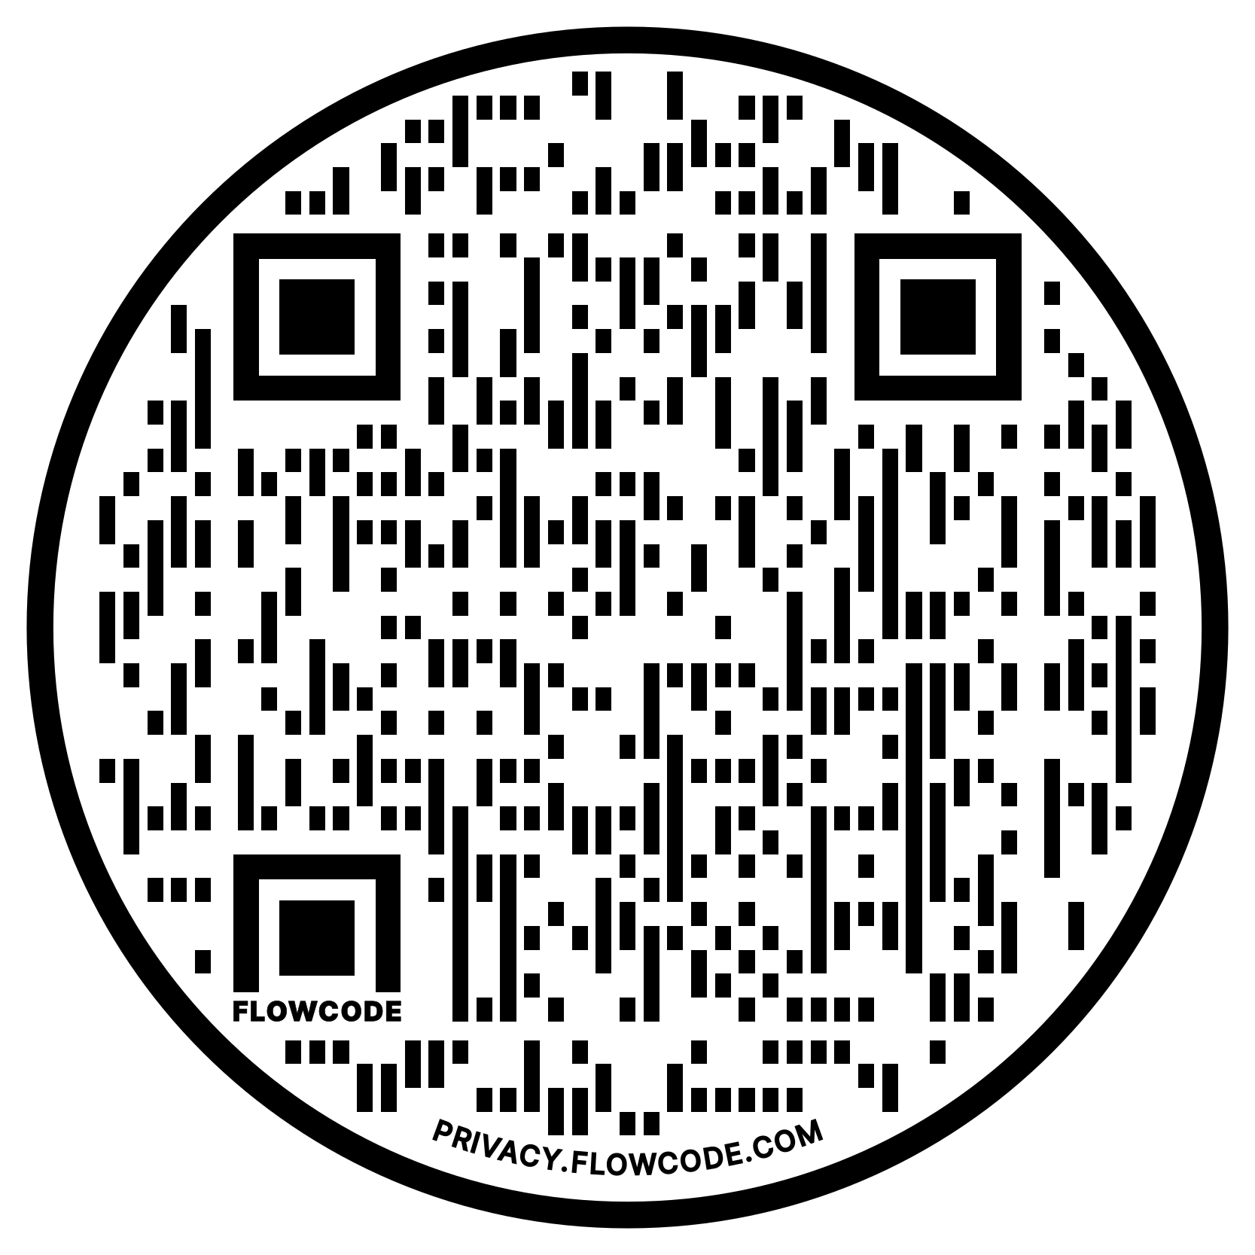
NEA Vision, Actions, Resources
Safe, Just, and Equitable Schools
Adopted by the 2022 NEA Representative Assembly
NBI 32
Training on Trans Gender Advocacy Issues for Affiliate Staff
NEA Online Toolkit – LGBTQ Resources

Slide 4

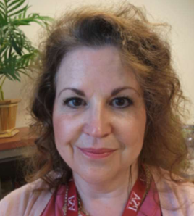
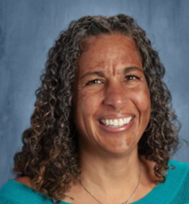
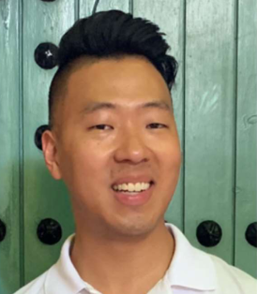
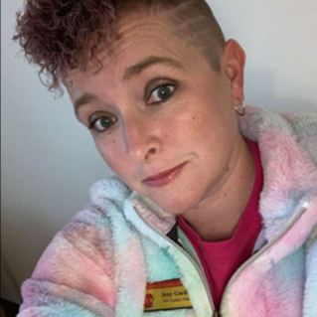
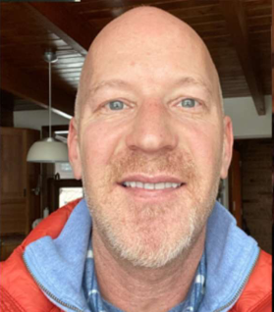
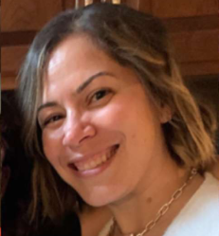
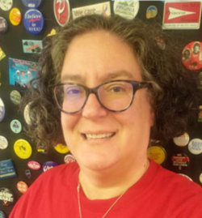

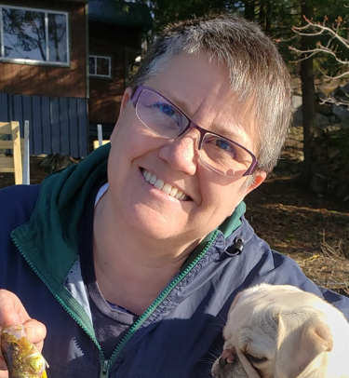
UniServ LGBTQ+ Training Team
Sara Fitouri
She/Hers
Colorado
Michelle Couture She/Hers
New York
Barb Whitman She/Hers
Utah
Ben West
He/Him
California
Jeny Gardner
She/Her
Wyoming
Grat Dalton
He/Him
Michigan
Linda Torres
She/Hers
Pennsylvania
Bekhah Saxton
She/Hers
Virginia
Colleen O’Connell
She/Hers
South Carolina
Ellen Holmes
She/Hers
NEA

Slide 5
Online Training Modules
3-part Online series focused on the transgender experience, the employment and legal landscape, and critical steps UniServ directors can take to support transgender educators in an anti-LGBTQ+ climate.
June 20, Session 1: Terminology & Gender: Understanding the Transgender Experience
June 22, Session 2: The Employment & Legal Landscape for Transitioning & Transgender Employees
June 27, Session 3: How to Support Transgender Educators in an Anti-LGBTQ+ Climate
85 Registrants

Slide 6
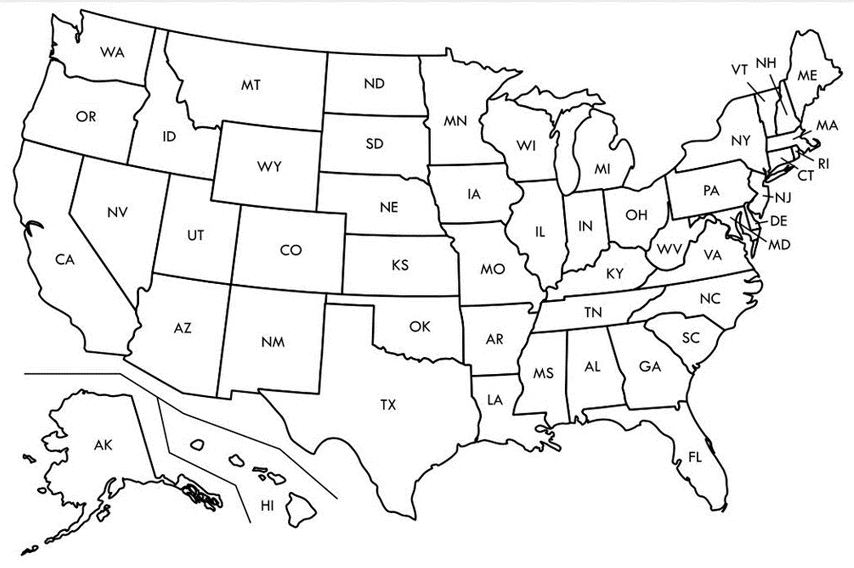

Face to Face Academy
LGBTQ+ and Trans Advocacy
35
Notes:
Grat - 9:30-10:00

Slide 7
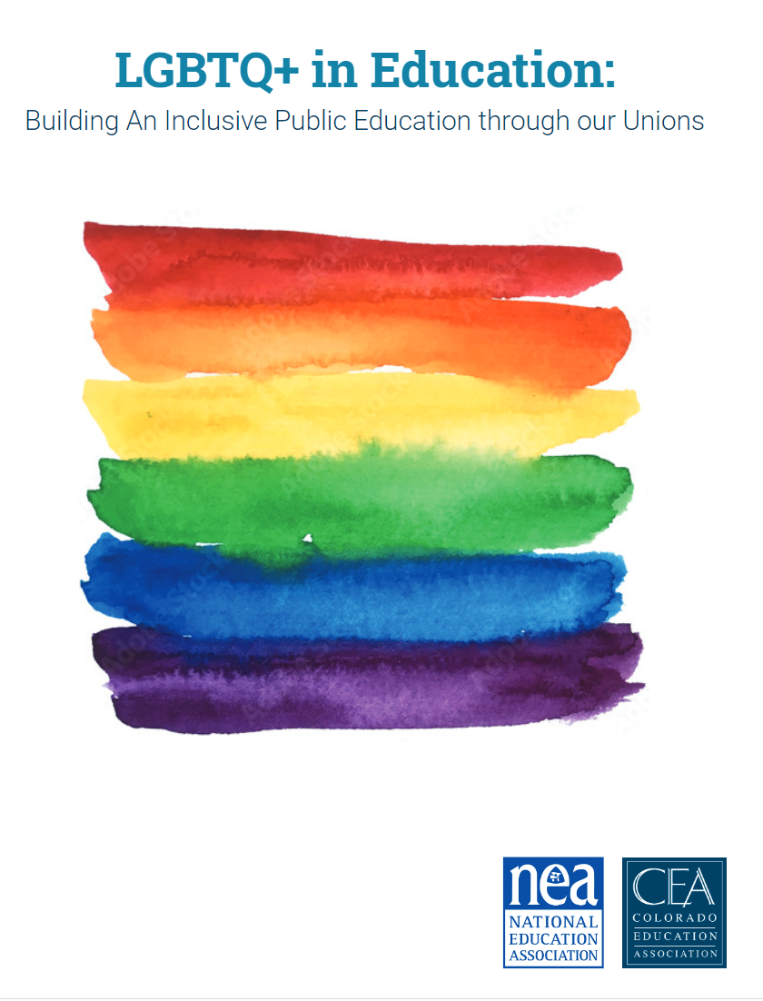
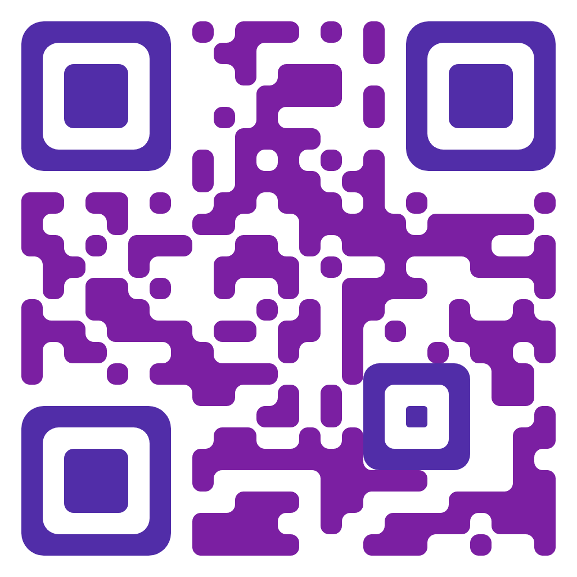
CEA Report and Wins

Slide 8
Our Stories
“Know that even if you do not personally know of any LGBTQ+ staff person in your district, they are there. Be an ally even if you do not know them. Speak up when you hear, see, or perceive bias and/or discrimination. Advocate for inclusive policies for both students and staff.”
8

