Slide 1
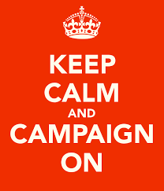

Why a campaign?
Notes:
Alice

Slide 2
Staff Led Grievance, Policy, or Legal Approach Only
Who's speaking, presenting, and doing the most talking/advocacy?
Direct, Staff-led Advocacy is the lowest form of member engagement and is most often invisible.
Wins through this method can have good outcomes but they often result in making members feel like it was a third party that got the win. (UD, Lawyer, Lobbyist)
There is low ownership and leadership by members in this approach
Notes:
Alice

Slide 3
An Organizing Approach
Well-organized worksites, locals, and coalitions have a positive, visible presences and members feel that they have the collective power to solve their problems – not a third party (UD, Lawyer, Lobbyist).
When the entire building, local, or coalition comes to act in ways to address the issue, those actors see themselves in both the action and win.
This builds power by continually increasing the amount of member leadership and ownership for the actions.

Slide 4
Campaigns
A campaign is an action plan with a beginning, middle, and end, working towards a specific demand
A campaign involves a series of escalating actions (or tactics)
A campaign creates increasing pressure on decision-makers over time by escalating the intensity and visibility of the tactics and increasing the numbers of people involved
Campaigns are a way to identify in advance the ingredients we need to win and put them together in a way that maximizes our chances of success
Notes:
Alice

Slide 5

Key Points
Staff led actions are low in leadership development, and low in member ownership.
Campaigns are visible to the people in the actions and shift power.
Notes:
Alice

Slide 6
Facilitator Name
Notes:
Hedy

Slide 7
Problem vs. Issue
Campaigns start with issue members care about.
An issue is a slice of a workplace problem.
Often a problem can have different issues depending on the perspective of the people we are working with.
It is KEY to get enough input on what the issues are that make up the problem so that YOU do not drive the solution.

Slide 8
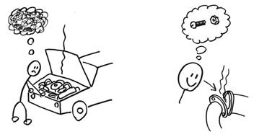
PROBLEM VS. ISSUE
Notes:
A problem is
something that you don’t like about the world
“broad areas of concern.”
They’re terrible things too big and/or too vague to grapple, but just thinking about them can be disempowering.
“Pollution” and “crime” are “problems.”
In the terms organizers use, an issue
is a more specific challenge that is pulled out from the larger “problem.”
An issue, when done right, always includes the solution or partial solution to a problem.”
E.g., an issue you might “cut” out of pollution might be a campaign to stop a new plant in your community.
E.g., an issue that one might “cut” out of the “problem” of crime is police accountability, and the solution that some groups are fighting for now are body cameras on all officers.
Be aware that you haven’t “cut” an issue until you have also defined how you plan to solve the specific challenge you have chosen.
Without an identified solution, your Association doesn’t have anything specific to fight for.

Slide 9
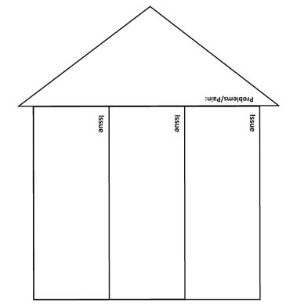
Identify the Problem(s)
What issues are contributing to this Problem?
Notes:
Your campaigns, some of them are larger, some are smaller but it’s about identifying how you move folks forward based on your organization.
So we are going to break out into our teams and we are going to do three things. This is on page 22 in your workbook.
3. The idea is that you are going to work on up to three particular issues.
Then we are going to move the issues through a criteria.

Slide 10
Example – Problem to Issue to Win
PROBLEM -Educators do not feel respected in this building.
  Issue – There is not structure or policy that allows educators to have meaningful input on decisions
  Issue – Educators’ time to teach is severely limited by tests that don’t improve learning
  Issue – Educators’ work and professional practices are not adequately compensated for
Strategic WIN – Educators feel Respected
  Tactical WIN – A joint building leadership team is established
  Tactical WIN – More time to teach meaningful content and less unnecessary testing
  Tactical WIN – Compensation matches work and expectations

Slide 11

Assessing an Issue
What makes a good issue:
It is widely felt.
It is deeply felt.
It is winnable.
It builds the union and builds leaders.
It has a connection to students and the public.
Notes:
Hedy
You’ve got 3 issues now … let’s assess them for how strong and viable they are for designing campaigns that will lead to a BIG WIN.
Assess each of your three issues based on the worksheet on PAGE ____.

Slide 12
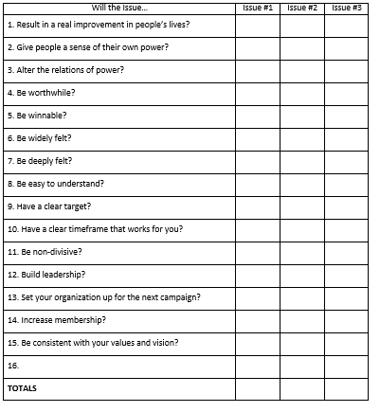
Choosing Your Issue
Notes:
The checklist on page 23 is an issue criteria model that can show you what’s really important in organizing. You can have a really good issue, but if it’s not building your power and your organization, and aligning the work you are doing with changes in members lives, it can be a challenge.
How do we look at issues, make them so convincing that we draw in members and make it clear we’re working on exactly what they’re feeling.
READ THROUGH
2. Engage
3. We talked about power yesterday. How is this creating power shift? How are they realizing they have leverage and their own power?
5. Some are somewhat subjective so just see how it sits on you.
7. When you are dealing with a diverse membership, you might choose an issue that works really well with one group but doesn’t resonate with the next
11. Are we picking issues that are unifying? Sometimes we pick think an issue is universal but again doesn’t resonate with majority of your membership.
14. We all have membership goals. Is it going to attract others to your work?
There is one blank because you might think “hey, there is one that is not here” that is unique to us.
Rate from 3 being the highest to 1 and through that come up individually with a score for each issue and then as a team, score to identify the one issue. Use this criteria as a tool to make a decision collectively.

Slide 13
Key Point
We don’t choose the issues, the people who want the change choose the issue.
Notes:
Hedy

Slide 14

BREAK

Slide 15
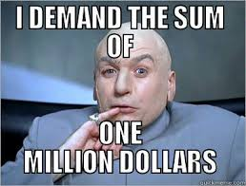
When making a demand …
  Measurable
  Achievable
  Should result in real tangible improvements in workers lives
  Focuses resources on a single outcome
  Builds the capacity of our constituency
  Uses a point of leverage: our constituency’s strength or our opposition’s weakness
  Focuses on a motivational issue that is visible and significant to our constituency
Notes:
Hedy

Slide 16
Key Point
The size of the demand you can win is driven by the amount of power your group can generate.

Slide 17


Notes:
Hedy

Slide 18
Targets:
A single person:
  - a name, face, & address
Has the power to give you what you are demanding
Notes:
Hedy

Slide 19
Campaigns
Campaigns are coordinated bursts of activity focused on achieving specific demands.
Campaigns unfold over time with a rhythm that slowly builds.
In organizing we assume we will begin the campaign with far fewer resources than we will need to tip the balance of power.
Growing capacity (people, money, skills) is critical for success.
Capacity buildings is what builds momentum.
Throughout the campaign we identify milestones that indicate we have enough power to try something more and something bigger.

Slide 20
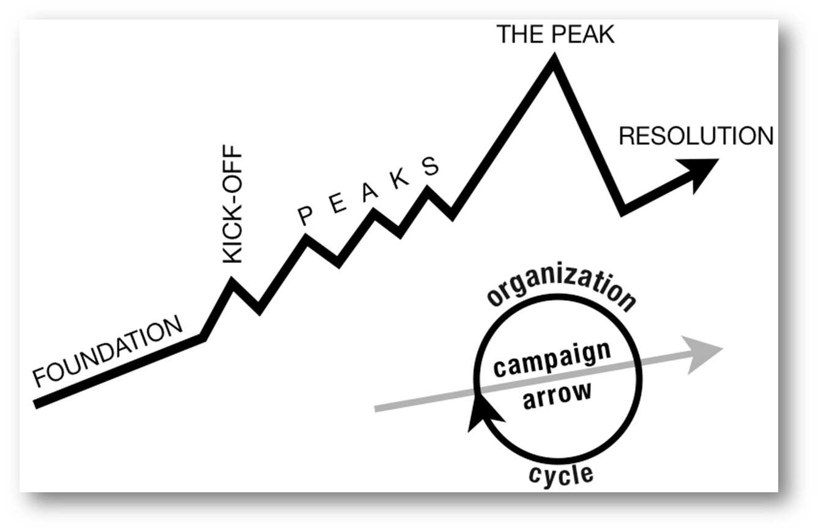
Structure of a Campaign
WIN
Notes:
Hedy
Tactic scramble!

Slide 21
Key Point
A well thought out campaign has a strong issue, with an identifiable target and a strategic demand.
Notes:
Hedy

Slide 22
Work Time
Refine your issue
Identify your demand
Pick your target
Set a "win" date
Don't worry about how – focus on "What",
"Who", and When".

Slide 23
Key Point
A well thought out campaign has a strong issue, with an identifiable target and a strategic demand.
Notes:
Hedy

Slide 24
Facilitator Name
Notes:
Sara

Slide 25

Demand
Tactics
Demand – Where you want to go – the destination – the BIG win.
Tactic – Small actions you to take to accomplish the small goals along the way to get to your destination.
Notes:
Sara

Slide 26


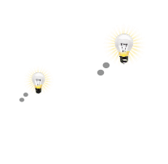

A GOOD TACTIC IS
Goal
1.
Strategic
2.
Strengthens your organization
Develops individuals
Notes:
Sara

Slide 27

Why do you think tactics escalate gradually?
GOAL
Tactic
Tactic
Notes:
Sara

Slide 28
Each escalation is more public, more visible, and has more risk. WE transform members to activists, activists to leaders by asking them to take bigger risks.
GOAL
Tactic
Tactic
Notes:
Sara

Slide 29
ORGANIZE TACTICS INTO… A CAMPAIGN Timeline
WIN
Notes:
Sara
Tactic scramble!

Slide 30
Key Points
Strategy without tactics is simply a collection of good ideas and big dreams.
Tactics without strategy are a random collection of activities and wasted resources.
Notes:
Sara

Slide 31

Remember the Framework
You are here ….
Who are my people?
What are their issues?
What is the change they want?
Who has the power to grant that?
What are the resources they have to achieve their goal?
How will they measure their progress?
Notes:
Sara

Slide 32
What is your people’s most precious resource ?
Notes:
Sara

Slide 33
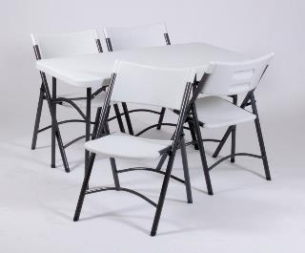
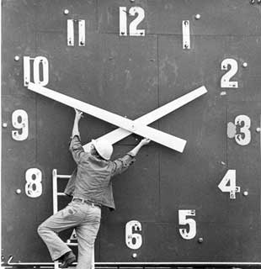

Tangibles
Resources that shrink as you use them.
Time/Energy
Money
Notes:
Sara
Resources are what your people have to help them make change. These are resources that are limited and are reduced as you use them.

Slide 34

Resources that Grow as You Use Them
Relationships
Skills
Hope
Trust
Notes:
Sara
These resources are the most important. The more you use relationships, the more you trust, the more that you coach people in using their skills the more capacity they develop for action- these resources grow.

Slide 35
Key Points
The bigger the win you want, the more resource you need.
Good tactics actually result in more resources – relationships, skills, hope and trust.
Notes:
Sara

Slide 36
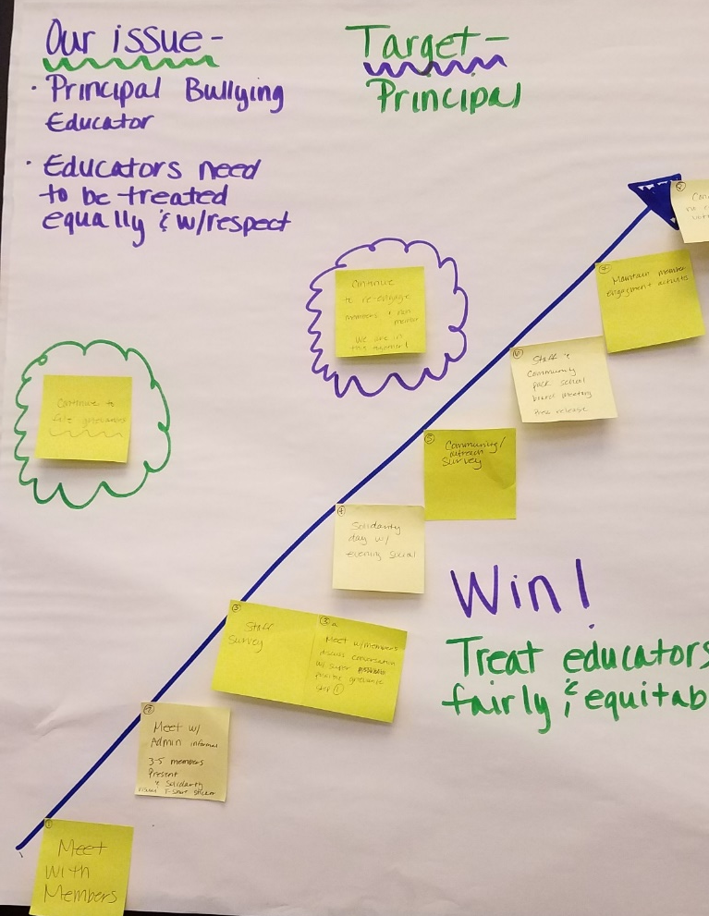

Team Work Time – p. 96, 102-103
Notes:
Sara

Slide 37

Resources and Tactics Pg. 100, and104-105
Notes:
Sara

Slide 38
Facilitator Name
Notes:
Adam

Slide 39
Team Work Time
Notes:
Adam

