Slide 1
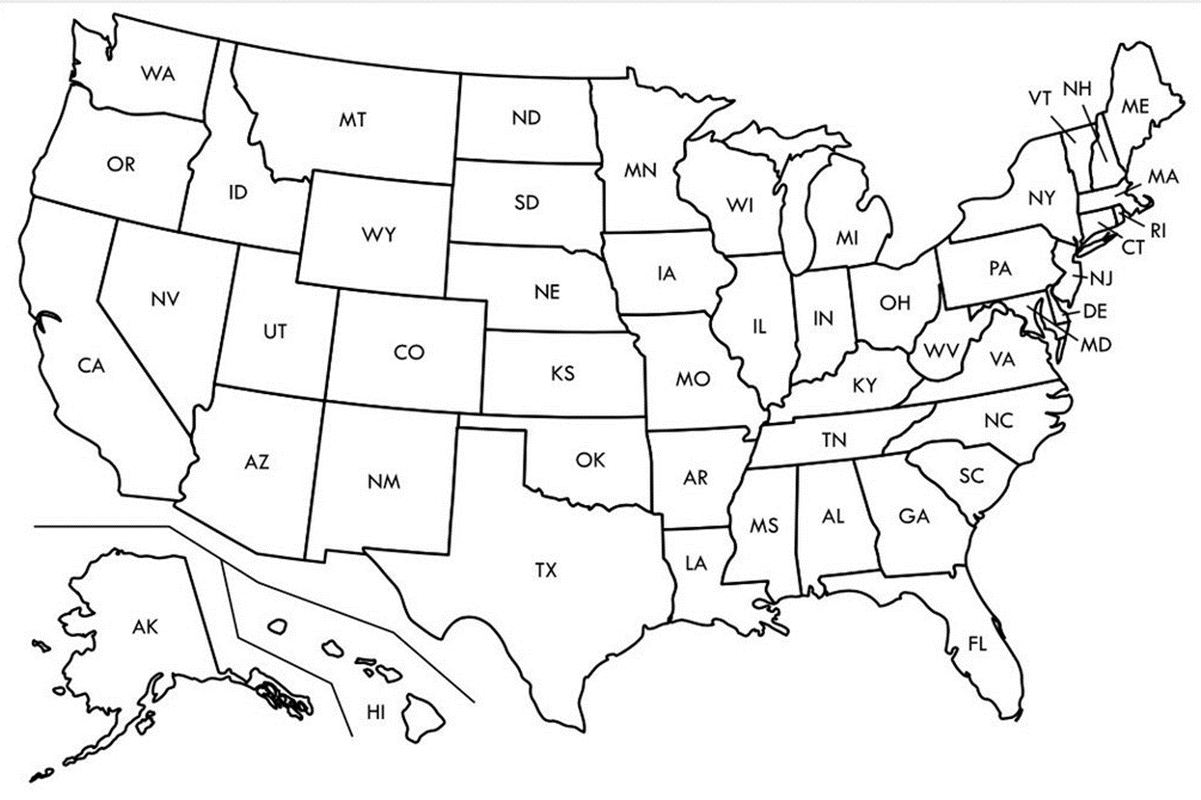

Entry Activity-Mapping
Place a dot on the map showing where you are from
Notes:
Grat - 9:30-10:00

Slide 2
Advancing LGBTQ+ Justice

Slide 3
Land Acknowledgement
We begin by acknowledging that we meet on the traditional lands served by the Lenape people. We honor America’s First People and all elders, past, present and emerging and we are called on to learn and share what we learn about the tribal history, culture, and contributions that have been suppressed in telling the story of what we now call the United States America. We invite you to think about the spaces you are inhabiting and the Indigenous people who came before them and were stewards of the land.

Slide 4

Our Time Together
Days 1 & 2: 8:30 am- 5:00 pm
◦15 Minute AM + PM Break
◦Lunch 12:00 – 1:00pm
◦4:30 - 5:00 pm “Adult Choice Networking”
Day 3: 8:30 am -2:00 pm
◦15 Minute AM + PM Break
◦Lunch 1:00 pm
◦1:00 - 2:00 pm “Adult Choice Networking”

Slide 5

Today’s Agenda
8:30 – 10:15 -- Getting Started and Building Our Community
10:15-10:30 -- Break
10:30 -12:00 -- Who am I in the work
12:00 -1:00 -- Lunch
1:00 – 2:30 -- LGBTQ History & Terminology
2:30 – 2:45 -- Break
2:45 - 4:15 -- Gender Identity
4:15 – 4:30 -- Wrap Up and Reflect
4:30 – 5:00 -- Adult Choice Networking

Slide 6
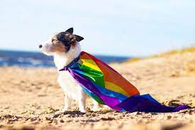
Logistics to Remember
Parking lot
Bathroom
Materials
Food
Room Temperature
Jasmine as Resource
Questions
Strike Support
Room Cleaning

Slide 7

But what if I want to say more....
Time at the End and
Start of the Day.
So...make note of what
You want to ask or
continue

Slide 8

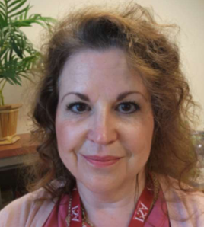
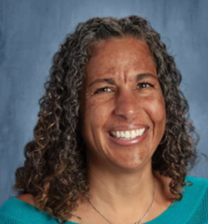
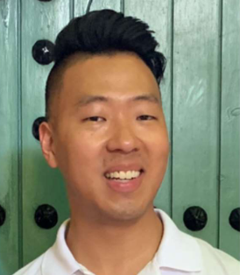
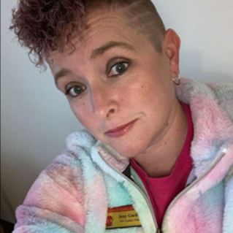
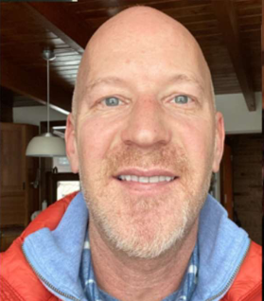
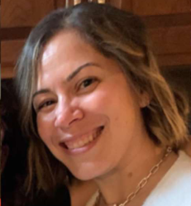
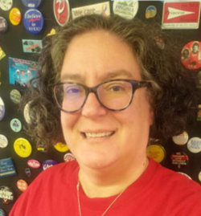
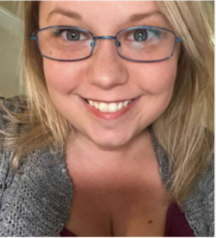
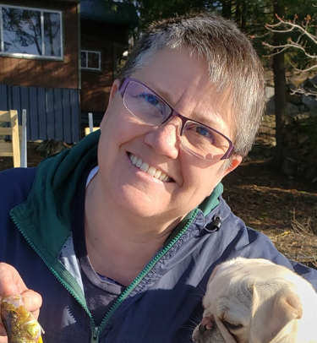
Introductions- Training Team
Sara Fitouri
She/Hers
Colorado
Michelle Couture She/Hers
New York
Barb Whitman She/Hers
Utah
Ben West
He/Him
California
Jeny Gardner
She/Her
Wyoming
Grat Dalton
He/Him
Michigan
Linda Torres
She/Hers
Pennsylvania
Bekhah Saxton
She/Hers
Virginia
Colleen O’Connell
She/Hers
South Carolina
Ellen Holmes
She/Hers
NEA

Slide 9
Introduction Whip -Who are you?
Name
Pronouns
Your title
15 Seconds Each

Slide 10
Why we are here!
LGBTQ youth are more than four times as likely to attempt suicide than their peers
A majority of LGBTQ+ people say that they or an LGBTQ+ friend or family member have been threatened or non-sexually harassed (57 percent), been sexually harassed (51 percent), or experienced violence (51 percent) because of their sexuality or gender identity. [2]
NEA RA Support and Part of NEA Mission and Vision Pg 5
[1] Human Rights Campaign Foundation. (2017, July). Mental health and the LGBTQ community. https://suicidepreventionlifeline.org/wp-content/uploads/2017/07/LGBTQ_MentalHealth_OnePager.pdf
[2] National Public Radio, the Robert Wood Johnson Foundation, & The Harvard T.H. Chan School of Public Health. (2017, November). Discrimination in America: Experiences and views of LGBTQ Americans. Retrieved June 24, 2020 from https://www.rwjf.org/en/library/research/2017/10/discrimination-in-america--experiences-and-views.html

Slide 11
The Words of Our Members
“Know that even if you do not personally know of any LGBTQ+ staff person in your district, they are there. Be an ally even if you do not know them. Speak up when you hear, see, or perceive bias and/or discrimination. Advocate for inclusive policies for both students and staff.”
11
Notes:
Throughout today’s training, we will be sharing the words of NEA members who are a part of the LGBTQ+ community. We shared an anonymous survey and think it’s important to hear the words of our colleagues—whether they are out or not—about their experiences as LGBTQ+ educators.

Slide 12
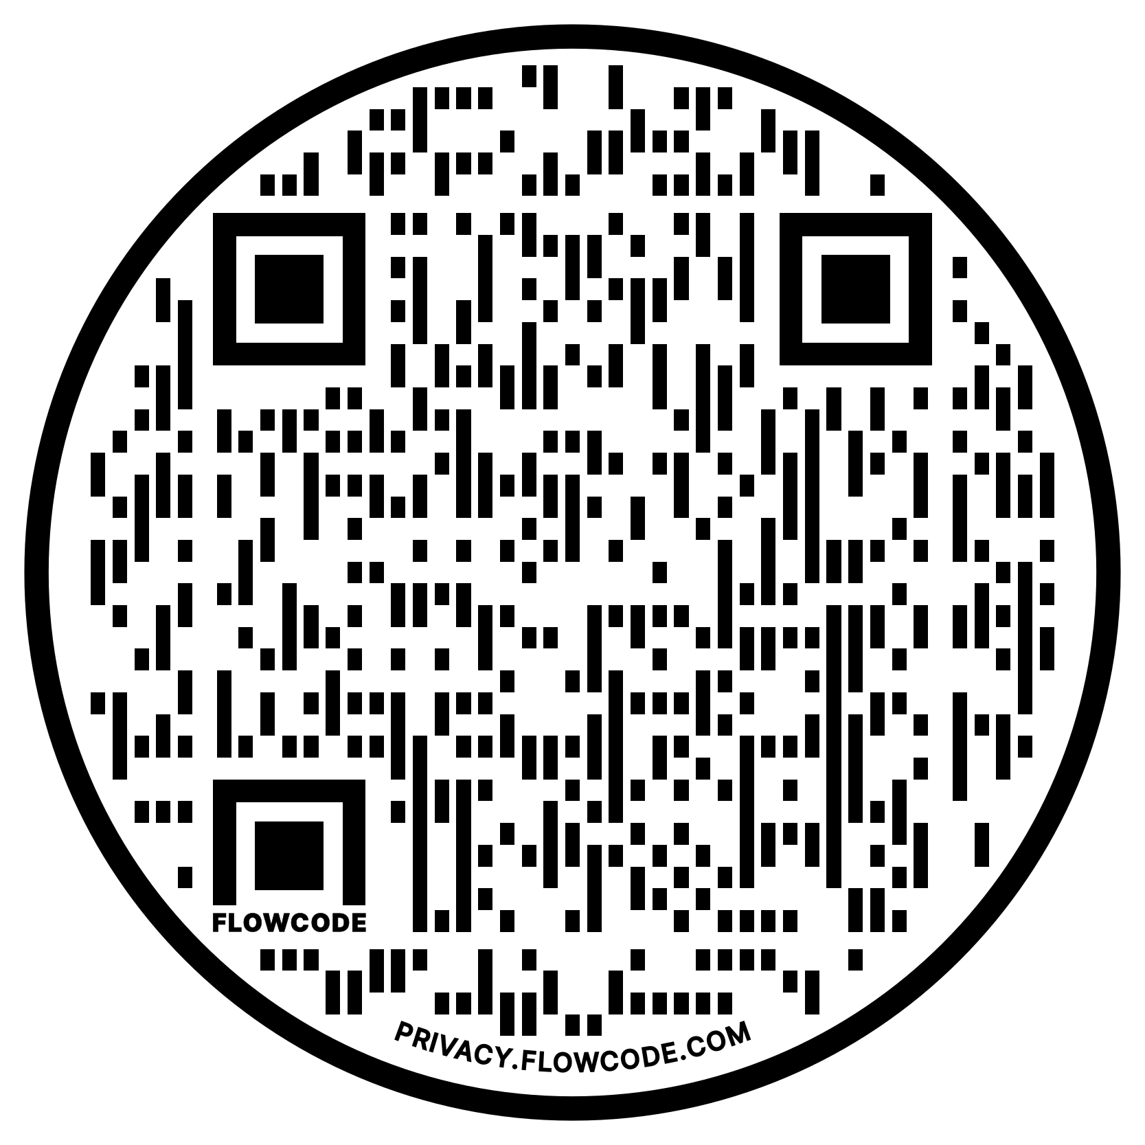
NEA Vision, Actions, Resources
Safe, Just, and Equitable Schools
Adopted by the 2022 NEA Representative Assembly
NBI 32
Training on Trans Gender Advocacy Issues for Affiliate Staff
NEA Online Toolkit – LGBTQ Resources

Slide 13
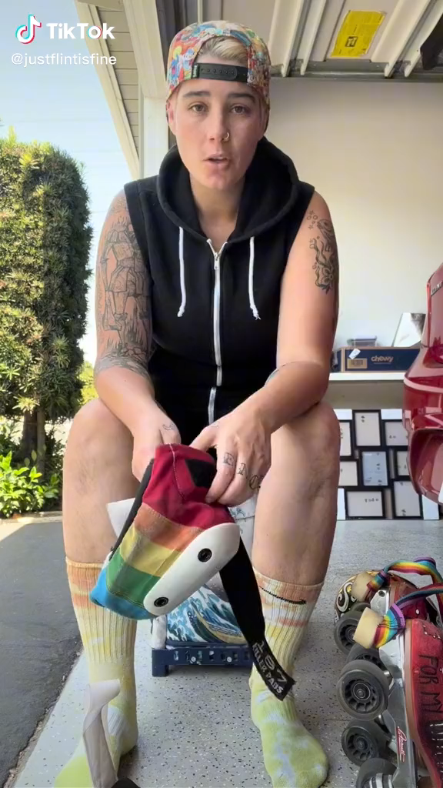

Slide 14

Community Agreements Pg 2
Awareness and Self-Knowledge
Listen for Understanding
Be Gracious
Stay Engaged
Be Open and Suspend Judgment
Say “I”- tell your truth
Seek Discomfort
Reach for Empathy
Expect non- Resolution and non-Closure

Slide 15
Grat

Slide 16
Ice Breaker
Find a partner that is not from your state
Be prepared to share a fun fact about your state or city with the group

Slide 17
Entry Activity-Mapping
Place a dot on the map showing where you are from
Notes:
Grat - 9:30-10:00

Slide 18
Barb

Slide 19
Core Values pg 11
Core values are the fundamental beliefs of a person. These guiding principles dictate behavior and can help people understand the difference between right and wrong – These can often be expressed using one or two words. We are taking a moment to consider our core values because they can provide a basis for solidarity in the midst of struggles.

Slide 20
Sharing Values for Solidarity
Core Values
1. Name
2. Core Value – One or two words that describes a fundamental belief held by you
**15 Seconds Each**
Core values are the fundamental beliefs of a person. These guiding principles dictate behavior and can help people understand the difference between right and wrong – These can often be expressed using one or two words.

Slide 21

Key Ideas
Solidarity
sol / i / dar / i / ty
Noun
  1. Unity or agreement of feeling or action especially among individuals with a common interest, mutual support; mutual support within a group.
Shared Core Values are critical for building solidarity in our work.

Slide 22
Ben

Slide 23
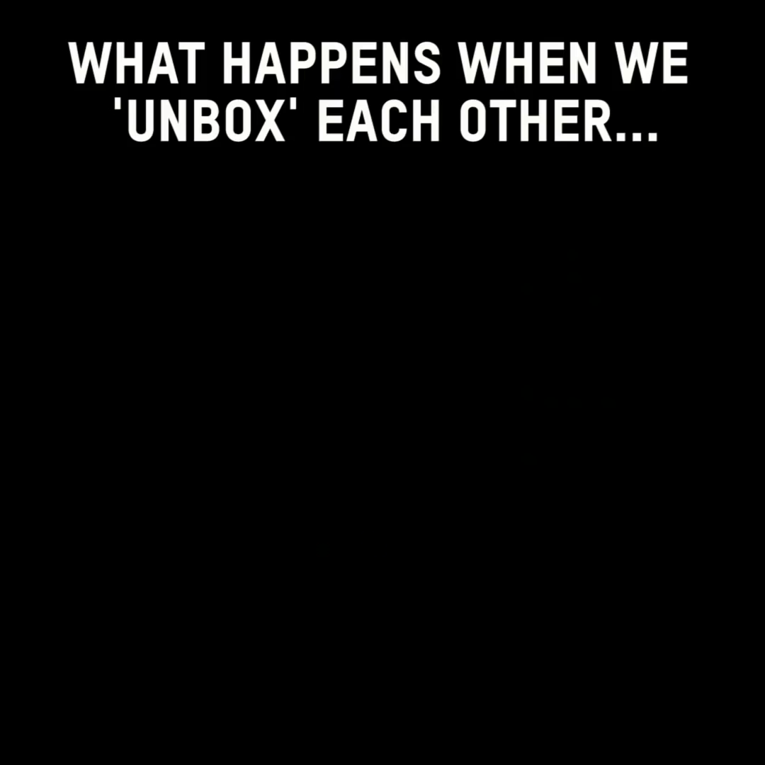

Slide 24

Shared Identity
Gather around an identity of your choosing
Answer the following discussion questions:
Why did you select this piece of your identity?
Notes:
Ben 10:00-10:15
musician, traveler, foodie, planner, nature lover, pet owner

Slide 25

Shared Identity
Debrief-
What was something you learned about someone else?
What was easy/hard about this activity?
How safe did you feel sharing in this activity?
Notes:
Ben 10:00-10:15

Slide 26
Key Ideas
Discreet identities bind us
We all have pre-conceptions that might not match an actual identity of another
We don't get to assign a person's identity for them

Slide 27

15 Minute Break!
During the break, follow these LGBTQ+ Member Educator Influencers on social media to continue our learning each time we scroll!
@justflintisfine @sabocat
@thegayschoolcounselor @keithkmusic

Slide 28
Linda

Slide 29
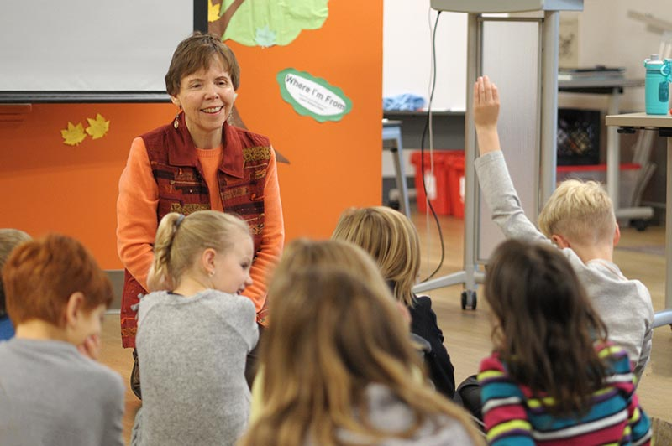
Where I am From
George Ella Lyons Poet Laureate, Author, Teacher from Kentucky.
Widely used as a way to get people to think about where they are from as more than a place.
It is in the sharing that we see how we are remarkably different and yet we have overlapping similarities.

Slide 30

Kenneth is from…

Slide 31
I am From by George Ella Lyons
I am from clothespins,
from Clorox and carbon-tetrachloride
I am from the dirt under the back porch
(Black, glistening it tasted like beets)
I am from the forsythia bush,
the Dutch elm whose long gone limbs I remember as if they were my own.
I’m from the fudge and eyeglasses,
from Imogene and Alafair.
I’m from the know-it-alls and the pass-it-ons, from perk up and pipe down.
I’m from He restoreth my soul with a cottonball lamb and ten verses I can say myself.
I’m from Artemus and Billie’s Branch,
fried corn and strong coffee.
from the finger my grandfather lost
to the auger
the eye my father shut to keep his sight.
Under my bed was a dress box
spilling old pictures, a sift of lost faces
to drift beneath my dreams.
I am from those moments–
snapped before I budded–
leaf-fall from the family tree
----George Ella Lyons

Slide 32
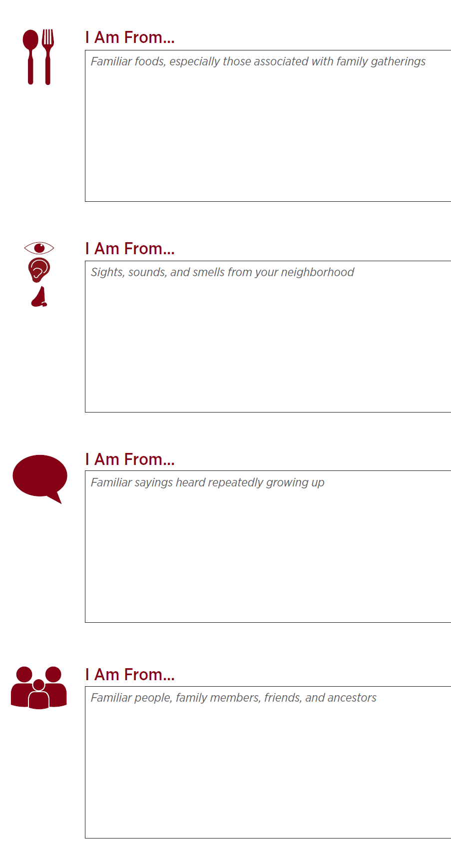
I Am From Poem Pg 12
Activity:
I Am From POEM
Notes:
10:30-11:00

Slide 33
Key Ideas
We are all individuals with unique sets of experiences and yet...
There are many points of common ground

Slide 34
Michelle

Slide 35

First Impressions Activity pg 15
On your own first
Notes:
11:00-11:30

Slide 36
Key Ideas
Our perceptions, beliefs, and biases are shaped passively, intentionally and reside in our unconscious.
These can be reshaped

Slide 37
Debrief- First Impressions Activity
What was it like to do that activity?
Does anyone have something that came up for them while they were answering the questions that they would like to share? Does anyone have an experience that was significantly different that they’d be interested in sharing?
What about question 5, would anyone share how their understanding of these issues have changed over time?

Slide 38
Grat and Ellen

Slide 39
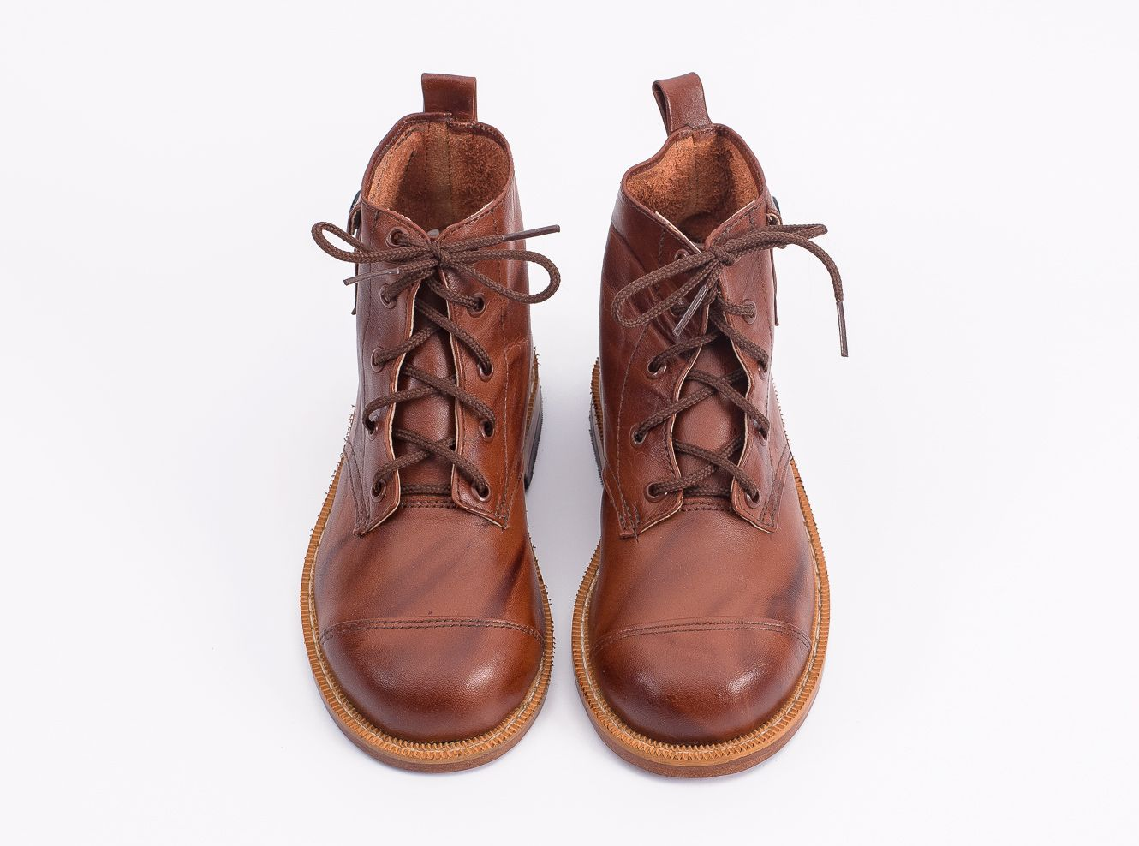
Movement and Change
39
Notes:
1:00-
Presenter Note:
Ask each participant to switch their left and right shoes (left shoe on the right foot, right shoe on the left foot). Say it’s part of the training, and then move on. DO NOT mention their shoes further. (The objective is that participants will experience a familiar but uncomfortable sensation that their shoes are on the opposite foot. This will help them experience, in a non-threatening way, the uncomfortable, awkward feelings or fear that transgender or gender non-conforming people may experience while they are in public.)

Slide 40
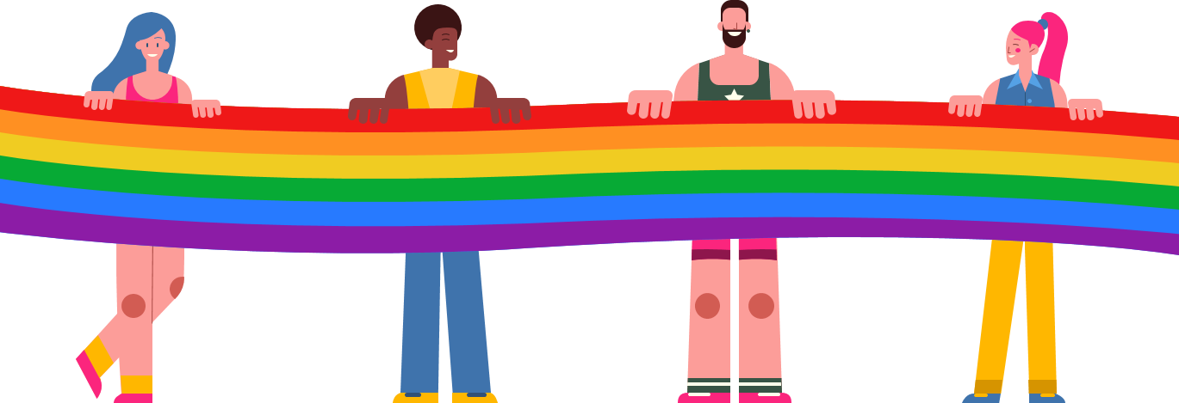
Timeline Activity
Look and read your Arc of LGBTQ Oppression and Justice Over Time card.
Notes:
11:30-12:00

Slide 41
Movement and Change
41
Notes:
1:00-
Presenter Note:
Ask each participant to switch their left and right shoes (left shoe on the right foot, right shoe on the left foot). Say it’s part of the training, and then move on. DO NOT mention their shoes further. (The objective is that participants will experience a familiar but uncomfortable sensation that their shoes are on the opposite foot. This will help them experience, in a non-threatening way, the uncomfortable, awkward feelings or fear that transgender or gender non-conforming people may experience while they are in public.)

Slide 42
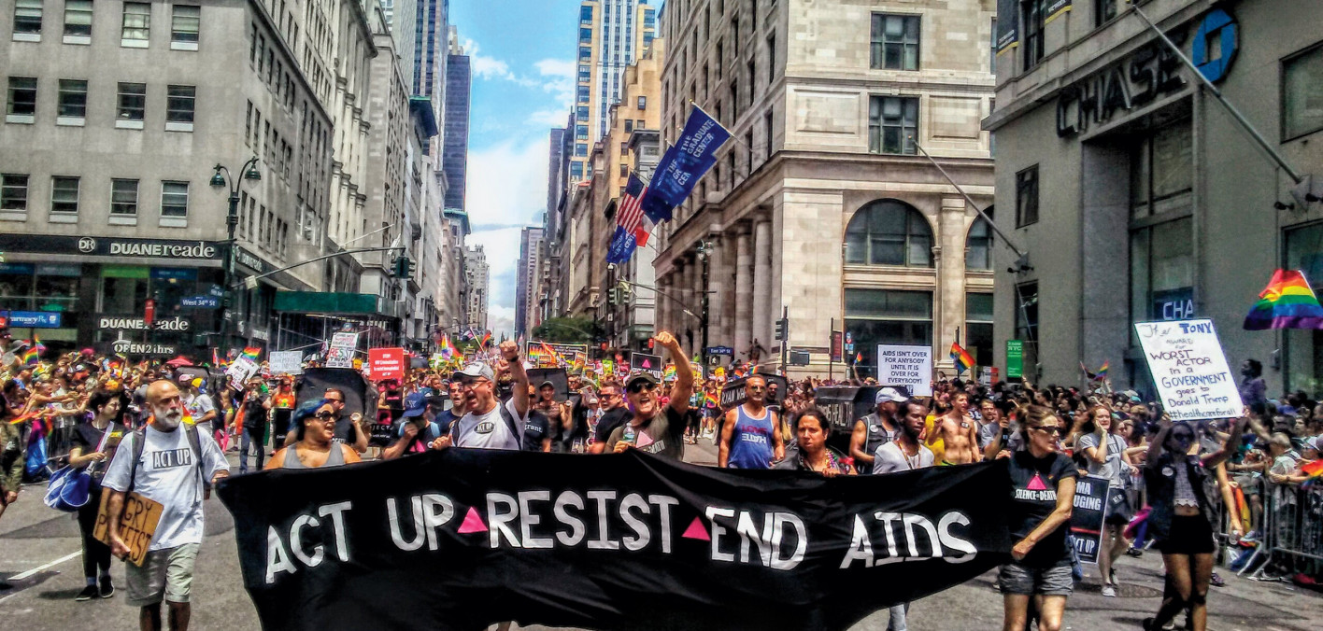
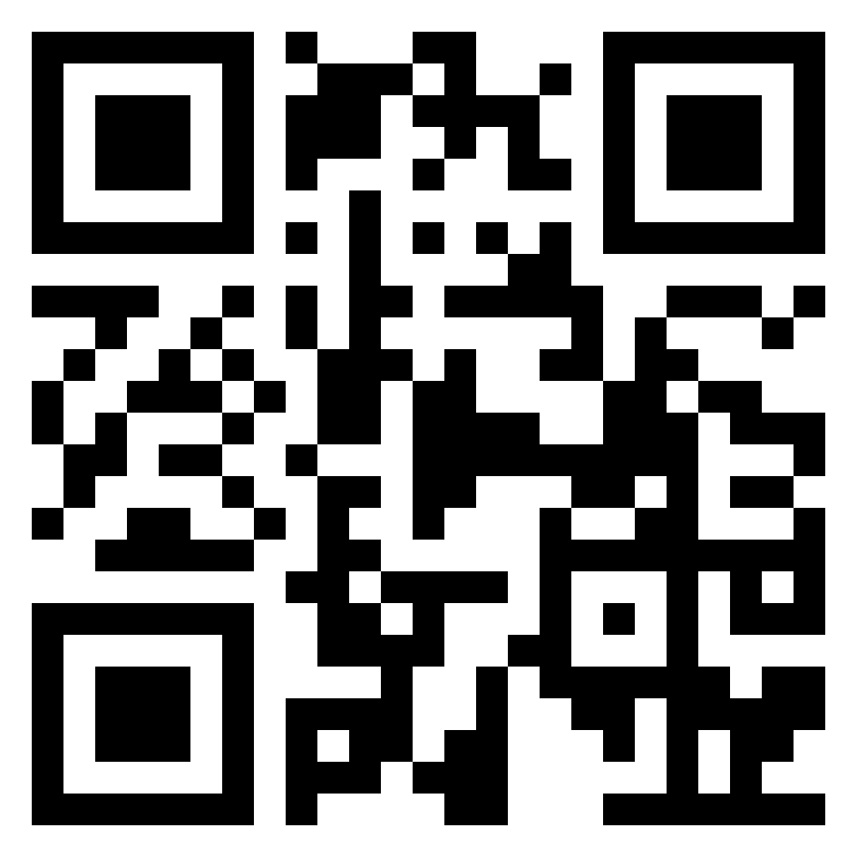
Lunch
1 hour for Lunch!
Over lunch, learn more about ACT UP!
Add the documentary “United In Anger” to your cue!
(available on Prime and Youtube!)

Slide 43
Ellen and Grat

Slide 44
Timeline Debrief
What were new events that you learned about?
Why do you think this was new to you?
What other communities of people in the United States have had their history erased?
What impact do you think this has on people who hold these identities?
What impact do you think this has on people who don’t hold these identities?
Notes:
1:00-1:30

Slide 45
Key Ideas
Oppressed people’s stories are deliberately kept out of the telling of the story of what we now as the United States of America

Slide 46
Ben

Slide 47
Shoe Debrief
How did it feel to have your shoes on the wrong feet?
What connections can we make between the uncomfortable, awkward feelings of having your shoes on the wrong feet to what transgender or gender non-conforming people may experience while in public?
47
Notes:
1:00-
Presenter Note:
Ask each participant to switch their left and right shoes (left shoe on the right foot, right shoe on the left foot). Say it’s part of the training, and then move on. DO NOT mention their shoes further. (The objective is that participants will experience a familiar but uncomfortable sensation that their shoes are on the opposite foot. This will help them experience, in a non-threatening way, the uncomfortable, awkward feelings or fear that transgender or gender non-conforming people may experience while they are in public.)

Slide 48
Key Ideas
What we know call the United States of America is still an uncomfortable, awkward, and sometimes unsafe place to be a member of the LGBTQ+ community.

Slide 49
Jeny

Slide 50
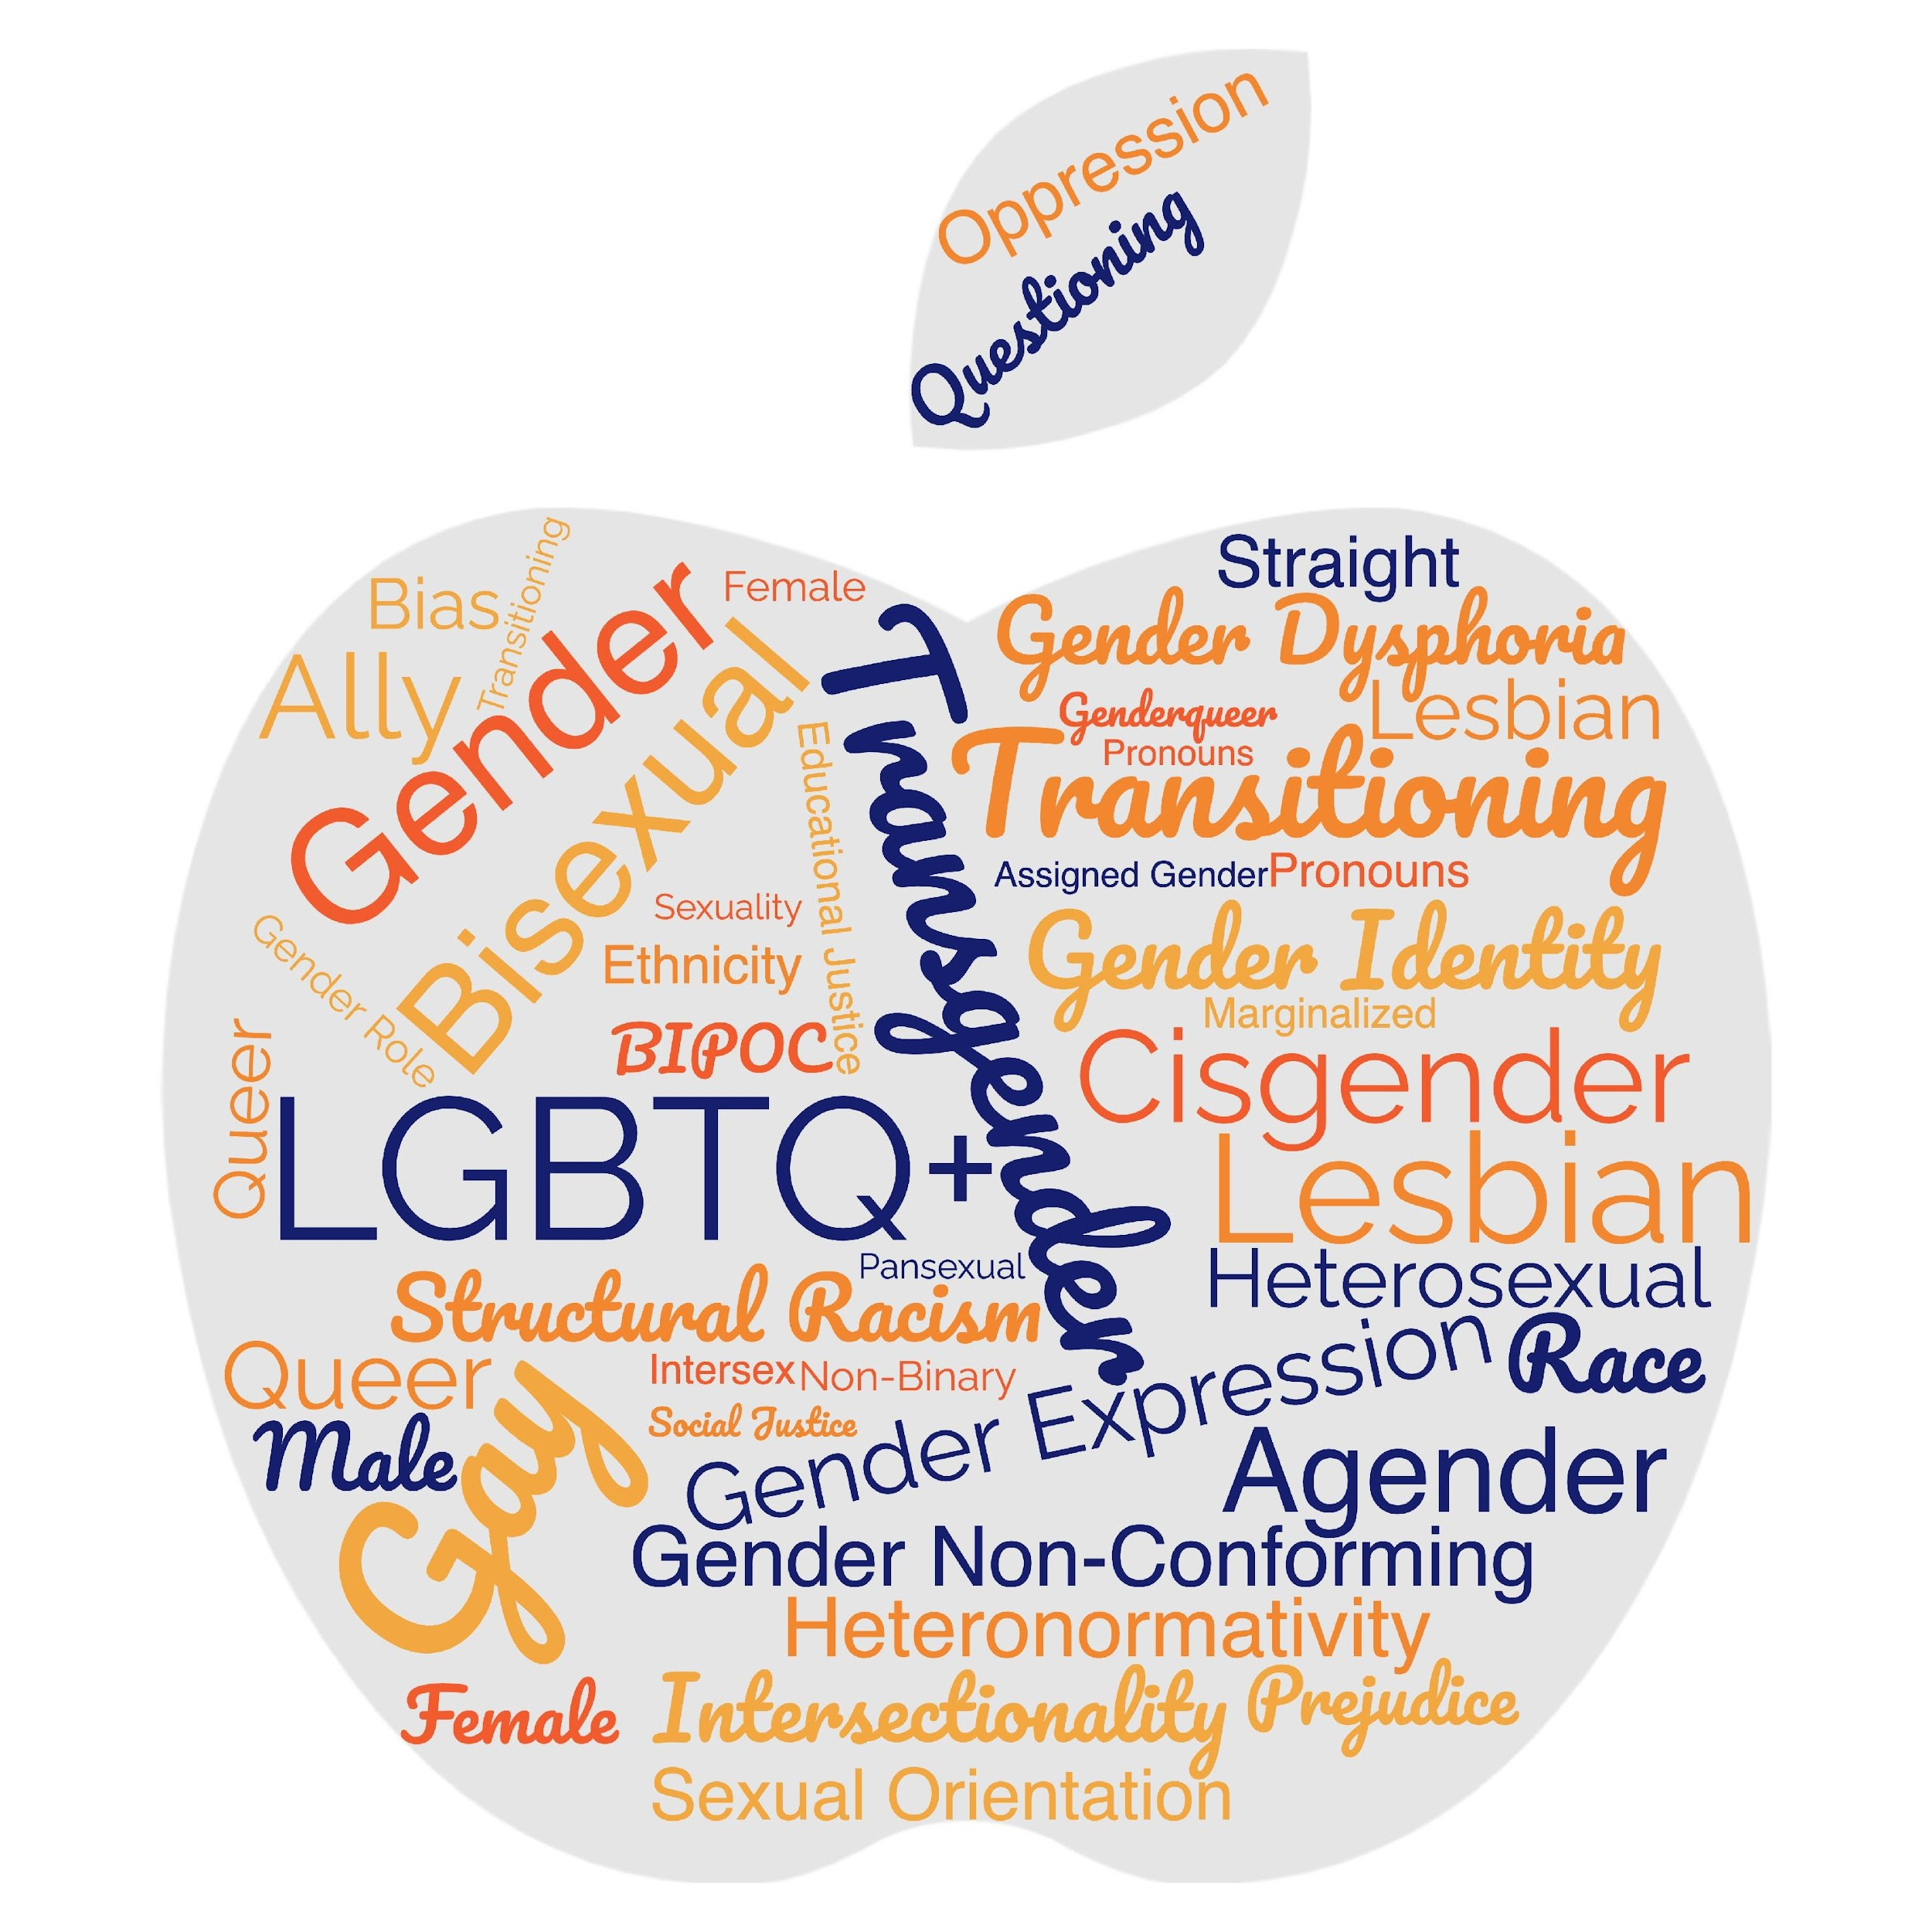
Turn and Talk
What makes a word a slur?

Slide 51
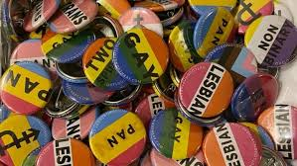
LGBTQ+ Terminology
Terminology Scavenger Hunt
Using the Word Bank Only
Go to the wall of definitions
Write the word you think that matches the definition on a post it and stick it near the definition sign.
Notes:
Terminology Handout

Slide 52
LGBTQ+ Terminology pg 16-20
52
Notes:
There are many LGBTQ+ terms. Please refer to your handout (see link below) for additional terms and definitions.
LGBTQ+ and Social Justice Terms: https://docs.google.com/document/d/1U6-vhknquf2Kkt-KUr6GlzaMt_58UPZ6BOJoSC-L5C8/edit?usp=sharing

Slide 53
LGBTQ+ Terminology
Word Bank
AGENDER GENDER DYSPHORIA
NON-BINARY GENDER EXPRESSION
ANTI-BIAS ANTI RACIST (ABAR) LESBIAN
GENDER IDENTITY QUEER
CISGENDER GENDER NON-CONFORMING
LGBTQ+ PANSEXUAL TWO-SPIRIT
GAY SEXUAL ORIENTATION ALLY
BISEXUAL/BI+ TRANSGENDER/TRANS
Notes:
Terminology Handout

Slide 54
Terminology Debrief
Let’s Ask the Room Debrief
What surprised you?
What is your biggest opportunity for growth?
Who has a helpful “hint”?
What else may you need?
Tomorrow we are going to talk about the Q in the LGBTQ+
Notes:
2:00-2:30

Slide 55
Language Changes
Terminology around race and ethnicity changes every 10 years
Terminology around gender, identity, and sexual orientation changes every 2 years

Slide 56
Key Ideas
Terminology matters in making sure that people feel seen and included in spaces.
The lived experience of someone is more important than what you think you know.
These terms change rapidly.
We can never assume we have mastered these concepts.
We need to continue to be humble and learn!

Slide 57
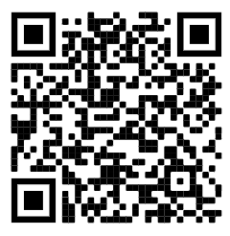
15 Minute Break!
Break time!
Ok… so all this means the sex ed we were taught is outdated and excludes a whole bunch of identities. Check out this website of best practices for talking with kids about sex.
(You might learn something new, too!)
https://sexpositivefamilies.com/10-best-sex-ed-resources-for-families/

Slide 58
Sara

Slide 59


Transgender Terminology
Transgender
Binary
Trans man
Trans woman
Non-Binary
Genderqueer
Genderfluid
Bigender
Demiboy
Demigirl
Agender
Neutrois
…and more!
59
Notes:
Language in the LGBTQ+ communities changes very quickly. Language in ethnic communities changes about every ten years while language in the LGBTQ+ communities changes about every two years.
Transgender/Trans: This is an umbrella term for people whose gender identity and/or expression is different from cultural expectations based on the sex they were assigned at birth. Being transgender does not imply any specific sexual orientation. Both binary and non-binary genders and gender expressions fall under the umbrella.
Often, we hear transphobic comments when the appearance of Black and Brown bodies are compared to white/Eurocentric views of femininity. For example, internet conspiracy theories have long criticized the natural muscular frame of tennis superstar Serena Williams, and even former First Lady Michelle Obama. Obviously, these comparisons are harmful, and are just one example of how hate, prejudice and fear show up.

Slide 60
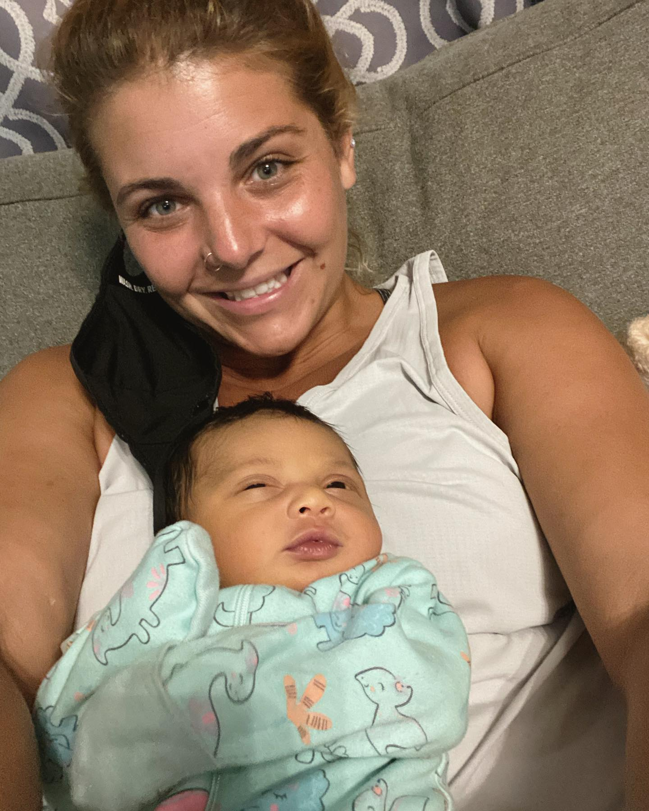

Slide 61

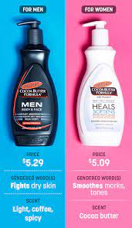



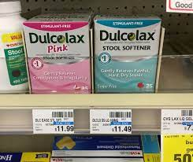
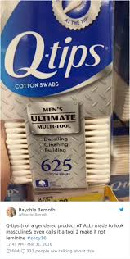
Turn and Share
Notes:
Turn and share gendered items (drinks, clothing, appearance) How embedded is binary in society?- ideas from media: Magazine, advertising, stores

Slide 62

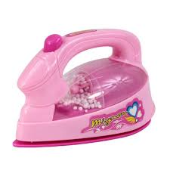
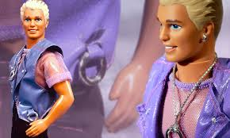
Debrief
    What Surprised you?
    What didn’t surprise you?
Notes:
Have we thought about the cost difference as well?

Slide 63


Billy Porter
Billy Porter
Pg. 21
Notes:
In his own words

Slide 64
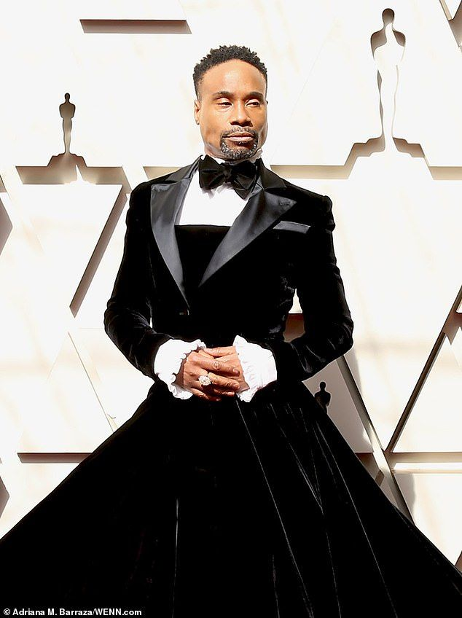
Debrief
    What do we assert via our clothing choices?
    How do people benefit from adhering to the gender binary?
    How are we all harmed by the gender binary?
    Practical Application: Dress Codes
Notes:
Have we thought about the cost difference as well?

Slide 65
Key Ideas
We have a rigidly enforced gender binary.
Everyone deviates from gendered expectations in some ways.
Folks under the transgender umbrella face oppression from these rigid social expectations

Slide 66
Barb

Slide 67

The Gender Unicorn pg 22
67
Notes:
The Gender Unicorn is a popular way to help explain gender that was developed by Trans Student Educational Resources. You may be familiar with the “Genderbread Person,” but we choose not to use it. It was created by a Black trans woman, but someone else popularized it, and continues to get credit, pay and notoriety for it.
As you see, the Gender Unicorn highlights gender identity, expression, sex assigned at birth, and physical and emotional attraction.
Children learn that there are two groups—boys and girls—and that they fit into one or the other based on how their bodies are made. They are then socialized to accept specific gender norms and stereotypes, which are ways of behaving, based on this gender assigned at birth.
There’s increasing understanding that gender is more than a binary division. The spectrum of gender identity is becoming more widely accepted and gender expression is more expansive.
However, there are challenges to looking at gender beyond male and female. Across states, many laws and policies are being passed that affirm or harm individuals outside of the gender binary.

Slide 68
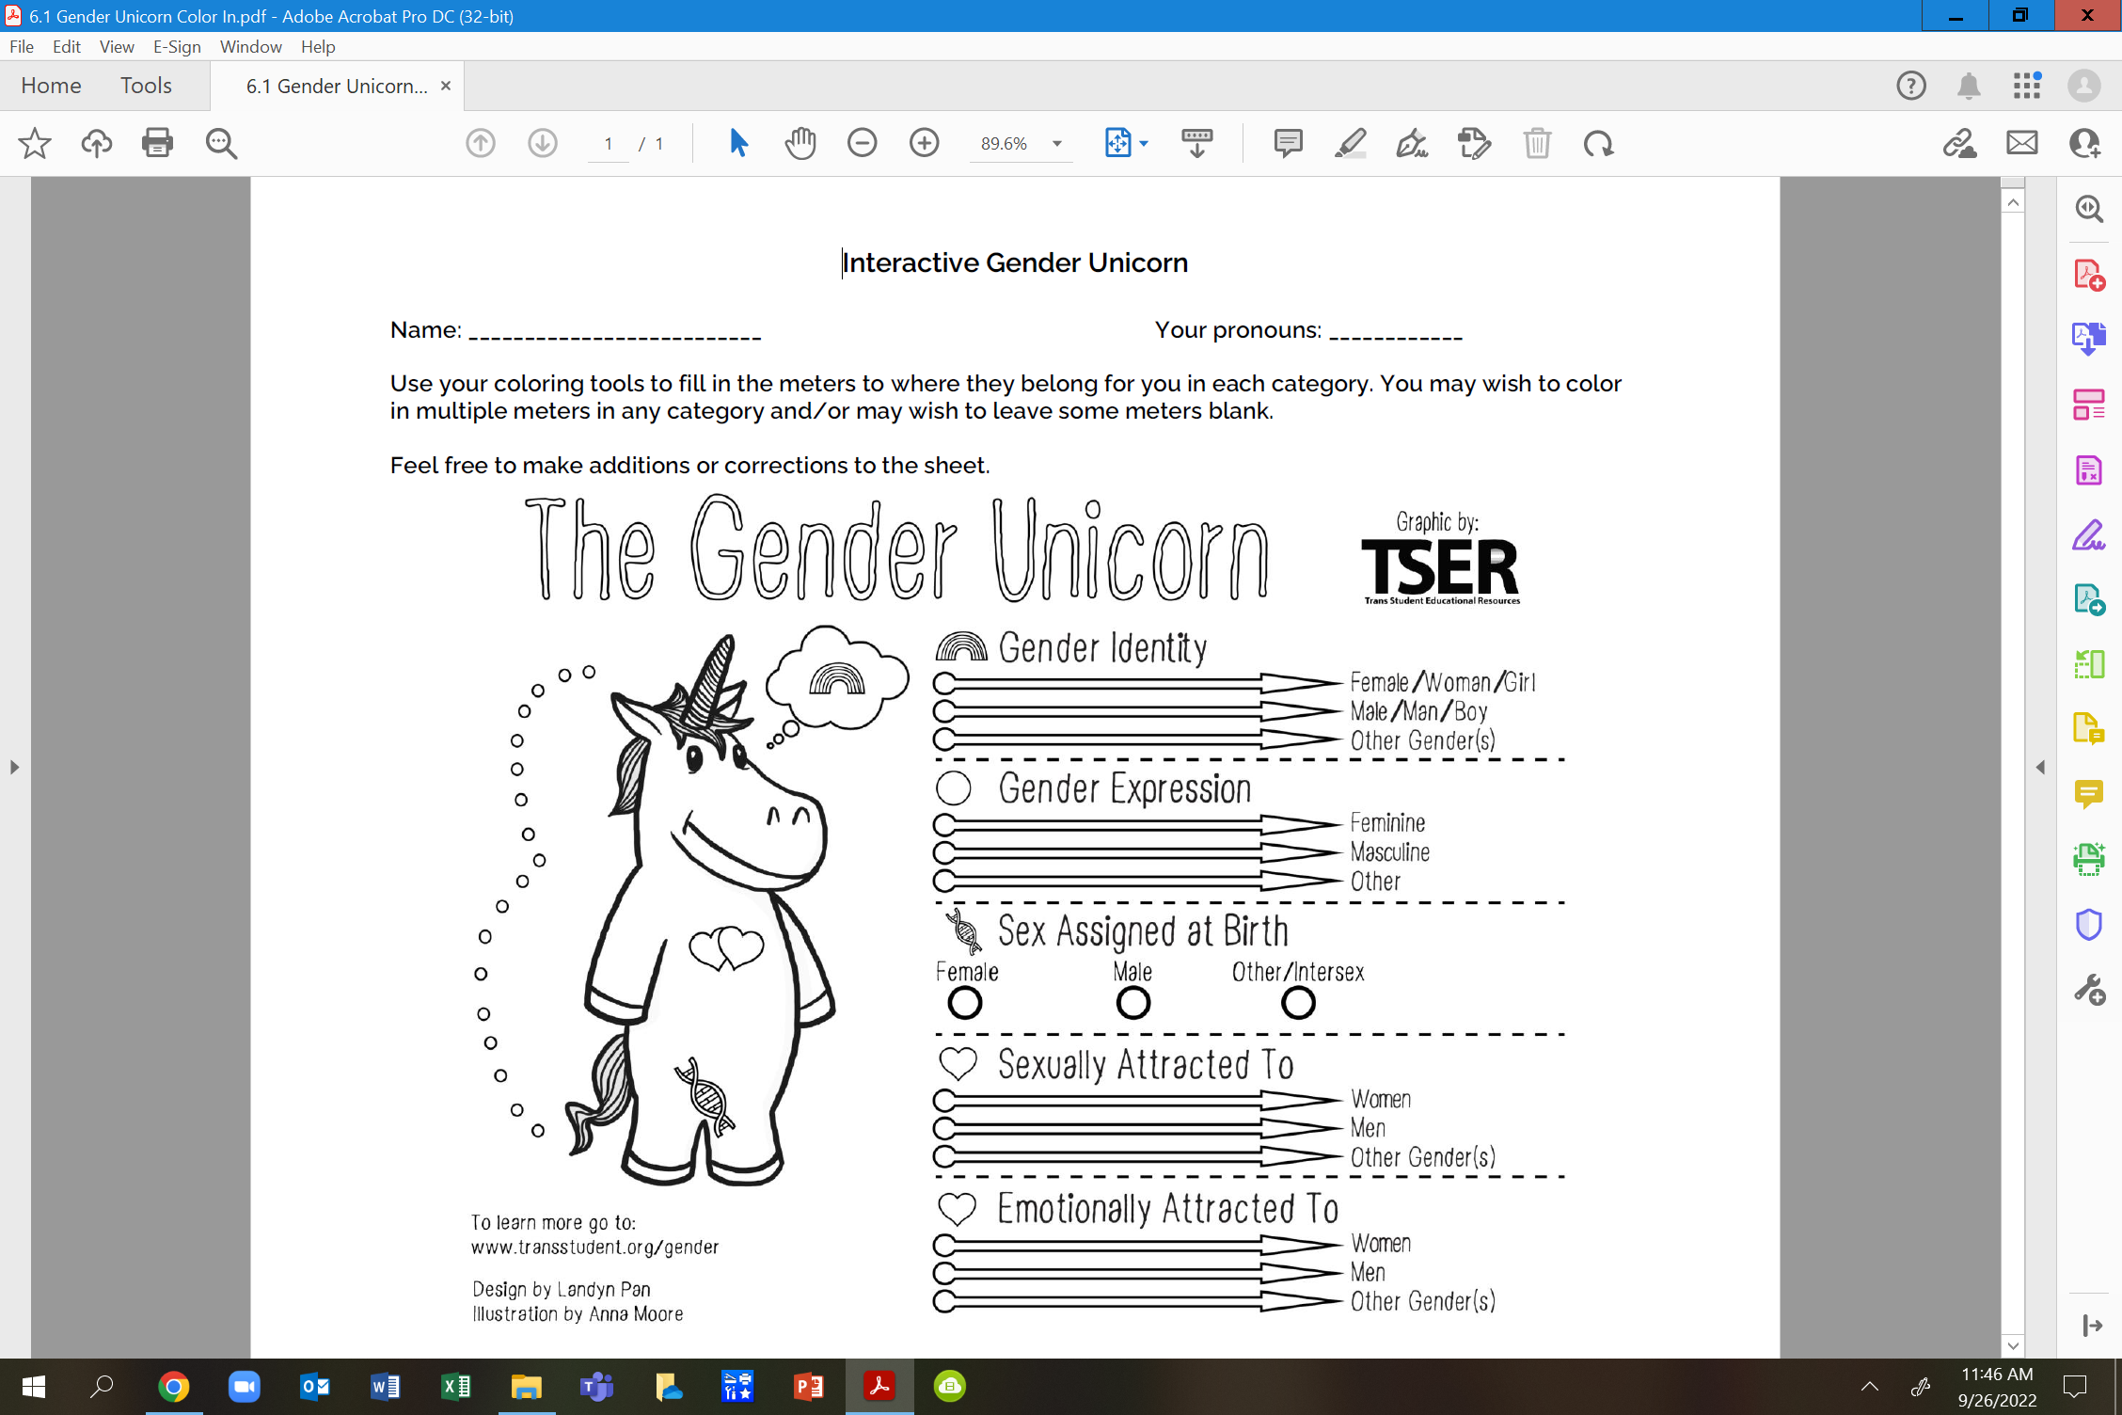
Your Turn... pg 23

Slide 69
Debrief
What is clearer to you?
Do you feel you can find yourself here?
Do you feel there is any nuance that may be missing?

Slide 70
Key Ideas
Our society reinforces the gender and sex binary – this is a construct
These are spectrums
These are separate categories and the way YOU present/identify in one is not an automatic indication of how you present/identify in another

Slide 71
Grat, Ellen and Anthony

Slide 72

Ending It Right
How does YOUR learning from today inform your work with members?
How might we inadvertently cause well-intentioned harm?
How can we prevent that?

Slide 73
Ending It Right
Open Questions
Added Information
Evening Email
Feedback Forms

Slide 74

Choice Networking Time

Slide 75
Entry Activity-Mapping
Place a dot on the map showing where you are from
Notes:
Grat - 9:30-10:00

