Slide 1
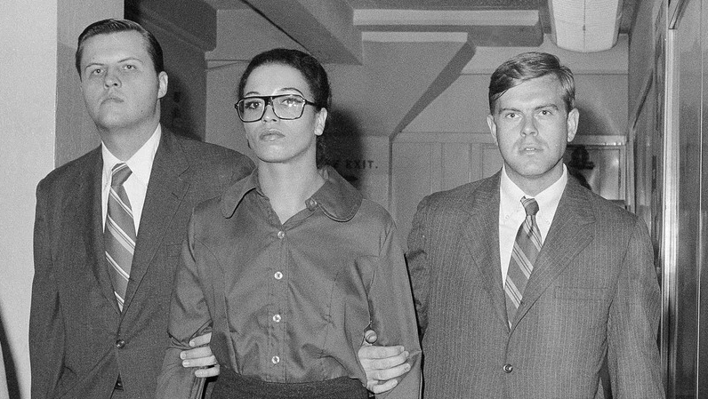
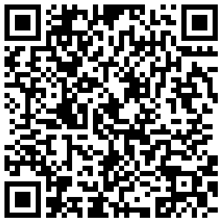
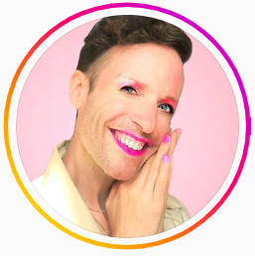
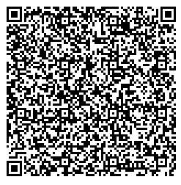
As you enter …
Scan this QR Code to view Jeffry Marsh’s Blog and Video on Pronouns
Scan this QR Code to listen to NPR’s, “This Forgotten Women’s Prison Helped Cement Greenwich Village’s Queer Identity”

Slide 2
Advancing LGBTQ+ Justice

Slide 3
Feedback
11 respondents
Mics --- I know
I liked the moving in the vocabulary, but it was dry. Maybe a teams game or matching people 1/2 with word and 1/2 with definitions moving around the room? All that and then the unicorn was a long stretch- But seriously this is great, I don’t mean that negatively. Just as feedback- this is really good.
QR Codes
Loved it!!!

Slide 4

Community Agreements
Awareness and Self-Knowledge
Listen for Understanding
Be Gracious
Stay Engaged
Be Open and Suspend Judgment
Say “I”- tell your truth
Seek Discomfort
Reach for Empathy
Expect non- Resolution and non-Closure

Slide 5

Today’s Agenda
8:30 – 10:15 -- Review and expand on key concepts
10:15-10:30 -- Break
10:30 -12:00 --
12:00 -1:00 -- Lunch
1:00 – 2:30 --
2:30 – 2:45 -- Break
2:45 - 4:15 --
4:15 – 4:30 -- Wrap Up and Reflect
4:30 – 5:00 -- Adult Choice Networking

Slide 6
Barb

Slide 7
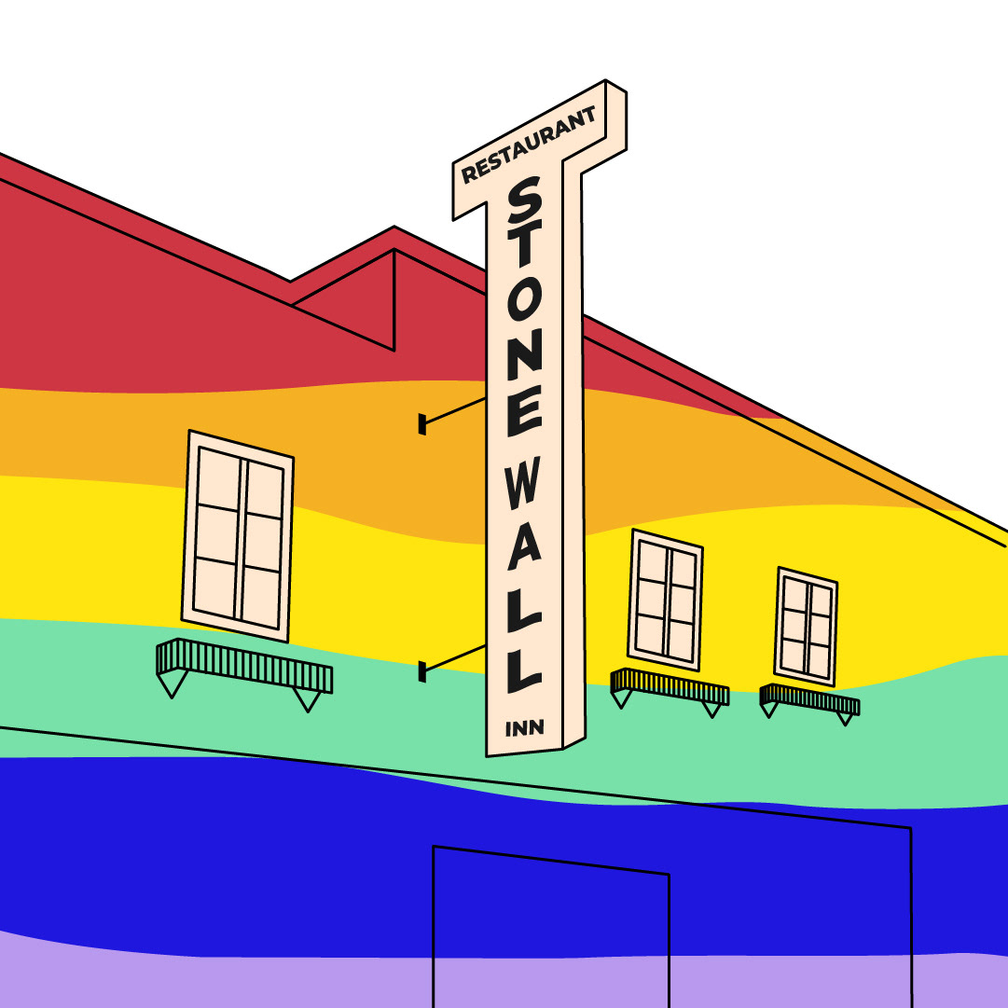
Shared Identity
Gather around an identity of your choosing
Answer the following discussion questions:
Why did you select this piece of your identity?
What are some challenges of this identity?
Notes:
Ben 10:00-10:15
parent, only child, has siblings, struggles with technology, tech is easy, life-long learner

Slide 8

Shared Identity
Debrief-
What was something you learned about someone else?
What was easy/hard about this activity?
How safe did you feel sharing in this activity?
Notes:
Ben 10:00-10:15

Slide 9

Key Ideas
Discreet identities bind us
We all have pre-conceptions that might not match an actual identity of another
We don't get to assign a person's identity for them

Slide 10
Jeny

Slide 11
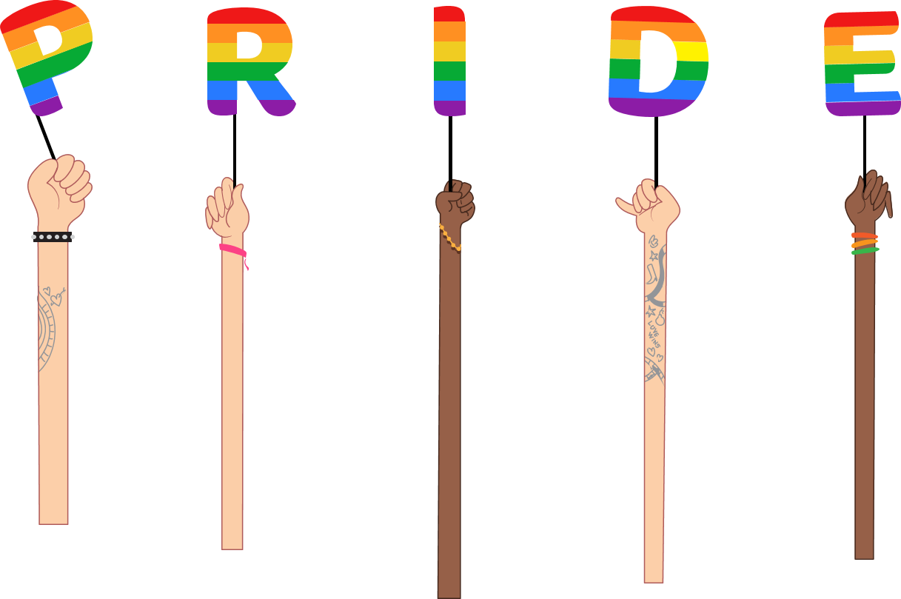
Quiz Time!
SET-UP
Each person take 4 sticky notes.
Write one letter on each- “A”, “B”, “C”, “D”
These will be your answer options for the quiz
For each question. Secretly select your answer.
WAIT FOR THE PRESENTER TO COUNT DOWN BEFORE PUTTING YOUR ANSWER IN THE AIR.

Slide 12

Terminology Quiz- Question 1
PRACTICE QUESTION:
What animal is the cutest pet
  Dog
  Cat
  Hamster
  Toad
Notes:
Goal- that gender identity is separate from sexual orientation

Slide 13
Terminology Quiz- Answer 1
PRACTICE QUESTION:
What animal is the cutest pet
  Dog
  Cat
  Hamster
  Toad
Notes:
Goal- that gender identity is separate from sexual orientation

Slide 14
Terminology Quiz- Question 2
This term is used to describe someone who doesn’t have a gender
  Transgender
  Gender Expression
  Agender
  Pansexual
Notes:
Goal- that gender identity is separate from sexual orientation

Slide 15
Terminology Quiz- Answer 2
This term is used to describe someone who doesn’t have a gender
  Transgender
  Gender Expression
  Agender
  Pansexual
Notes:
Goal- that gender identity is separate from sexual orientation

Slide 16
Terminology Quiz- Question 3
2. A cisgender woman who is in a relationship with a cisgender man is?
  Straight
  Heterosexual
  Unknown
  Heteronormative
Notes:
Goal- that identity is not the same as someone’s current relationship

Slide 17
Terminology Quiz- Answer 3
2. A cisgender woman who is in a relationship with a cisgender man is?
  Straight
  Heterosexual
  Unknown
  Heteronormative
Notes:
Goal- that identity is not the same as someone’s current relationship

Slide 18
Terminology Quiz- Question 4
3. A man who is transgender can be…
  Bisexual
  Straight
  Queer
  All the Above
Notes:
Goal- that gender identity is separate from sexual orientation

Slide 19
Terminology Quiz- Answer 4
3. A man who is transgender can be…
  Bisexual
  Straight
  Queer
  All the Above
Notes:
(Goal- that gender identity is separate from sexual orientation)

Slide 20
Terminology Quiz- Question 5
4. A person who identifies as a woman and is attracted to women can be
Gay
Queer
Lesbian
Bisexual
Notes:
Goal- emphasize that there is some overlap in these terms, but that the identity someone chooses for themselves is what matters

Slide 21
Terminology Quiz- Answer 5
4. A person who identifies as a woman and is attracted to women can be
Gay
Queer
Lesbian
Bisexual
ALL THE ABOVE!
Notes:
Goal- emphasize that there is some overlap in these terms, but that the identity someone chooses for themselves is what matters. AND people may use different descriptors for their identity based on the situation.

Slide 22
Key Ideas
Identity is separate from who someone is in a relationship with
Gender identity and sexual orientation are different!

Slide 23
Sara

Slide 24
Digging into Key Terminology
102

Slide 25

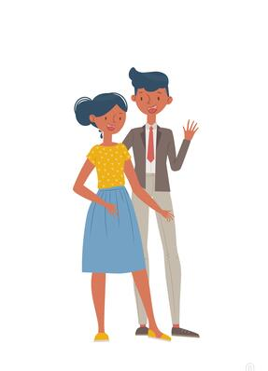
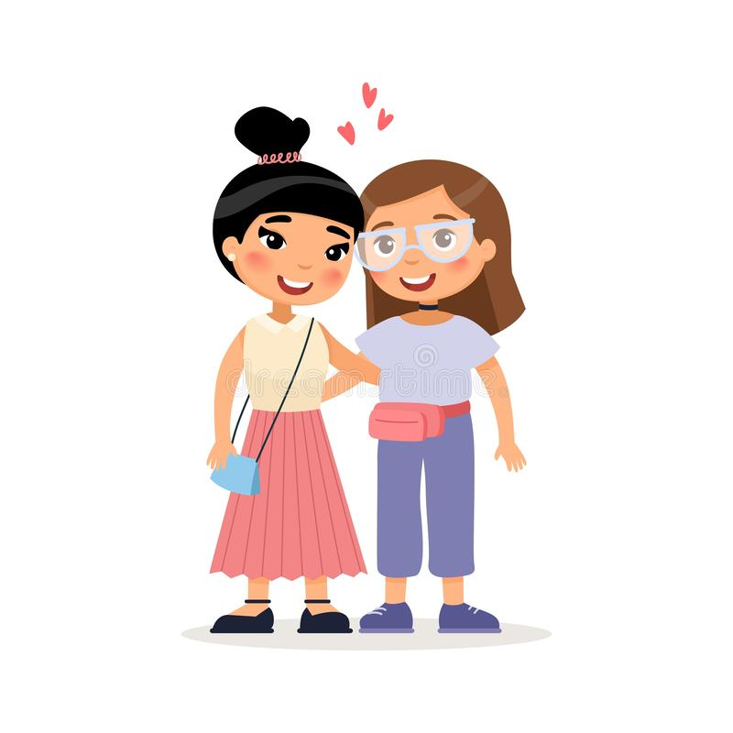

What is Sexual Orientation?
Sexual orientation is who you are emotionally,
romantically, and/or physically attracted to.
Sexual orientation is not dependent on your gender.
25
Notes:
Sexual orientation is an important part of a person’s identity. It is not a decision that one makes, rather it is an awakening.
There are a variety of sexual orientations:
Heterosexual
Bisexual
Homosexual
Pansexual
Asexual
Even though sexual orientation is a private identity, it can be a source of public scorn and a basis for exclusionary practices and discrimination.

Slide 26
Sex vs. Gender
SEX
Biological attributes that include physical features, chromosomes, internal and external reproductive organs, hormones, and anatomy.
GENDER
A person’s innermost, deeply held reality of self as male, female, both, in between or neither.
VS.
26
Notes:
Sex and Gender do NOT mean the same thing.
Our sex is determined by biological attributes such as chromosomes, hormones, reproductive organs, and other parts of our anatomy.
Gender is a person’s innermost, deeply held reality of self. It’s almost like being right-handed or left-handed. We don’t know why each person favors one hand over the other, but we all know that one just feels more correct for us. And, some people feel comfortable using either hand.
A person can have an inner reality of being male, female, both, neither, or somewhere in between.

Slide 27
Gender
Gender
Identity
How you feel. Female, male, both, or neither.
Gender
Expression
The ways you show your gender identity.
Gender
Role
A social role based on a person’s sex.
27
Notes:
Gender, or gender identity, is that internal sense of self we just mentioned—the feeling of being male, female, both, neither, or somewhere in between.
Gender expression includes all the ways you show your gender to the world. For example, your hair and clothes, how you cross your legs, how you walk, and even your voice inflections. Some of these are innate, and some are learned from our cultural norms.
Gender roles are social constructs based on one’s sex or biological attributes. They can be very different from one culture to another. These roles can become so internalized that they create stereotypes or an implicit bias within us (e.g., assuming nurses are women, or mechanics are men).
Gender non-conforming simply means the person is breaking cultural or social rules about gender roles and/or expression.
There is a huge difference between not conforming to certain societal norms and expectations for one’s gender and having an internal identity that is not in alignment with one’s biological sex.
A Note About Phobias:
A phobia is a persistent, irrational and exaggerated fear of an object, person, activity, animal or situation. Homophobia is a fear of people who are gay and lesbian. Transphobia is a fear of people who are transgender. When someone’s identity challenges a person’s expectations or preconceived notions of male and female, they may go into a panic. The incongruence of what someone sees, and what they think creates fear and misunderstanding.
We say “i-dentity” because it’s about the individual and how they personally identify, not “you-dentity” because of how you want to determine someone else’s existence.

Slide 28

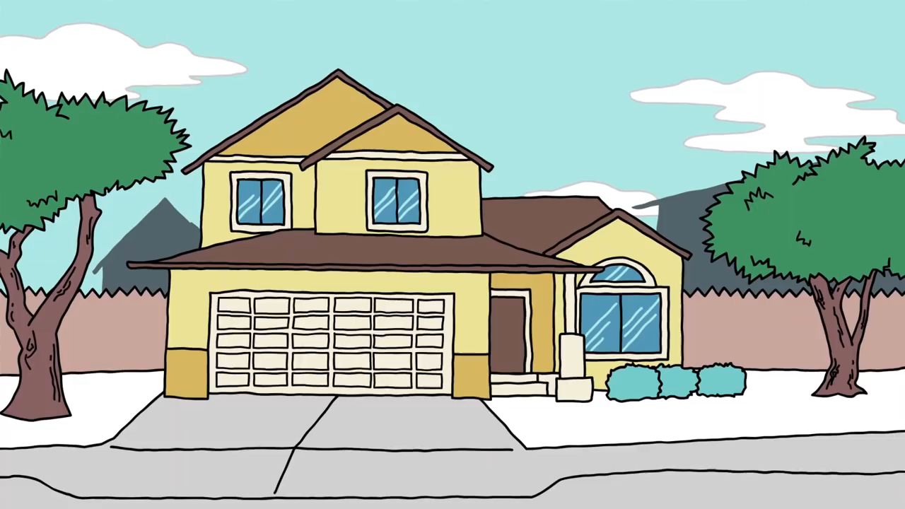
Explaining Gender Identity
Range of Gender Identities
28
Notes:
Video: https://youtu.be/i83VQIaDlQw
(3 minute)
This video offers a simple way of looking at various gender identities (~3 mins).
Debrief the video with these three questions:
What is the gender binary? How many of you grew up thinking the only gender options were male or female?
What does it mean to be non-binary?
What is the difference between transgender and non-binary?

Slide 29
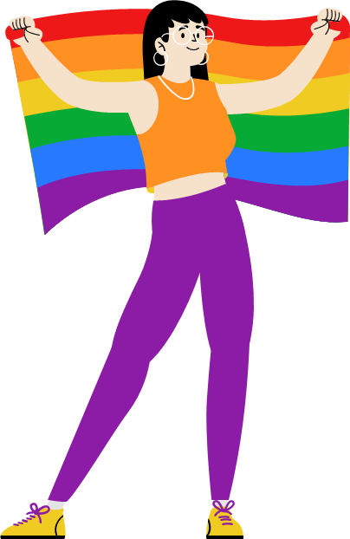
Debrief
  How many of you grew up thinking the only gender options were male or female?
  Unlearning the gender binary takes a lot of work. What questions do we still have?
  What is the difference between transgender and non-binary?

Slide 30
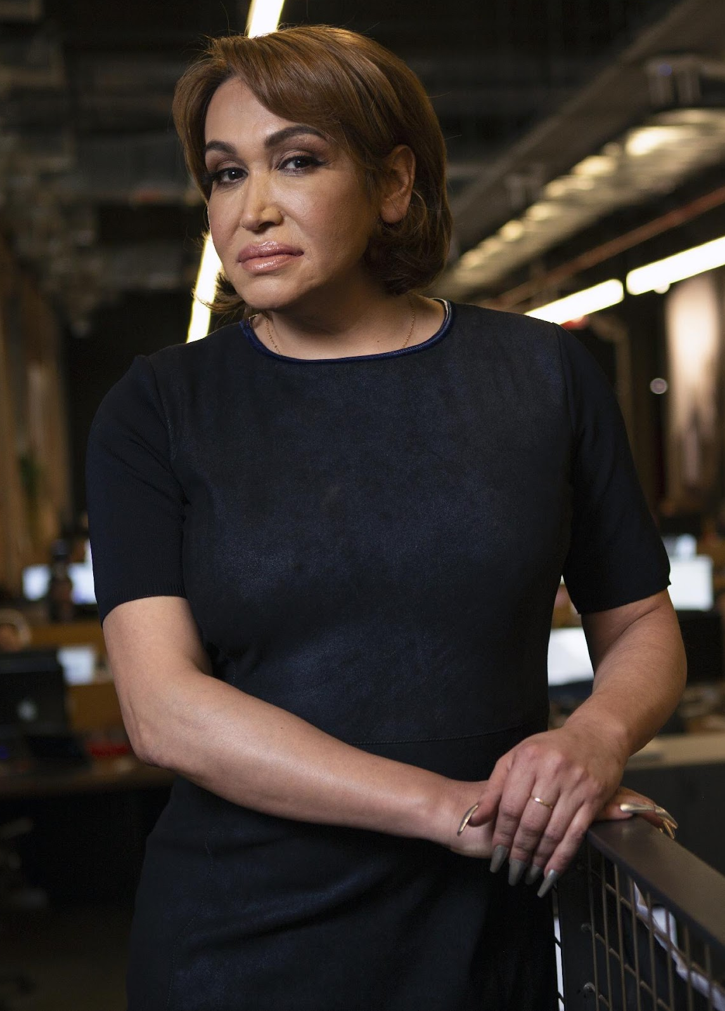
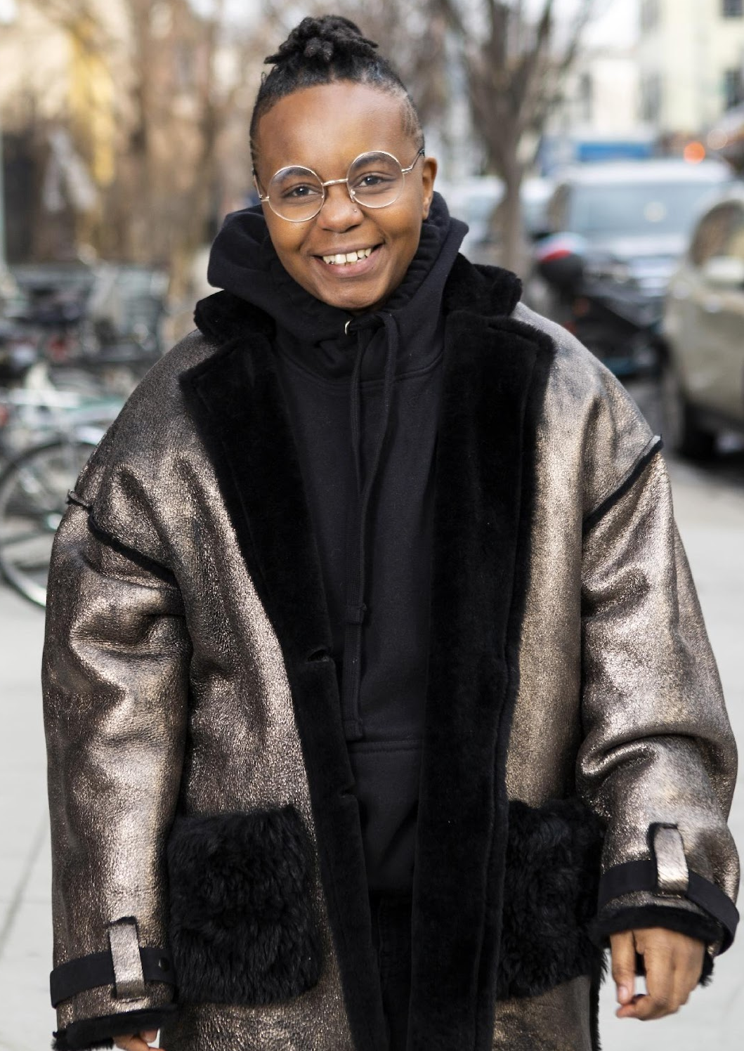
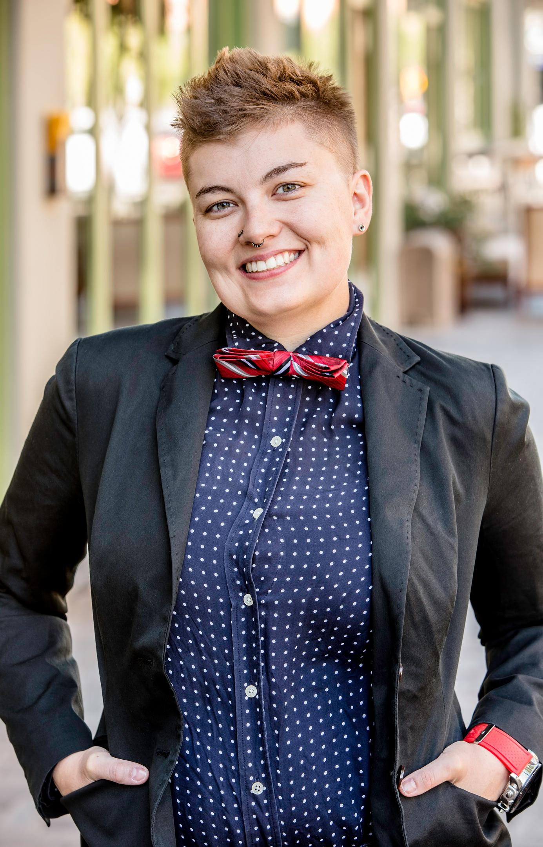
Gender Expression
A transgender woman
in an office.
A transmasculine person in a winter coat.
A gender-fluid woman on a city sidewalk.
Photos courtesy of the Gender Spectrum Collection.
30
Notes:
Transgender, non-binary, and gender non-conforming individuals show their gender to the world in many ways. Just as cisgender people have different hairstyles, clothing choices, mannerisms, and more, the same is true for trans, non-binary, and gender-non-conforming people. There is no “one way” to look to be any gender.
These images are from the Gender Spectrum Collection – a group that works with trans and non-binary models. In the first image we see a transgender woman in an office. The second is a transmasculine person in a winter coat. Transmasculine is a term generally used for people who were born female at birth, but who identify with masculinity. As we can see in both of these two photos, they present within the gender binary of male and female.
In the last image, we see a gender-fluid woman. Gender fluid refers to a person who does not feel they have a fixed gender.

Slide 31

Remember, it is all a spectrum!
GENDER IDENTITY
GENDER EXPRESSION
GENDER ROLE
Reese Witherspoon as Elle Woods in the 2001 film, Legally Blonde.
31
Notes:
Gender identity, gender expression, and gender roles all exist on a spectrum. Using our handy stereotypes of blue to represent masculinity and pink to represent femininity, let’s think about how people might rate themselves.
The character Elle Woods in the film Legally Blonde, likely (we don’t know, because we didn’t ask) had a gender identity that was strongly female. Her gender expression was also strongly female – she often wore high heels, the color pink, and was often getting her nails done. Her gender role, however, was slightly more toward the middle. Elle was a law student – a field that has historically been dominated by men.
The construct of gender has changed over time. In the 17th century, European aristocrats wore long, flowing clothes, make up and high heels. It’s not the same today. Gender is about the values society ascribes to males and females, and it changes over time.

Slide 32
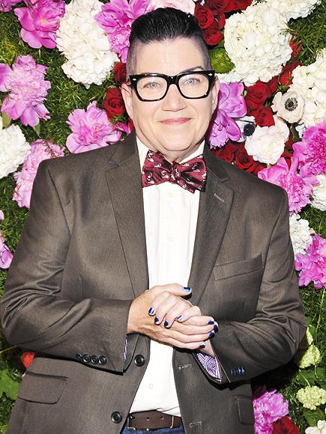
Remember, it is all a spectrum!
GENDER IDENTITY
GENDER EXPRESSION
GENDER ROLE
Lea DeLaria, actress in
Orange is the New Black, 2013
32
Notes:
Let’s consider the actress Lea DeLaria. She identifies pretty strongly with being female, but has a very masculine gender expression. Her short hair, little if any makeup, more boxy clothes, and swagger when she walks give her a more masculine gender expression. Lea considers herself a butch lesbian. (For reference, the descriptor “butch” has generally referred to a woman whose gender expression and traits present as traditionally masculine.)
Envision another person who falls at the same places on this scale. Instead of being an actress, she could be a married woman and mother who prefers a masculine presentation and works as a mechanic in an auto body shop. In that case, the person could also be gender non-conforming. Remember, gender is a spectrum.
Gender non-conforming refers to people who do not follow dominant social norms or stereotypes about how they should look or act based on their biological sex at birth.
Check in - Where are you on the spectrum? Note that some people will feel this does not apply to them.

Slide 33
Binary & Non-binary
Gender Identities
BINARY
NON-BINARY
MAN WOMAN
A person who does not identify exclusively as a woman or man. They may be both, somewhere in between, or outside the categories of woman and man.
33
Notes:
Binary and non-binary are two types of gender identities.
Gender is a social construct. What it means to be male and what it means to be female are concepts created by humans, and over time, those definitions and views became generally accepted by society at large. Most of us align with these long-standing definitions of male and female and feel comfortable saying so.
A non-binary person is someone who does not adhere to these gender expectations or stereotypes. The binary—being male or female—will feel very foreign to them.

Slide 34
Binary & Non-binary
NON-BINARY
“It’s not that I don’t fit into being a man or woman.
I don’t see a difference.”
34
Notes:
For a non-binary person, their gender identity does not fit within the binary of male and female.
While we might see two separate colors, yellow and blue, a non-binary person may only see green. Someone who is agender (or who has no gender identity) might only see gray.
This is why non-binary is a gender identity and not a gender expression. Non-binary people are not attached to gender.

Slide 35
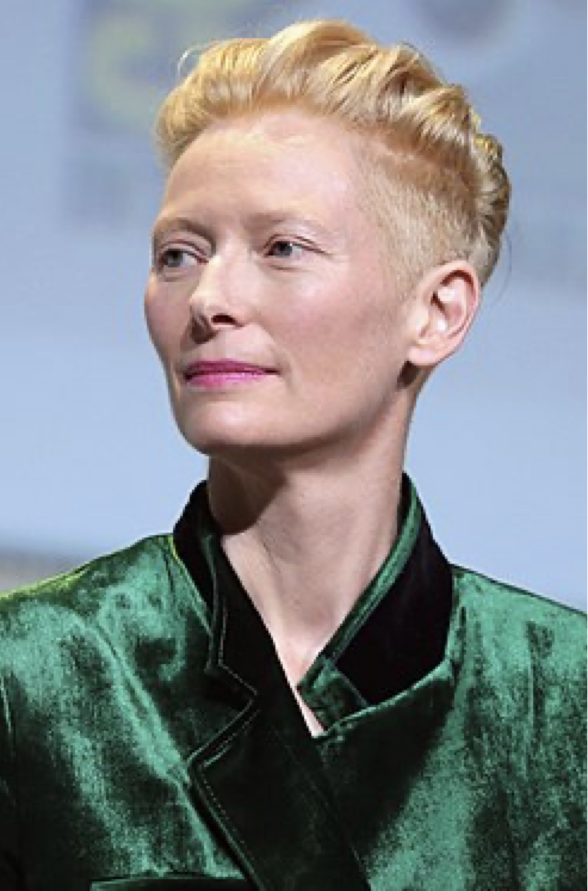
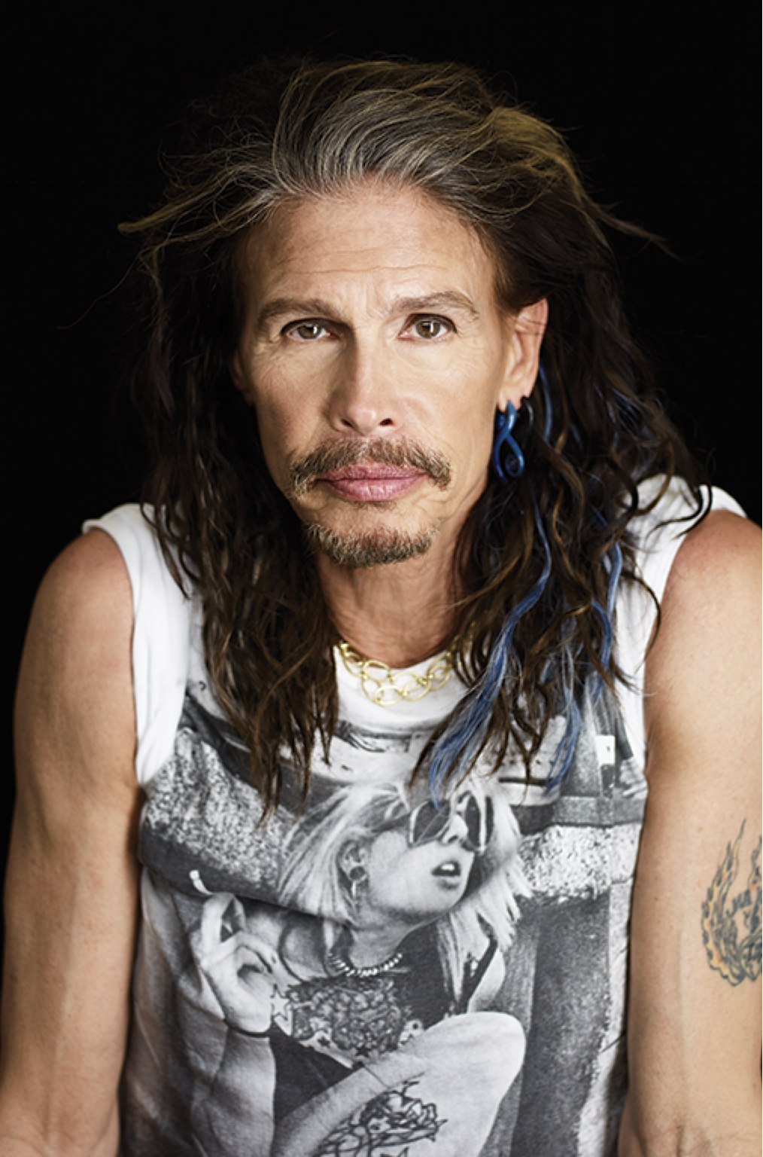
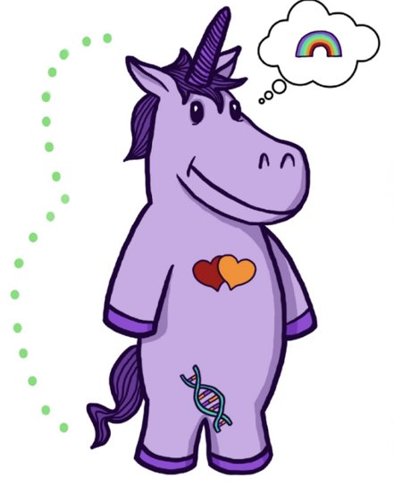
Non-binary Voices
“I don't know if I could ever really say that I was a girl—I was kind of a boy for a long time. I don't know, who knows? It changes.”
“I’ve been misquoted as saying I’m more female than male. Let me set the record straight—it’s more half and half.”
Tilda Swinton
Academy Award Winning Actress
Steven Tyler
Lead singer of Aerosmith
35
Notes:
For a lot of cisgender people, those whose sex and gender align really well, the concept of non-binary identities is really hard to understand. But we have some famous people who have described it really well.
Tilda Swinton and Steven Tyler have never indicated that they identify as transgender, but they describe a blending or fluidity of gender. For a lot of non-binary folks, that’s the only label they apply to themselves. Others can refine things a bit more.
(Read the slide.)

Slide 36
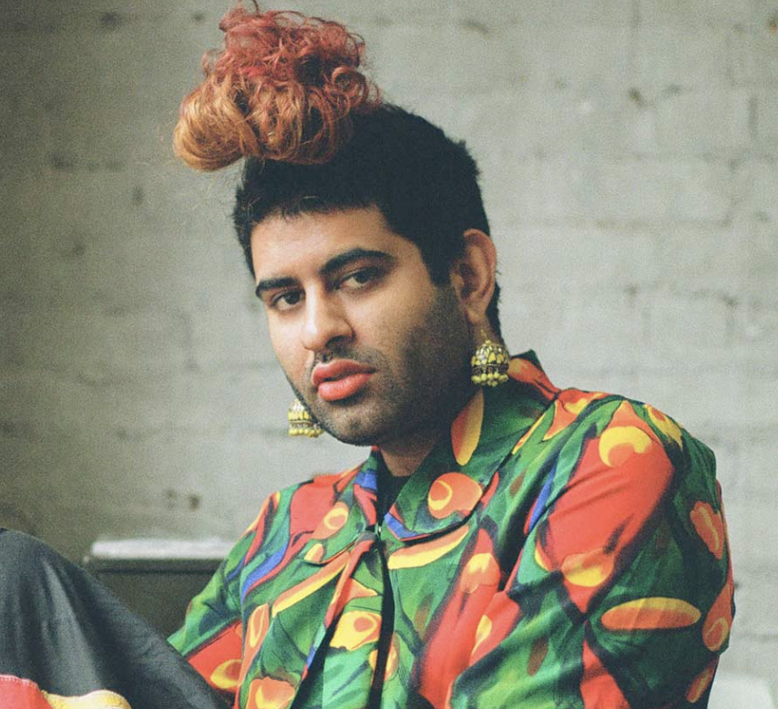
Non-binary voices
“Being non-binary isn’t just about being defined by my absence (I am not a man or a woman), but also by my abundance (I am far too expansive to be encapsulated by the gender binary). Being non-binary is about embracing my fluidity, my becoming, my journey without a fixed destination.”
Alok Vaid-Menon
(they/them)
36
Notes:
Here we see the words of Alok Vaid-Menon who uses the gender pronouns they/them. They are an internationally acclaimed gender non-conforming writer, performer, and public speaker. As a mixed-media artist, Alok’s work explores themes of trauma, belonging, and the human condition.
(Read the slide.)

Slide 37
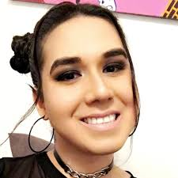
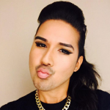
Non-binary voices
“Throughout my life, I have made so many stops all along the gender and sexuality spectrums. Each one felt like home until it didn’t. I’d stumble across a new shell and try it on. If it fit, I’d keep it, and leave my old one behind.
So I’ve been gay. I’ve been gender non-conforming. I’ve been queer. I’ve been genderqueer. And now I’m non-binary. And sometimes a demiwoman.”
Karari Olvera Orozco (they/she)
Activist, writer, co-founder and former editor-in-chief of xQsí Magazine, an online LGBTQ Latin@ Multimedia Publication.
37
Notes:
As we’ve said, gender can be fluid. Here, writer and activist Karari Olvera Orozco shares a bit of their story. (Read the slide.)
A demiwoman is someone who was assigned female at birth but does not fully identify with being a woman, socially or mentally.
If someone has two types of pronouns, like we see here with Karari, they may feel more comfortable with one over the other. So be sure to ask which one they are most comfortable with.

Slide 38
Key Ideas
Gender identities are constructed as binary, however, people's identities are much more fluid.
People who identify as non-binary express their gender identity in many ways
People's gender identity and sexual orientation can shift at different times.

Slide 39
"But science says..."

Slide 40
Intersex
Intersex is a general term used for a variety of conditions in which a person is born with a reproductive or sexual anatomy that doesn’t fit the typical definitions of female or male.
Intersex
XO
XXX
XXY
XYY
Male
XY
Female
XX
40
Notes:
Intersex conditions comprise more than 30 natural genetic variations. Historically, these variations have not been socially acceptable.
Proposed laws focused on the rights of transgender people regarding restroom usage, participation in sports, and even access to specific health care coverage, and have centered on genitals or proposed chromosome tests. These laws also affect the intersex community, who are often entirely ignored or left out of those conversations.
More people are intersex than we realize. In the past, this was often discovered in testing for the Olympic games, because some women were subjected to gender testing if they were thought to have a perceived physical advantage.
Scientists say there is no clear definition of male & female – that one’s sex includes more than just physical anatomy. It also includes hormone levels, chromosomes, and more.
The LGBTQ+ movement is now often referred to as LGBTQIA+ to include intersex people because of the similar issues facing each group around body autonomy and identity. (The “I” is for Intersex and the “A” for Asexual, which is a lack of sexual attraction.)

Slide 41
Trans identities
Trans woman
Trans girl
Someone assigned a male sex at birth who knows themselves to be a woman (or girl).
Trans man
Trans boy
Someone assigned a female sex at birth who knows themselves to be as a man (or boy).
Trans-feminine
Trans-masculine
Descriptive terms that transgender people use to explain where their gender expression lies.
41
Notes:
Please note that “transgender” or “trans” are adjectives. They are terms that describe. A person is transgender, not “a transgender.”
A trans woman (or trans girl) is assigned a male sex at birth but knows themself to be a woman. Alternately, a trans man is assigned a female sex at birth but knows themself to be a man.
Someone who is transmasculine, identifies on the masculine side of the gender spectrum, but may not identify as a man. The same is true for transfeminine people. They may identify as more female, but not see themselves as a woman.

Slide 42
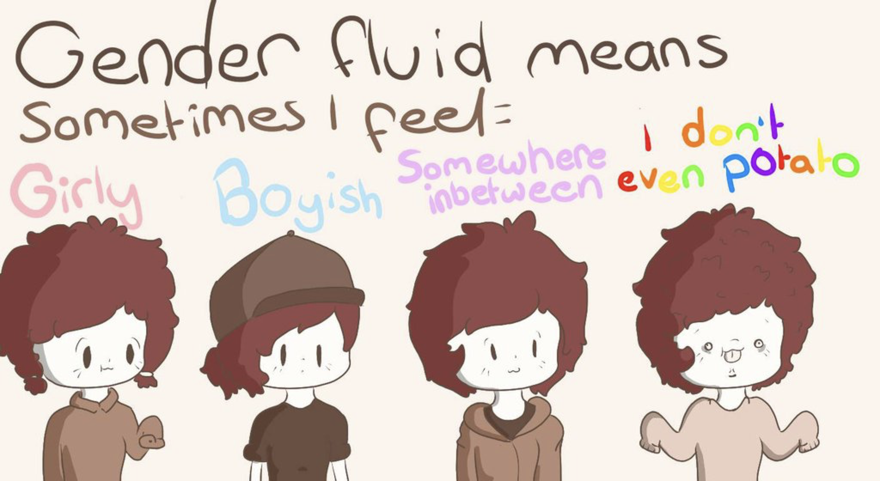
Other Gender Identities
Gender Fluid Genderqueer Agender
42
Notes:
Gender fluid is exactly what it sounds like. Gender flows in a more masculine way at times and in a more feminine way at others, with no internal struggle between the two. That fluidity could happen over many years, or it may fluctuate during a week.
Genderqueer people are fluid in their gender and often their sexuality. People who consider themselves genderqueer will often say that no rules apply. They like what they like, who they like, and feel the best living outside of any boxes.
Older generations often regard the word “queer” as a derogatory term. It causes LGBTQ+ people of a certain age to feel pain and relive some tough times when they hear it. But younger generations have reclaimed the word and are using “queer” for themselves. They don’t want to be narrowly defined as gay, lesbian, bi, or trans. Because there is respect for the spectrums of gender and sexuality, “queer” feels more all encompassing for who they are.
Agender is the last term on this slide, and it describes someone who does not have a gender. Agender people can feel no connection to the concept of gender at all. They may feel genderless or gender neutral.

Slide 43
Questions and Topics to Avoid
    Questions about genitalia or anatomy
It’s not your business!
    Questions about sexual experiences
Also, not your business
    Any questions that imply someone should delay or stop transitioning
Are you sure you want to switch your pronouns this school year?
    Any comments on someone’s transition
“I never would have known! You pass so well! You don’t look trans!”
    Questions or comments about, or using a person’s dead name
A dead name is the birth name of a transgender person who has changed their name
    Anything that assumes they are the expert on everything LGBTQ+
It's not their job to teach you or to speak for an entire, diverse community
Notes:
Added some from here- https://freedomforallamericans.org/messaging-terms-avoid/ (Sara)

Slide 44
TERMINOLOGY TO AVOID:
Best Practice: People first terminology AND Ask (respectfully)
Don’t use… | Because… | Use…
a Transgendered | Trans is not a noun! Trans is an adjective that helps describe someone’s gender identity. | “Person who is Transgender” or the identity the person chooses for themselves!
Homosexual/ Homosexuality (unless someone chooses it for themselves) | This term comes across clinical and dog whistle-y | The identity someone chooses! LGBTQ+ as an umbrella.
“Sexual preference”, “homosexual lifestyle” | These words have been co-opted as dog whistles to suggest gayness is a choice. | “Sexual Orientation”
“Sex Change”, “Pre-op/Post-op” | These are antiquated and centralize surgeries and anatomy as a determining factor in gender identity. | “Transition” or “gender confirmation surgery”
“Biologically male/female” | It is rarely relevant what sex someone was assigned at birth and this suggests that trans women/men are not “real” women/men | IF NECESSARY… Assigned Female/Male at Birth (AFAB/AMAB)
"Hermaphrodite" | This is a super stigmatized word! | Intersex
Notes:
Added some from here- https://freedomforallamericans.org/messaging-terms-avoid/ (Sara)

Slide 45
So…
What about “Queer”?
Notes:
Added some from here- https://freedomforallamericans.org/messaging-terms-avoid/ (Sara)

Slide 46
Key Ideas
There is a long history of language being weaponized to harm members of the LGBTQ+ community
We must be intentional with our language and how we show up
Again, a lot of this language is constantly changing, it is our responsibility to adjust and learn.

Slide 47

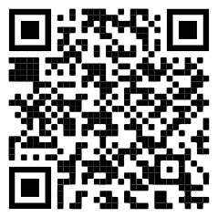
15 Minute Break!
Check out this site! It includes accurate and up to date maps that track LGBTQ+ policies across the nation. (We will revisit this map later)
https://www.lgbtmap.org/democracy-maps/ratings_by_state

Slide 48
Ellen and Ben

Slide 49
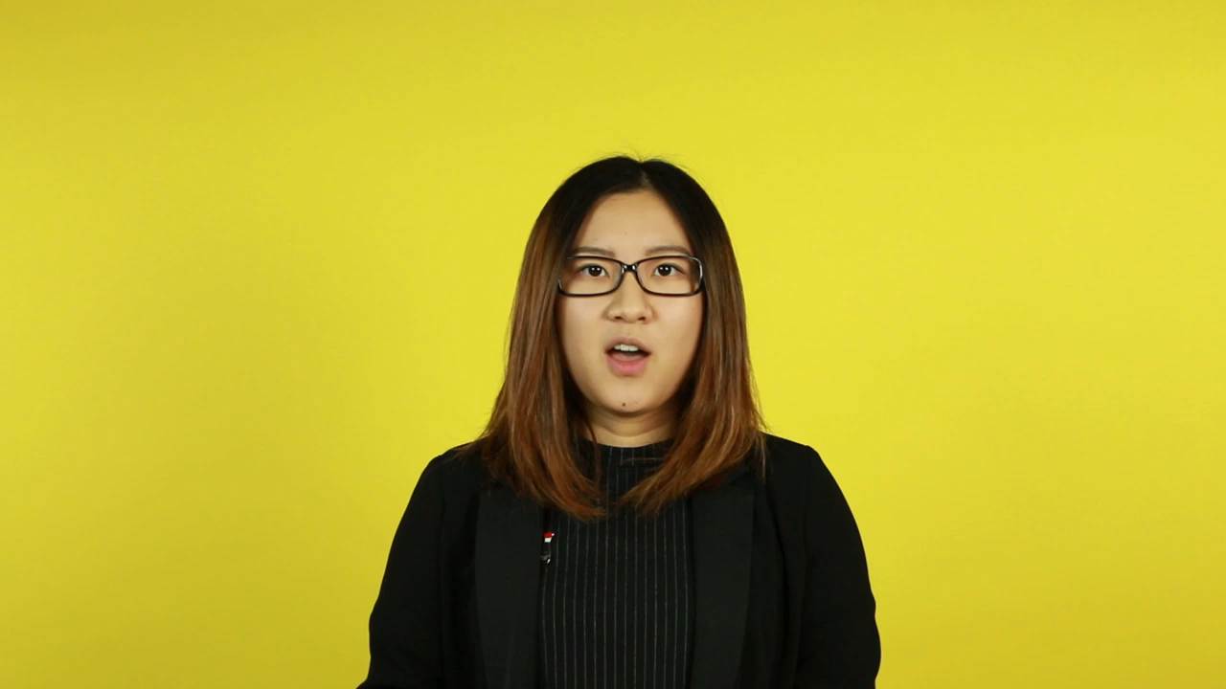
Pg 24 INTERSECTIONALITY

Slide 50
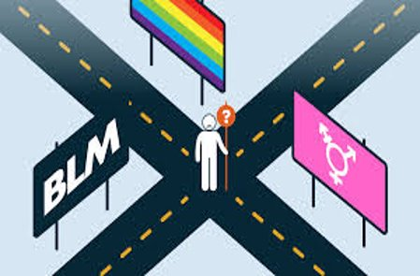
INTERSECTIONALITY
Intersectionality is a framework for understanding a person, group of people, or social problem as affected by a number of discriminations and disadvantages. It takes into account people's overlapping identities and experiences in order to understand the complexity of prejudices they face.​

Slide 51
Pg 27 LEVELS OF EXPRESSION OF OPPRESSION
I n d i v i d u a l | Internalized Oppression lies within individuals. These are our private beliefs and biases about others, influenced by our culture, that reside inside our minds. | S y s t e m i c | Institutional Oppression occurs within institutions and systems of power. It is the norms, policies and practices that are structured into political, societal and economic institutions that have the net effect of imposing oppressive conditions and denying rights, opportunity, and equality to identifiable groups.
 | Interpersonal Oppression occurs between individuals. Once we bring our private beliefs into our interactions with others, we are now in the interpersonal realm. |  | Structural Oppression is bias across institutions and society. It’s the cumulative and compounded effects of an array of factors that systematically privilege some and disadvantage others.
Notes:
10:45-11:30 Ben

Slide 52
KEY POINTS
1. There are no hard and fast lines between the levels – and changing one can affect another. ​
​
While we believe that the individual is ​
responsible for exploring personal bias …​
​2. The way to effect change is by addressing institutionalized and structural oppression – this is where injustice lives.

Slide 53
UNDERSTANDING EXPRESSIONS OF OPPRESSION
Drawing on your knowledge base and experiences: ​
Independently analyze the scenarios and determine the expression of oppression. ​
Discuss at your tables and reach consensus about the expression of oppression in each scenario.​
TOTAL Report Out – 3 Minutes be prepared to report a 2 Sentence Summary of your scenario and the Consensus Decision about what level of oppression is being expressing and why.
Notes:
Count off by 8
Three Minute Report Outs ​
Summary​
What Level​
Why​
Then for all groups…​
What did you struggle with? ​
What was Clear to You?

Slide 54
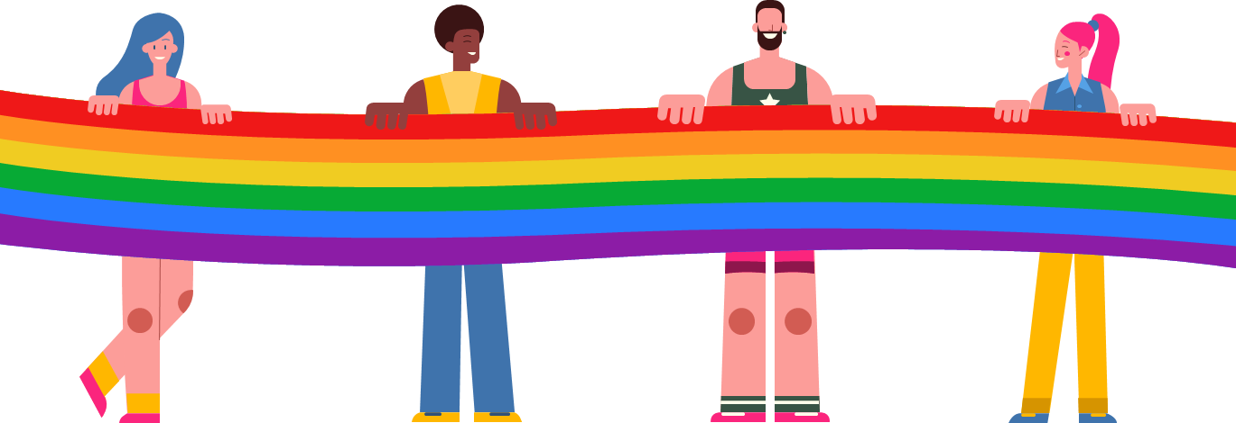
What did you struggle with?
What was clear to you?

Slide 55
Key Ideas
There are not hard and fast lines between the levels – and changing one can affect another.
This framework helps us think about the size of the solution we need to fight the injustice at a particular level.

Slide 56
Grat

Slide 57
8.1 Million
WHAT’S THE SIGNIFICANCE?
57
Notes:
In 2019, there were 157 million employees in the US. What do you think this number represents?
According to Catalyst.org, there are an estimated 8.1 million LGBTQ+ employees in the United States who are age 16 or older. 50% of these employees are not out at work because of fears of discrimination or ostracization. And 1 in 5 LGBTQ+ employees have experienced discrimination.
Reference: https://www.catalyst.org/research/lesbian-gay-bisexual-and-transgender-workplace-issues/

Slide 58
TRUE OR FALSE
In my state, an employee can be fired for being transgender

Slide 59
TRUE OR FALSE
In my state, an employee can be fired for being a lesbian.

Slide 60
FALSE!
There are federal laws that protect LGBTQ+ workers from workplace discrimination in ALL states (yes, even yours).

Slide 61
Federal Law
Notes:
Let’s first look at federal laws.

Slide 62
A NATION OF LAWS
1600s
Founding of Jamestown, VA
Mass. Bay General Court determined “sex crimes” and punishments.
1700s
Colonial sodomy laws passed and remained in place until 1925.
US Constitution passed and counts African-Americans as 3/5 a person.
1800s
14th Amendment passed that declares “equal protection of the laws.”
Plessy v. Ferguson declares racial segregation legal.
1900s
President Dwight Eisenhower bans gay people from working in the federal gov’t.
Famous celebrities, athletes & politicians start publicly coming out.
2000s
President Obama repealed “Don’t Ask Don’t Tell” so LGBTQ+ people could serve openly in the military.
Same-sex couples granted the right to marry across the US.
Notes:
The US has called itself a “Nation of Laws,” but what are the laws for? And, who do they help or harm? This timeline shows only a glimpse of how discrimination, exclusion, and beliefs in white supremacy have been a part of US laws since the earliest of colonial times. For a more comprehensive list of laws that impact LGBTQ+ people throughout US history, please see your handout.
Highlights for further discussion:
1607 – Founding of Jamestown, VA, the first permanent English settlement in the “New World.”
1607 – Massachusetts Bay Colony was established believing they made a “covenant with God to build an ideal Christian community.”
1619 – The first enslaved Africans arrive to Jamestown, VA
1631 – The Massachusetts Bay General Court, in accordance with Puritan religious and moral beliefs, declared that the following were considered sex crimes and punishable by whipping, banishment or execution: fornication, adultery, rape and sodomy.
1705 – The Colony of Virginia adopted the first Blood Quantum Law. A person’s blood quantum is defined as the fraction of their ancestors, out of their total ancestors, who are documented as full-blood Native Americans. These laws were applied across the thirteen colonies and later the entire United States. They limited the civil rights of Native Americans and regulated who could be classified as Native American.
1714 – Sodomy laws were passed in the early colonies and in the colonial militia. They stayed in place until challenged in 1925.
1775 – Population of enslaved people in the colonies is nearly 500,000.
1776 – Declaration of Independence signed.
1778 – Lieutenant Gotthold Frederick Enslin of the Continental Army becomes the first documented service member to be dismissed from the U.S. military for homosexuality. Read more at U.S. History Naval Institute Blog / Timeline of Military Gay History.
1779 – Thomas Jefferson proposes Virginia law to make sodomy punishable by mutilation rather than death. It was rejected by the Virginia legislature.
1788 – U.S. Constitution adopted. Includes a three-fifths clause that counted each enslaved person as three-fifths of a person for the purposes of congressional representation and tax apportionment.
1852 – Scottish writer J.D. Bothwick reports his attendance at a “miner’s ball” – a men’s only dance held in Angels’ Camp in California.
1857-1861 – James Buchanan elected president. A lifelong bachelor, Buchanan had a long-term relationship with William Rufus King, who served as vice president under Franklin Pierce. The two men lived together from 1840-1853 until King’s death. Some historians suggest Buchanan, by today’s terms, was gay.
1868 – Fourteenth Amendment Ratified. This is the most cited amendment in Supreme Court civil rights cases and has been the basis for landmark civil rights cases such as Brown v. Board of Education, Roe v. Wade and Obergefell v. Hodges. Gay rights advocates cite this amendment in support of equality for future court cases.
“All persons born or naturalized in the United States and subject to the jurisdiction thereof, are citizens of the United States and of the State wherein they reside. No State shall make or enforce any law, which shall abridge the privileges or immunities of citizens of the United States; nor shall any State deprive any person of life, liberty, or property, without due process of law; nor deny to any person within its jurisdiction the equal protection of the laws.”
1868 – Two-Spirit, We’wha, a Zuni Native American, meets with President Grover Cleveland.
Source: https://www.lgbtqhistory.org/lgbt-rights-timeline-in-american-history/
Source: https://en.wikipedia.org/wiki/Blood_quantum_laws

Slide 63
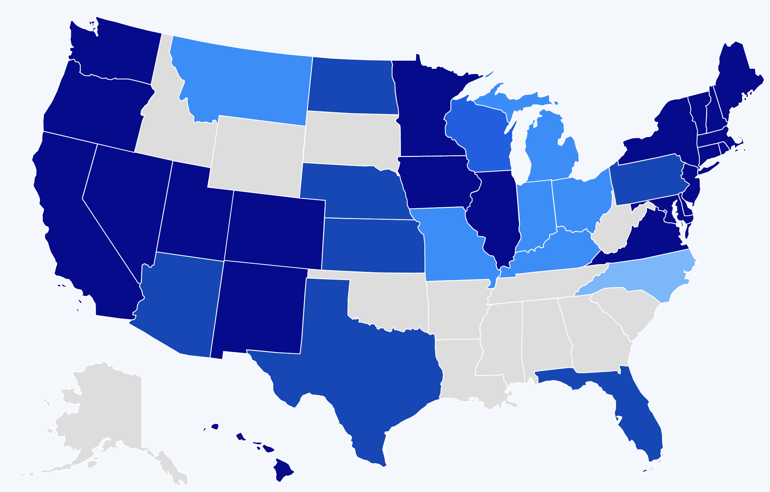
A HISTORY OF BARRIERS
In 2019, Just 22 States + DC Prohibited Workplace Discrimination Based On Sexual Orientation And Gender Identity.
Source: Human Rights Campaign
63
Notes:
US history is full of barriers for BIPOC and LGBTQ+ people. Discrimination because of one’s race and LGBTQ+ identity means lost wages, jobs, promotions, unfair treatment and even harassment at work. This discrimination compels many to hide their LGBTQ+ status for fear of retribution, losing one’s livelihood, support system, and more.
Before 2019, only a handful of states (in dark blue above) provided LGBTQ+ people some protection against employment discrimination, as well as in housing and public accommodations. This meant that in all the other states (those in tan and lighter shades of blue), LGBTQ+ people could be denied jobs, health care, housing, hotels, and more. This discrimination – across the majority of the US, and nearly all of the South— was perfectly legal.

Slide 64
A LANDMARK RULING
Bostock v. Clayton County
Prior to June 15, 2020
It was legal to fire an employee for being gay, bisexual or transgender, in more than half of the 50 states.
June 15, 2020
The Supreme Court rules it is illegal to discriminate against
or fire an employee based on their sexual orientation or gender identity.
64
Notes:
The Civil Rights Act of 1964 prohibits discrimination based on race, color, religion, sex, or national origin. The courts and the federal government have long refused to recognize LGBTQ+ discrimination as a form of sex discrimination. Over the past 20 years, however, federal courts and the government have at times recognized LGBTQ+ discrimination as sex discrimination.
It was not until June 15, 2020 that the Supreme Court finally recognized that LGBTQ+ employment discrimination is prohibited sex discrimination under Title VII of the Civil Rights Act of 1964.
This ruling recognized that it is illegal to discriminate against or fire an employee based on their sexual orientation or gender identity. Now lower federal courts and the Biden Administration are applying that ruling to education, health care, housing, credit discrimination, and more.

Slide 65
BOSTOCK V. CLAYTON COUNTY
Employment Discrimination is Illegal
Title VII of the 1964 Civil Rights Act prohibits employment discrimination based on race, color, religion, sex and national origin. Bostock interprets “sex” to include gender identity and sexual orientation.
65
Notes:
The Bostock ruling specifically states that employment discrimination on the basis of gender identity and sexual orientation is illegal.
Title VII of the Civil Rights Act covers the full spectrum of employment decisions, including recruitment, selections, terminations, and other actions concerning terms and conditions of employment. This is significant for the LGBTQ+ community because, as we saw, in many states it was legal to be denied an interview or a promotion, and even to be fired because of one’s gender identity or sexual orientation.

Slide 66
BOSTOCK V. CLAYTON COUNTY
Discrimination in Educational
Programs is Illegal
Title IX of the Education Amendments Act of 1972 states: "No person in the United States shall, on the basis of sex, be excluded from participation in, be denied the benefits of, or be subjected to discrimination under any education program or activity receiving Federal financial assistance."
66
Notes:
On March 26, 2021, the Department of Justice concluded that, as a result of the Bostock ruling, Title IX of the Education Amendments Act of 1972 also prohibits sexual-orientation and gender-identity discrimination in educational institutions that receive federal funding. This means all public schools. This means that students cannot be discriminated against in schools based on their LGBTQ+ identity.
There have been some significant wins recently for LGBTQ+ rights in the US But while progress is being made, attacks on LGBTQ+ rights in certain states have accelerated.
Reference: Department of Justice, “Application of Bostock v. Clayton County to Title IX of the Education Amendments of 1972,” March 26, 2021, https://www.justice.gov/crt/page/file/1383026/download

Slide 67
The following topics are currently being debated in state legislatures:
ANTI-LGBTQ+ LEGISLATION
Prohibiting healthcare for transgender youth
Single-sex facility restrictions
Excluding transgender youth from athletics
Restrictions on identification documents
Religious exemptions
Source: ACLU.org
67
Notes:
While some schools and districts are implementing gender-affirming policies and practices, like recognizing proper names and pronouns for children, in the background, states are trying to license LGBTQ+ discrimination under the guise of religious freedom. The proposed legislation in these areas, if passed, would serve to limit, further marginalize, and in some cases criminalize efforts to support LGBTQ+ youth and adults.
These attacks on LGBTQ+ people, especially young people, are being challenged in court and should be struck down under the reasoning of Bostock. But those lawsuits are just getting started.

Slide 68
WHAT WE KNOW TODAY
The Bostock ruling only applies to employment discrimination.
Discrimination in other areas (e.g., housing) is still legal in many states.
The Equality Act – a federal law currently stalled in Congress - would end discrimination across all areas for LGBTQ+ people.
68
Notes:
Key Notes
Bostock only applies to employers with more than 15 employees. Employers with fewer than 15 total employees are not covered by Title VII.
Bostock applies nationwide and protects employees from sexual orientation or gender identity discrimination regardless of state or local laws.
An employer covered by Title VII is not allowed to fire, refuse to hire, or take assignments away from someone (or discriminate in any other way) because customers or clients would prefer to work with people who have a different sexual orientation or gender identity. (For example, keeping LGBTQ+ employees out of public-facing positions.)
Although accidental misuse of a transgender employee’s preferred name and pronouns does not violate Title VII, intentionally and repeatedly using the wrong name and pronouns to refer to a transgender employee could contribute to an unlawful hostile work environment.

Slide 69
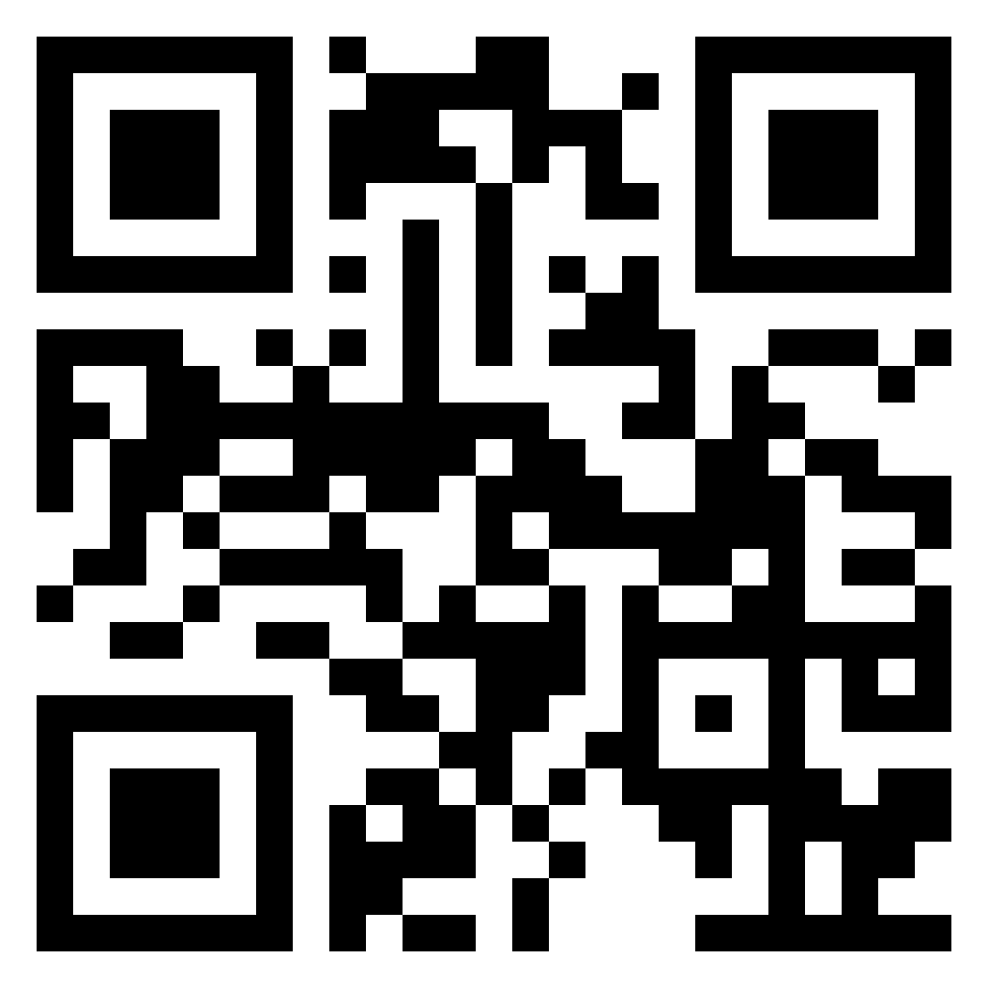
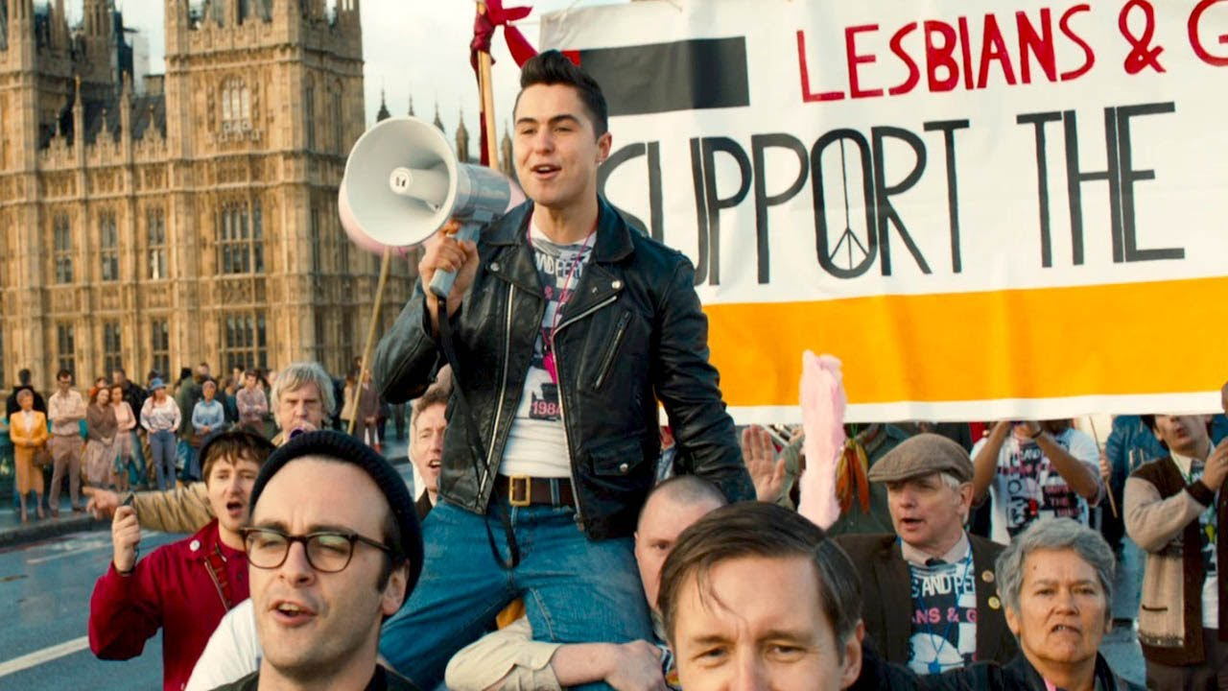
Lunch
1 hour for Lunch!
CUE IT UP!
Add the movie “Pride” to your to watch list. It is based on a true story about an LGBTQ+ group’s solidarity with striking miners. A feel good union story, but make sure to have tissues handy!

Slide 70

TURN & TALK
How have past and recent federal laws impacted LGBTQ+ individuals?
2. How does the Bostock ruling impact LGBTQ+ members? How does it impact the work of UniServ directors?
70
Notes:
Turn & Talk: Suggested Discussion Questions
How have past and recent federal laws impacted LGBTQ+ individuals?
How does the Bostock ruling support LGBTQ+ members? How does it impact the work of UniServ directors?

Slide 71
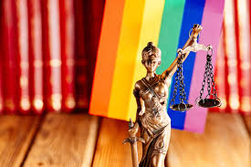
STATE & LOCAL LAWS ON THE RISE
In the absence of federal law that protects LGBTQ+ individuals, states are rushing to pass legislation.
State laws range from being affirming to harmful of LGBTQ+ individuals & their families.
Local School Boards have joined in passing policies that affirm or further marginalize/erase the history and lived experiences of LGBTQ+ and BIPOC students.
Notes:
Well funded political groups have launched a coordinated and strategic approach to overwhelm and see what legislation sticks regarding harmful legislation.
Local School boards & the public education system have become a focus for advancing anti-LGBTQ+ policies
While children of color make up the majority of U.S. public school students, policies that affirm their histories and lived experiences are not centered in local and state legislation.

Slide 72
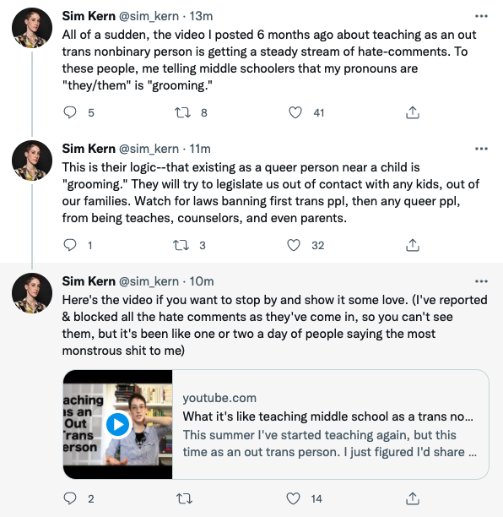
IMPACT ON EDUCATORS
Notes:
The coordinated attacks on LGBTQ+ individuals include providing people scripts that denounce teaching topics such as transgender rights, banning books from well known authors, and labeling inclusive and culturally responsive instruction as “critical race theory.” Unfortunately, these efforts have been effective.
As we see in this Twitter thread, a post from an out trans person, who six months ago shared their experience of teaching in middle school, is now accused of “grooming” students by sharing their pronouns.

Slide 73
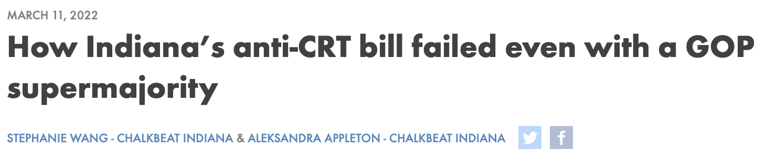
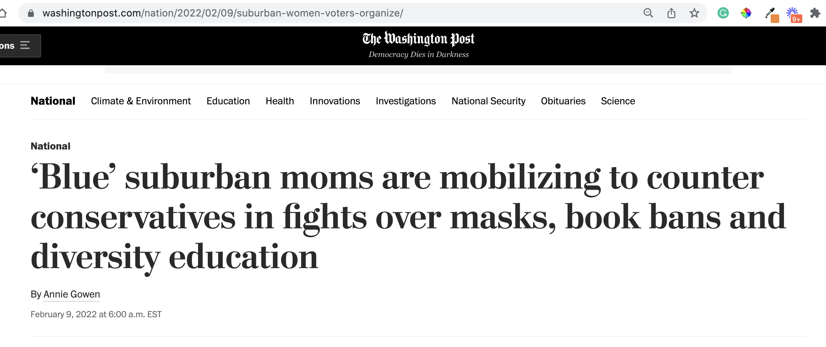


FIGHTING BACK
Notes:
While many states and lawmakers are working to advance anti-LGBTQ+ and other laws that discourage teaching an honest history of the US, not every effort is successful. While many of these efforts are specific to students, it worth noting that not all attempts have been successful.
In March 2022, a “CRT” bill in Indiana failed despite having a GOP supermajority.
Parents are mobilizing to counter the loud voices that dominate local school board meetings:
Red Wine & Blue is a a national network of more than 300,000 like-minded, mostly Democratic suburban women who believe the only way to fight back is to present a calm face to counter the angry groups that have dominated and disrupted board meetings and in some cases threatened officials. The group recently broadened its focus to fight the rising number of book bans across the country, and is running training sessions to help women testify and manage highly charged government meetings.
One WillCo is a community organization in Williamson County Tennessee that was organized by two mothers to address racial disparities in the community in 2021.
Invite discussion: Ask participants if they have heard of anti-LGBTQ+ or anti “CRT” laws that have failed to pass. Why do they think this is?
Sources:
https://www.wfyi.org/news/articles/indiana-anti-crt-bill-failed-republican-supermajority
https://onewillco.org/

Slide 74
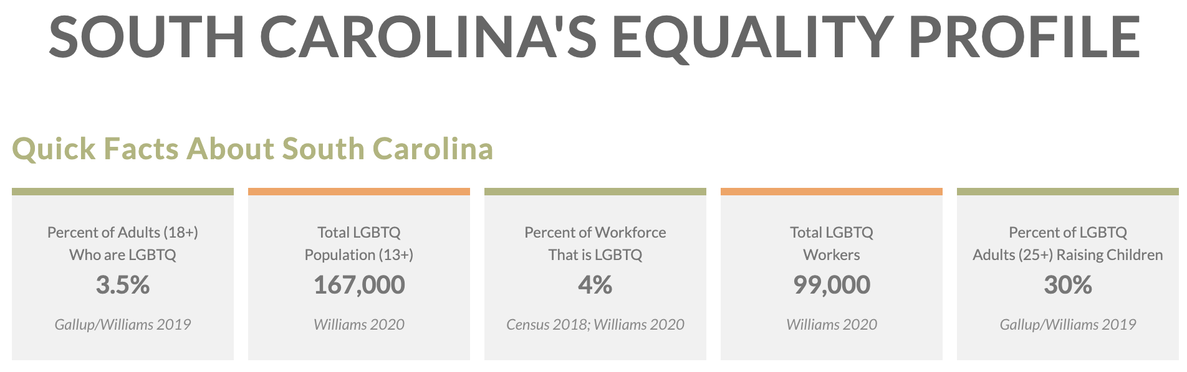
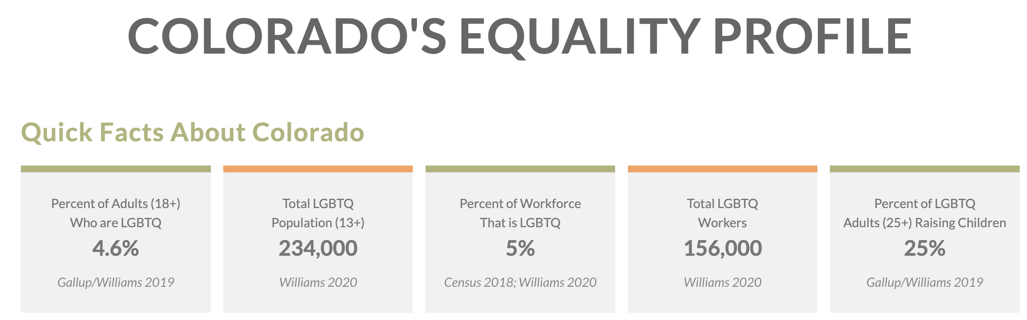
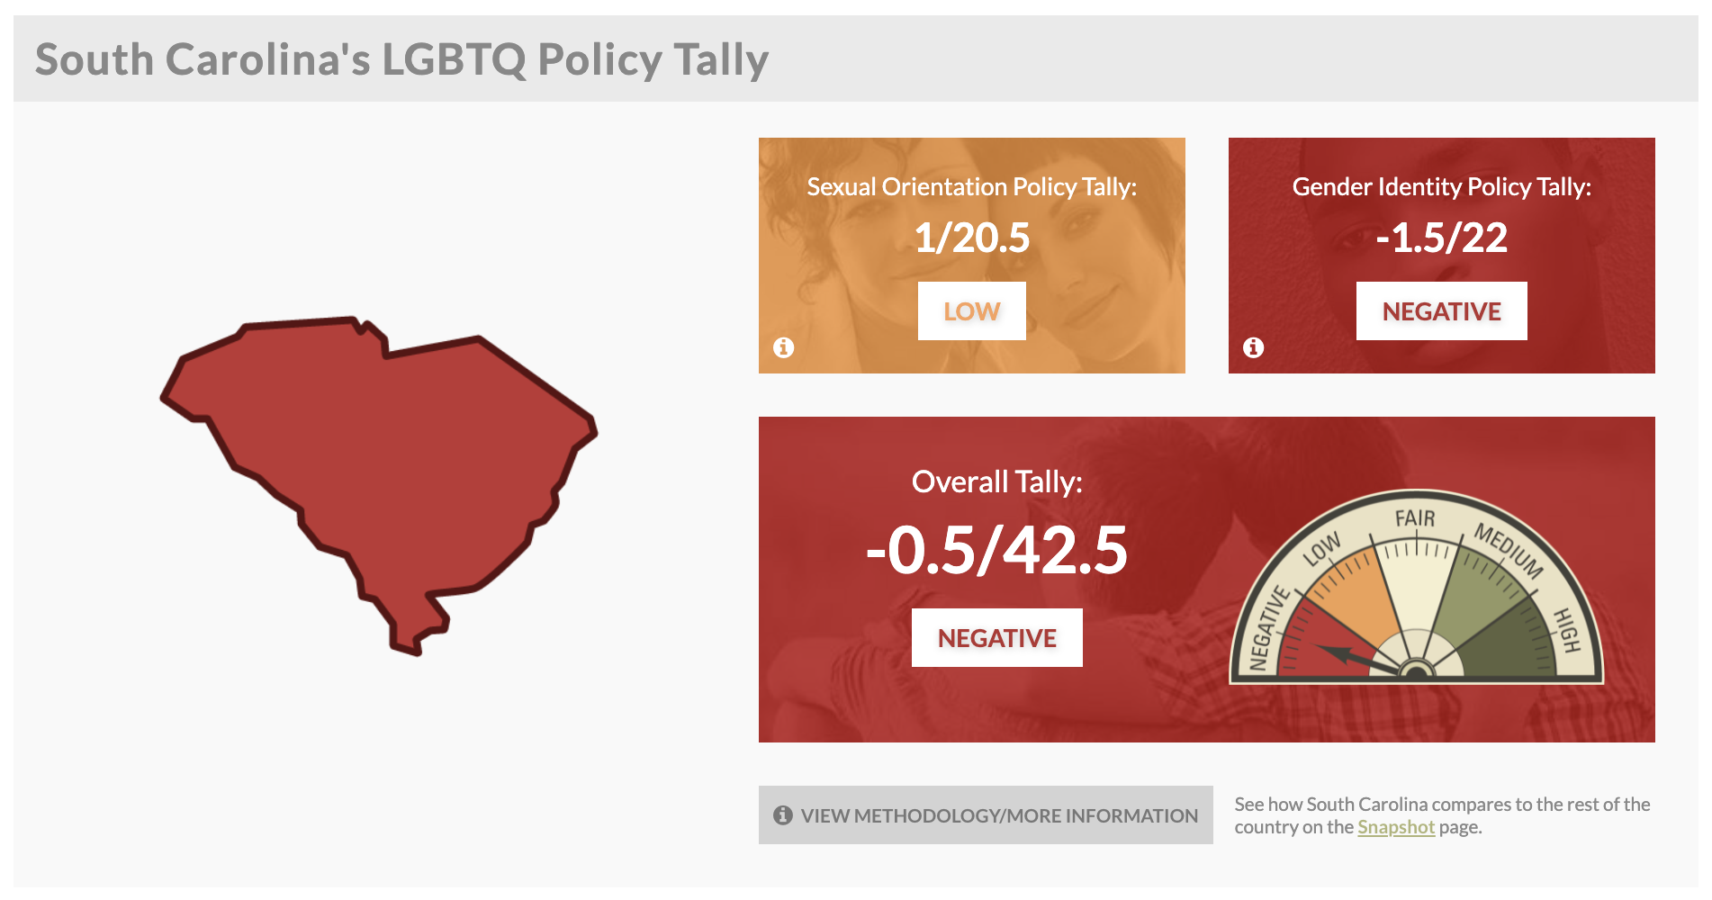
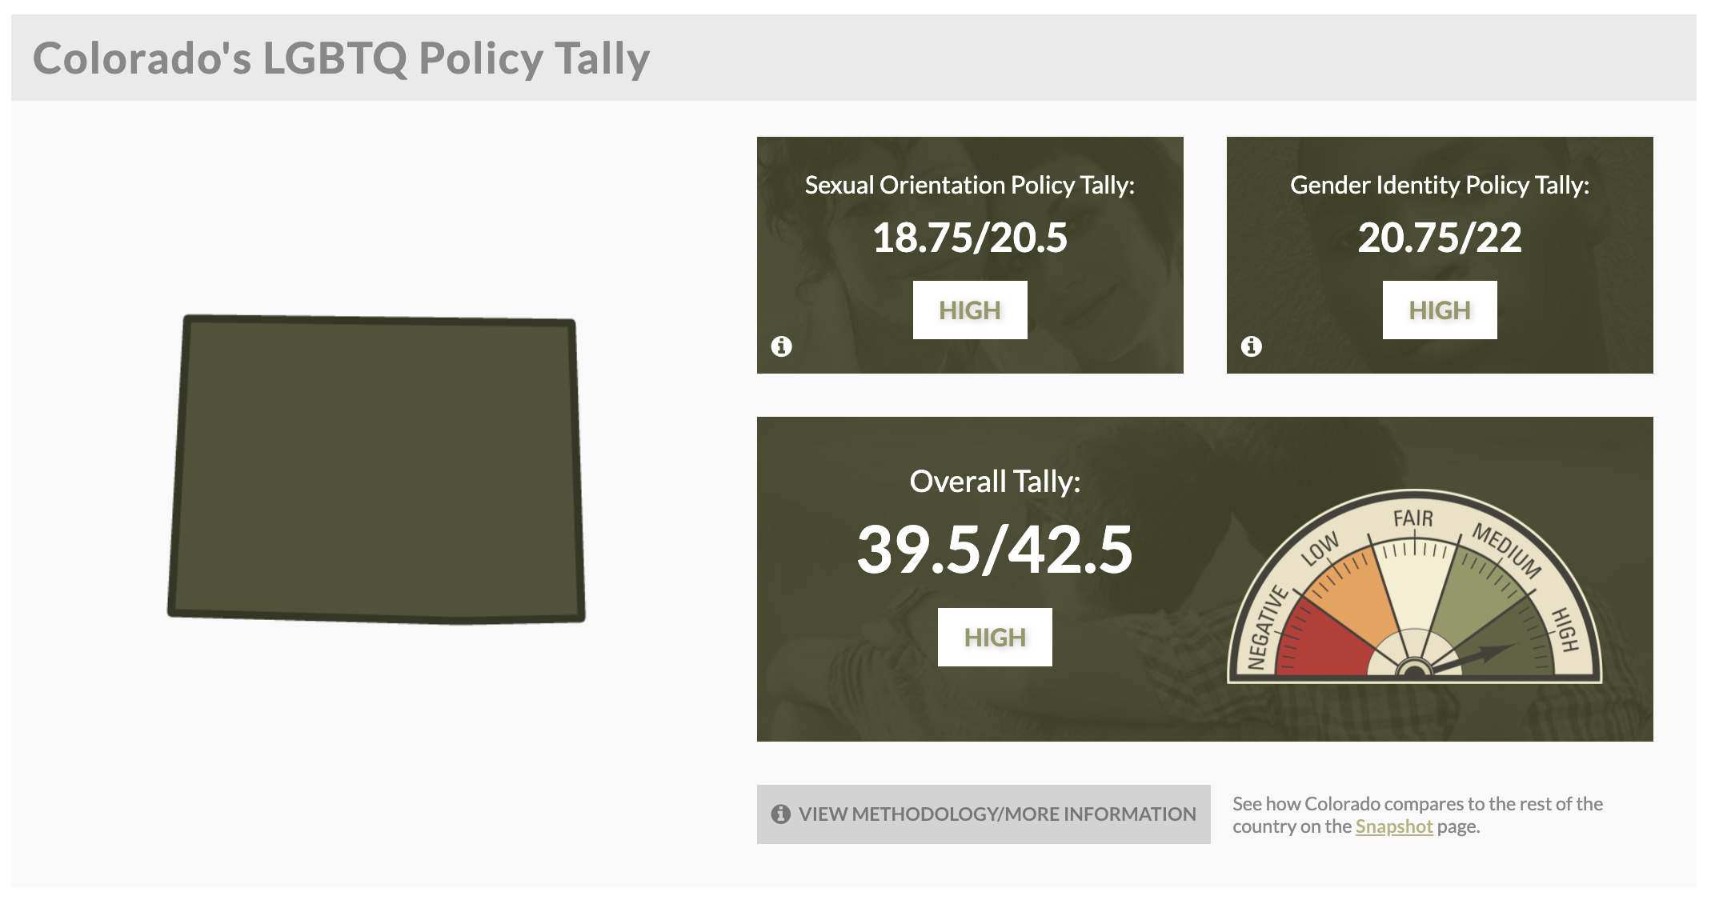
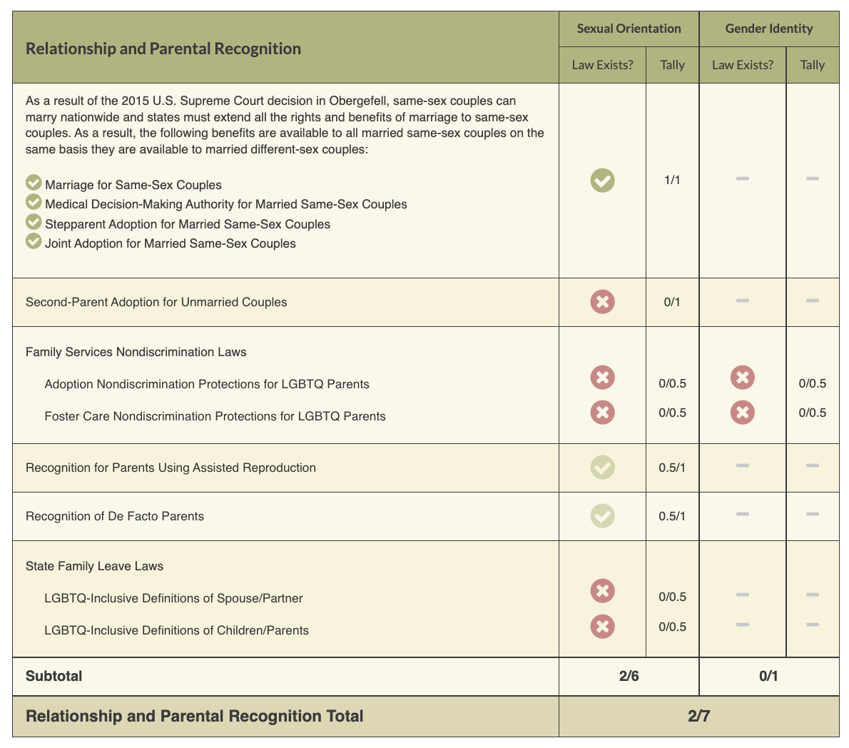
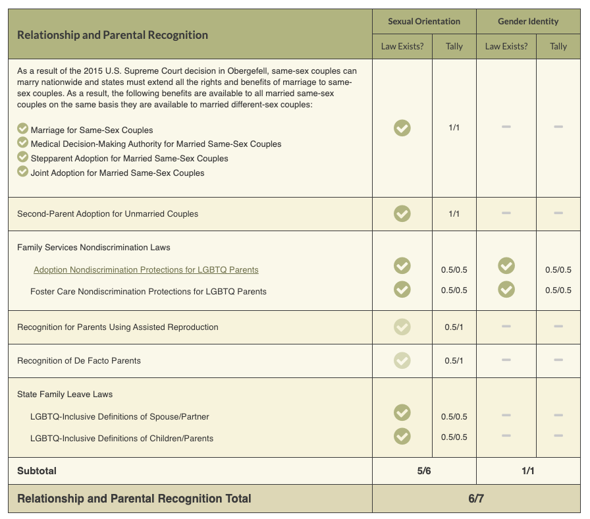
ACTIVITY #2
Review the Laws in Your State
Notes:
Look at Your State’s Equality Profile.
How might this impact members who are transitioning or transgender?
Instructions:
Go to www.lgbtqmap.org
Click Equality Maps
Select “Choose a State” in the drop down menu.
Select a state and review the data. How might this data impact members who are transitioning or transgender in your selected state?

Slide 75

Move it Move it

Slide 76
Review the Laws in Your State
1. Go to www.lgbtmap.org and Click Equality Maps or use the QR Code
2. Select “Choose a State” in the drop down menu.
3. Select a state and review the data.
How might this data impact members who are transitioning or transgender in your selected state?
Notes:
Look at Your State’s Equality Profile.
How might this impact members who are transitioning or transgender?
Instructions:
Go to www.lgbtqmap.org
Click Equality Maps
Select “Choose a State” in the drop down menu.
Select a state and review the data. How might this data impact members who are transitioning or transgender in your selected state?

Slide 77

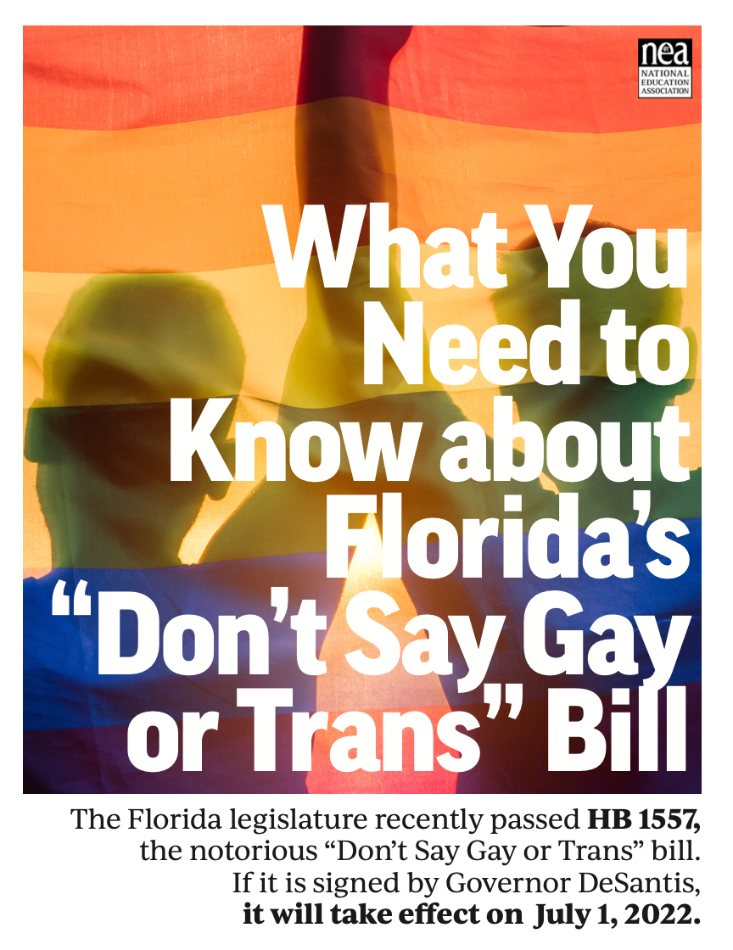



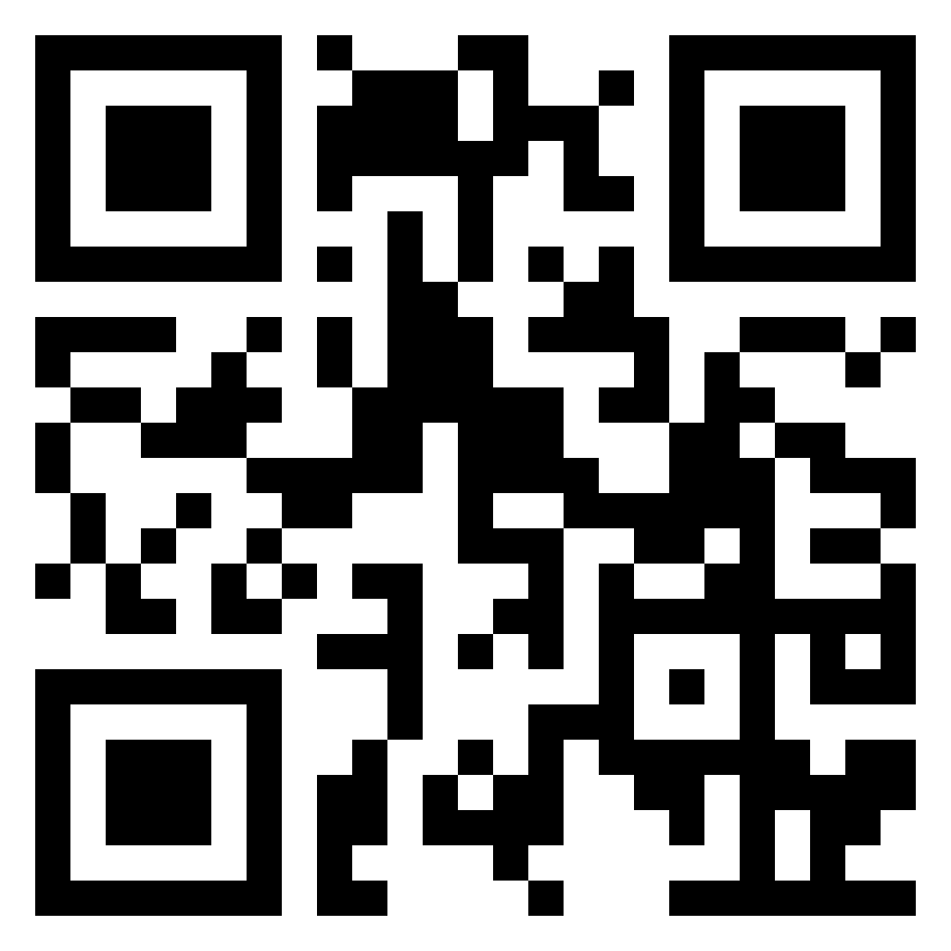
NEA Partners
Legislative Trackers
Notes:
The NEA has several resources and recommendations for legislative trackers. (See handout for full list and website links.)
https://www.icnl.org/usprotestlawtracker/
https://www.aclu.org/legislation-affecting-lgbtq-rights-across-country

Slide 78
Key Ideas
At least for now, ALL LGBTQ+ workers are protected under Bostock.
BUT Bostock is limited to Employment
Affirming and destructive policies are popping up everywhere- The map resource is a good way to stay up to date.
With the current Supreme Court, we don't know how long Bostock will survive

Slide 79
Jeny

Slide 80
Pg. 33 Pronoun Practice Exercise
Partner up
Share a story of a friend
Replace binary pronouns with they/them
Listener should correct every pronoun error
Notes:
10:30-10:45 Ben

Slide 81
Key Ideas
Using someone's correct pronouns is an important way to show respect.
It is on us to get good at this.
Using someone's name or neutral pronouns is the most respectful approach if you don't know.

Slide 82
Michelle

Slide 83
What Does It Mean To Transition?
Notes:
Given all that a transgender person may be experiencing, one option is to transition. This means they align their inner identity with their external one. We’re going to talk about this process and how it affects trans adults.

Slide 84



Individuals May Go Through Various Transitions
Social Transition
Legal Transition
Physical Transition
84
Notes:
Transitioning is not a simple, one-time event, and there is no “one-size-fits-all” process, checklist, or approach. Transitioning is a complex issue, and it involves a wide variety of options for an individual.
Many factors influence a person’s decision to transition, and because of these factors, their transition may not be linear. Transitioning is a personal decision specific to the individual, so how a person goes about transitioning can change over time and vary from person to person.
There are 3 main types of transitions someone could go through: social, legal, and physical.

Slide 85
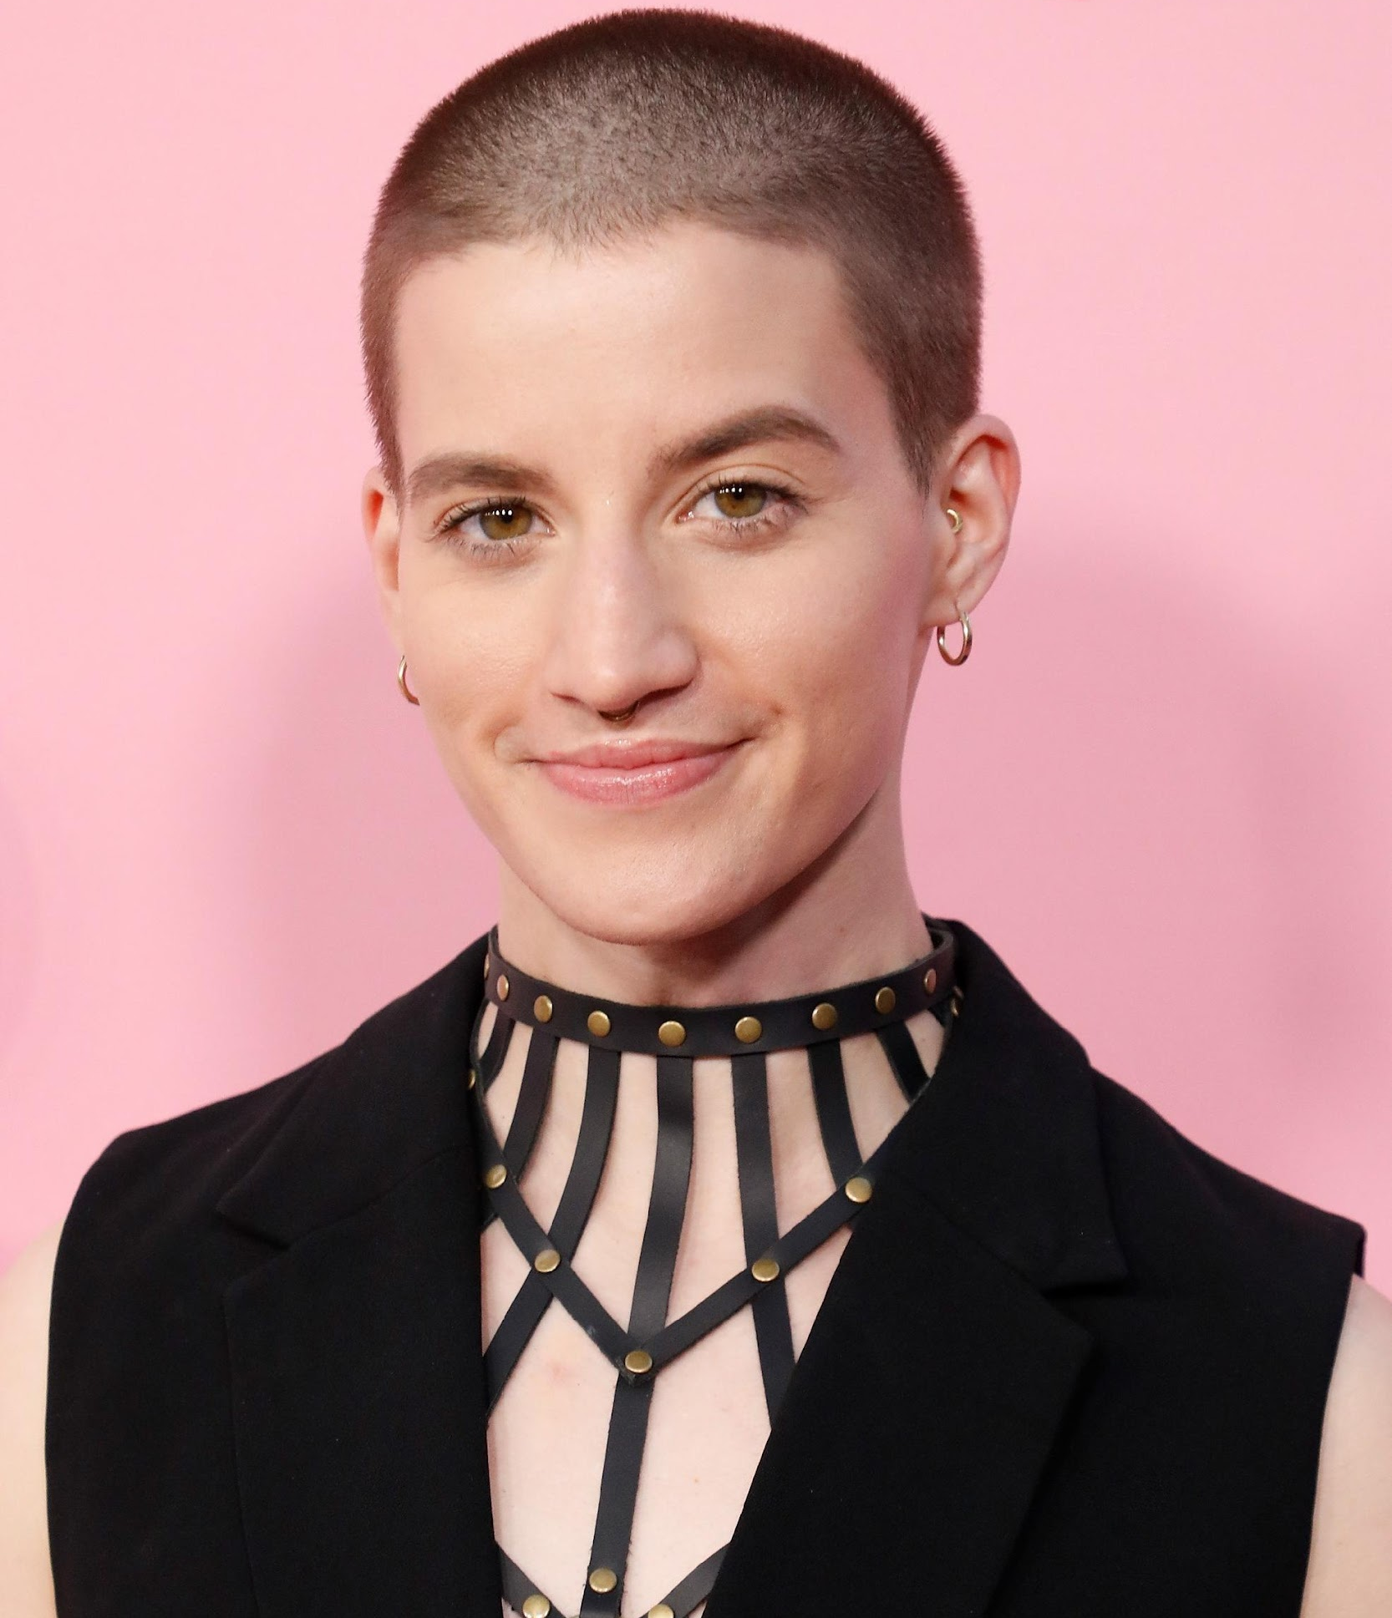
SOCIAL TRANSITION
Social transition is when a transgender person makes others aware of their gender identity.
Theo Germaine, actor in
Netflix’s The Politician
They/Them and He/His
85
Notes:
Social transition is just what it sounds like—changing how you present yourself and how others see you socially. A social transition can happen at any age. A person may start their transition, pause it, move back, and move forward again. It often includes changing clothing or hairstyles. Usually, it entails changing a name and switching pronouns—sometimes more than once.
A person may try on names for a while and switch from one gendered pronoun to another, only to decide that a non-binary pronoun fits better. Again, no rules.

Slide 86

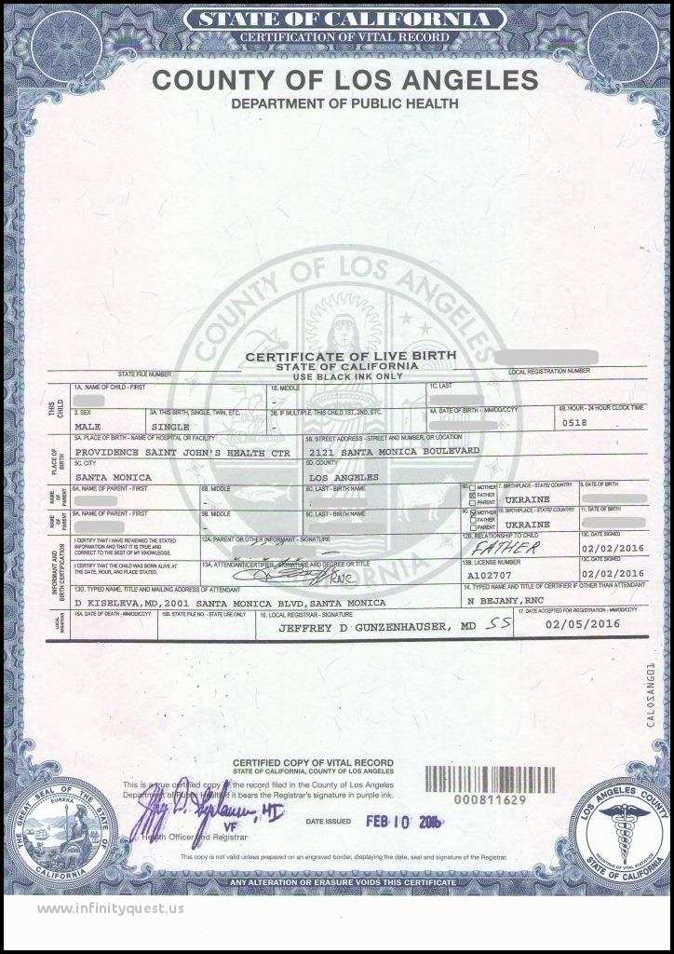
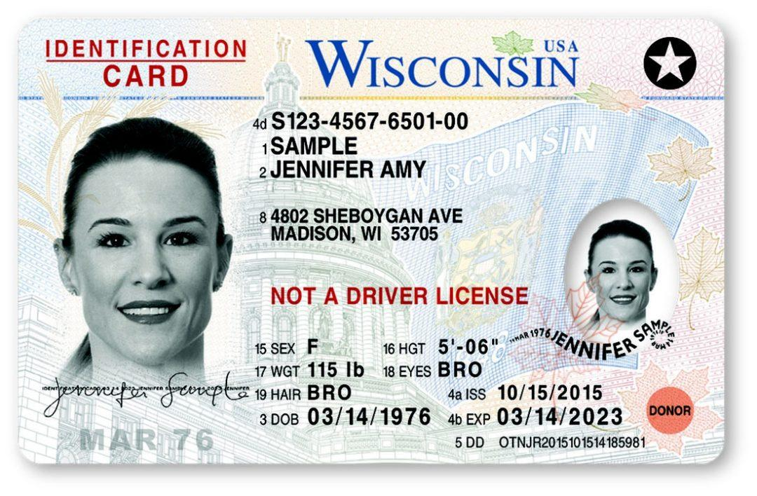
LEGAL TRANSITION
Legal transition is when a transgender person legally changes their existing documentation to match their gender identity.
These can be done by
court order or state law.
86
Notes:
A legal transition means updating documents through the legal process.
Some parts of the legal transition can include changing gender markers on birth certificates, changing names on social security cards, driver’s licenses, or passports. Legal transitions can also have other identification components, such as school documents. Passports are the easiest documents to change.
People cannot always experience a legal transition because of several barriers. Those barriers do not make their gender identity or their distress at being misgendered any less real.

Slide 87
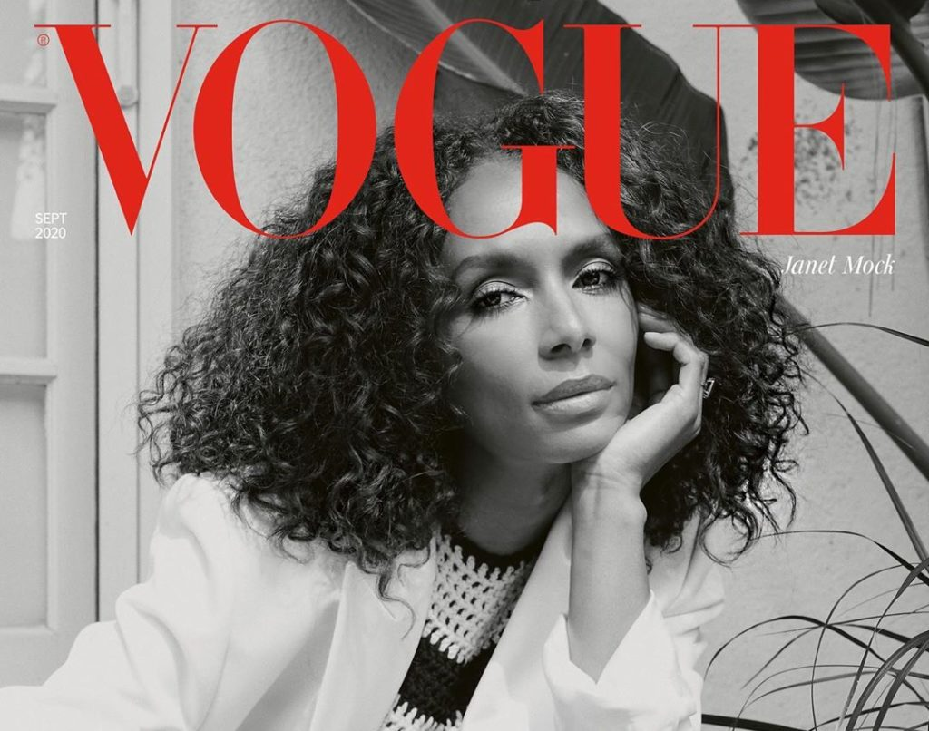
PHYSICAL TRANSITION
Physical transition is when a transgender person undergoes medical treatments so that their sex characteristics better match their gender identity. Before puberty, there are no medical interventions. Ever.
Janet Mock (She/Her), Writer, Director & Transgender Activist
87
Notes:
Transgender health is a specialized area of medicine. There is no one way to have a physical transition.
Given the specialized nature of transgender health care, we can see how problematic it is for a trans person to be told they can only access gender-segregated spaces once they have “had a surgery.” It puts a burden on them that is impossible to overcome, denies their full identity, and creates equal-access issues. Additionally, not all trans people want to have surgery. It’s wrong to demand that another person undergo serious, invasive medical procedures to make other people comfortable.
Keep in mind that just like you would not want to be asked about your medical procedures, we don’t ask others about theirs.

Slide 88
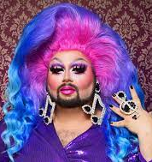
So, what about Drag?
Transgender refers to a personal gender identity and an authentic, lasting sense of self. In contrast, “drag” is a temporary and deliberate performance of gender.
Notes:
“Transgender” refers to a personal gender identity and an authentic, lasting sense of self. In contrast, “drag” is a temporary and deliberate performance of gender.
Drag is most commonly associated with gay men dressing up and embodying a “larger-than-life” female persona. Drag queens are flamboyant and this form of drag often involves sequins and feathers but it can also be sleek and edgy.
For drag queens, their drag persona can be an important part of their own identity as a gay man (this does not mean they are transgender). Similarly, women also perform drag as drag kings. Drag kings dress as men and take on male personas, often wearing facial hair, adopting masculine mannerisms and a deep voice.

Slide 89
TURN & TALK
Describe a time when you had to make a transition. Why did you want to make this change and did you face any barriers?
2. Based on what you know, what are some of the barriers
members can face when transitioning?
89
Notes:
Turn & Talk: Suggested Discussion Questions:
Describe a time when you had to transition (e.g. moving to a new city, starting a new job, getting married, having or adopting a child, becoming a pet parent, etc.). Why did you want to make this change and did you have support?
Based on what you know, what are some of the barriers members can face when transitioning?

Slide 90
BARRIERS TO TRANSITIONING
Debrief and Key Ideas
Not all trans people can transition as they would like to because of any number of factors, including:
Financial cost
Legislative rules/roadblocks
Lack of access to competent healthcare
Health problems
Unhappy with options available
Unsupportive family/family instability
Homelessness/domestic violence
Other personal reasons
90
Notes:
Here are a few examples of barriers a transgender educator might face:
Legislative rules/roadblocks — In most states, a person’s gender marker can only be changed on their birth certificate after permanent medical procedures have occurred. This is often stipulated as surgery.
Lack of access to competent healthcare — Trans health is still not taught in most medical schools. Often there is one class (class period…not entire course) devoted to it, if at all. Many providers are afraid to treat trans patients, and some patients travel to other states just to get competent care.
Health problems — Underlying health conditions can complicate a physical transition just as they would complicate any number of other medical treatments or procedures.
Unhappy with options available — This could be surgical options, but could also affect a non-binary person who does not want to proceed with hormones that would make them look too feminine or too masculine.
And, other personal reasons.

Slide 91
SCENARIO: Supporting a Trans Educator
You are a Uniserv Director in a medium-sized conservative school district. A member reaches out to you and asks for your help. She explains to you that she is a returning employee who is transgender and began transitioning over the summer break. She is nervous about coming back in the fall and is asking for your help in navigating her return.
•What additional information would you need? How would you go about finding that information? What resources would you use or seek out?
•What would be your first steps?
•Knowing what we know now about transitioning and gender, what would you avoid doing?
15 minutes to answer the questions at your table.
One person from each group will report out on the questions.
91

Slide 92
DEBRIEF pg 37
What additional information would you need? How would you go about finding that information? What resources would you use or seek out?
What would be your first steps?
Knowing what we know now about transitioning and gender, what would you avoid doing?

Slide 93
KEY IDEAS
We don’t have to have all the answers immediately, but we have to know enough to find the information we need.
We need to follow the lead of the trans individual however, it would be best to have some ideas of steps that can be taken.
NEVER try to talk someone out of transitioning or question their decisions around their identity.

Slide 94
Linda

Slide 95
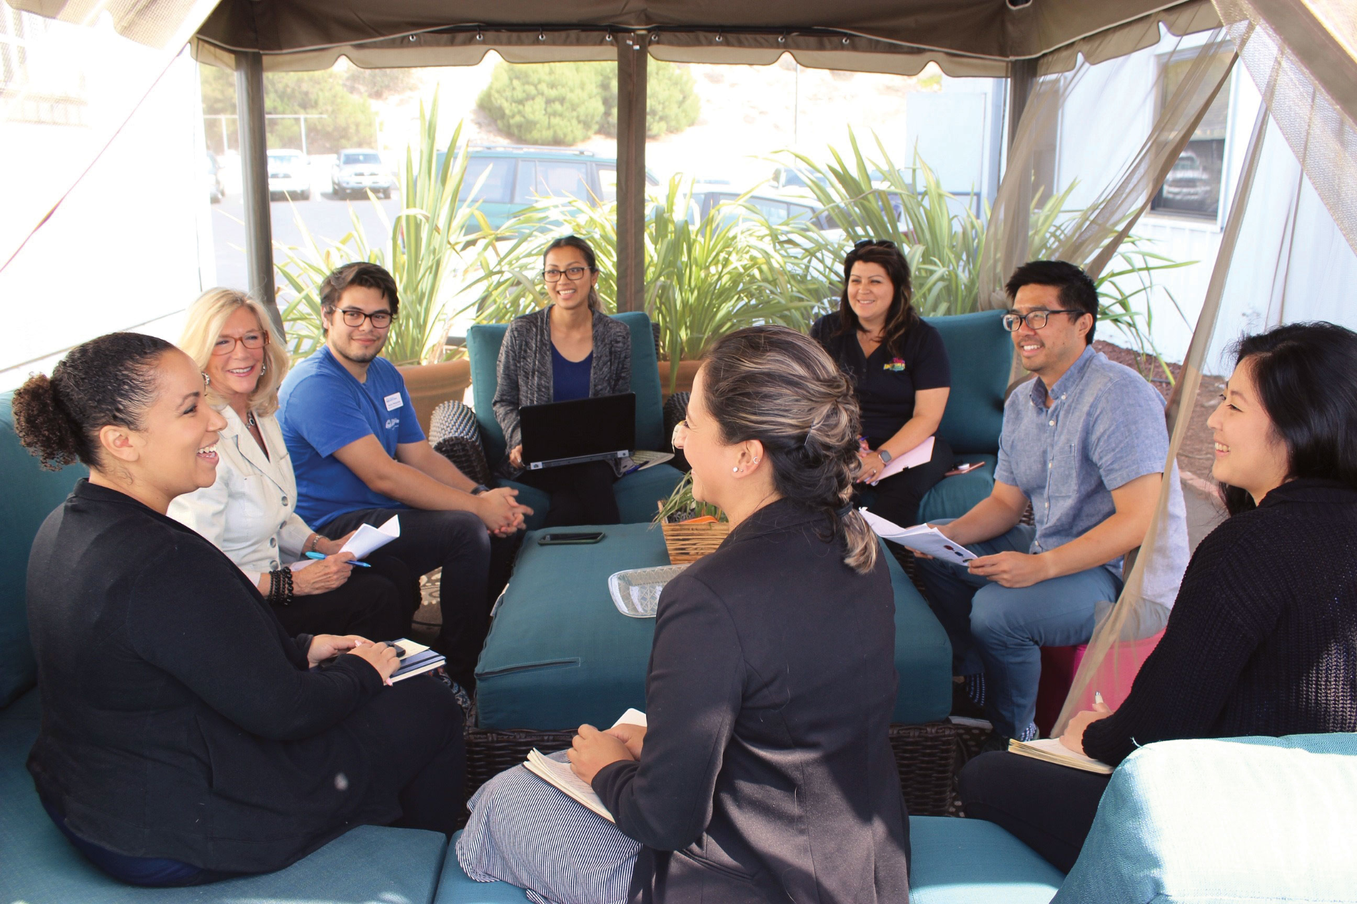
Pg 48 Building an equitable workplace
Family Meeting Time
Topic: Just how LGBTQ inclusive (or toxic?) is your workplace?

Slide 96
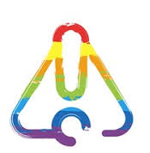
Content Warning
Content warning :
The next section discusses microaggressions commonly found in the workplace.

Slide 97


Building an equitable workplace
Microaggressions. They aren’t just about race.
Notes:
https://www.youtube.com/watch?v=Lh0Qw0THHAE

Slide 98
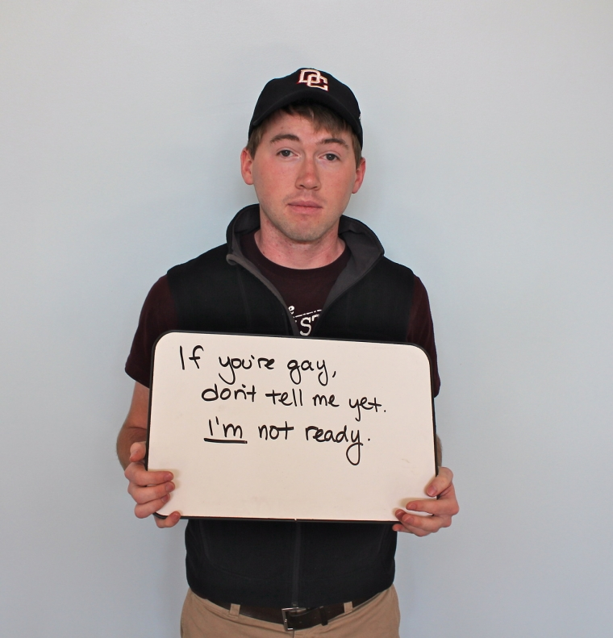
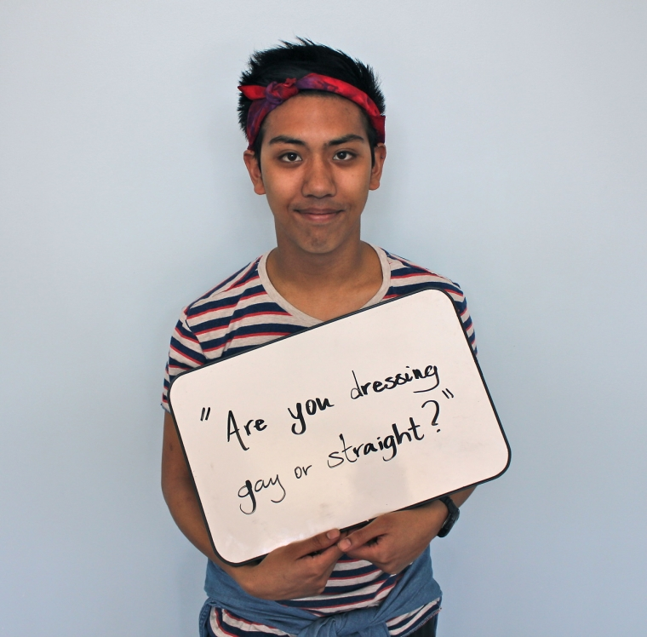
Building an equitable workplace
Microaggressions. They aren’t just about race.

Slide 99
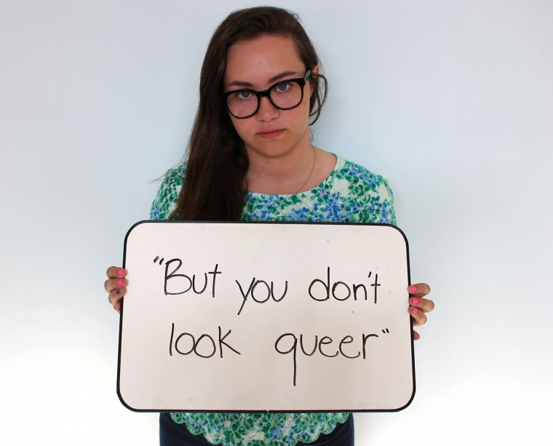


Building an equitable workplace
Microaggressions. They aren’t just about race.

Slide 100

Turn and Talk

Slide 101
Building an equitable workplace
TYPES OF
MICROAGRESSIONS

Slide 102

Building an equitable workplace
TYPES OF
MICROAGRESSIONS
"You don't look ________"
Assuming "man"/"woman" roles in queer relationships
excluding family members
"It's a lifestyle"
"No homo"
speaking for instead
of letting speak
Thinking you can
"turn" someone
Invasive body part(s) questions
"I don't use singular 'they'"

Slide 103
Building an equitable workplace
WHAT to do when you witness a microaggression:
Assess the situation: are you able to respond
  Environment
  Physical/Employment Safety
  Your own mental/emotional status
PAUSE. Breathe.
Ask the person to repeat what was said
  “I don’t understand the joke. Can you please repeat it so I can get what was funny?
  “Did you just say______?”

Slide 104
Building an equitable workplace
WHAT to do when you witness a microaggression:
4. Take control of the situation.
a. “I don’t find that funny.”
b. “That type of language/question makes me uncomfortable, particularly in the workplace.”
5. Offer a way to learn/grow (if you are in a place to do so with generosity, not passive aggressively).
6. Reflect: What information did you need to help educate the person OR to better understand the microaggression yourself?

Slide 105
Building an equitable workplace
Be aware of:
Context
Environment
Assessing whether or not the person directly affected wants the help or not.

Slide 106
Allyship means
Allyship is the use of personal PRIVILEGE and
proximity-to -power to advocate for change
Allyship is a verb not a self-proclaimed identity
Allyship is continuous
Allyship means checking in not saving the day
How do you incorporate allyship into your collegial and professional relationships?

Slide 107

From Savior to Ally to Accomplice

Slide 108
Building an equitable workplace
Turn and Talk:
Describe a time when you witnessed a microaggression against the LGBTQ+ community at work.
How did you respond?
Do you wish you could have handled it differently?
What roadblocks exist to your most complete response?

Slide 109

Building an equitable workplace
What to do when YOU are called out ?

Slide 110
Building an equitable workplace
What to do when YOU are called out for a microaggression?
Apologize
  Without “if” or “but”
  context and excuse does not matter here
Make a commitment to be better in the future
Don’t expect forgiveness without earning it
Don’t apologize ad nauseum (it’s just weird).
Don't expect the person to let you out of it.

Slide 111

Building an equitable workplace
Brainstorm: How to deal with the religiously grounded aggression?
Take a few minutes with your table to discuss how to respond when the microaggression is vocally rooted in faith or religion.
Be prepared to share your table’s thinking.

Slide 112
Key Ideas
Everyone deserves to work in an environment that is free of vocal indignities.
We each have a role in responding to microaggressions when we witness them, if we are in a place to do so safely and responsibly.
If we are responsible for the microaggression, an apology combined with a commitment to be better is essential for moving forward.

Slide 113

15 Minute Break!
During the break, continue our earlier conversation about intersectionality.
Check out the Human Rights Campaigns report
“Black and African American LGBTQ Youth Report” for more information about the challenges experienced by youth navigating multiple identities.

Slide 114
Barb

Slide 115
BUILDING AN ORGANIZING CAMPAIGN

Slide 116
Selecting a Scenario
Take 2 minutes to review the Scenarios on page 52 of your handouts.
Pick the scenario you want to work on!
Move to the table that corresponds to that scenario

Slide 117
BREAKOUT SESSION
What Would You Do?
Scenario #1: Member disciplined for student’s “about me” project which included pride flags
Scenario #2: Board policy issue and community outcry regarding treatment of transgender students
Scenario #3: Member disciplined for drag show on campus
117
Notes:
In small groups, invite participants to discuss what they would do in one of the following scenarios:
For the following scenarios, imagine you’re in a state that has recently banned conversation about LGBTQ+ topics. What would you do?
Scenario #1: In a US government class students begin discussing local elections. One student mentions a popular candidate’s LGBTQ+ status and other students began to chime in for a discussion. What would you do?
Scenario #2: During a group activity a kindergartner tells their peer a “secret” about their identity: they may look like a boy, but they’re really a girl.
Scenario #3: It’s bring your favorite book to school day, and a first-grader brings And Tango Makes Three, the true life story of a same-sex penguin couple who reside at the Central Park Zoo, to share with the class.

Slide 118
Why do you think that it is important that we address concerns around LGBTQ+ equity through an organizing model ?
(as opposed to relying solely on lawsuits and grievances?)

Slide 119
Why an Organizing Approach
Well-organized worksites and locals have a positive, visible presences
Members feel that they have the collective power to solve their problems and see themselves as responsible for the win – not a third party (UD, Lawyer, Lobbyist).
Builds power by continually increasing the amount of member leadership and ownership for the actions.
We cannot assume that the law/policy will always be on the side of LGBTQ+ equity!!!

Slide 120
What is an Organizing Campaign?
An action plan with a beginning, middle, and end, working towards a specific demand
•Involves a series of escalating actions (or tactics)
•Increases pressure on decision-makers
•Builds power by increasing engagement, developing leaders, and building capacity.
•Throughout the campaign we identify milestones that indicate we have enough power to try something more and something bigger and win!

Slide 121
Pg. 108 Key Parts of an Organizing Campaign
•Issue
•Demand
•Target
•Tactics
•Escalation

Slide 122
Grat and Ellen with the Spirit of Anthony

Slide 123

Time to Talk
How are you feeling?
How are you thinking about the ways you will act differently to improve the systems that you work in?
Questions?
Concerns?

Slide 124

Ending It Right
Added Information
Evening Email
Feedback Forms

Slide 125

Choice Networking Time

Slide 126
STEP 1:
Issue

Slide 127
PROBLEM vs. ISSUE
Campaigns start with issues members care about.
An issue is a slice of a workplace problem.
Often a problem can have different issues depending on the perspective of the people we are working with.
It is KEY to get enough input on what the issues are that make up the problem so that YOU do not drive the solution.

Slide 128

PROBLEM vs. ISSUE

Slide 129

Issues are the small(er) actionable pieces that contribute to the larger problem
(Pg. 111)

Slide 130
EXAMPLE- Problem and Issue
PROBLEM -Our school is hostile to LGBTQ+ staff and students
◦ Issue – There are no gender inclusive bathrooms and/or transgender students are forced to use the wrong restroom
◦ Issue – Our healthcare and leave benefits do not cover non-“traditional” family structures or are not fully accessible to people with same-gender partners.
◦ Issue – Our administration forces us to “out” trans and queer students to their families.

Slide 131

SCENARIO WORK!
TIME: 10 Minutes
In your group, spend 10 minutes identifying the potential “Issues” in your scenario.

Slide 132
Assessing our Issues pg 110
What makes a good issue:
It is widely felt and/or deeply felt.
It is winnable.
It builds the union and builds leaders.
It has a connection to students and the public.

Slide 133

Assessing our Issues Pg 112
Sample chart that can be used to assess our issues

Slide 134
SCENARIO WORK!
TIME: 5 Minutes
In your group, spend 15 minutes evaluating your issue using the chart in the handouts.

Slide 135
Sara

Slide 136
STEP 2:
Demand

Slide 137
Demand:
A demand is the outcome that addresses the issue that you are making of a target.
Measurable
Achievable
“Hey Target’s Name, we demand gender affirming bathrooms in every school!”

Slide 138
STEP 3:
Target

Slide 139
Targets:
Is the person with the power to give you what you are demanding.
A single person:
- a name, face, & address

Slide 140
SCENARIO WORK!
TIME: 20 Minutes
In your group, spend 20 minutes deciding the following:
• Issue
revisit to make sure its the one you want!
• Demand
What do you want to win to solve your issue?
• Target
Who has the power to give you your demand?
(feel free to make up names and titles if your scenario doesn’t have one!)

Slide 141
Advancing LGBTQ+ Justice

