Slide 1
Advancing LGBTQ+ Justice

Slide 2
Feedback
Range of ratings 4.17-5.0
Conversation circle – positive addition and a suggestion
A LOT OF CONTENT – Break it up, more engagement
Tour was a value add
Time to discuss how to use this back home

Slide 3

COMMUNITY AGREEMENTS
Awareness and Self-Knowledge
Listen for Understanding
Be Gracious
Stay Engaged
Be Open and Suspend Judgment
Say “I”- tell your truth
Seek Discomfort
Reach for Empathy
Expect non- Resolution and non-Closure

Slide 4

TODAY’S AGENDA
8:30 – 8:50 Morning Routine
8:50- 9:20 -- Shared Identity
9:20- 10:15- Scenarios work in team
10:15-10:30 -- Break- self directed
10:30-11:00 - Scenarios work
11:00-11:45- Presentation of scenarios
11:45-12:15pm – Lingering questions
12:15 -1:00 -- Closing circle
1:00 – Lunch - grab and go

Slide 5
Ben

Slide 6

SHARED IDENTITY
Gather around an identity of your choosing
Answer the following discussion questions:
Why did you select this piece of your identity?
Notes:
Ben 10:00-10:15
Post the following identities around the room:
High risk (day 3) – religious, spiritual, agnostic, survivor, immigrant, LGBTQ+, middle class
Participants will get up and gather around an identity of their choosing (2 min instructions), then they will answer the following discussion questions (8 min):
Why did you select this piece of your identity?
What are some challenges you face with this identity?
Share out/debrief (5 min)
What was something you learned about someone else
What was easy/hard about this activity?

Slide 7

More from our members!

Slide 8

SHARED IDENTITY
Debrief-
What was something you learned about someone else?
What was easy/hard about this activity?
How safe did you feel sharing in this activity?
Which of these identities are internal vs external?
Notes:
Ben 10:00-10:15

Slide 9

CIRCLING BACK TO INTERSECTIONALITY
How might the experiences of transgender individuals differ across racial identities?
How can I help my colleagues become aware of the challenges trans BIPOC educators face, and the actions we can take to advance equity?

Slide 10

Ellen

Slide 11
Pg. 108 Key Parts of an Organizing Campaign
REVIEW
•Issue
•Demand
•Target
•Tactics
•Escalation

Slide 12
STEP 1:
Issue

Slide 13
PROBLEM vs. ISSUE
Campaigns start with issues that workers have value-based solidarity around.
An issue is a slice of a workplace problem.
Often a problem can have different issues depending on the perspective of the people we are working with.
It is KEY to get enough input on what the issues are that make up the problem so that YOU do not drive the solution.
Investigating the issue is necessary but not sufficient – we also need to identify workers’ SHARED values – WHY is this an issue? WHY do you want to fix this?

Slide 14

PROBLEM vs. ISSUE
Values that build a relatable “why”
Deserve safe and reliable transportation
Access to quality parts

Slide 15
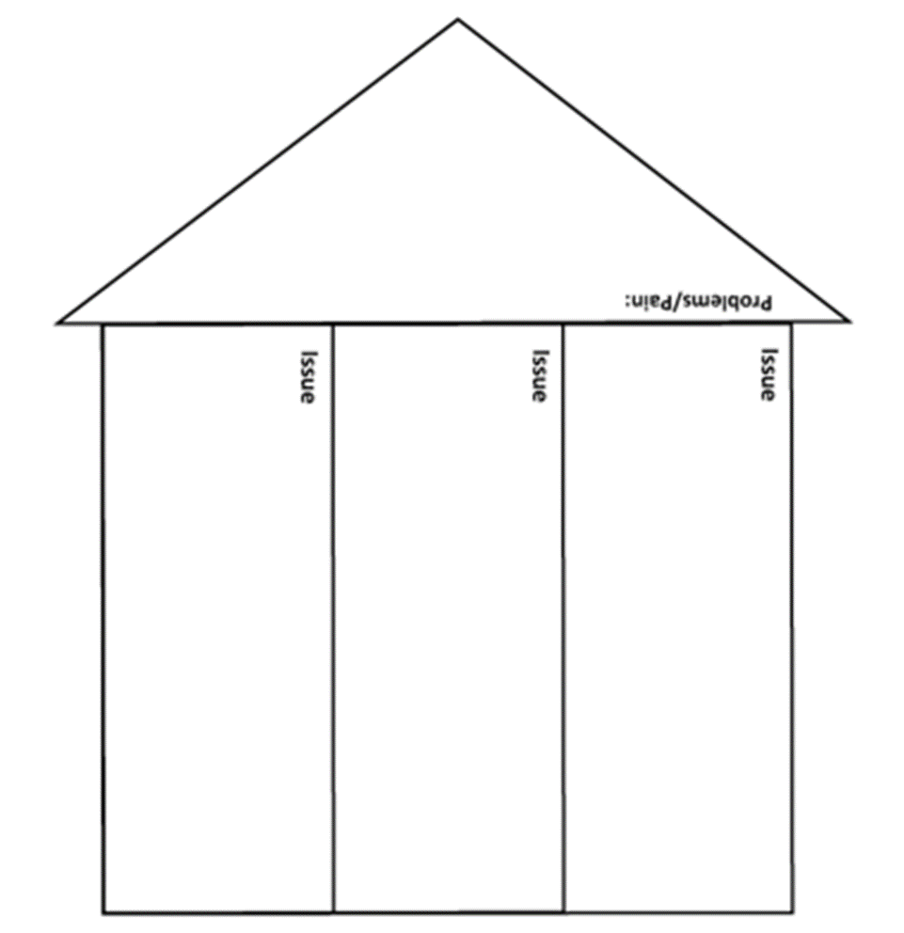
Issues are the small(er) actionable pieces that contribute to the larger problem
(Pg. 111)

Slide 16
EXAMPLE- Problem and Issue
PROBLEM -Our school is hostile to LGBTQ+ staff and students
◦ Issue – There are no gender inclusive bathrooms and/or transgender students are forced to use the wrong restroom
Values – Equity, Safety, Personal Choice, Student Choice
◦ Issue – Our healthcare and leave benefits do not cover non-“traditional” family structures or are not fully accessible to people with same-gender partners.
Values – Equitable Access, Fair Pay, Family
◦ Issue – Our administration forces us to “out” trans and queer students to their families.
Values- Professional Judgement, Safety, Student Choice

Slide 17

SCENARIO WORK!
TIME: 10 Minutes
In your group, spend 10 minutes identifying the potential “Issues” in your scenario.

Slide 18
Assessing our Issues pg 110
What makes a good issue:
It is widely felt and/or deeply felt.
  The pain can be felt by just one, but the injustice of that pain is shared by many.
  The pain AND the injustice of that pain is felt by many.
It is winnable.
It builds the union and builds leaders.
It has a values-based connection to our workers, students, and the public.

Slide 19

Assessing our Issues Pg 112
Sample chart that can be used to assess our issues

Slide 20
SCENARIO WORK!
TIME: 15 Minutes
In your group, spend 15 minutes evaluating your issue using the chart in the handouts.
Be sure to identify which of the issues you listed that would have the most opportunities to connect shared values?

Slide 21
Sara

Slide 22
STEP 2:
Demand

Slide 23
Demand:
A demand is the outcome that addresses the issue that you are making of a target.
Measurable
Achievable
“We demand gender affirming bathrooms in every school because all students need to feel safe and included in our schools. ”

Slide 24
STEP 3:
Target

Slide 25
Targets:
Is the person with the power to give you what you are demanding.
A single person:
a name, face, & address
“ Hey Superintendent Sam - We demand gender affirming bathrooms in every school because all our students need to feel safe and included in our schools ”

Slide 26
SCENARIO WORK!
TIME: 20 Minutes
In your group, spend 20 minutes deciding the following:
• Issue
Revisit to make sure its the one you want!
• Demand
What do you want to win (and why) to solve your issue?
• Target
Who has the power to give you your demand?
(feel free to make up names and titles if your scenario doesn’t have one!)

Slide 27
Sara

Slide 28
CONTINUING TO BUILD OUR ORGANIZING CAMPAIGNS

Slide 29
REVIEW
• Issue: a slice of a workplace problem that is deeply/widely felt, winnable, and will build our power.
• Demand:the outcome that addresses the issue that you are making directed at a target.
• Target: Is the person with the power to give you what you are demanding.

Slide 30

Structure of a Campaign

Slide 31
STEP 4:
Tactics

Slide 32
Tactics
Tactic: Actions you to take as a part of an escalation plan that increases pressure on your target to try to win your demand.

Slide 33

A Tactic Should
Puts pressure on your Target
(puts them out of their comfort zone)
Builds your Power
(develops leaders, brings more people in, etc.)
Is Strategic

Slide 34
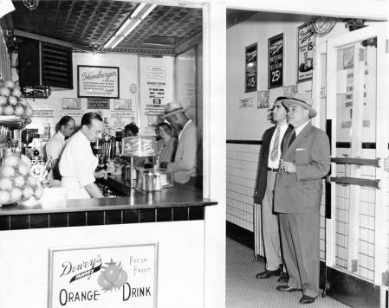
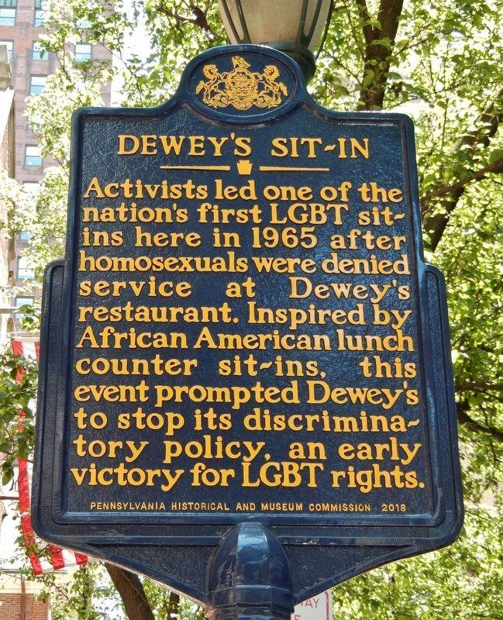
Historic LGBTQ+ Tactics

Slide 35
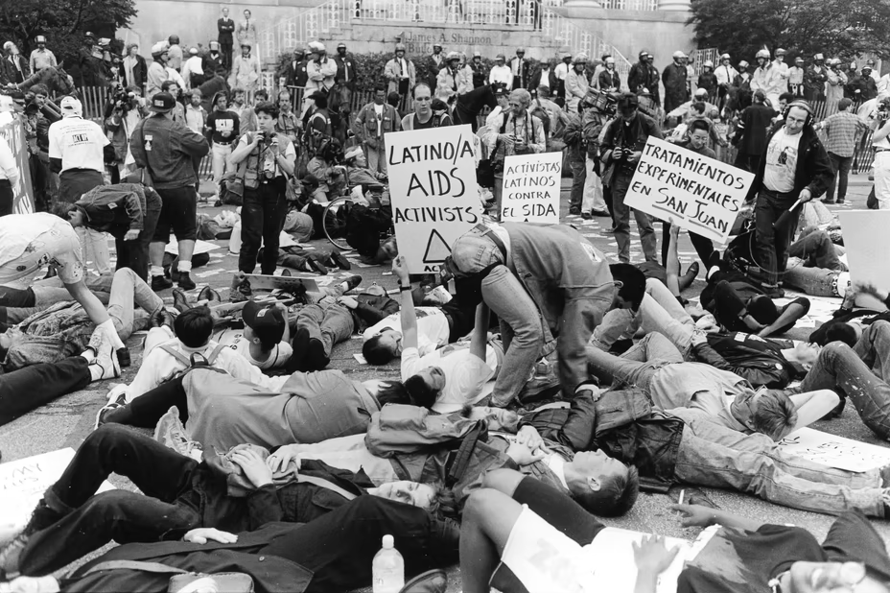

Historic LGBTQ+ Tactics
ACT UP!

Slide 36
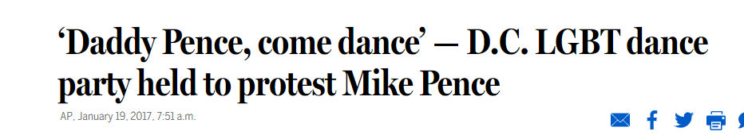
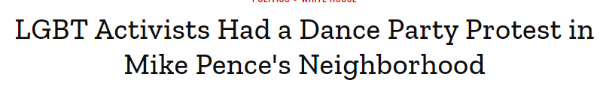
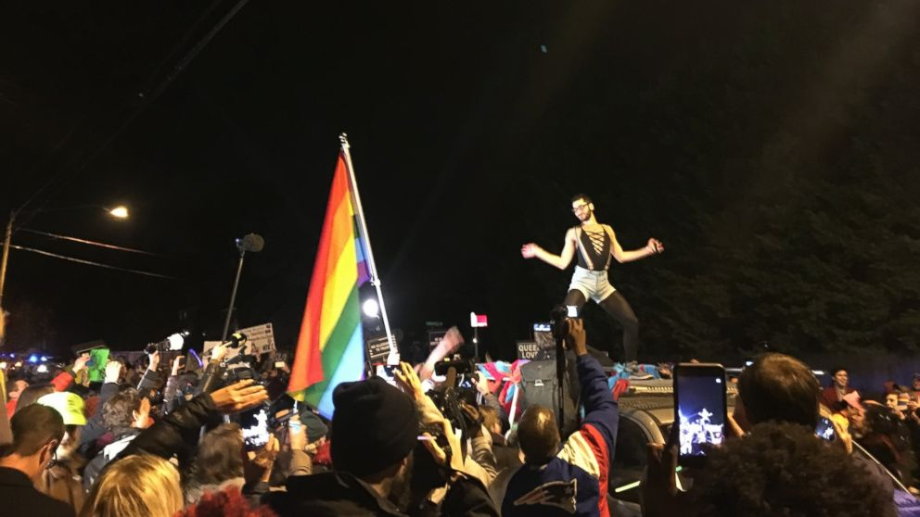
Historic LGBTQ+ Tactics

Slide 37
SCENARIO WORK!
TIME: 5 Minutes
TACTICS BRAINSTORM!
+++YOU HAVE 5 MINUTES!+++
Brainstorm AS MANY tactics as you can on 1 chart.
•Be creative!
•You are NOT evaluating right now! Everything goes on the board!

Slide 38
Evaluating Tactics
Does the action relate to your issue?
Will it increase the pressure on the decision-maker?
Is it visible?
Is it timed for effect?
Is it new and different—or tried and true?
Are enough people ready to do it?​
Will it unify people?​
How will management react?​
Does it violate the law? (If so, are we prepared for the consequences?)​
Will it be fun?

Slide 39
STEP 5:
Compression Points and
Escalation

Slide 40
Compression Points
Points on the calendar where you celebrate short term wins or escalate your tactics.
◦Naturally occurring deadlines- Breaks, Board Meetings
◦Artificial deadlines-target has till day X to act
◦Help us build urgency and crisis

Slide 41

Why do you think tactics escalate gradually?

Slide 42
Less escalated actions prepare our people for more escalated actions
Give the target to do the right thing before things escalate
Use the threat of escalation

Slide 43
Ben

Slide 44
Group Work
TIME: 30 minutes
Build your campaign!
You have 30 minutes to build your campaign and be ready to present out! Make sure that you include at least…
Issue
Demand
Target
Tactics + Compression points in a campaign mountain!
Extra points if you include some messaging, graphics, hashtags, etc.

Slide 45
Ben

Slide 46

Campaign Presentations!
Each group will have ____ to present their solution to their scenario.
Notes:
10:30-11:00

Slide 47
Ellen and Ben

Slide 48

LINGERING QUESTIONS
Anything you NEED to ask before leaving?
What feels VERY unsettled or confusing?
Notes:
11:00-11:30

