Slide 1
NBI 32 Training Series: Session 2
THE EMPLOYMENT & LEGAL LANDSCAPE FOR TRANSITIONING AND TRANSGENDER EMPLOYEES
Presented by:
Debi Jackson

Slide 2
AGENDA
Introductions
Opening Activity
Federal Laws
State Laws
The Impact on LGBTQ+ Educators
Closing Activity
Q & A
2

Slide 3

INTRODUCTIONS
Raise Your Hand If…
3
Notes:
(Presenter Note: This slide can be used or replaced with another type of group introduction.)
Let’s find out who’s in the room today. If your answer is yes, please raise your hand.
Do you teach at the elementary level?
Do you at the middle school level?
Do you teach at the high school level?
Have you been a teacher for less than 5 years?
Have you been a teacher for more than 20 years?
Raise your hand if you want to better support LGBTQ+ students.

Slide 4
Two Truths & A Lie
ACTIVITY #1
4
Notes:
Today, we’re focusing on the law. Let’s begin with some laws that may or may not be real.
Share the following three laws. Ask participants, which ones have actually been proposed? (Feel free to read these aloud or display in another format.)
#1: The law will prohibit the performance of a medical procedure or the prescription or issuance of medication, upon or to a minor, that is intended to alter the appearance of the minor's gender or delay puberty. This law will also create criminal penalties.
#2: The bill prohibits any school board employee or individual who provides any school-sponsored program from teaching or promoting to any student or school board employee the concept that (a) any race is inherently superior or inferior; (b) any individual is racist, privileged, oppressive, biased, or responsible for actions committed by others of the same race or skin color by virtue of the individual's race or skin color; (c) the United States is fundamentally racist; or (d) market-based economics is inherently racist.
#3: The state determines and declares that discrimination against an inhabitant of the state because of race, religion, color, national origin, age, sex, sexual orientation, gender identity or expression, physical or mental disability, marital status, changes in marital status, pregnancy, or parenthood is a matter of public concern and that this discrimination not only threatens the rights and privileges of the inhabitants of the state but also menaces the institutions of the state and threatens peace, order, health, safety, and general welfare of the state and its inhabitants.
Answers – They’re all TRUE!
#1: True. As of March 18, 2022 this law is being proposed in the state of South Carolina. (Reference: https://www.billtrack50.com/billdetail/1340971)
#2: True. As of March 18, 2022 this proposed law is in the education committee in the State of Virginia.
(Reference: https://www.billtrack50.com/billdetail/1418766)
#3: True. This is language from a proposed bill in the state of Alaska. It was proposed on January 18, 2021 and as of May 18, 2021 remains in the Alaska House Judiciary committee. (Reference: http://www.legis.state.ak.us/basis/Bill/Detail/32?Root=HB17#tab6_4)

Slide 5

THE RACIAL JUSTICE FRAMEWORK
Racial Justice
+
Social Justice
=
Educational Justice
5
Notes:
When we speak of racial and social justice, we envision schools with no statistical differences in educational outcomes based on race, gender, sexual orientation, or class. We also envision schools that are just and equitable for all educators. This is educational justice.
To realize this, we believe there are three requirements:
1 - Develop awareness about the causes and impacts of institutional and structural racism in education.
2 - Capacity building. All of us are needed to achieve the goal of educational justice. And, we need to build our individual and collective capacity to do this.
3 - Action. We must be ready and able to take action and address inequity when we see it and partner with others.
We can be engaged in all three requirements at the same time. The process of creating and realizing educational justice in our schools is not linear.

Slide 6

RACIAL JUSTICE & LGBTQ+ LAWS
Awareness
What local policies or state and national legislation affects LGBTQ+ and BIPOC educators?
Action
What actions are most helpful when supporting LGBTQ+ and BIPOC educators? How do you know?
Capacity Building
How can UniServ directors and teams deepen our ability to support LGBTQ+ and BIPOC educators in the workplace? What does this include, specifically?
6
Notes:
When we think about racial justice and supportive working environments for LGBTQ+ educators, we can draw the following connections to the Racial Justice in Education Framework (read questions on slide).
(Presenter Note: These questions can be modified/tailored to better meet the needs of your community.)

Slide 7
8.1 Million
WHAT’S THE SIGNIFIGANCE?
7
Notes:
In 2019, there were 157 million employees in the US. What do you think this number represents?
According to Catalyst.org, there are an estimated 8.1 million LGBTQ+ employees in the United States who are age 16 or older. 50% of these employees are not out at work because of fears of discrimination or ostracization. And 1 in 5 LGBTQ+ employees have experienced discrimination.
Reference: https://www.catalyst.org/research/lesbian-gay-bisexual-and-transgender-workplace-issues/

Slide 8
Federal Law
Notes:
Let’s first look at federal laws.

Slide 9
A NATION OF LAWS
1600s
Founding of Jamestown, VA
Mass. Bay General Court determined “sex crimes” and punishments.
1700s
Colonial sodomy laws passed and remained in place until 1925.
US Constitution passed and counts African-Americans as 3/5 a person.
1800s
14th Amendment passed that declares “equal protection of the laws.”
Plessy v. Ferguson declares racial segregation legal.
1900s
President Dwight Eisenhower bans gay people from working in the federal gov’t.
Famous celebrities, athletes & politicians start publicly coming out.
2000s
President Obama repealed “Don’t Ask Don’t Tell” so LGBTQ+ people could serve openly in the military.
Same-sex couples granted the right to marry across the US.
Notes:
The US has called itself a “Nation of Laws,” but what are the laws for? And, who do they help or harm? This timeline shows only a glimpse of how discrimination, exclusion, and beliefs in white supremacy have been a part of US laws since the earliest of colonial times. For a more comprehensive list of laws that impact LGBTQ+ people throughout US history, please see your handout.
Highlights for further discussion:
1607 – Founding of Jamestown, VA, the first permanent English settlement in the “New World.”
1607 – Massachusetts Bay Colony was established believing they made a “covenant with God to build an ideal Christian community.”
1619 – The first enslaved Africans arrive to Jamestown, VA
1631 – The Massachusetts Bay General Court, in accordance with Puritan religious and moral beliefs, declared that the following were considered sex crimes and punishable by whipping, banishment or execution: fornication, adultery, rape and sodomy.
1714 – Sodomy laws were passed in the early colonies and in the colonial militia. They stayed in place until challenged in 1925.
1775 – Population of enslaved people in the colonies is nearly 500,000.
1776 – Declaration of Independence signed.
1778 – Lieutenant Gotthold Frederick Enslin of the Continental Army becomes the first documented service member to be dismissed from the U.S. military for homosexuality. Read more at U.S. History Naval Institute Blog / Timeline of Military Gay History.
1779 – Thomas Jefferson proposes Virginia law to make sodomy punishable by mutilation rather than death. It was rejected by the Virginia legislature.
1788 – U.S. Constitution adopted. Includes a three-fifths clause that counted each enslaved person as three-fifths of a person for the purposes of congressional representation and tax apportionment.
1852 – Scottish writer J.D. Bothwick reports his attendance at a “miner’s ball” – a men’s only dance held in Angels’ Camp in California.
1857-1861 – James Buchanan elected president. A lifelong bachelor, Buchanan had a long-term relationship with William Rufus King, who served as vice president under Franklin Pierce. The two men lived together from 1840-1853 until King’s death. Some historians suggest Buchanan, by today’s terms, was gay.
1868 – Fourteenth Amendment Ratified. This is the most cited amendment in Supreme Court civil rights cases and has been the basis for landmark civil rights cases such as Brown v. Board of Education, Roe v. Wade and Obergefell v. Hodges. Gay rights advocates cite this amendment in support of equality for future court cases.
“All persons born or naturalized in the United States and subject to the jurisdiction thereof, are citizens of the United States and of the State wherein they reside. No State shall make or enforce any law, which shall abridge the privileges or immunities of citizens of the United States; nor shall any State deprive any person of life, liberty, or property, without due process of law; nor deny to any person within its jurisdiction the equal protection of the laws.”
1868 – Two-Spirit, We’wha, a Zuni Native American, meets with President Grover Cleveland.
Source: https://www.lgbtqhistory.org/lgbt-rights-timeline-in-american-history/

Slide 10
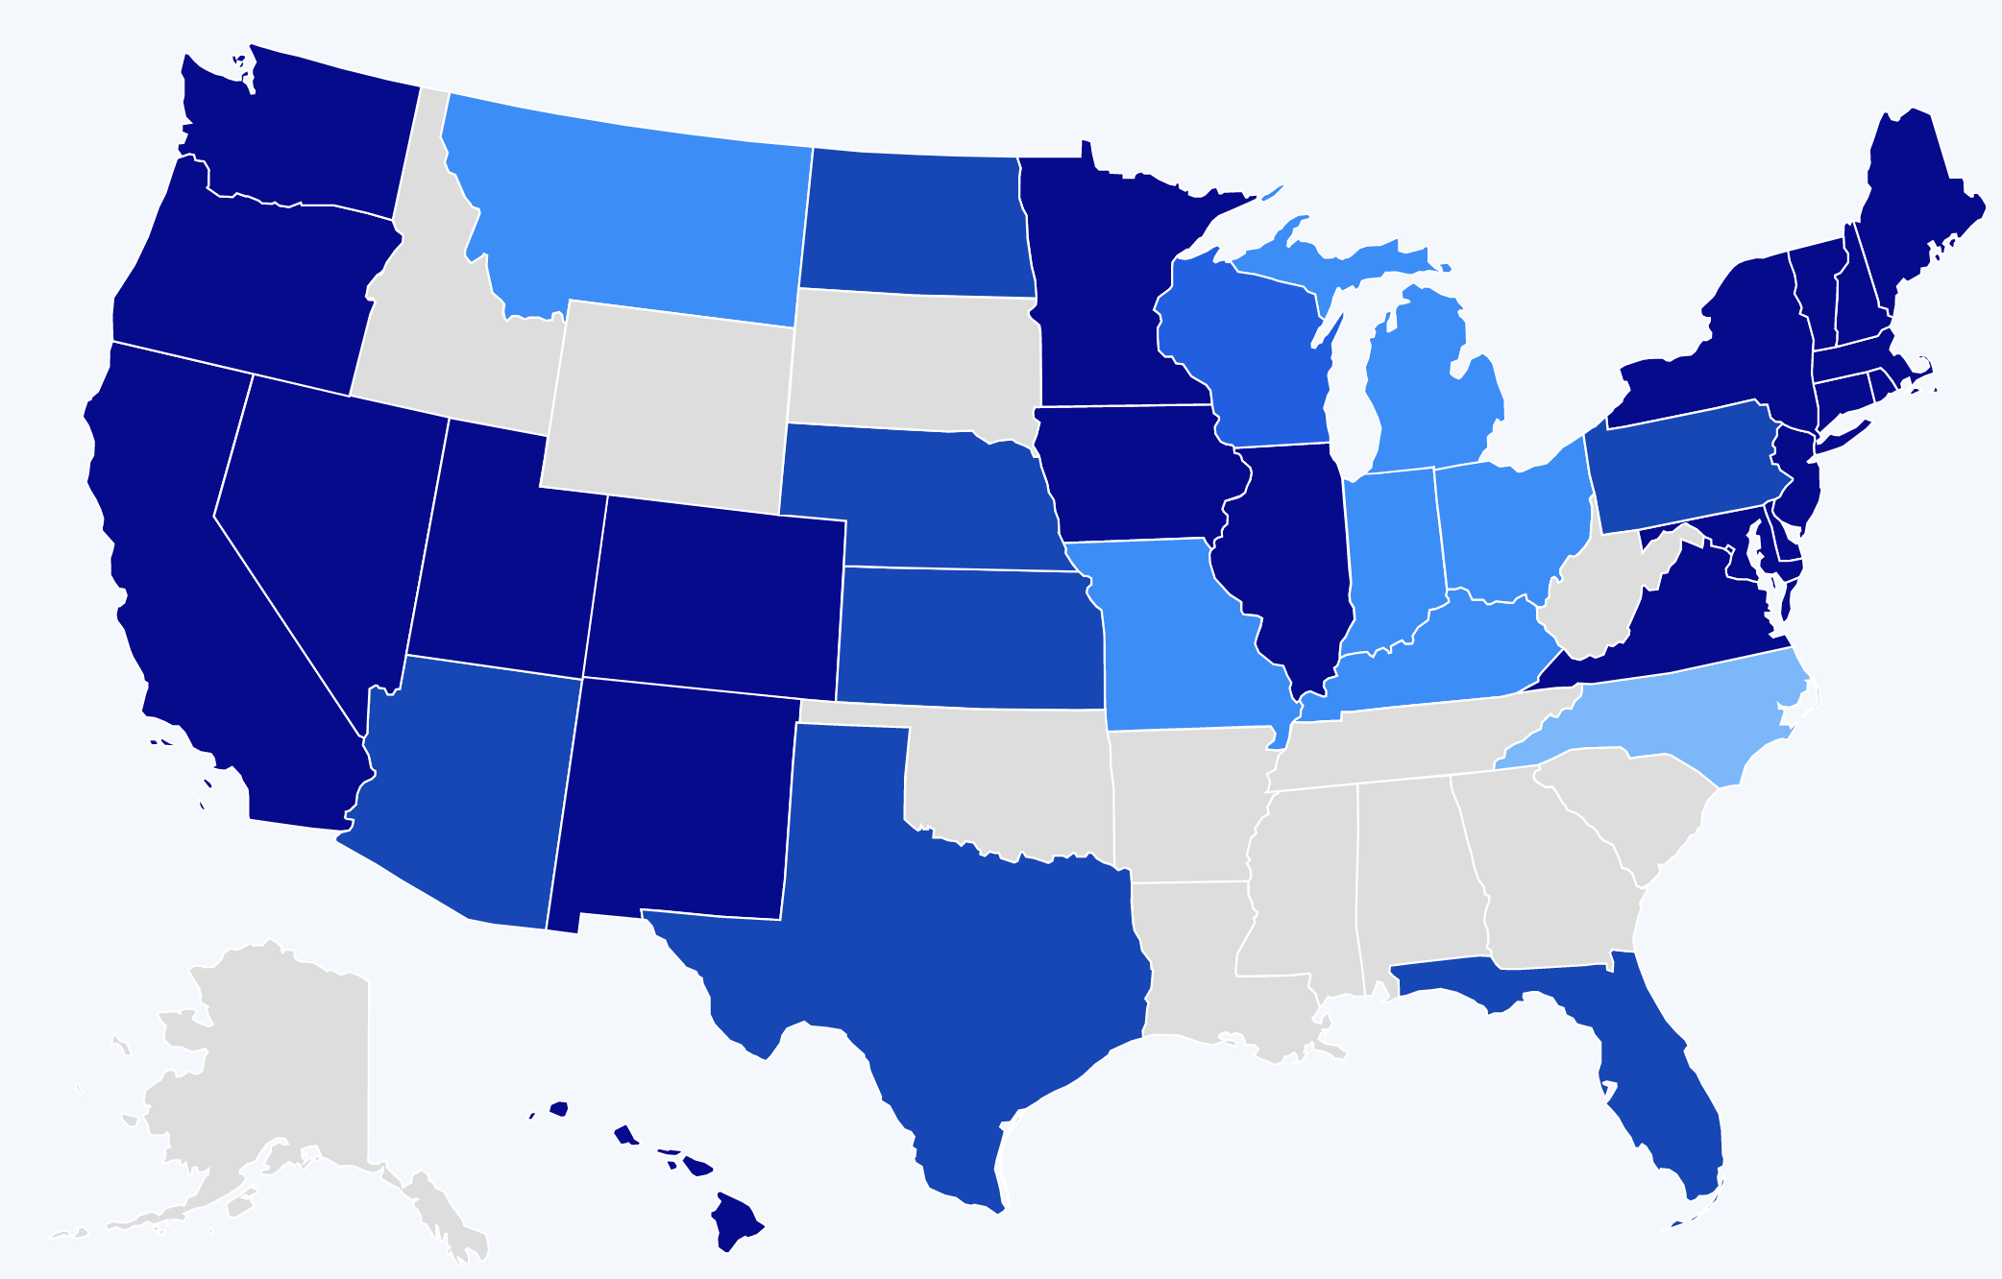
A HISTORY OF BARRIERS
In 2019, Just 22 States + DC Prohibited Workplace Discrimination Based On Sexual Orientation And Gender Identity.
Source: Human Rights Campaign
10
Notes:
US history is full of barriers for BIPOC and LGBTQ+ people. Discrimination because of one’s race and LGBTQ+ identity means lost wages, jobs, promotions, unfair treatment and even harassment at work. This discrimination compels many to hide their LGBTQ+ status for fear of retribution, losing one’s livelihood, support system, and more.
Before 2019, only a handful of states (in dark blue above) provided LGBTQ+ people some protection against employment discrimination, as well as in housing and public accommodations. This meant that in all the other states (those in tan and lighter shades of blue), LGBTQ+ people could be denied jobs, health care, housing, hotels, and more. This discrimination – across the majority of the US, and nearly all of the South— was perfectly legal.

Slide 11
A LANDMARK RULING
Bostock v. Clayton County
Prior to June 15, 2020
It was legal to fire an employee for being gay, bisexual or transgender, in more than half of the 50 states.
June 15, 2020
The Supreme Court rules it is illegal to discriminate against
or fire an employee based on their sexual orientation or gender identity.
11
Notes:
The Civil Rights Act of 1964 prohibits discrimination based on race, color, religion, sex, or national origin. The courts and the federal government have long refused to recognize LGBTQ+ discrimination as a form of sex discrimination. Over the past 20 years, however, federal courts and the government have at times recognized LGBTQ+ discrimination as sex discrimination.
It was not until June 15, 2020 that the Supreme Court finally recognized that LGBTQ+ employment discrimination is prohibited sex discrimination under Title VII of the Civil Rights Act of 1964.
This ruling recognized that it is illegal to discriminate against or fire an employee based on their sexual orientation or gender identity. Now lower federal courts and the Biden Administration are applying that ruling to education, health care, housing, credit discrimination, and more.

Slide 12
BOSTOCK V. CLAYTON COUNTY
Employment Discrimination is Illegal
Title VII of the 1964 Civil Rights Act prohibits employment discrimination based on race, color, religion, sex and national origin. Bostock interprets “sex” to include gender identity and sexual orientation.
12
Notes:
The Bostock ruling specifically states that employment discrimination on the basis of gender identity and sexual orientation is illegal.
Title VII of the Civil Rights Act covers the full spectrum of employment decisions, including recruitment, selections, terminations, and other actions concerning terms and conditions of employment. This is significant for the LGBTQ+ community because, as we saw, in many states it was legal to be denied an interview or a promotion, and even to be fired because of one’s gender identity or sexual orientation.

Slide 13
BOSTOCK V. CLAYTON COUNTY
Discrimination in Educational
Programs is Illegal
Title IX of the Education Amendments Act of 1972 states: "No person in the United States shall, on the basis of sex, be excluded from participation in, be denied the benefits of, or be subjected to discrimination under any education program or activity receiving Federal financial assistance."
13
Notes:
On March 26, 2021, the Department of Justice concluded that, as a result of the Bostock ruling, Title IX of the Education Amendments Act of 1972 also prohibits sexual-orientation and gender-identity discrimination in educational institutions that receive federal funding. This means all public schools. This means that students cannot be discriminated against in schools based on their LGBTQ+ identity.
There have been some significant wins recently for LGBTQ+ rights in the US But while progress is being made, attacks on LGBTQ+ rights in certain states have accelerated.
Reference: Department of Justice, “Application of Bostock v. Clayton County to Title IX of the Education Amendments of 1972,” March 26, 2021, https://www.justice.gov/crt/page/file/1383026/download

Slide 14
The following topics are currently being debated in state legislatures:
ANTI-LGBTQ+ LEGISLATION
Prohibiting healthcare for transgender youth
Single-sex facility restrictions
Excluding transgender youth from athletics
Restrictions on identification documents
Religious exemptions
Source: ACLU.org
14
Notes:
While some schools and districts are implementing gender-affirming policies and practices, like recognizing proper names and pronouns for children, in the background, states are trying to license LGBTQ+ discrimination under the guise of religious freedom. The proposed legislation in these areas, if passed, would serve to limit, further marginalize, and in some cases criminalize efforts to support LGBTQ+ youth and adults.
These attacks on LGBTQ+ people, especially young people, are being challenged in court and should be struck down under the reasoning of Bostock. But those lawsuits are just getting started.

Slide 15
FEDERAL AGENCIES
The U.S. Equal Employment Opportunity Commission (EEOC) is responsible for enforcing federal laws that make it illegal to discriminate against job applicants and employees.
  Bostock applies nationwide regardless of state or local laws.
  It is Illegal to discriminate because customers/clients want to work with someone with a different sexual orientation or gender identity.
  Repeated misuse of pronouns could contribute to a hostile work environment.
  Filings with the EEOC must be within 180 days of the alleged violation.
Notes:
The U.S. Equal Employment Opportunity Commission is responsible for enforcing federal laws that make it illegal to discriminate against job applicants and employees. The EEOC offers the following guidelines for what the Bostock decision means for LGBTQ+ employees and employers across the country:
Bostock only applies to employers with more than 15 employees. Employers with fewer than 15 total employees are not covered by Title VII.
Bostock applies nationwide and protects employees from sexual orientation or gender identity discrimination regardless of state or local laws.
An employer covered by Title VII is not allowed to fire, refuse to hire, or take assignments away from someone (or discriminate in any other way) because customers or clients would prefer to work with people who have a different sexual orientation or gender identity. (For example, keeping LGBTQ+ employees out of public-facing positions.)
Although accidental misuse of a transgender employee’s preferred name and pronouns does not violate Title VII, intentionally and repeatedly using the wrong name and pronouns to refer to a transgender employee could contribute to an unlawful hostile work environment.
For applicants and employees of private sector employers and state and local government employers, the individual can contact the EEOC for help in deciding what to do next. If the individual decides to file a charge of discrimination with the EEOC, the agency will conduct an investigation to determine if applicable Equal Employment Opportunity (EEO) laws have been violated. Because an individual must file an EEOC charge within 180 days of the alleged violation
Reference: EEOC Website - https://www.eeoc.gov/laws/guidance/protections-against-employment-discrimination-based-sexual-orientation-or-gender

Slide 16
FEDERAL AGENCIES
The U.S. Office of Civil Rights enforces federal civil rights laws.
Title IX protects transgender students from discrimination on the basis of gender identity.
Applied the analysis of “sex” in the Bostock case to additional federal statutes:
  The Omnibus Crime Control & Safe Streets Act of 1968
  The Juvenile Justice and Delinquency Prevention At of 1974
  The Victims of Crime Act of 1984
  The Violence Against Women Reauthorization Act of 2013
Notes:
Bostock interprets sex to include sexual orientation and gender identity. This analysis of the word “sex” was critical to the ruling.
Title IX of the of the Education Amendments of 1972 has been determined to protect transgender students from discrimination on the basis of gender identity.
The Bostock ruling is far reaching. The Office of Civil Rights now applies this analysis of the word “sex” to existing statutes that reference “sex.” The term is extended to include sexual orientation and gender identity in the following statues:
The Omnibus Crime Control & Safe Streets Act of 1968
The Juvenile Justice and Delinquency Prevention At of 1974
The Victims of Crime Act of 1984
The Violence Against Women Reauthorization Act of 2013
Reference: https://www.justice.gov/crt/page/file/1383026/download and https://www.justice.gov/crt/page/file/1481776/download

Slide 17
WHAT WE KNOW TODAY
The Bostock ruling only applies to employment discrimination.
Discrimination in other areas (e.g., housing) is still legal in many states.
The Equality Act – a federal law currently stalled in Congress - would end discrimination across all areas for LGBTQ+ people.
17
Notes:
Key Notes
Bostock only applies to employers with more than 15 employees. Employers with fewer than 15 total employees are not covered by Title VII.
Bostock applies nationwide and protects employees from sexual orientation or gender identity discrimination regardless of state or local laws.
An employer covered by Title VII is not allowed to fire, refuse to hire, or take assignments away from someone (or discriminate in any other way) because customers or clients would prefer to work with people who have a different sexual orientation or gender identity. (For example, keeping LGBTQ+ employees out of public-facing positions.)
Although accidental misuse of a transgender employee’s preferred name and pronouns does not violate Title VII, intentionally and repeatedly using the wrong name and pronouns to refer to a transgender employee could contribute to an unlawful hostile work environment.

Slide 18


TURN & TALK
How have past and recent federal laws impacted LGBTQ+ individuals?
How does the Bostock ruling impact LGBTQ+ members? How does it impact the work of UniServ directors?
18
Notes:
Turn & Talk: Suggested Discussion Questions
How have past and recent federal laws impacted LGBTQ+ individuals?
How does the Bostock ruling support LGBTQ+ members? How does it impact the work of UniServ directors?

Slide 19
Current State Laws
Notes:
Now that we have an understanding of federal laws, let’s look at the current state laws as it relates to protections for LGBTQ+ individuals.

Slide 20
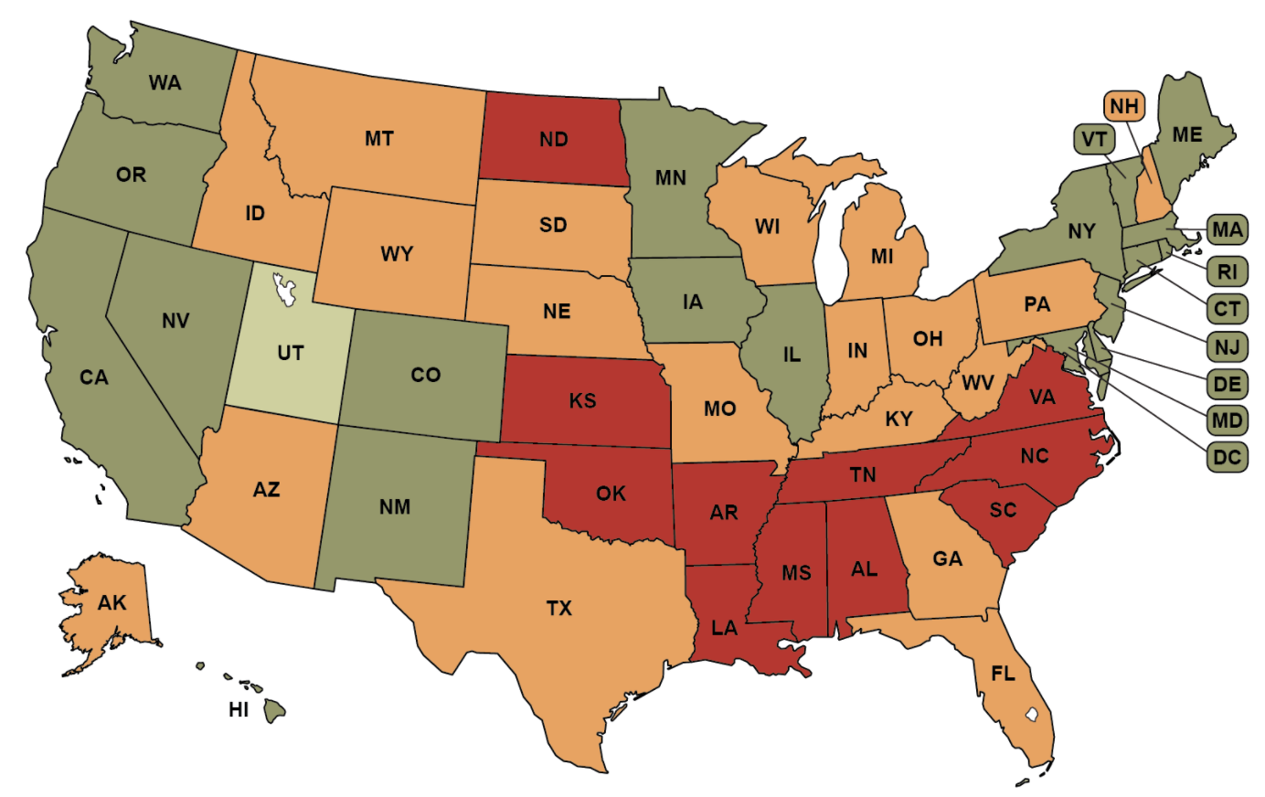
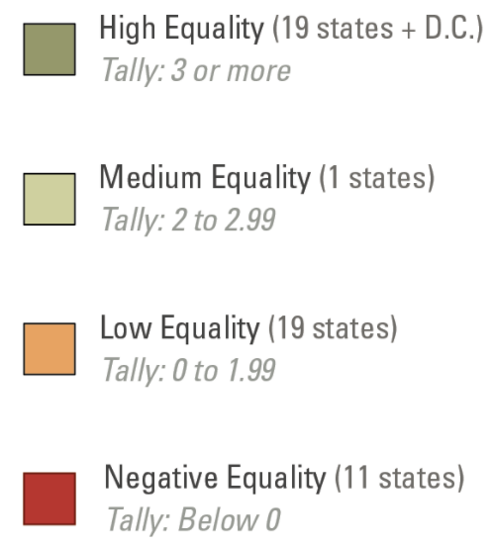
NON-DISCRIMINATION LAWS
The Bostock ruling prohibits discrimination in employment and education, but transgender individuals still face other forms of discrimination.
Source: Movement Advancement Project
Notes:
The Movement Advancement Project (MAP) is an excellent resource to learn more about state laws regarding LGBTQ+ topics.
State non-discrimination laws prohibit discrimination based on gender identity and sexual orientation in a number of areas – specifically employment, housing, public accommodations and credit.
Transgender individuals still face discrimination as it relates to housing (it is not illegal to evict someone because they’re transgender), credit and lending laws, and public accommodations. Transgender individuals can still face refusal of service, verbal harassment, or being physically attacked in many states due to their identity, and not be protected by law.
Some states have passed laws that limit non-discrimination protections through religious exemption laws and through laws that preemptively ban cities and counties from passing their own non-discrimination legislation.
Source -https://www.lgbtmap.org/file/mapping-trans-equality-infographic-non-discrimination.png

Slide 21
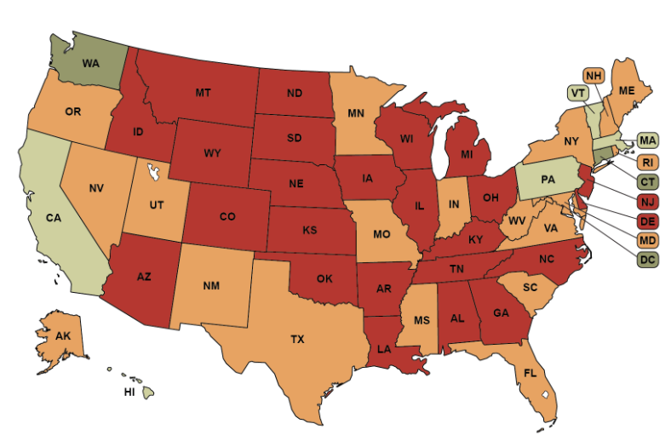
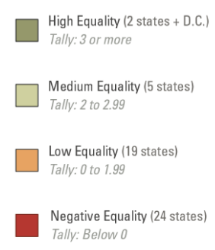
IDENTITY DOCUMENTS
Many state laws make it difficult to obtain accurate identity documents for transgender individuals.
Source: Movement Advancement Project
Notes:
Having identity documents that match your gender identity are essential for social participation. From being able to open a bank account, apply for a job, or board a plane, you must present documents to verify your identity.
Some states (in green such as Washington and Connecticut) have minimal barriers to obtaining accurate documents. States in red, such as Georgia and Arizona can have outdated surgical requirements for transgender people to change their identification – something many transgender people do not want, or cannot afford.
Source - https://www.lgbtmap.org/file/mapping-trans-equality-infographic-ID-laws.png
See alternate map - https://www.lgbtmap.org/equality-maps/identity_document_laws/name_change

Slide 22
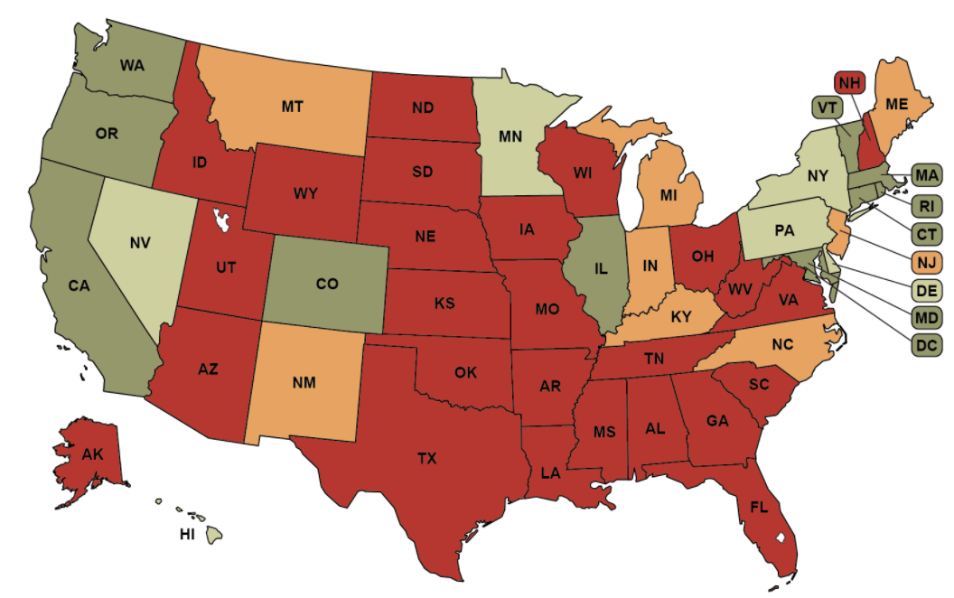
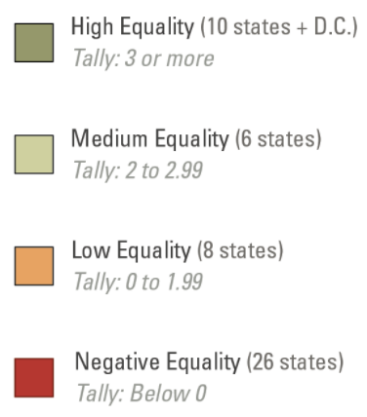
HEALTH AND SAFETY
Many state laws maintain harmful healthcare exclusions and outdated HIV laws that affect transgender individuals.
Source: Movement Advancement Project
Notes:
Transgender individuals face significant health disparities, threats to their safety and systemic barriers to healthcare. This infographic from the Movement Advancement Project incorporates the presence of Hate Crimes Laws that cover LGBTQ+ people, health insurance providers that may exclude coverage for transgender-specific care, state Medicaid policies, and whether or not states criminalize exposure to and/or transmission of HIV. The result is a nation where more than half of our states have negative ratings as it relates to the LGBTQ+ population.
Source -https://www.lgbtmap.org/file/mapping-trans-equality-infographic-health.png

Slide 23
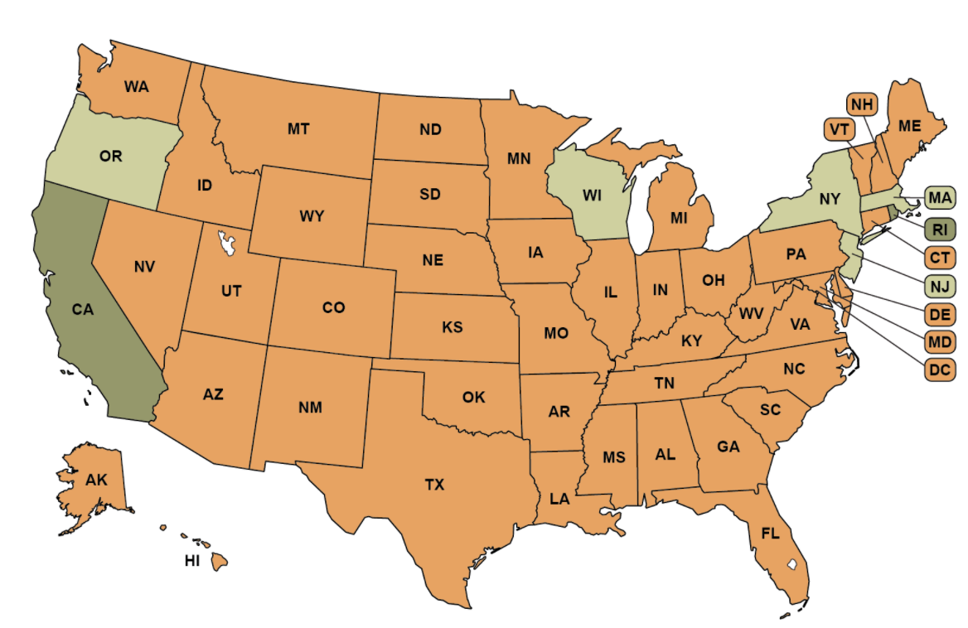
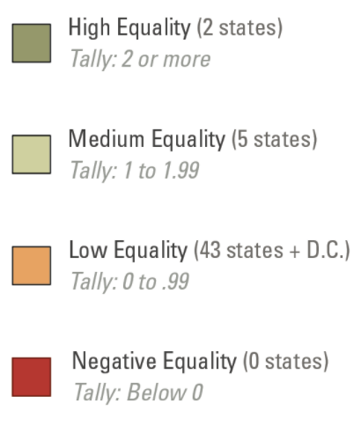
ADOPTION & PARENTING
Across the US, few states have taken steps to prohibit discrimination in adoption, foster parenting, or other parental recognition rights for transgender individuals.
Source: Movement Advancement Project
Notes:
Transgender people can and do become parents in a number of ways - from having a child, to adoption to surrogacy. In many states, laws lack explicit protections of transgender parents, which places their rights in the hands of individual courts.
While no state bans transgender people from adopting or fostering children, few states have taken the step to prohibit discrimination based on gender identity in these areas.
Source - https://www.lgbtmap.org/file/mapping-trans-equality-infographic-Adoption.png

Slide 24
TURN & TALK
Where does your state stand regarding additional protections for transgender individuals?
How might these existing laws impact transitioning and transgender educators in your state?
24
Notes:
Turn & Talk: Suggested Discussion Questions
Based on the maps we just reviewed, where does your state stand regarding additional protections for transgender individuals?
How might these existing laws impact transitioning and transgender educators in your state?

Slide 25
State Laws:
Anti-LGBTQ+ Legislation on the Rise
Notes:
Now that we have an understanding of federal laws, let’s look at state laws.

Slide 26
563
WHAT’S THE SIGNIFIGANCE?
26
Notes:
Can you guess what this number represents?
As of March 11, 2022, this is the number of LGBTQ+ legislation items the HRC is currently tracking for the 2022 state legislative sessions.
~132 bills are affirming and support LGBTQ+ individuals
~302 are harmful to LGBTQ+ individuals and/or their families
~129 bills are being watched

Slide 27
THE WORDS OF NEA MEMBERS
“Try to think of a time when you were discriminated against. Imagine what it must be like if the world wanted you gone because you are left handed or too tall, etc. Diversity is an essential part of nature and we all benefit when we realize that we are not clones of an imaginary perfect human. Empathy towards others is the key
to a peaceful planet.”
27
Notes:
This quote is from an NEA member with a message for non-LGBTQ+ educators.

Slide 28
STATE & LOCAL LAWS ON THE RISE
In the absence of federal law that protects LGBTQ+ individuals, states are rushing to pass legislation.
State laws range from being affirming to harmful of LGBTQ+ individuals & their families.
Local School Boards have joined in passing policies that affirm or further marginalize/erase the history and lived experiences of LGBTQ+ and BIPOC students.
Notes:
Well funded political groups have launched a coordinated and strategic approach to overwhelm and see what legislation sticks regarding harmful legislation.
Local School boards & the public education system have become a focus for advancing anti-LGBTQ+ policies
While children of color make up the majority of U.S. public school students, policies that affirm their histories and lived experiences are not centered in local and state legislation.

Slide 29
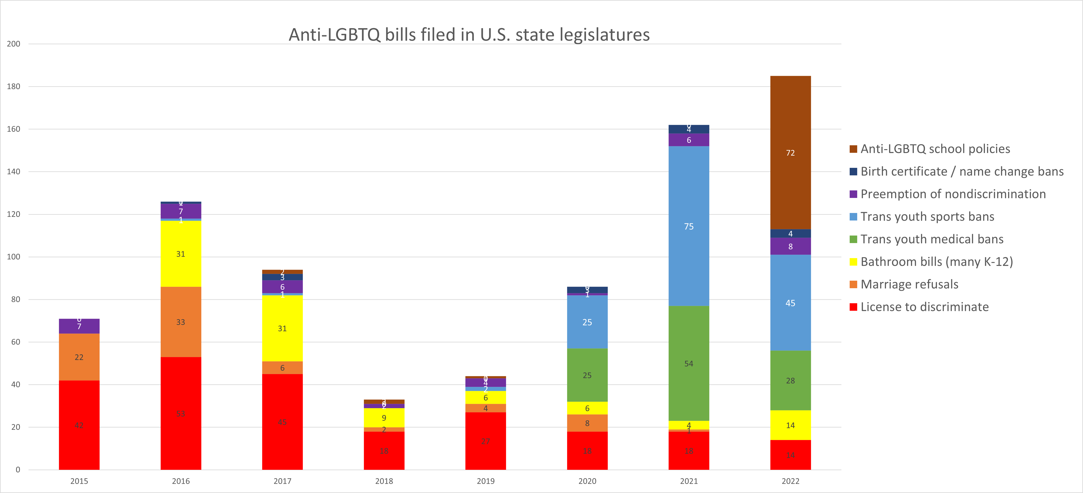
ANTI-LGBTQ+ BILLS ON THE RISE
Notes:
Four years ago, less than 40 bills regarding LGBTQ+ individuals were filed in the US. This year is on track to set a record with hundreds being considered.
Take a look at this chart. What do you notice about the trend?

Slide 30
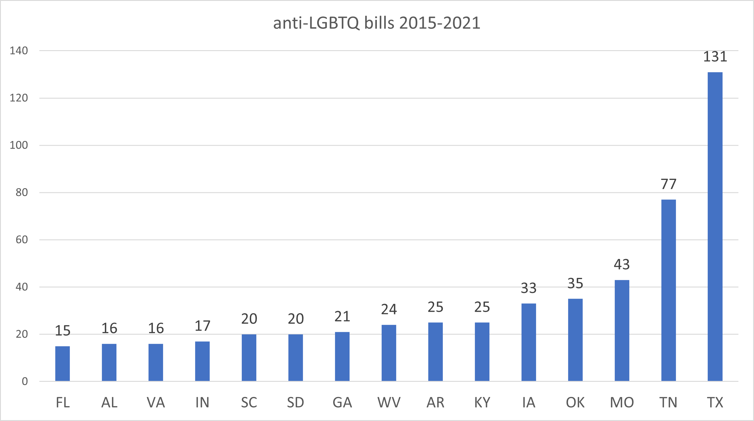
TOP 15 STATES
Notes:
These 15 states lead the nation with anti-LGBTQ+ legislation.

Slide 31
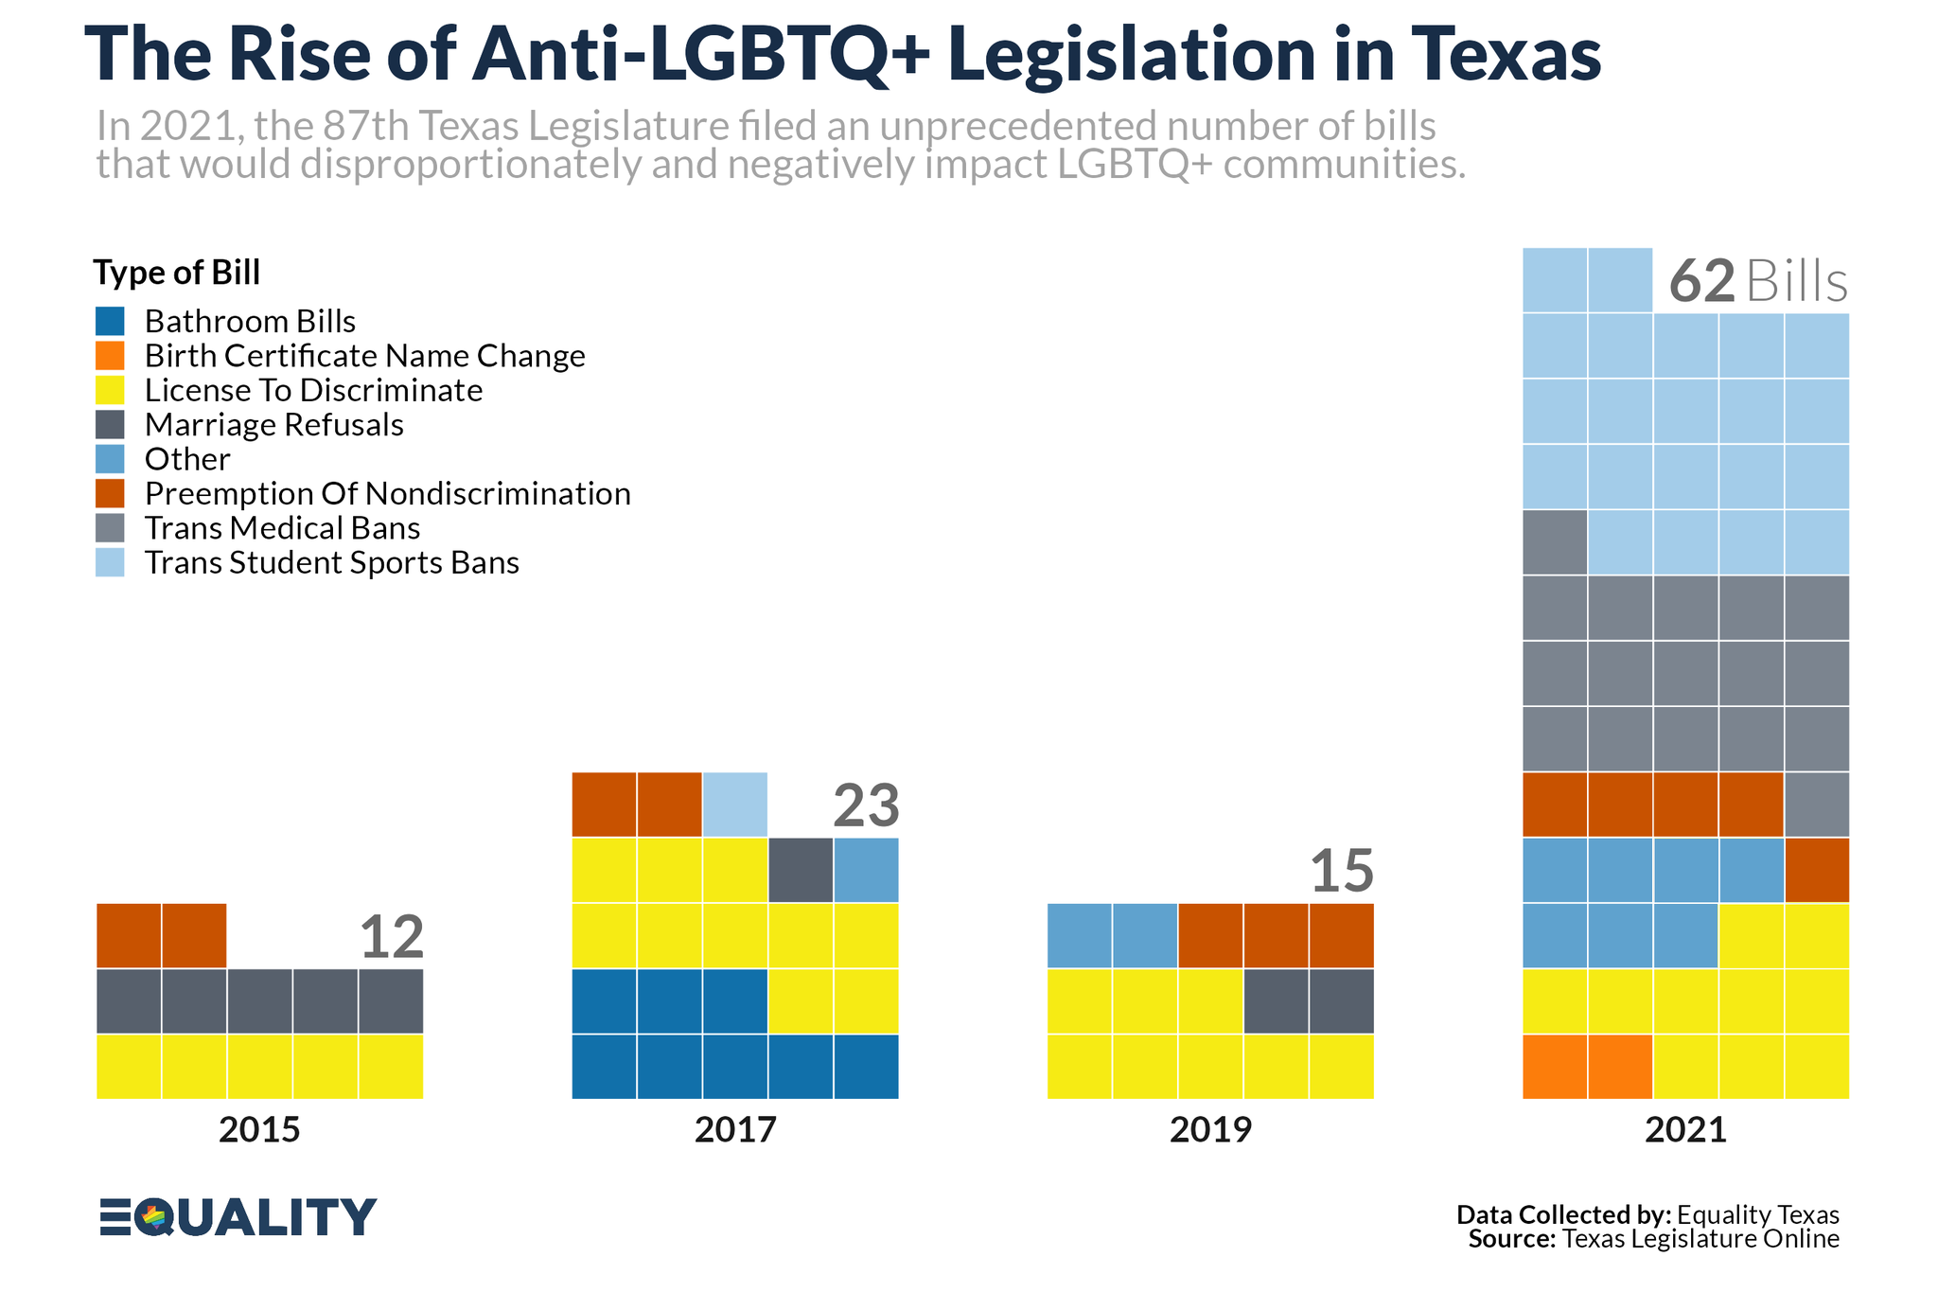
SPOTLIGHT ON TEXAS

Slide 32
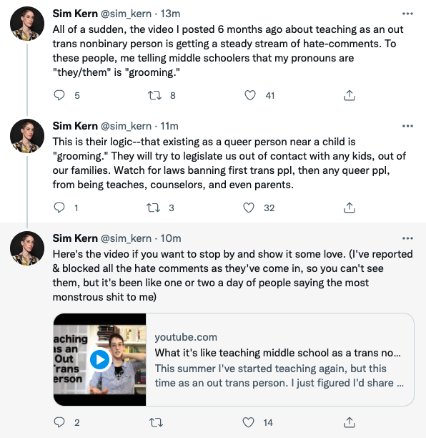
IMPACT ON EDUCATORS
Notes:
The coordinated attacks on LGBTQ+ individuals include providing people scripts that denounce teaching topics such as transgender rights, banning books from well known authors, and labeling inclusive and culturally responsive instruction as “critical race theory.” Unfortunately, these efforts have been effective.
As we see in this Twitter thread, a post from an out trans person, who six months ago shared their experience of teaching in middle school, is now accused of “grooming” students by sharing their pronouns.

Slide 33
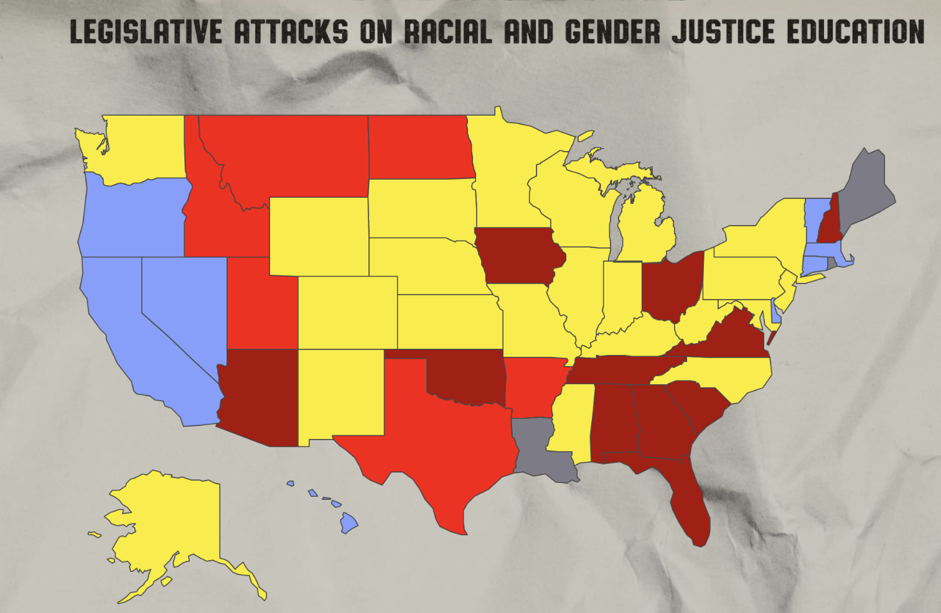

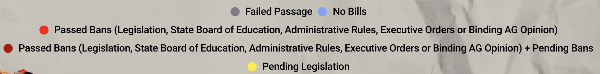
RACIAL & GENDER JUSTICE AT RISK
Notes:
This map from the African American Policy Forum shows just how urgent the need is to halt the passage of laws that put racial and gender justice at risk.
Take a look at this map. What do you notice?

Slide 34
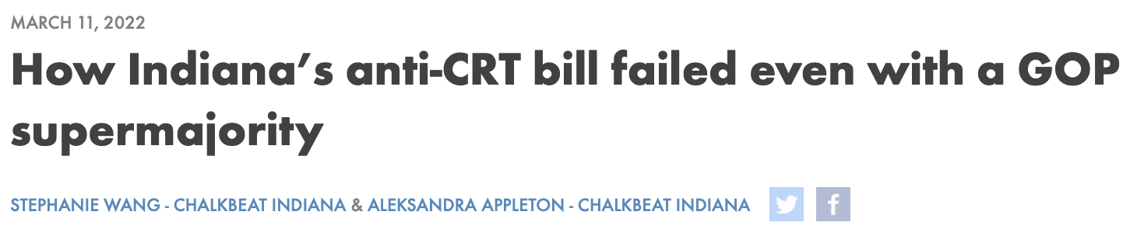
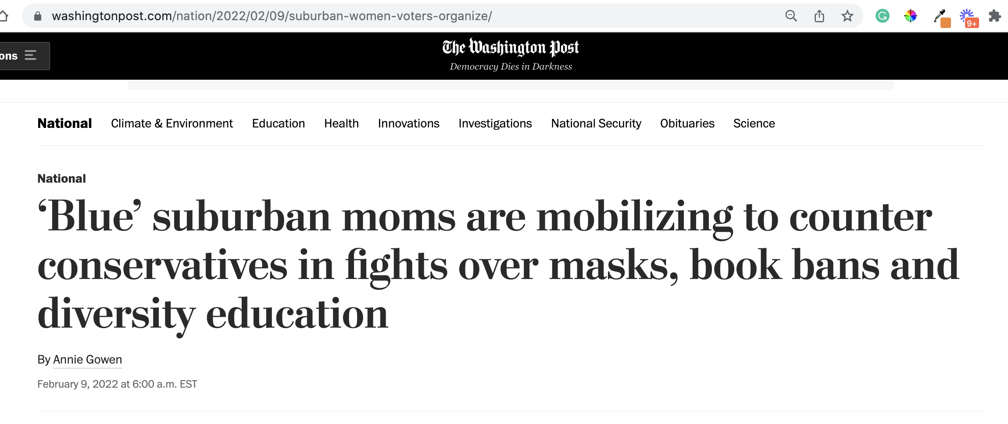


FIGHTING BACK
Notes:
While many states and lawmakers are working to advance anti-LGBTQ+ and other laws that discourage teaching an honest history of the US, not every effort is successful. While many of these efforts are specific to students, it worth noting that not all attempts have been successful.
In March 2022, a “CRT” bill in Indiana failed despite having a GOP supermajority.
Parents are mobilizing to counter the loud voices that dominate local school board meetings:
Red Wine & Blue is a a national network of more than 300,000 like-minded, mostly Democratic suburban women who believe the only way to fight back is to present a calm face to counter the angry groups that have dominated and disrupted board meetings and in some cases threatened officials. The group recently broadened its focus to fight the rising number of book bans across the country, and is running training sessions to help women testify and manage highly charged government meetings.
One WillCo is a community organization in Williamson County Tennessee that was organized by two mothers to address racial disparities in the community in 2021.
Invite discussion: Ask participants if they have heard of anti-LGBTQ+ or anti “CRT” laws that have failed to pass. Why do they think this is?
Sources:
https://www.wfyi.org/news/articles/indiana-anti-crt-bill-failed-republican-supermajority
https://onewillco.org/

Slide 35
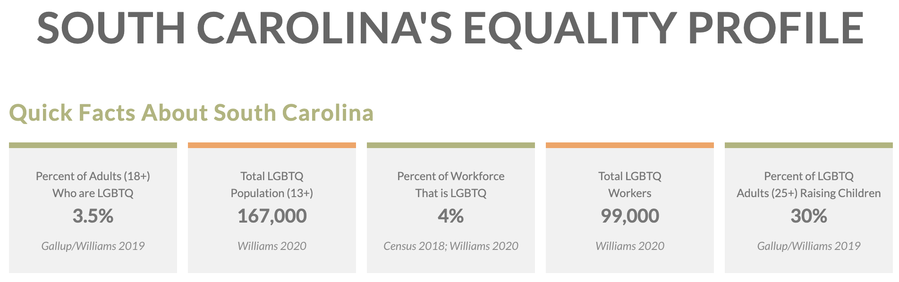
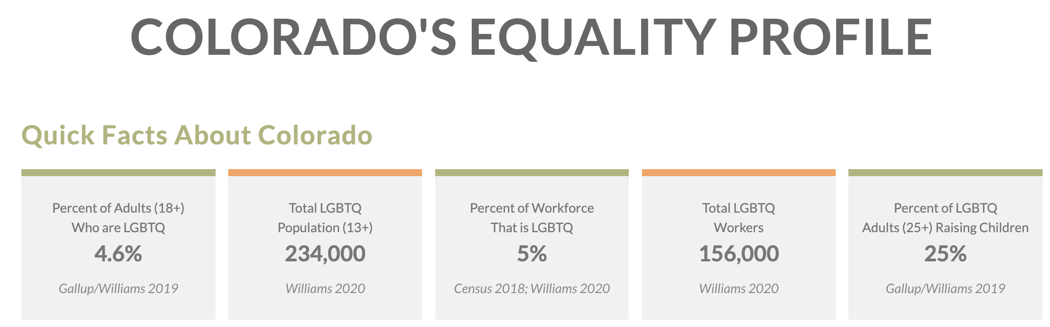
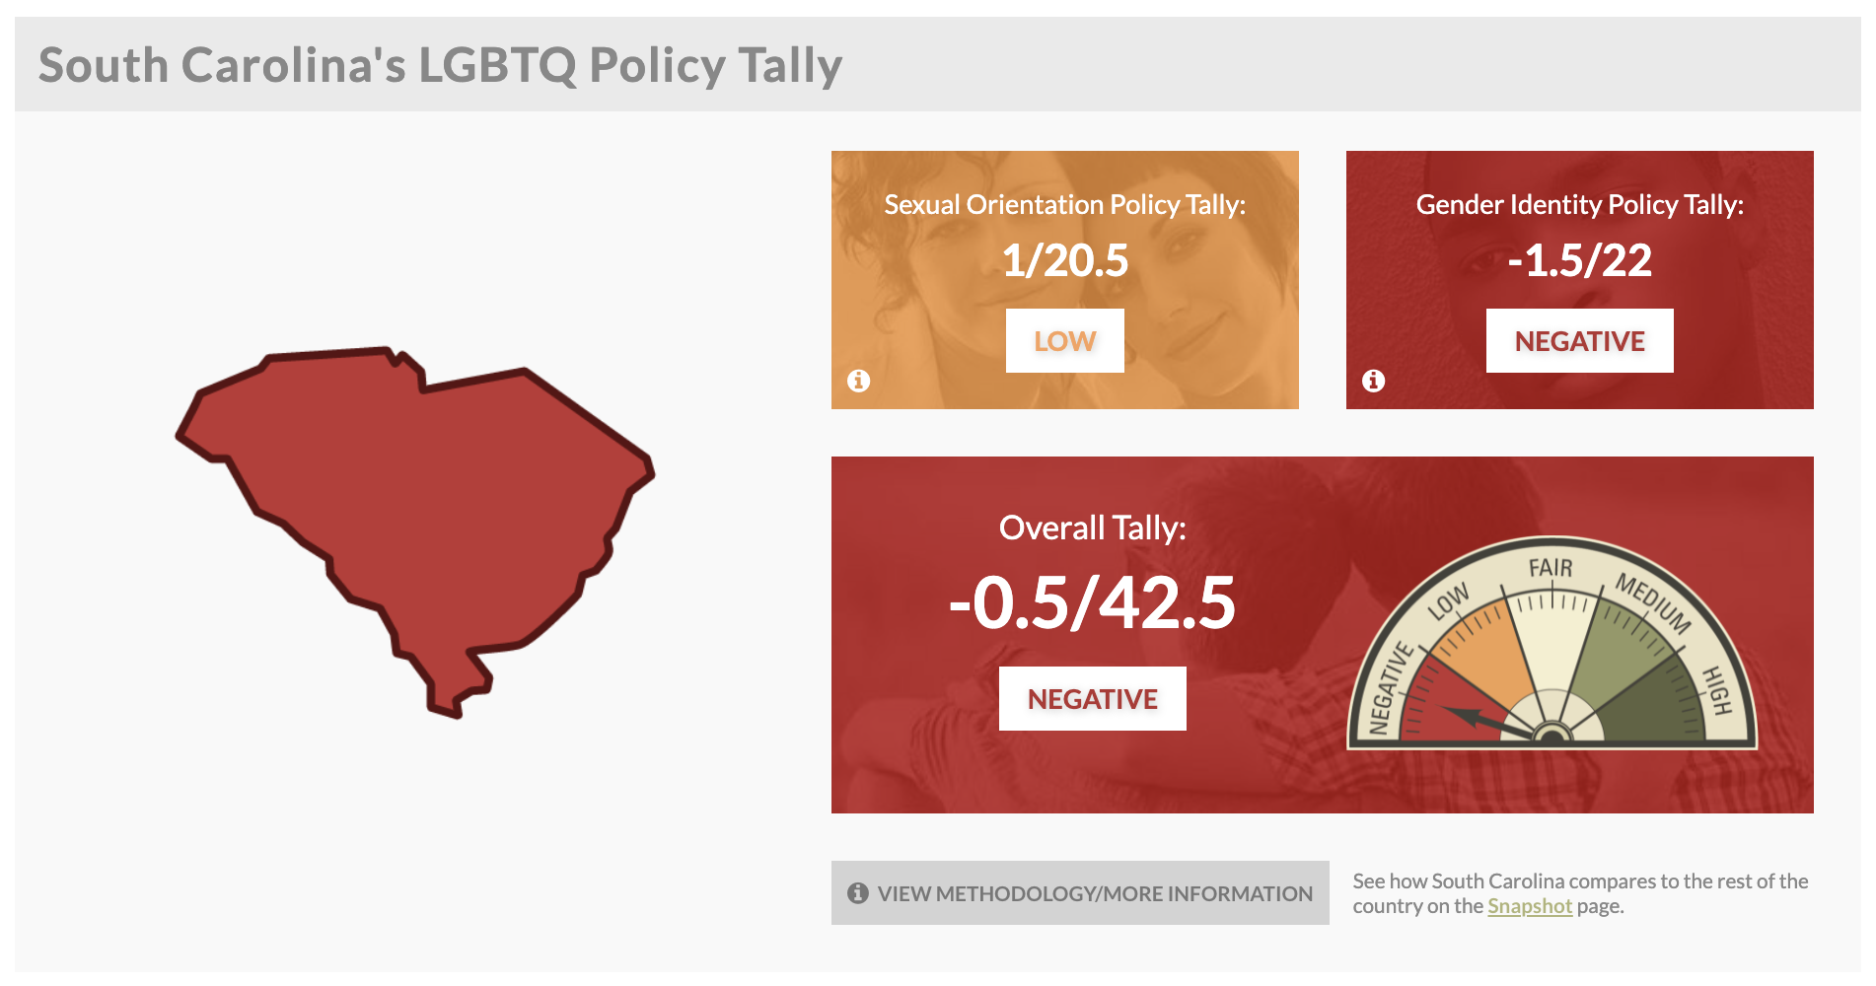
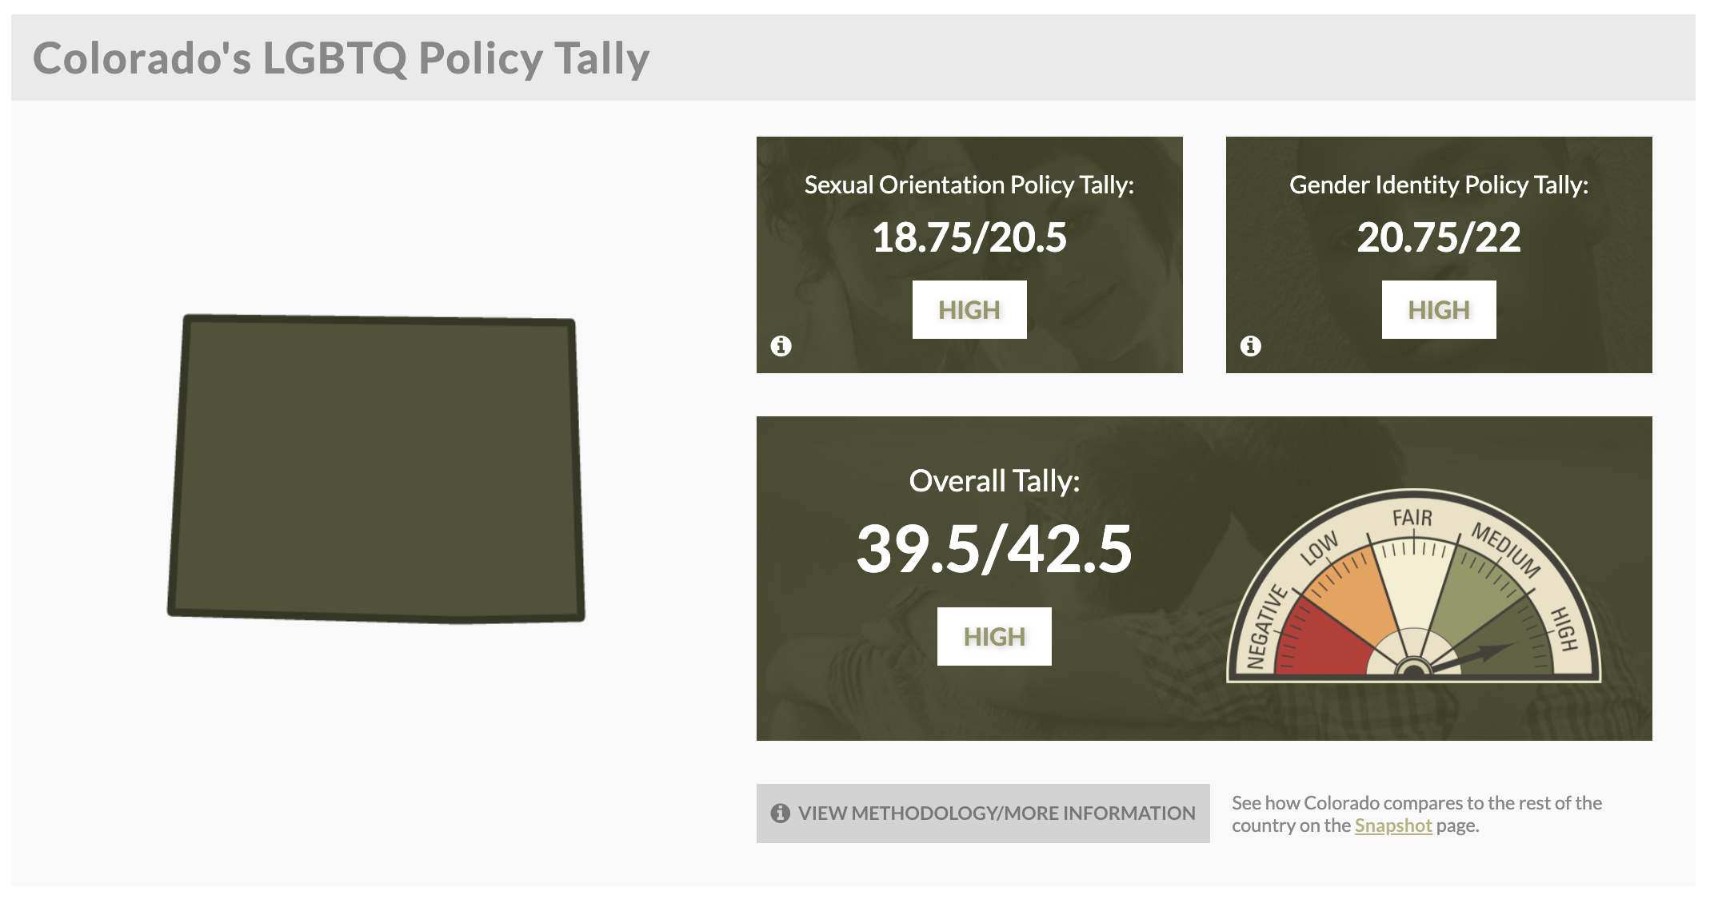
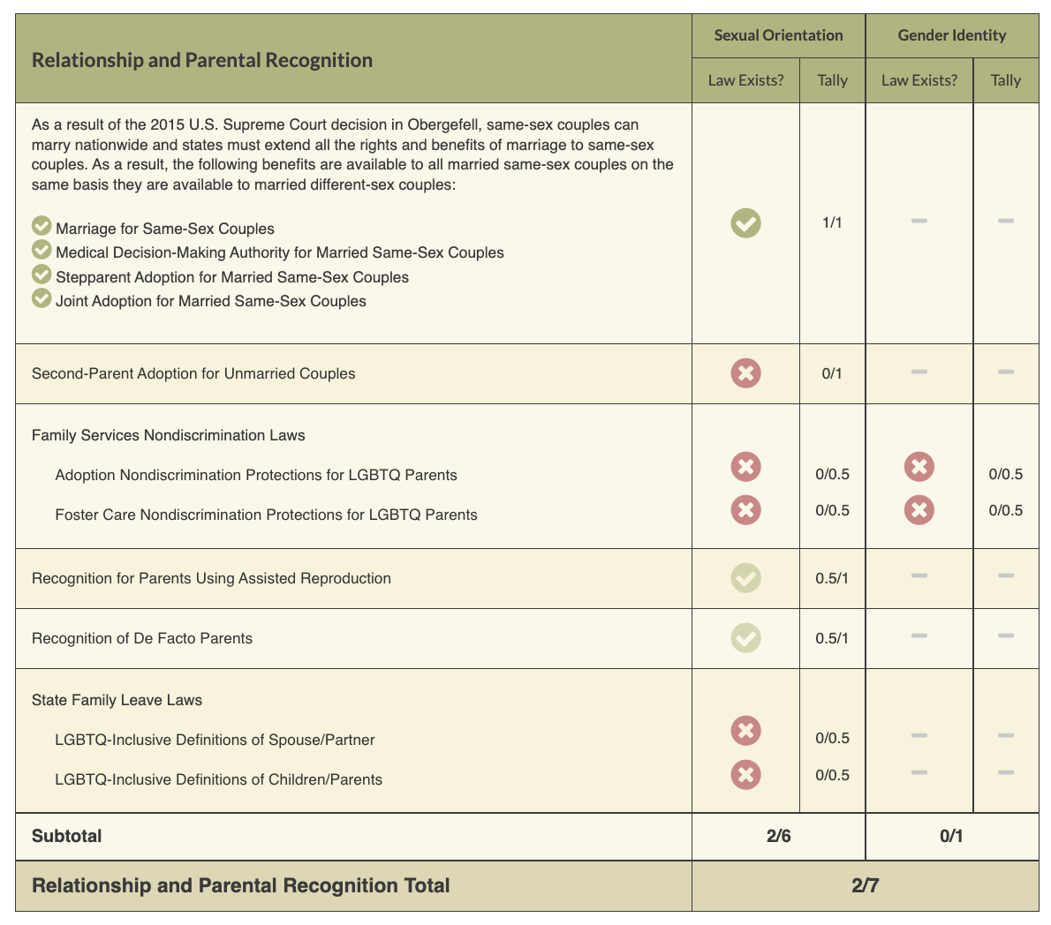
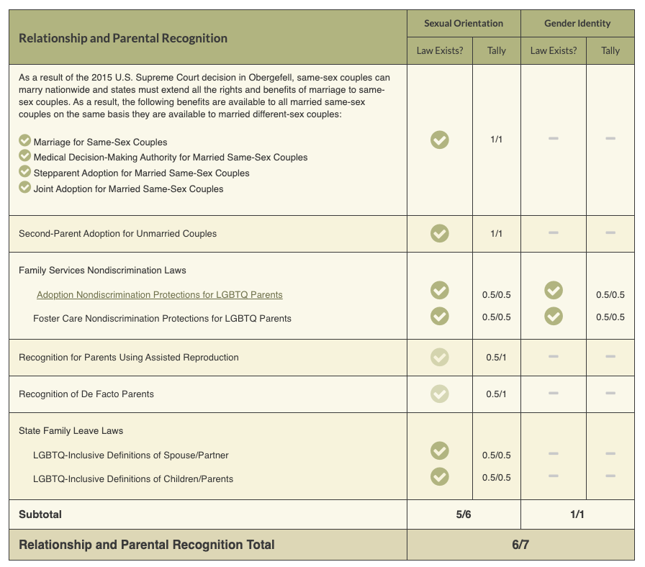
ACTIVITY #2
Review the Laws in Your State
Notes:
Look at Your State’s Equality Profile.
How might this impact members who are transitioning or transgender?
Instructions:
Go to www.lgbtqmap.org
Click Equality Maps
Select “Choose a State” in the drop down menu.
Select a state and review the data. How might this data impact members who are transitioning or transgender in your selected state?

Slide 36
CFU – BREAKOUT SESSION
What Would You Do?
Scenario #1: A Government Class
Scenario #2: A Kindergartner’s Secret
Scenario #3: Show and Tell
36
Notes:
In small groups, invite participants to discuss what they would do in one of the following scenarios:
For the following scenarios, imagine you’re in a state that has recently banned conversation about LGBTQ+ topics. What would you do?
Scenario #1: In a US government class students begin discussing local elections. One student mentions a popular candidate’s LGBTQ+ status and other students began to chime in for a discussion. What would you do?
Scenario #2: During a group activity a kindergartner tells their peer a “secret” about their identity: they may look like a boy, but they’re really a girl.
Scenario #3: It’s bring your favorite book to school day, and a first-grader brings And Tango Makes Three, the true life story of a same-sex penguin couple who reside at the Central Park Zoo, to share with the class.

Slide 37
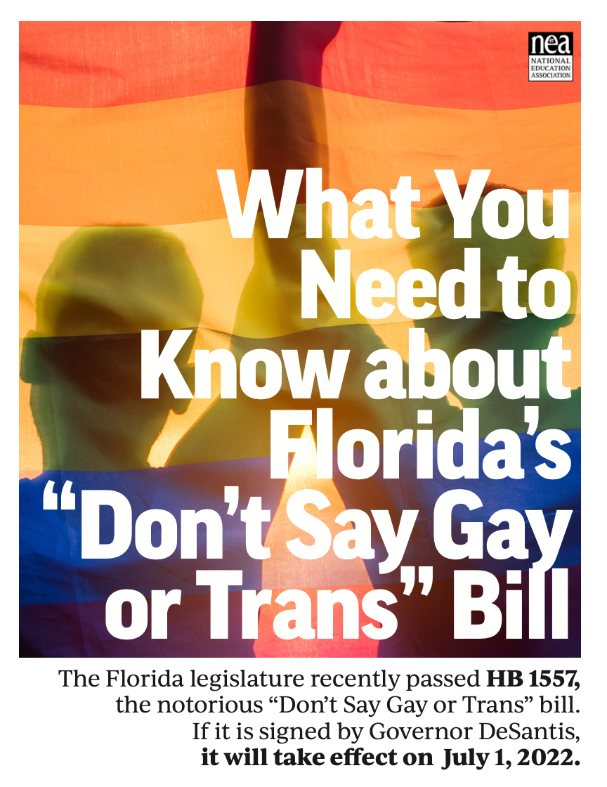




NEA RESOURCES
Legislative Trackers
Notes:
The NEA has several resources and recommendations for legislative trackers. (See handout for full list and website links.)
https://www.icnl.org/usprotestlawtracker/
https://www.aclu.org/legislation-affecting-lgbtq-rights-across-country

Slide 38
Q & A
Let’s Talk.
38

