Slide 1
NBI 32 Training Series:
LGBTQUIA+ 101
Session 1: Terminology & Gender: Understanding the Transgender Experience
Presented by:
Ben West, Linda Torres , Jeny Gardner, Colleen O’Connell, Grat Dalton, Michelle Couture, Sara Fitouri, Bekah Saxon, Barbera Whitman

Slide 2

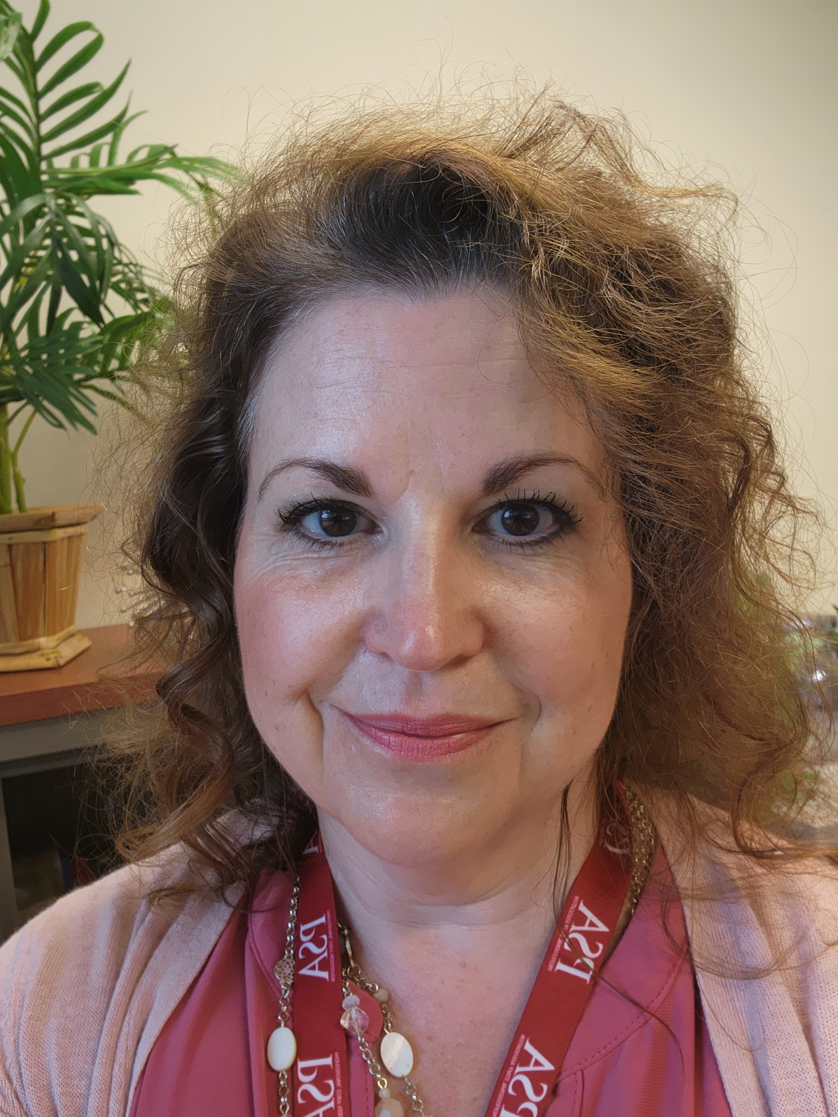
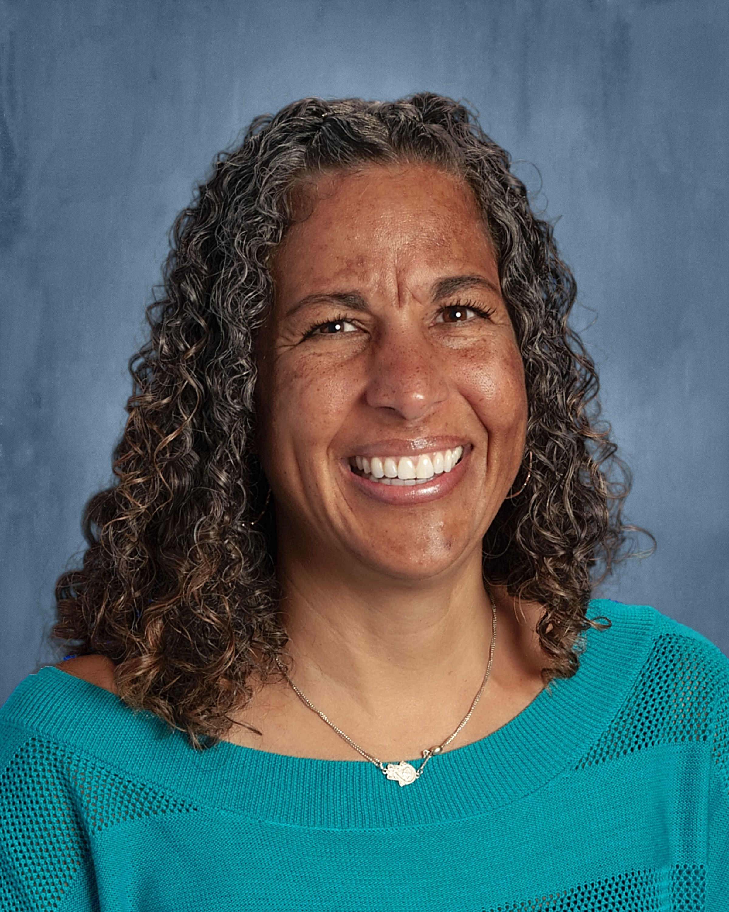
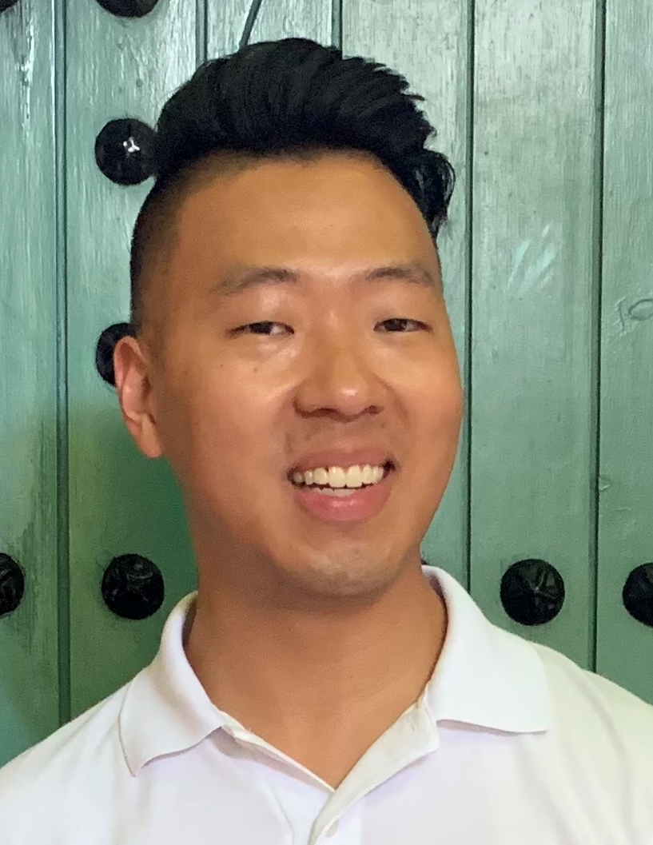
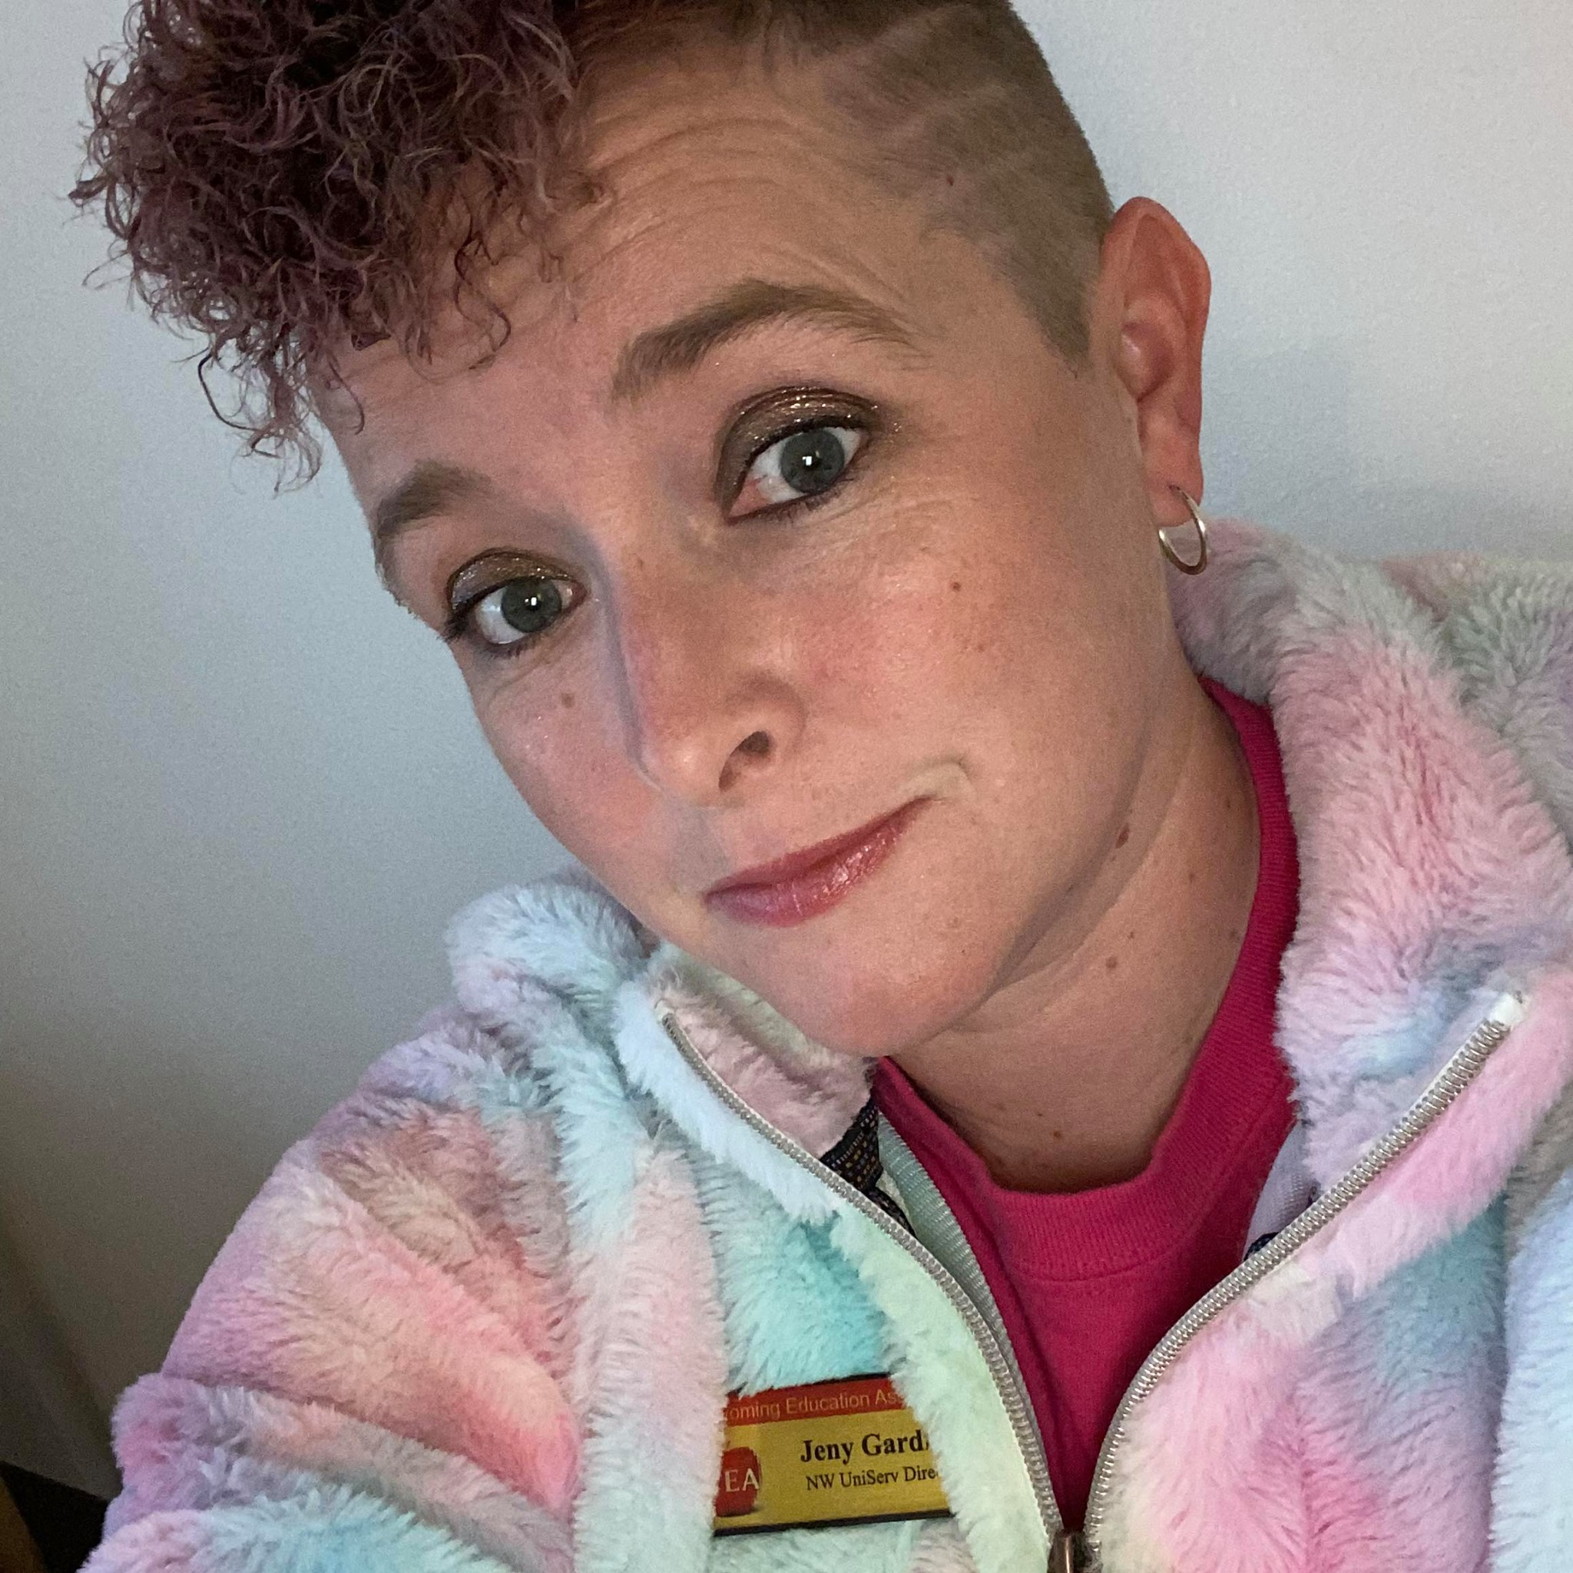

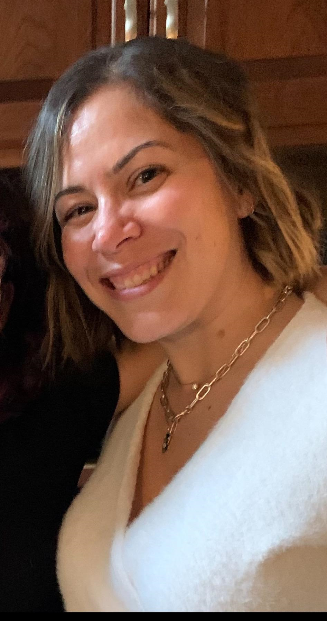
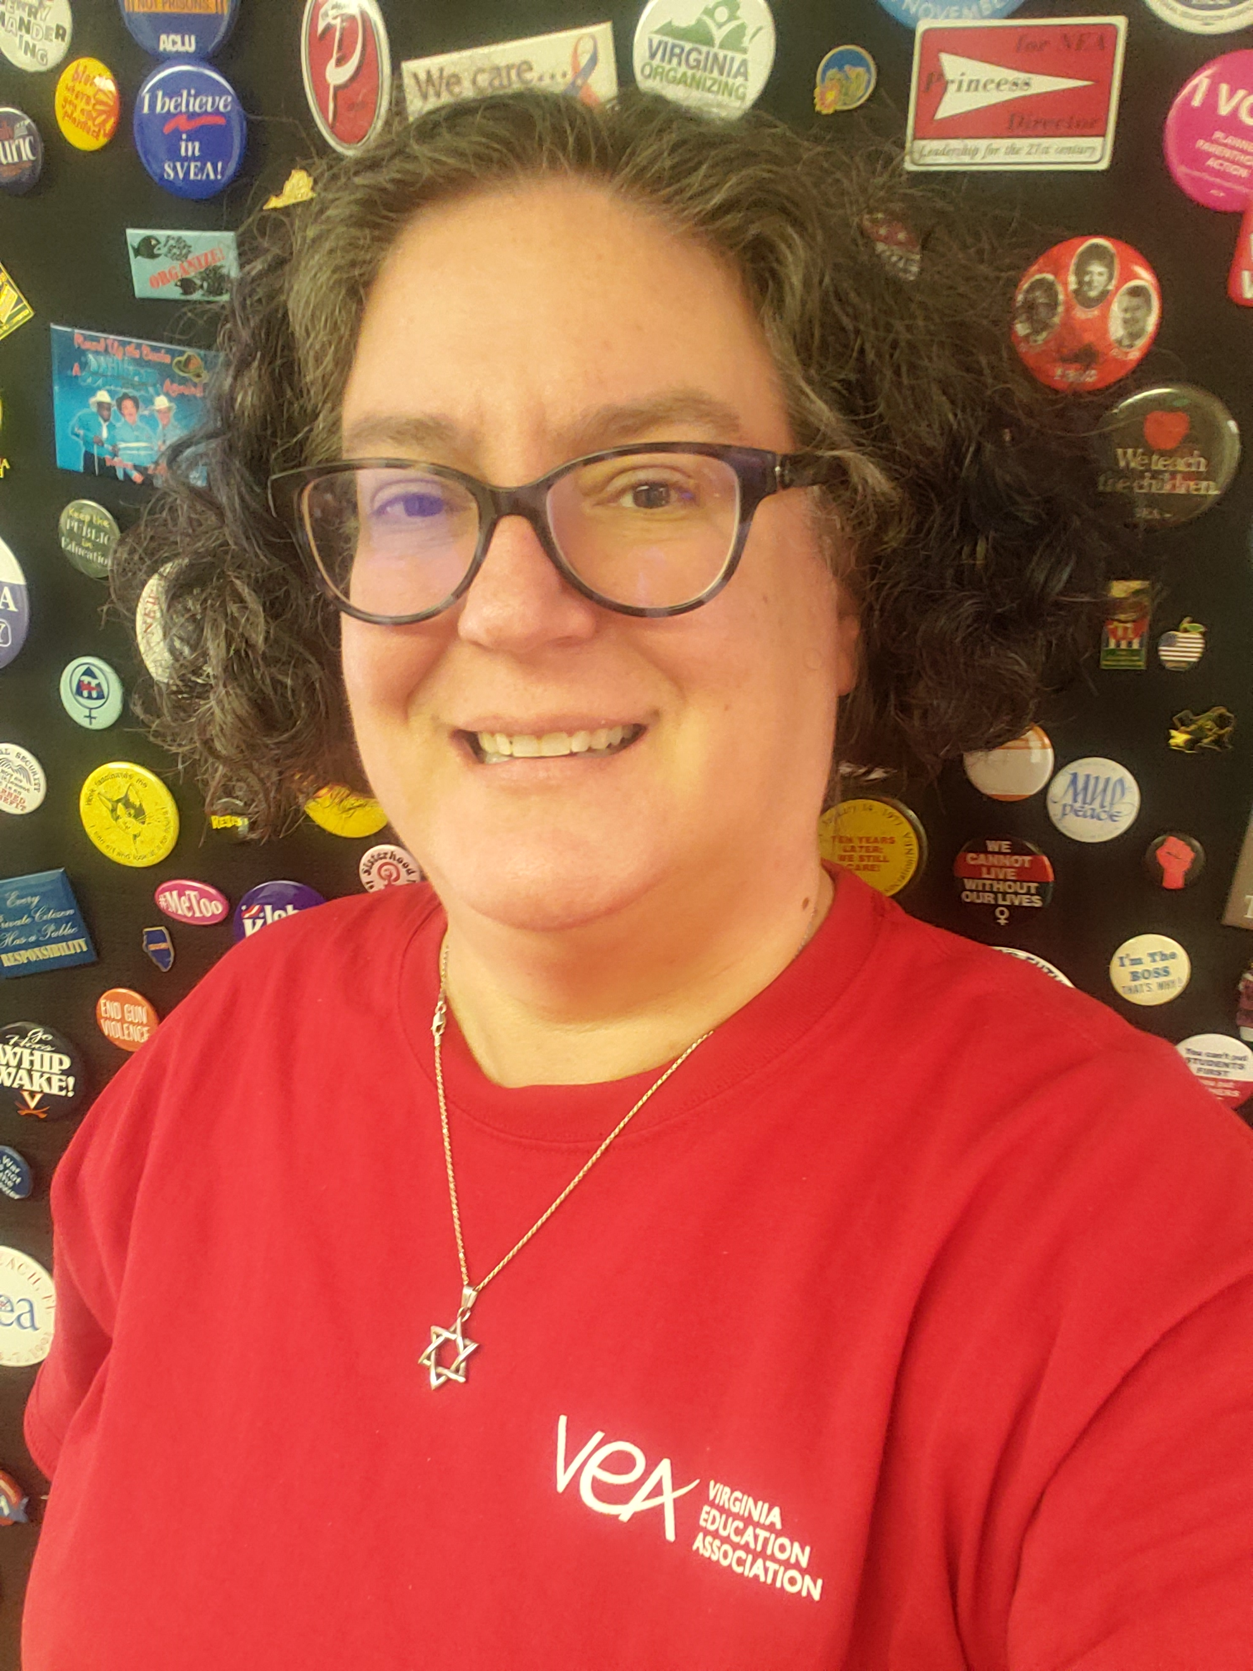


Slide 3

Land Acknowledgement
We begin by acknowledging that we meet on the traditional lands served by the Kusso and Sewee people. We honor America’s First People and all elders, past, present and emerging and we are called on to learn and share what we learn about the tribal history, culture, and contributions that have been suppressed in telling the story of America. We invite you to think about the spaces you are inhabiting and the Indigenous people who came before them and were stewards of the land.
3

Slide 4
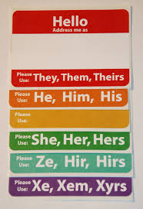
WHY PREFERRED PRONOUNS?
You can’t just assume by looking.
Asking and correctly using someone's preferred pronoun is the easiest way to show your respect for their gender identity.
Wrong pronoun use can make a person feel disrespected, invalidated, dismissed, alienated, or dysphoric (or, often, all of the above.)
It is a privilege to not have to worry about which pronoun someone is going to use for you.
Notes:
30 seconds
matt

Slide 5
COMMUNITY AGREEMENTS
Share Responsibility for the Success of Each Learning Session
Move up, Move back
Respect Confidentiality
Be Responsible for Building Deep Understanding
  Be timely with your presence, your speaking, and your listening
  Be fully present with speakers, open to new perspectives, and accept challenges
  Place tech on silent and stay checked-in
  Share using "I" statements
  Connect to your core values and speak from your heart
Expect and Accept Imperfection
Expect/accept non-closure – Agree to disagree
5

Slide 6
AGENDA
Introductions
Opening Activity
Key LGBTQ+ Terms
Gender Unicorn
What does it mean to transition?
6

Slide 7
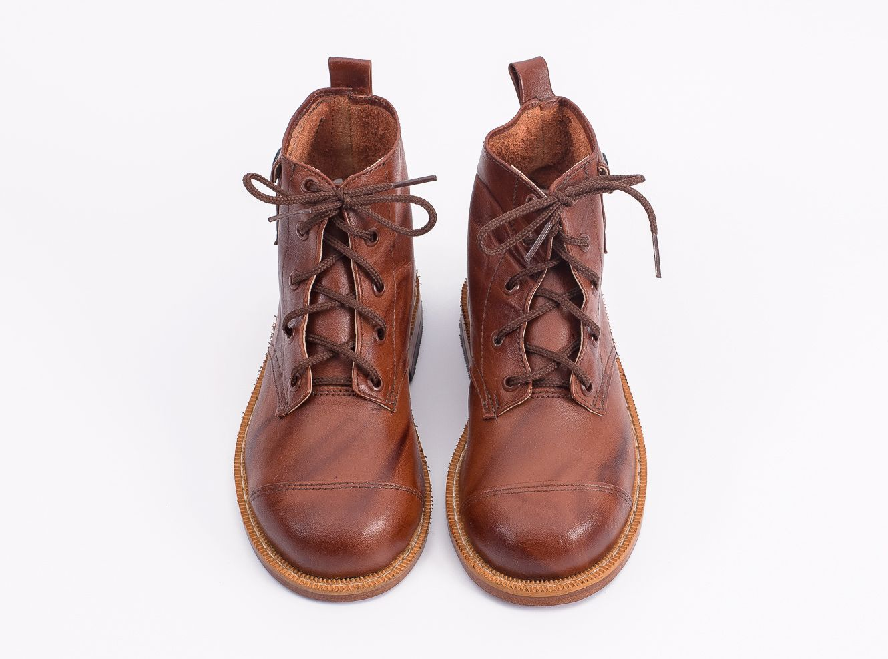
OPENING ACTIVITY
7
Notes:
Presenter Note:
Ask each participant to switch their left and right shoes (left shoe on the right foot, right shoe on the left foot). Say it’s part of the training, and then move on. DO NOT mention their shoes further. (The objective is that participants will experience a familiar but uncomfortable sensation that their shoes are on the opposite foot. This will help them experience, in a non-threatening way, the uncomfortable, awkward feelings or fear that transgender or gender non-conforming people may experience while they are in public.)

Slide 8

THE RACIAL JUSTICE FRAMEWORK
Racial Justice
+
Social Justice
=
Educational Justice
8
Notes:
When we speak of racial and social justice, we envision schools with no statistical differences in educational outcomes based on race, gender, sexual orientation, or class. We also envision schools that are just and equitable for all educators. This is educational justice.
To realize this, we believe there are three requirements:
1 - Develop awareness about the causes and impacts of institutional and structural racism in education.
2 - Capacity building. All of us are needed to achieve the goal of educational justice. And, we need to build our individual and collective capacity to do this.
3 - Action. We must be ready and able to take action and address inequity when we see it and partner with others.
We can be engaged in all three requirements at the same time. The process of creating and realizing educational justice in our schools is not linear.

Slide 9
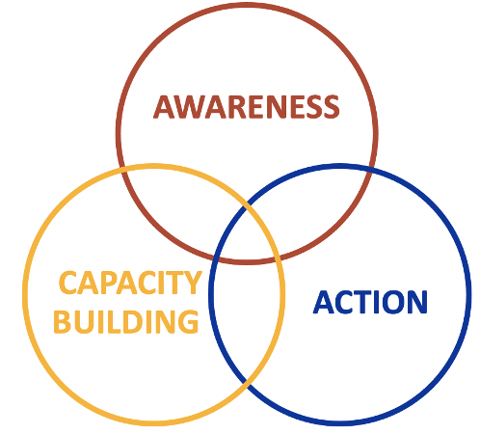
RACIAL JUSTICE & NBI 32
Awareness
How might the experiences of transgender individuals differ across racial identities?
Capacity Building
How can I help my colleagues become aware of the challenges trans BIPOC educators face, and the actions we can take to advance equity?
Action
What actions will UniServ directors and teams take to support trans and transitioning educators while advocating for racial justice?
9
Notes:
When we think about racial justice and supportive working environments for LGBTQ+ educators, we can draw the following connections to the Racial Justice in Education Framework (read questions on slide).
(Presenter Note: These questions can be modified/tailored to better meet the needs of your community.)

Slide 10
Key LGBTQ+ Terms
10
Notes:
We’ll begin with Key LGBTQ+ Terms

Slide 11

DO
YOU KNOW?
11
Notes:
Suggested Survey Questions:
1. An adjective describing a person who does not identify exclusively as a woman or a man.
Gender Expression
Non-Binary
Transitioning
Bisexual
2. The idea that there are only two genders and is based on physical anatomy at birth.
Gender Expression
Gender Binary
Gender Identity
Gender Role
3. An umbrella term for people whose gender identity and/or expression is different from cultural expectations based on the sex they were assigned at birth.
Agender
Cisgender
Transgender
Pansexual
4. The complex interaction of culture, policy, and institutions that holds in place inequitable outcomes and opportunities for individuals based on an individual’s perceived race.
Stereotype
BIPOC
Systemic Racism
Intersectionality
5. A term that describes the clinically significant distress a person experiences when their assigned birth gender does not match their gender identity.
Trauma
Gender Dysphoria
Non-Binary
Two-Spirit
Notes:
Two-Spirit does not mean someone who is Indigenous and gay. According to the the National Indian Health Service, “Native American two-spirit people were male, female, and sometimes intersexed individuals who combined activities of both men and women with traits unique to their status as two-spirit people. In most tribes, they were considered neither men nor women; they occupied a distinct, alternative gender status.” There are over 500 surviving Native American cultures, and attitudes about gender can be diverse. Not all cultures perceive two-spirit people the same way, and not every Native American/Alaska Native culture uses the term “two-spirit.”
(Source: https://www.ihs.gov/lgbt/health/twospirit/)

Slide 12
1. An adjective describing a person who does not identify exclusively as a woman or a man.
  Gender Expression
  Non-Binary
  Transitioning
  Bisexual
Notes:
B. Non Binary

Slide 13
The idea that there are only two genders and is based on physical anatomy at birth.
Gender Expression
Gender Binary
Gender Identity
Gender Role
Notes:
Gender Binary

Slide 14
3. An umbrella term for people whose gender identity and/or expression is different from cultural expectations based on the sex they were assigned at birth.
  Agender
  Cisgender
  Transgender
  Pansexual
Notes:
Transgender

Slide 15
4. The complex interaction of culture, policy, and institutions that holds in place inequitable outcomes and opportunities for individuals based on an individual’s perceived race.
  Stereotype
  BIPOC
  Systemic Racism
  Intersectionality
Notes:
Systemic Racism

Slide 16
5. A term that describes the clinically significant distress a person experiences when their assigned birth gender does not match their gender identity.
  Trauma
  Gender Dysphoria
  Non-Binary
  Two-Spirit
Notes:
Gender Dysphoria

Slide 17
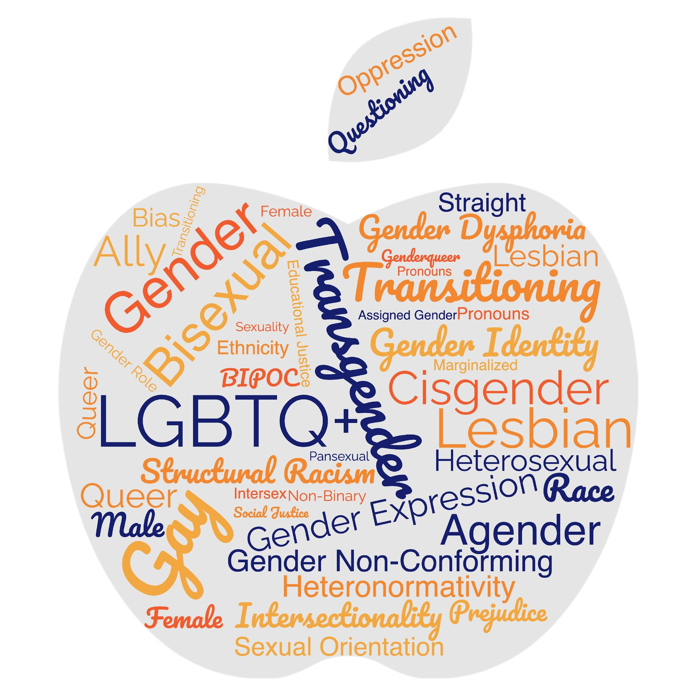
LGBTQ+ TERMS
17
Notes:
There are many LGBTQ+ terms. Please refer to your handout (see link below) for additional terms and definitions.
LGBTQ+ and Social Justice Terms: https://docs.google.com/document/d/1U6-vhknquf2Kkt-KUr6GlzaMt_58UPZ6BOJoSC-L5C8/edit?usp=sharing

Slide 18
BREAKOUT- 10 minutes- review the Definition handout provided. Click on the link in the chat box to open the document.
DEBRIEF: Upon return, is there a definition that your group is still struggling to understand?

Slide 19

THE GENDER UNICORN
19
Notes:
The Gender Unicorn is a popular way to help explain gender that was developed by Trans Student Educational Resources. You may be familiar with the “Genderbread Person,” but we choose not to use it. It was created by a Black trans woman, but someone else popularized it, and continues to get credit, pay and notoriety for it.
As you see, the Gender Unicorn highlights gender identity, expression, sex assigned at birth, and physical and emotional attraction.
Children learn that there are two groups—boys and girls—and that they fit into one or the other based on how their bodies are made. They are then socialized to accept specific gender norms and stereotypes, which are ways of behaving, based on this gender assigned at birth.
There’s increasing understanding that gender is more than a binary division. The spectrum of gender identity is becoming more widely accepted and gender expression is more expansive.
However, there are challenges to looking at gender beyond male and female. Across states, many laws and policies are being passed that affirm or harm individuals outside of the gender binary.
Link to the Gender Unicorn document: https://transstudent.org/gender/

Slide 20

TRANSGENDER TERMINOLOGY
Transgender
Binary
Trans man
Trans woman
Non-Binary
Genderqueer
Genderfluid
Bigender
Demiboy
Demigirl
Agender
Neutrois
…and more!
20
Notes:
Language in the LGBTQ+ communities changes very quickly. Language in ethnic communities changes about every ten years while language in the LGBTQ+ communities changes about every two years.
Trans men and trans women are men or women- don’t need the trans as a choice!- or reason to be asking for it- as if tracking it for demographic purposes
Transgender/Trans: This is an umbrella term for people whose gender identity and/or expression is different from cultural expectations based on the sex they were assigned at birth. Being transgender does not imply any specific sexual orientation. Both binary and non-binary genders and gender expressions fall under the umbrella.
Often, we hear transphobic comments when the appearance of Black and Brown bodies are compared to white/Eurocentric views of femininity. For example, internet conspiracy theories have long criticized the natural muscular frame of tennis superstar Serena Williams, and even former First Lady Michelle Obama. Obviously, these comparisons are harmful, and are just one example of how hate, prejudice and fear show up.

Slide 21

BREAK OUT
Share your takeaways about gender identity, gender expression and physical and emotional attraction.
How does this help you understand members that may identify with different combinations of the Gender Unicorn?
21
Notes:
Turn & Talk - Suggested Discussion Questions:
1. Share your takeaways about gender identity, gender expression, and physical and emotional attraction. What is clearer to you?
2. How does this help you understand members that may identify with different combinations of the Gender Unicorn? How might UniServ support this member if they're ever questioned about their different combinations?

Slide 22
What Does It Mean To Transition?
Notes:
Given all that a transgender person may be experiencing, one option is to transition. This means they align their inner identity with their external one. We’re going to talk about this process and how it affects trans adults.

Slide 23



Individuals May Go Through Various Transitions
THREE TRANSITIONS
Social Transition
Legal Transition
Physical Transition
23
Notes:
Transitioning is not a simple, one-time event, and there is no “one-size-fits-all” process, checklist, or approach. Transitioning is a complex issue, and it involves a wide variety of options for an individual.
Many factors influence a person’s decision to transition, and because of these factors, their transition may not be linear. Transitioning is a personal decision specific to the individual, so how a person goes about transitioning can change over time and vary from person to person.
There are 3 main types of transitions someone could go through: social, legal, and physical.

Slide 24
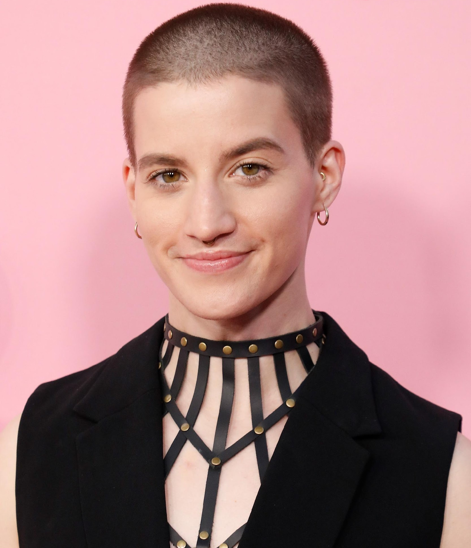
SOCIAL TRANSITION
Social transition is when a transgender person makes others aware of their gender identity.
Theo Germaine, actor in
Netflix’s The Politician
They/Them and He/His
24
Notes:
Social transition is just what it sounds like—changing how you present yourself and how others see you socially. A social transition can happen at any age. A person may start their transition, pause it, move back, and move forward again. It often includes changing clothing or hairstyles. Usually, it entails changing a name and switching pronouns—sometimes more than once.
A person may try on names for a while and switch from one gendered pronoun to another, only to decide that a non-binary pronoun fits better. Again, no rules.

Slide 25

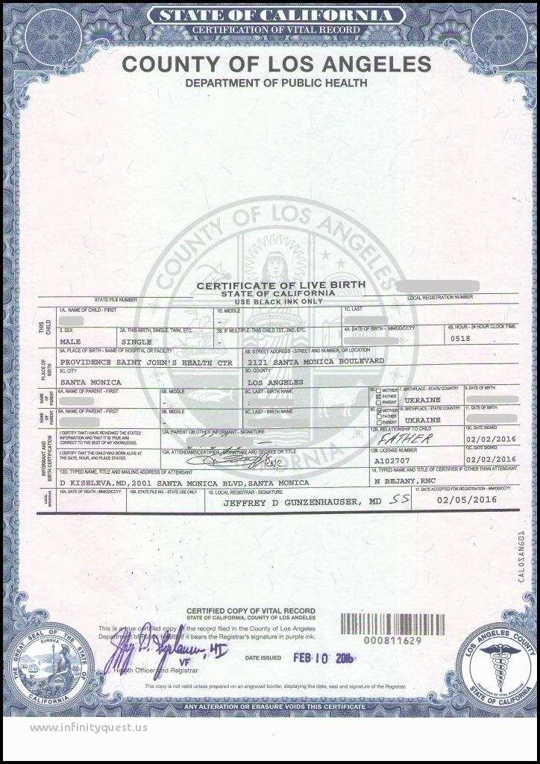
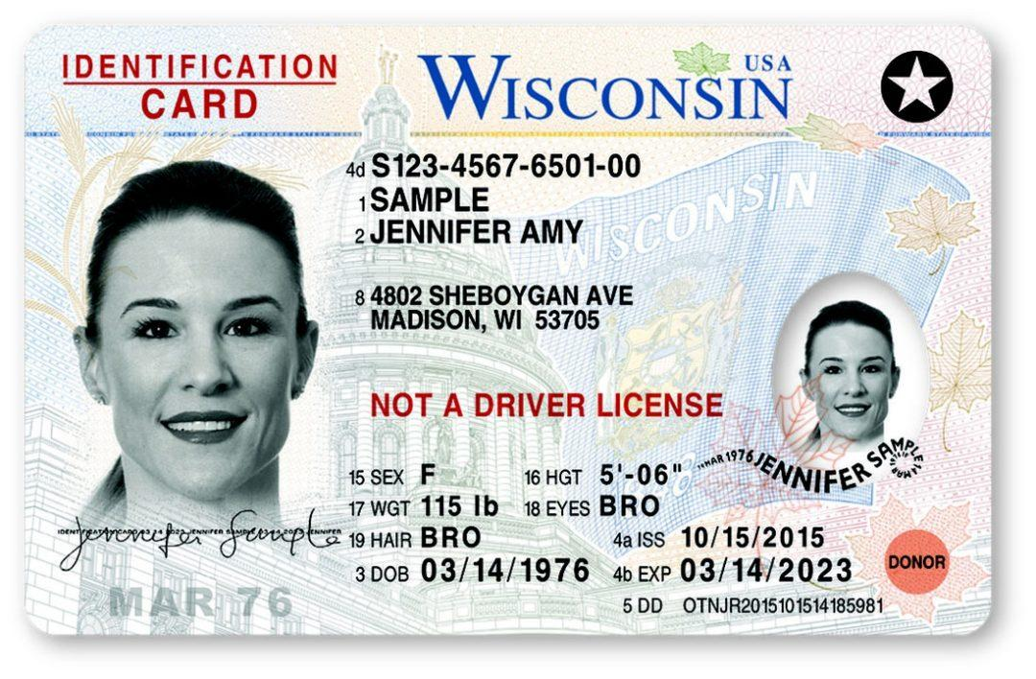
LEGAL TRANSITION
Legal transition is when a transgender person legally changes their existing documentation to match their gender identity.
These can be done by
court order or state law.
25
Notes:
A legal transition means updating documents through the legal process.
Some parts of the legal transition can include changing gender markers on birth certificates, changing names on social security cards, driver’s licenses, or passports. Legal transitions can also have other identification components, such as school documents. Passports are the easiest documents to change.
People cannot always experience a legal transition because of several barriers. Those barriers do not make their gender identity or their distress at being misgendered any less real.

Slide 26

PHYSICAL TRANSITION
Physical transition is when a transgender person undergoes medical treatments so that their sex characteristics better match their gender identity. Before puberty, there are no medical interventions. Ever.
Janet Mock (She/Her), Writer, Director & Transgender Activist
26
Notes:
Transgender health is a specialized area of medicine. There is no one way to have a physical transition.
Given the specialized nature of transgender health care, we can see how problematic it is for a trans person to be told they can only access gender-segregated spaces once they have “had a surgery.” It puts a burden on them that is impossible to overcome, denies their full identity, and creates equal-access issues. Additionally, not all trans people want to have surgery. It’s wrong to demand that another person undergo serious, invasive medical procedures to make other people comfortable.
Keep in mind that just like you would not want to be asked about your medical procedures, we don’t ask others about theirs.

Slide 27

BREAK OUT
Based on what you know, what are some of the barriers members can face when transitioning?
27
Notes:
Turn & Talk: Suggested Discussion Questions:
Describe a time when you had to transition (e.g. moving to a new city, starting a new job, getting married, having or adopting a child, becoming a pet parent, etc.). Why did you want to make this change and did you have support?
Based on what you know, what are some of the barriers members can face when transitioning?

Slide 28
BARRIERS TO TRANSITIONING
Not all trans people can transition as they would like to because of any number of factors, including:
Financial cost
Legislative rules/roadblocks
Lack of access to competent healthcare
Health problems
Unhappy with options available
Unsupportive family/family instability
Homelessness/domestic violence
Other personal reasons
28
Notes:
Here are a few examples of barriers a transgender educator might face:
Legislative rules/roadblocks — In most states, a person’s gender marker can only be changed on their birth certificate after permanent medical procedures have occurred. This is often stipulated as surgery.
Lack of access to competent healthcare — Trans health is still not taught in most medical schools. Often there is one class (class period…not entire course) devoted to it, if at all. Many providers are afraid to treat trans patients, and some patients travel to other states just to get competent care.
Health problems — Underlying health conditions can complicate a physical transition just as they would complicate any number of other medical treatments or procedures.
Unhappy with options available — This could be surgical options, but could also affect a non-binary person who does not want to proceed with hormones that would make them look too feminine or too masculine.
And, other personal reasons.

Slide 29
YOUR SHOES
29
Notes:
Presenter Note:
Ask participants to focus on their feet. How has it felt to have their shoes on the wrong feet during today’s session? What connections can they make between the uncomfortable, awkward feelings of having their shoes on the wrong feet to what transgender or gender non-conforming people may experience while in public?
It’s important to note that this activity was created by a transgender person, not because it fully captures how Gender Dysphoria feels or to even reflect one person’s experience living with it. It is a very simplified exercise intended to create empathy based on feelings and emotions we can all understand: discomfort, irritation, pain, inability to focus, forced conformity, self-consciousness, embarrassment, or recognizing privilege in not doing the exercise.
As a reminder, as we wrap up today, it’s important to note that trans visibility does not equal the advancement of transgender rights, or progress for transgender people. The goal is liberation. Our hope is that with what we’ve learned today, that you too will be an advocate for trans educators across all our schools and districts.

Slide 30
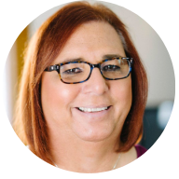
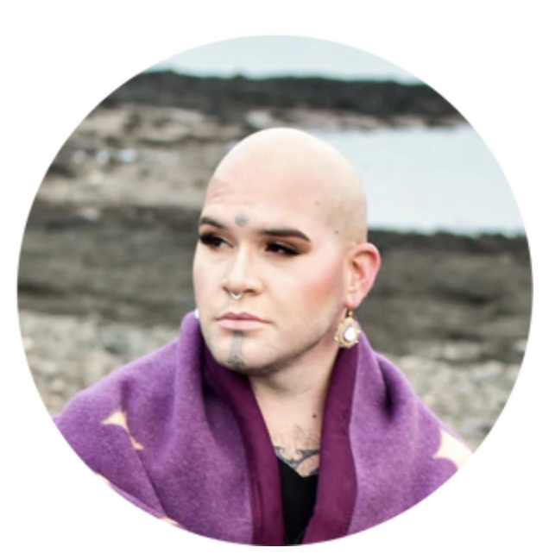

Other Gender Identities
CELEBRATING LEADERS
Stephanie Byers (she/her)
The first openly transgender Native American to be elected to office in the U.S.
Geo Neptune (they/them)
Maine’s First Transgender, Nonbinary, Two-Spirit Elected Official
Chella Man (he/him)
Transgender, Jewish, Chinese and deaf actor who works expand how deaf & LGBTQ+ people are represented.
30
Notes:
Geo Neptune is Maine’s first transgender, nonbinary, two-spirit elected official. Also known for their artistry in basketry, beadwork and hand-poke tattooing, Geo is a 2021 winner of the United States Artists Fellow award.
Stephanie Byers is a member of the Chickasaw Nation, and the first openly transgender Native American to be elected to office in the U.S. She currently serves in the Kansas House of Representatives. Prior to that, she was an educator for 29 years, and in 2019 was awarded the National Teacher of the Year award by GLSEN.
Chella Man is a transgender, Jewish, Chinese, and deaf actor. He is an activist who has been involved in many campaigns to support the LGBTQ+ and disabled communities. He has been cast in many roles including the role of Jericho, a mute crime fighter who uses sign language in the DC Universe digital series, Titans. He works to expand the way deaf and LGBTQ+ individuals are represented.
Sources: https://www.glad.org/post/lgbtq-advocates-in-the-asian-american-and-pacific-islander-community/

Slide 31

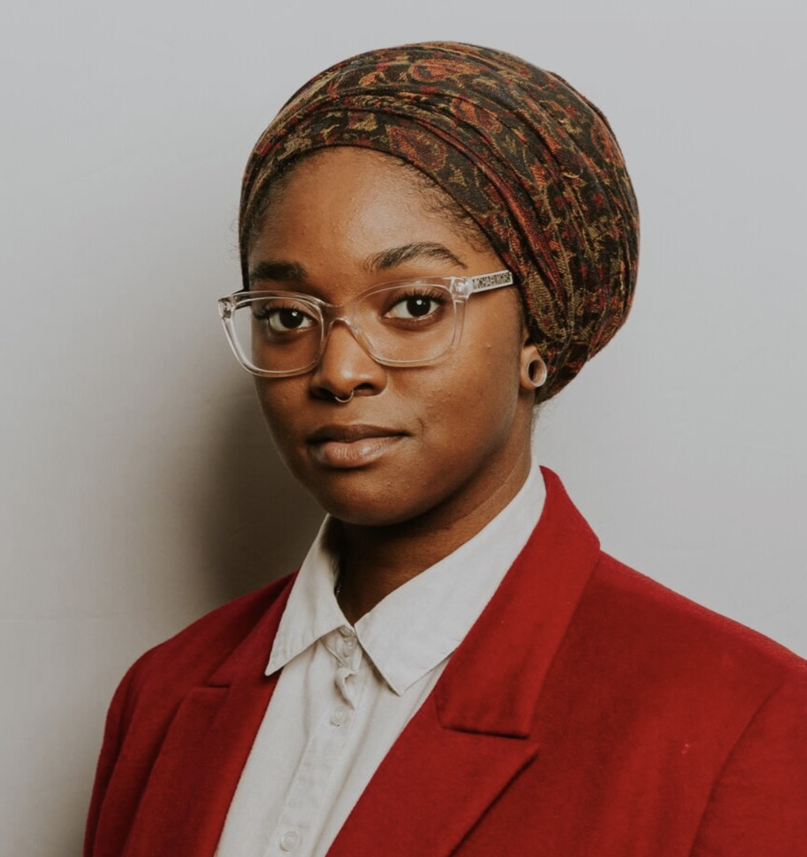

Other Gender Identities
CELEBRATING LEADERS
Sage Grace Dolan-Sandrino
(she/her)
Afro-Latinx student and
activist who came out at age 13
Sarah McBride (she/her)
First transgender senator
(2020)
Mauree Turner (they/them)
The first publicly non-binary U.S. state lawmaker and the first Muslim member of the Oklahoma Legislature (2020)
31
Notes:
Sarah McBride is from the state of Delaware. She is our nation’s first transgender senator and was elected in 2020.
Sage Grace Dolan-Sandrino is currently a college student. She is an Afro-Latinx transgender activist who came out at age 13. When her middle school wasn’t supportive, she and her mom gained the help of the Human Rights Campaign to transform her school community.
Mauree Turner is the first publicly non-binary US state lawmaker and the first Muslim member of the Oklahoma Legislature. They were elected in 2020.

Slide 32


Slide 33
NBI 32 Training Series:
LGBTQUIA+ 101
Session 2: The Employment & Legal Landscape for Transitioning & Transgender Employees
Presented by:
Ben West, Linda Torres , Jeny Gardner, Colleen O’Connell, Grat Dalton, Michelle Couture, Sara Fitouri, Bekah Saxon, Barbera Whitman

Slide 35
Land Acknowledgement
We begin by acknowledging that we meet on the traditional lands served by the Kusso and Sewee people. We honor America’s First People and all elders, past, present and emerging and we are called on to learn and share what we learn about the tribal history, culture, and contributions that have been suppressed in telling the story of America. We invite you to think about the spaces you are inhabiting and the Indigenous people who came before them and were stewards of the land.
35

Slide 36
WHY PREFERRED PRONOUNS?
You can’t just assume by looking.
Asking and correctly using someone's preferred pronoun is the easiest way to show your respect for their gender identity.
Wrong pronoun use can make a person feel disrespected, invalidated, dismissed, alienated, or dysphoric (or, often, all of the above.)
It is a privilege to not have to worry about which pronoun someone is going to use for you.
Notes:
30 seconds
matt

Slide 37
COMMUNITY AGREEMENTS
Share Responsibility for the Success of Each Learning Session
Move up, Move back
Respect Confidentiality
Be Responsible for Building Deep Understanding
  Be timely with your presence, your speaking, and your listening
  Be fully present with speakers, open to new perspectives, and accept challenges
  Place tech on silent and stay checked-in
  Share using "I" statements
  Connect to your core values and speak from your heart
Expect and Accept Imperfection
Expect/accept non-closure – Agree to disagree
37

Slide 38
AGENDA
Introductions
Review from yesterday's terminology convo
Legal Framework
Breakout Group #1
State Laws
Scenario Work/Breakout Groups #2
Debrief/Closing
38

Slide 39
RECAP!
39
Notes:
Suggested Survey Questions:
1. An adjective describing a person who does not identify exclusively as a woman or a man.
Gender Expression
Non-Binary
Transitioning
Bisexual
2. The idea that there are only two genders and is based on physical anatomy at birth.
Gender Expression
Gender Binary
Gender Identity
Gender Role
3. An umbrella term for people whose gender identity and/or expression is different from cultural expectations based on the sex they were assigned at birth.
Agender
Cisgender
Transgender
Pansexual
4. The complex interaction of culture, policy, and institutions that holds in place inequitable outcomes and opportunities for individuals based on an individual’s perceived race.
Stereotype
BIPOC
Systemic Racism
Intersectionality
5. A term that describes the clinically significant distress a person experiences when their assigned birth gender does not match their gender identity.
Trauma
Gender Dysphoria
Non-Binary
Two-Spirit
Notes:
Two-Spirit does not mean someone who is Indigenous and gay. According to the the National Indian Health Service, “Native American two-spirit people were male, female, and sometimes intersexed individuals who combined activities of both men and women with traits unique to their status as two-spirit people. In most tribes, they were considered neither men nor women; they occupied a distinct, alternative gender status.” There are over 500 surviving Native American cultures, and attitudes about gender can be diverse. Not all cultures perceive two-spirit people the same way, and not every Native American/Alaska Native culture uses the term “two-spirit.”
(Source: https://www.ihs.gov/lgbt/health/twospirit/)

Slide 40
1. This term is used to describe someone who doesn’t have a gender
  Transgender
  Gender Expression
  Agender
Notes:
C. (Goal - dig into the difference between the absence of gender, and non-binary/binary gender identity)

Slide 41
2. A man who is transgender can be…
  Bisexual
  Straight
  Queer
  All the above
Notes:
d. (Goal- that gender identity is separate from sexual orientation)

Slide 42
3. A cisgender woman who is in a relationship with a cisgender man is?
Straight
Heterosexual
Unknown
Notes:
C. (Goal- that identity is not the same as someone’s current relationship)

Slide 43
4. A person who identifies as a woman and is attracted to women may be
  Gay
  Queer
  Lesbian
  Bisexual
  All the above
Notes:
e. (Goal- emphasize that there is some overlap in these terms, but that the identity someone chooses for themselves is what matters.)

Slide 44
What issues might we notice in this membership form question? How could we make it more inclusive/accurate?
  What is your gender?
    Female
    Male
    Transgender
    Other
Notes:
GOAL- Don’t ask if not needed. Ask what you mean.

Slide 45
A NATION OF LAWS
1600s
Founding of Jamestown, VA
Mass. Bay General Court determined “sex crimes” and punishments.
1700s
Colonial sodomy laws passed and remained in place until 1925.
US Constitution passed and counts African-Americans as 3/5 a person.
1800s
14th Amendment passed that declares “equal protection of the laws.”
Plessy v. Ferguson declares racial segregation legal.
1900s
President Dwight Eisenhower bans gay people from working in the federal gov’t.
Famous celebrities, athletes & politicians start publicly coming out.
2000s
President Obama repealed “Don’t Ask Don’t Tell” so LGBTQ+ people could serve openly in the military.
Same-sex couples granted the right to marry across the US.
Notes:
The US has called itself a “Nation of Laws,” but what are the laws for? And, who do they help or harm? This timeline shows only a glimpse of how discrimination, exclusion, and beliefs in white supremacy have been a part of US laws since the earliest of colonial times. For a more comprehensive list of laws that impact LGBTQ+ people throughout US history, please see your handout.
Highlights for further discussion:
1607 – Founding of Jamestown, VA, the first permanent English settlement in the “New World.”
1607 – Massachusetts Bay Colony was established believing they made a “covenant with God to build an ideal Christian community.”
1619 – The first enslaved Africans arrive to Jamestown, VA
1631 – The Massachusetts Bay General Court, in accordance with Puritan religious and moral beliefs, declared that the following were considered sex crimes and punishable by whipping, banishment or execution: fornication, adultery, rape and sodomy.
1705 – The Colony of Virginia adopted the first Blood Quantum Law. A person’s blood quantum is defined as the fraction of their ancestors, out of their total ancestors, who are documented as full-blood Native Americans. These laws were applied across the thirteen colonies and later the entire United States. They limited the civil rights of Native Americans and regulated who could be classified as Native American.
1714 – Sodomy laws were passed in the early colonies and in the colonial militia. They stayed in place until challenged in 1925.
1775 – Population of enslaved people in the colonies is nearly 500,000.
1776 – Declaration of Independence signed.
1778 – Lieutenant Gotthold Frederick Enslin of the Continental Army becomes the first documented service member to be dismissed from the U.S. military for homosexuality. Read more at U.S. History Naval Institute Blog / Timeline of Military Gay History.
1779 – Thomas Jefferson proposes Virginia law to make sodomy punishable by mutilation rather than death. It was rejected by the Virginia legislature.
1788 – U.S. Constitution adopted. Includes a three-fifths clause that counted each enslaved person as three-fifths of a person for the purposes of congressional representation and tax apportionment.
1852 – Scottish writer J.D. Bothwick reports his attendance at a “miner’s ball” – a men’s only dance held in Angels’ Camp in California.
1857-1861 – James Buchanan elected president. A lifelong bachelor, Buchanan had a long-term relationship with William Rufus King, who served as vice president under Franklin Pierce. The two men lived together from 1840-1853 until King’s death. Some historians suggest Buchanan, by today’s terms, was gay.
1868 – Fourteenth Amendment Ratified. This is the most cited amendment in Supreme Court civil rights cases and has been the basis for landmark civil rights cases such as Brown v. Board of Education, Roe v. Wade and Obergefell v. Hodges. Gay rights advocates cite this amendment in support of equality for future court cases.
“All persons born or naturalized in the United States and subject to the jurisdiction thereof, are citizens of the United States and of the State wherein they reside. No State shall make or enforce any law, which shall abridge the privileges or immunities of citizens of the United States; nor shall any State deprive any person of life, liberty, or property, without due process of law; nor deny to any person within its jurisdiction the equal protection of the laws.”
1868 – Two-Spirit, We’wha, a Zuni Native American, meets with President Grover Cleveland.
Source: https://www.lgbtqhistory.org/lgbt-rights-timeline-in-american-history/
Source: https://en.wikipedia.org/wiki/Blood_quantum_laws

Slide 46
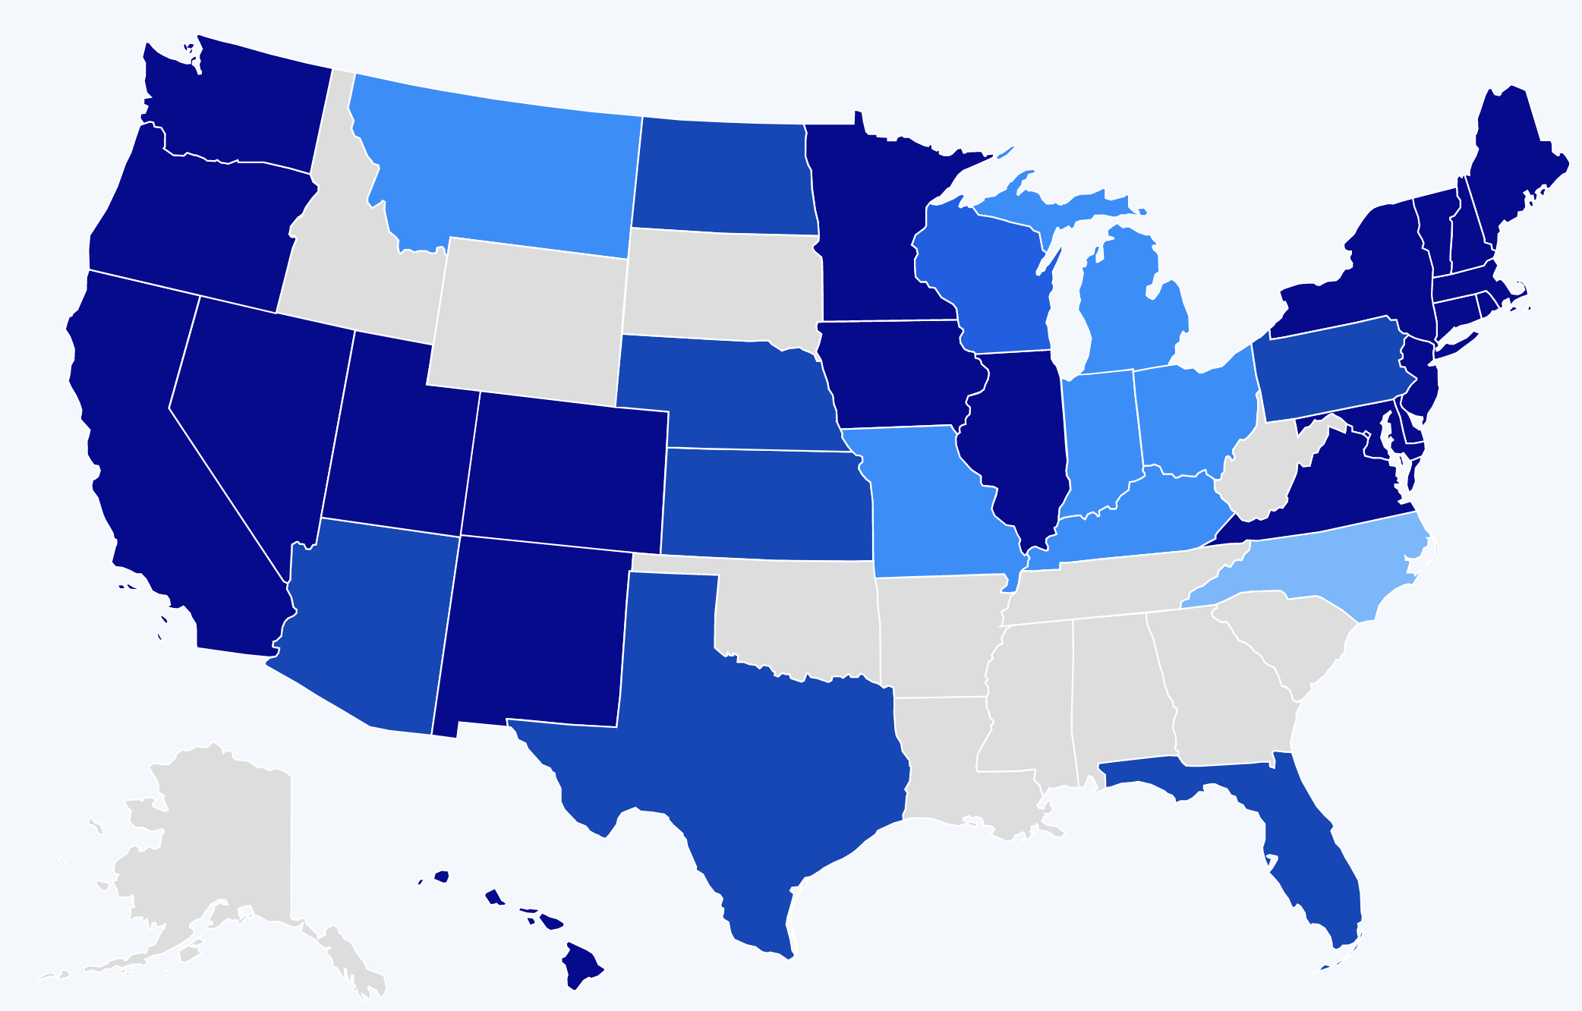
A HISTORY OF BARRIERS
In 2019, Just 22 States + DC Prohibited Workplace Discrimination Based On Sexual Orientation And Gender Identity.
Source: Human Rights Campaign
46
Notes:
US history is full of barriers for BIPOC and LGBTQ+ people. Discrimination because of one’s race and LGBTQ+ identity means lost wages, jobs, promotions, unfair treatment and even harassment at work. This discrimination compels many to hide their LGBTQ+ status for fear of retribution, losing one’s livelihood, support system, and more.
Before 2019, only a handful of states (in dark blue above) provided LGBTQ+ people some protection against employment discrimination, as well as in housing and public accommodations. This meant that in all the other states (those in tan and lighter shades of blue), LGBTQ+ people could be denied jobs, health care, housing, hotels, and more. This discrimination – across the majority of the US, and nearly all of the South— was perfectly legal.

Slide 47
A LANDMARK RULING
Bostock v. Clayton County
Prior to June 15, 2020
It was legal to fire an employee for being gay, bisexual or transgender, in more than half of the 50 states.
June 15, 2020
The Supreme Court rules it is illegal to discriminate against
or fire an employee based on their sexual orientation or gender identity.
47
Notes:
The Civil Rights Act of 1964 prohibits discrimination based on race, color, religion, sex, or national origin. The courts and the federal government have long refused to recognize LGBTQ+ discrimination as a form of sex discrimination. Over the past 20 years, however, federal courts and the government have at times recognized LGBTQ+ discrimination as sex discrimination.
It was not until June 15, 2020 that the Supreme Court finally recognized that LGBTQ+ employment discrimination is prohibited sex discrimination under Title VII of the Civil Rights Act of 1964.
This ruling recognized that it is illegal to discriminate against or fire an employee based on their sexual orientation or gender identity. Now lower federal courts and the Biden Administration are applying that ruling to education, health care, housing, credit discrimination, and more.

Slide 48
THE BOSTOCK RULING
Employment Discrimination is Illegal
Title VII of the 1964 Civil Rights Act prohibits employment discrimination based on race, color, religion, sex and national origin. Bostock interprets “sex” to include gender identity and sexual orientation.
48
Notes:
The Bostock ruling specifically states that employment discrimination on the basis of gender identity and sexual orientation is illegal.
Title VII of the Civil Rights Act covers the full spectrum of employment decisions, including recruitment, selections, terminations, and other actions concerning terms and conditions of employment. This is significant for the LGBTQ+ community because, as we saw, in many states it was legal to be denied an interview or a promotion, and even to be fired because of one’s gender identity or sexual orientation.

Slide 49
THE BOSTOCK RULING
Discrimination in Educational
Programs is Illegal
Title IX of the Education Amendments Act of 1972 states: "No person in the United States shall, on the basis of sex, be excluded from participation in, be denied the benefits of, or be subjected to discrimination under any education program or activity receiving Federal financial assistance."
49
Notes:
On March 26, 2021, the Department of Justice concluded that, as a result of the Bostock ruling, Title IX of the Education Amendments Act of 1972 also prohibits sexual-orientation and gender-identity discrimination in educational institutions that receive federal funding. This means all public schools. This means that students cannot be discriminated against in schools based on their LGBTQ+ identity.
There have been some significant wins recently for LGBTQ+ rights in the US But while progress is being made, attacks on LGBTQ+ rights in certain states have accelerated.
Reference: Department of Justice, “Application of Bostock v. Clayton County to Title IX of the Education Amendments of 1972,” March 26, 2021, https://www.justice.gov/crt/page/file/1383026/download

Slide 50
WHAT WE KNOW TODAY
The Bostock ruling only applies to employment discrimination.
Discrimination in other areas (e.g., housing) is still legal in many states.
The Equality Act – a federal law currently stalled in Congress - would end discrimination across all areas for LGBTQ+ people.
50
Notes:
Key Notes
Bostock only applies to employers with more than 15 employees. Employers with fewer than 15 total employees are not covered by Title VII.
Bostock applies nationwide and protects employees from sexual orientation or gender identity discrimination regardless of state or local laws.
An employer covered by Title VII is not allowed to fire, refuse to hire, or take assignments away from someone (or discriminate in any other way) because customers or clients would prefer to work with people who have a different sexual orientation or gender identity. (For example, keeping LGBTQ+ employees out of public-facing positions.)
Although accidental misuse of a transgender employee’s preferred name and pronouns does not violate Title VII, intentionally and repeatedly using the wrong name and pronouns to refer to a transgender employee could contribute to an unlawful hostile work environment.

Slide 51
A WELCOMING WORKPLACE
A welcoming workplace includes:
Non-Discrimination and a “Right to be Out”
Right to Self-Identification
Inclusive & Accessible Facilities
Inclusive Employment Benefits
Intentionally Building an Inclusive School Culture
Inclusive Contracts & Collective Bargaining
Visibility & Representation of Diverse Identities (e.g. race, sexual orientation, gender, ability, etc.) across all Levels
Intentional Hiring Practices & Representation in the Workplace
Hiqh Quality Professional Development around LGBTQ+ Identities
Often formal policies are required to enforce these features of a welcoming workplace.
51
Notes:
5 mins break out
Which of these stood out to you?
Which of these have you seen done well in the schools you support? Which of these have you not seen done well?

Slide 52
A WELCOMING WORKPLACE
Debrief
Which of these stood out to you?
Which of these have you seen done well in the schools you support?
Which of these have you not seen done well?
52
Notes:
5 mins debrief
Which of these stood out to you?
Which of these have you seen done well in the schools you support? Which of these have you not seen done well?

Slide 53
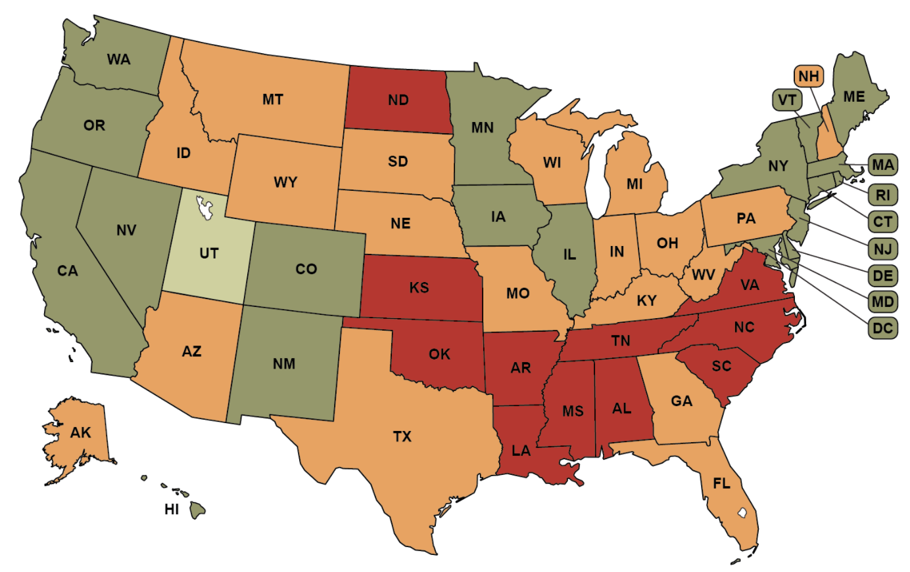
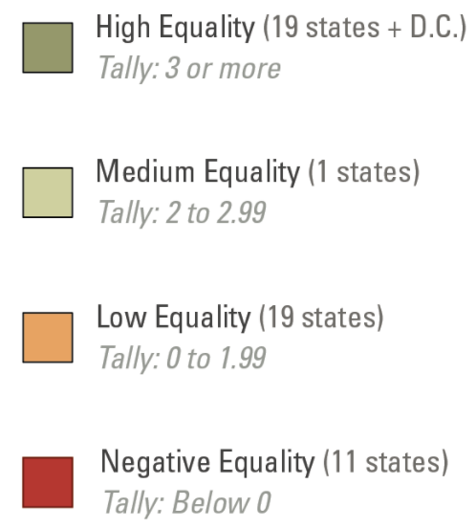
NON-DISCRIMINATION LAWS
The Bostock ruling prohibits discrimination in employment and education, but transgender individuals still face other forms of discrimination.
Source: Movement Advancement Project
Notes:
The map is already changed
We should all feel like “red”- these are changing constantly
Bostock only employment- not housing, credit, etc.
The Movement Advancement Project (MAP) is an excellent resource to learn more about state laws regarding LGBTQ+ topics.
State non-discrimination laws prohibit discrimination based on gender identity and sexual orientation in a number of areas – specifically employment, housing, public accommodations and credit.
Transgender individuals still face discrimination as it relates to housing (it is not illegal to evict someone because they’re transgender), credit and lending laws, and public accommodations. Transgender individuals can still face refusal of service, verbal harassment, or being physically attacked in many states due to their identity, and not be protected by law.
Some states have passed laws that limit non-discrimination protections through religious exemption laws and through laws that preemptively ban cities and counties from passing their own non-discrimination legislation.
Map 2019
Source -https://www.lgbtmap.org/file/mapping-trans-equality-infographic-non-discrimination.png

Slide 54
SCENARIO
You are a Uniserv Director in a medium-sized conservative school district. A member reaches out to you and asks for your help. She explains to you that she is a returning employee who is transgender and began transitioning over the summer break. She is nervous about coming back in the fall and is asking for your help in navigating her return.

Slide 55
SCENARIO - DEBRIEF
What additional information would you like?
What would be your first steps?
What resources would you use?

Slide 56

Q & A
THANK YOU FOR YOUR PARTICIPATION!
Please place any questions in the chat, particularly those that may help us develop and focus our larger 3-day session.
Interested in learning more?
September 27-29, 2022
Location: TBD
56

Slide 57
NBI 32 Training Series:
LGBTQUIA+ 101
Session 3: How to Support Transgender Educators in an Anti-LGBTQ+ Climate
Presented by:
Ben West, Linda Torres , Jeny Gardner, Colleen O’Connell, Grat Dalton, Michelle Couture, Sara Fitouri, Bekah Saxon, Barbera Whitman
Notes:
Ben

Slide 58
Notes:
Ben

Slide 59
Land Acknowledgement
We begin by acknowledging that we meet on the traditional lands served by the Chumash, Susquehannock, and Monacan people. We honor America’s First People and all elders, past, present and emerging and we are called on to learn and share what we learn about the tribal history, culture, and contributions that have been suppressed in telling the story of America. We invite you to think about the spaces you are inhabiting and the Indigenous people who came before them and were stewards of the land.
59
Notes:
Ben
Ben – Chumash
Linda – Susquehannock
Bekah - Monacan

Slide 60
WHY SHARE PRONOUNS?
You can’t just assume by looking.
Asking and correctly using someone's pronouns is the easiest way to show your respect for their gender identity.
Wrong pronouns use can make a person feel disrespected, invalidated, dismissed, alienated, or dysphoric (or, often, all of the above.)
It is a privilege to not have to worry about which pronouns someone is going to use for you.
Notes:
Ben
- encourage, forcing is not inclusive

Slide 61
COMMUNITY AGREEMENTS
Share Responsibility for the Success of Each Learning Session
Move up, Move back
Respect Confidentiality
Be Responsible for Building Deep Understanding
  Be timely with your presence, your speaking, and your listening
  Be fully present with speakers, open to new perspectives, and accept challenges
  Place tech on silent and stay checked-in
  Share using "I" statements
  Connect to your core values and speak from your heart
Expect and Accept Imperfection
Expect/accept non-closure – Agree to disagree
61
Notes:
Ben

Slide 62
660
WHAT’S THE SIGNIFICANCE?
62
Notes:
Bekah
Can you guess what this number represents?
As of June 6, 2022, this is the number of LGBTQ+ legislation items the HRC tracked for the 2022 state legislative sessions.
~152 bills are affirming and support LGBTQ+ individuals
~341 are harmful to LGBTQ+ individuals and/or their families
~143 are anti-trans (40 healthcare bans, 76 sports bans, 15 bathroom bills), ~80 are discriminatory education bills, ~34 are religious refusal bills

Slide 63
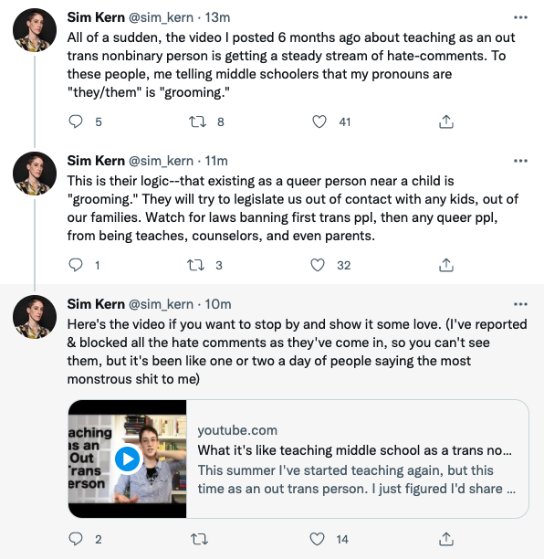
IMPACT ON EDUCATORS
Notes:
Bekah
The coordinated attacks on LGBTQ+ individuals include providing people scripts that denounce teaching topics such as transgender rights, banning books from well known authors, and labeling inclusive and culturally responsive instruction as “critical race theory.” Unfortunately, these efforts have been effective.
As we see in this Twitter thread, a post from an out trans person, who six months ago shared their experience of teaching in middle school, is now accused of “grooming” students by sharing their pronouns.

Slide 64
THE IMPACT ON UNISERV STAFF
Break Out Group-5 minutes
How does anti-LGBTQ+ and CRT legislation impact UniServ members and their work
in the field?
Notes:
Bekah 2:40
How does anti-LGBTQ+ and anti-CRT legislation work to impact UniServ members?
Hostile climates
Forced silence
There is an “elephant” in the room
Walking on eggshells about what to say, what if a student interprets something one way and tells their parents who complain?
Fear of parents
Create an environment where you’re forced to ignore the current reality of many students.
Discuss:
Recent and pending laws will silence LGBTQ+ topics in schools, silence discussion of gender and gender identity, silence the history and lived experiences of BIPOC students (currently the majority of all public school students), while creating barriers for transgender individuals who seek to transition, and more. What will be the impact of these laws?
What is the impact of these combined efforts on UniServ staff who are BIPOC and/or LGBTQ+?

Slide 65
DEBRIEF
What information was surprising to you?
How many degrees of separation exist between the work and the legislation?
Notes:
Bekah 2:45

Slide 66
Language
Notes:
Linda
Let’s talk about language. The words we use, and the meaning behind them can clarify or conveniently disguise the real intention. Let’s look at how language is used in the new and proposed legislation that can create a minefield for educators - especially those who are LGBTQ+.

Slide 67
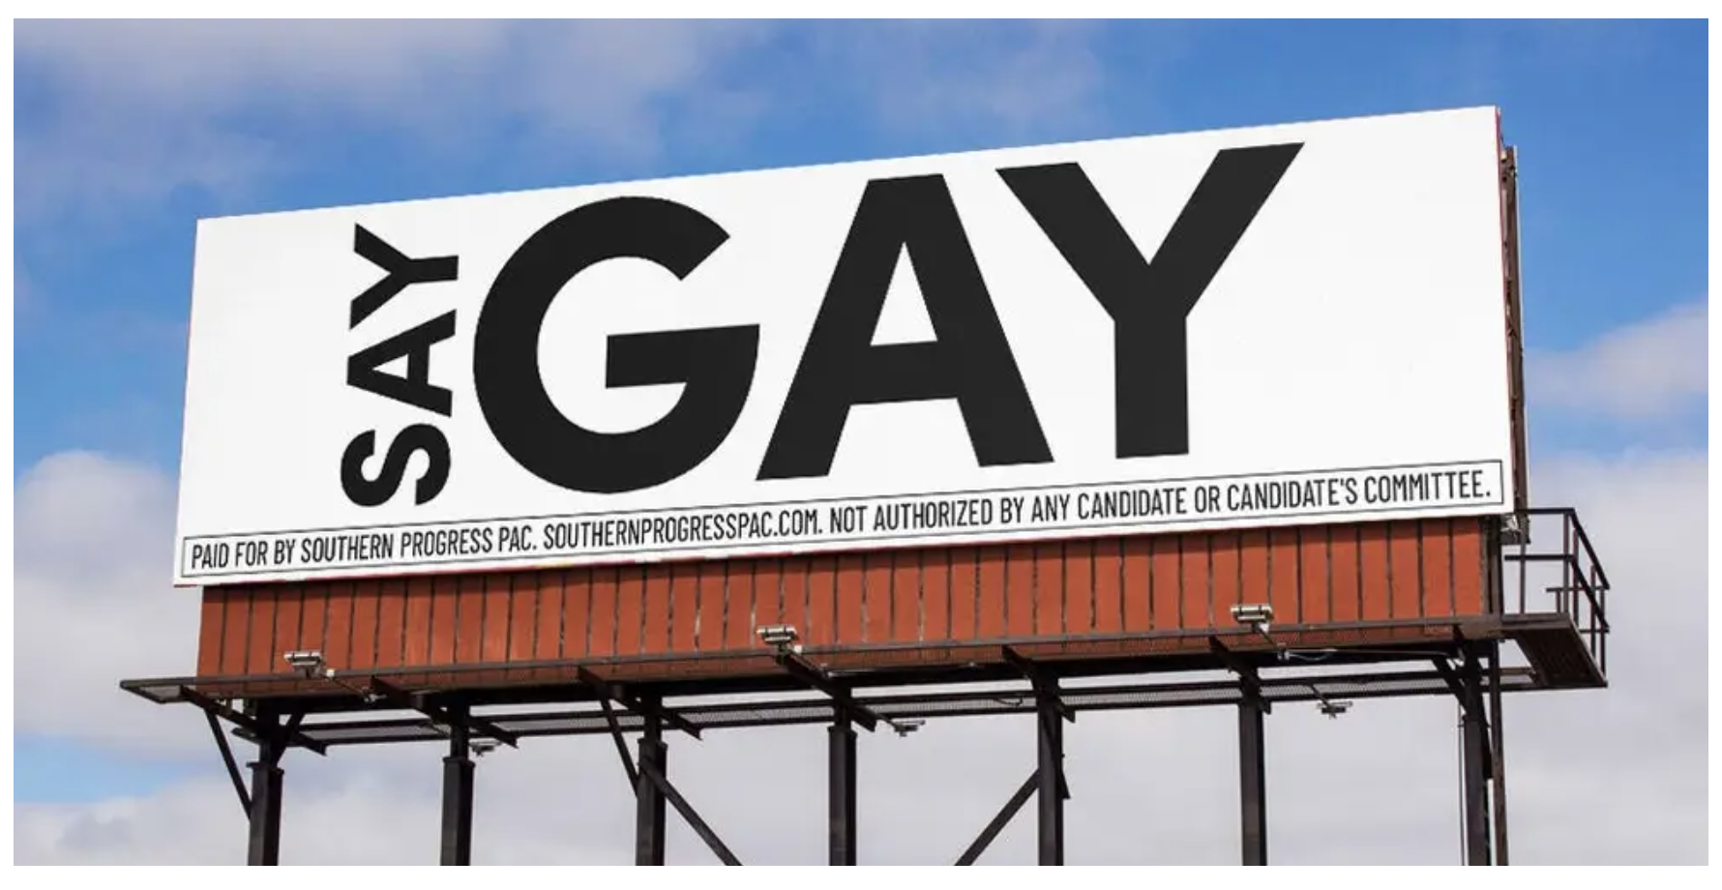
LANGUAGE & NEW LAWS
Notes:
Linda
OVERT–Easy to identify
Don’t Say Gay bills to limit discussion of LGBTQ topics in schools
These bills would limit the discussion of sexual orientation and gender identity in schools. Some are aimed at “curriculum” only and claim they do not stifle discussion in general, most include language about “age-appropriate” and “developmentally appropriate” content without defining what those are, and some prohibit teachers and other school employees from discussing their own sexual orientation or gender identity.
Florida’s HB 1557 “limits classroom instruction by school personnel or third parties on sexual orientation or gender identity in K-3, or in a manner not age or developmentally appropriate” which is what opens it up to being used against teachers in higher grades.
Louisiana’s HB 837 would ban the discussion of SOGI in K-8th grade classrooms and ban teachers from discussing their own lives with K-12 student.
Image Source: https://www.businessinsider.com/florida-dont-say-gay-ron-desantis-anti-lgbtq-trans-2022-3

Slide 68
ANTI-CRT & ANTI-LGBTQ+ BILLS
“…ban K-12 schools and college from teaching, including in curricula, or compelling student to adopt or affirm certain ideas about American history, race, sex or other characteristics.”
Notes:
Linda
Most of these bills include language to “ban K-12 schools and college from teaching, including in curricula, or compelling student to adopt or affirm certain ideas about American history, race, sex or other characteristics.”
Some include language that prohibits “requiring or encouraging employees to attend workshops or training where such ideas are promoted.” Often the language is vague using terms such as “controversial issues of public policy or social affairs”, “divisive concepts”, or “cynical forms of social analysis”, or “anti-American sentiments”.
Some of these bill are:
Alabama’s HB 312
Arizona’s HCR 2001 (a proposed amendment to the state constitution)
Florida’s HB 7 / SB 148
Iowa’s HB 2053
Kansas’s HB 2662 which “bars K-12 schools from displaying, presenting, or distributing to students, any material containing “sexual conduct”. “Sexual conduct” is defined in the bill a including any discription of homosexuality.
Kentucky’s HB 487
Missouri’s HB 2827, which includes language about “nonindoctrination principles”
Oklahoma’s SB 1141
Tennessee’s SB 2290/HB 2670
Virginia’s HB 787

Slide 69
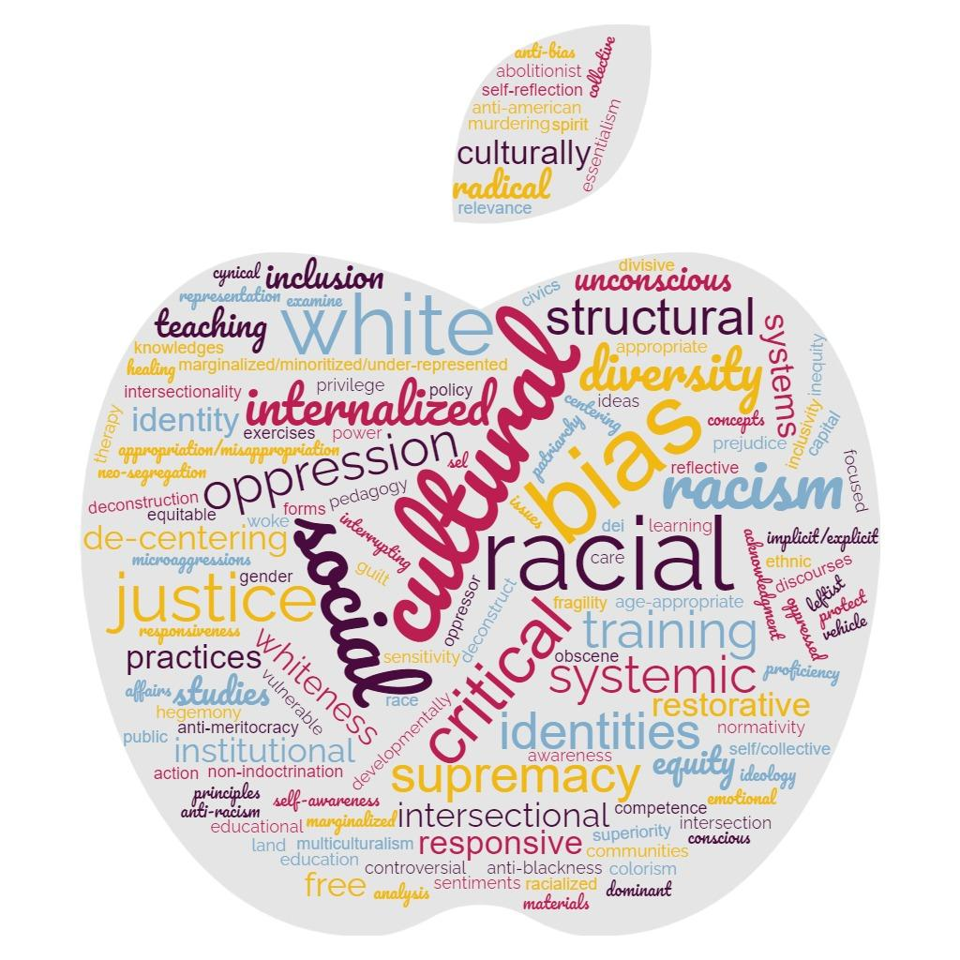
THE IMPACT ON UNISERV STAFF
Coded Language
Notes:
Linda
Not every bill comes across as overtly as what we just described. Politicians have become incredibly savvy so they can sell what they know is hateful content…
An example many of us have begun to see deals with novels and supplemental materials. The rally cry is to ban books with explicit sexual content or sexual content at all. In reality, they aren't looking to ban canonical novels that have sex in them. Instead, they are looking to ban books that feature or highlight LGBTQ+ relationships, explicitly sexual or not.

Slide 70
THE IMPACT ON UNISERV STAFF
CODED LANGUAGE
“cynical forms of social analysis”
“divisive concepts”
“controversial issues of public policy or social affairs”
“anti-American sentiments”
“Non-indoctrination principles”
“age-appropriate”
“developmentally appropriate”
“obscene materials”
“a vehicle for leftist ideas”
“gender ideology”
Notes:
Bekah
(This can be an activity)
How would you rephrase this language back to someone to help people understand what’s really at stake and clarify what they’re actually talking about?
For example, the complaint: “I don’t want you indoctrinating my child with your gender ideology. You’re teaching gender confusion.”
Generates this response: “We’re teaching respect for the variety of gender identities, and the variances in gender.”
Or,
“Talking about diversity, equity and inclusion is a leftist tactic to introduce divisive concepts.”
Becomes, “Discussing the different experiences of people across the US, and how our institutions impact them creates an opportunity to make our country/community better.”
Keep this tied to UniServ members:
What is the impact of these efforts on UniServ staff who are BIPOC and/or LGBTQ+?
What situations might this create for them?
WRAP UP:
We have seen that some of these bills will pass (Florida’s already has, but several others could within the next two months). Even in states where they don’t pass, the principles contained in the bills and a few other tactics are being used to intimidate educators into compliance or silence.
School boards are attempting to pass similar policies, lawsuits are being filed against schools and individual teachers, and in some places, other methods of intimidation are being used against teachers or school board members who speak up to stop them.
Let’s look at some of the tactics being used to shut down conversation…

Slide 71
BREAKOUT (10 minutes)
How would you rephrase this language back to someone to help people understand what’s really at stake and clarify what they’re actually talking about?
Example, the complaint: “I don’t want you indoctrinating my child with your gender ideology. You’re teaching gender confusion.”
Generates the response: “We’re teaching respect for the variety of gender identities, and the variances in gender.”
Talking about diversity, equity and inclusion is a leftist tactic to introduce divisive concepts.
Any of your own?
https://bit.ly/Breakout062722
Notes:
Bekah 3:00
How would you rephrase this language back to someone to help people understand what’s really at stake and clarify what they’re actually talking about?
For example, the complaint: “I don’t want you indoctrinating my child with your gender ideology. You’re teaching gender confusion.”
Generates this response: “We’re teaching respect for the variety of gender identities, and the variances in gender.”
Or,
“Talking about diversity, equity and inclusion is a leftist tactic to introduce divisive concepts.”
Becomes, “Discussing the different experiences of people across the US, and how our institutions impact them creates an opportunity to make our country/community better.”
Keep this tied to UniServ members:
What is the impact of these efforts on UniServ staff who are BIPOC and/or LGBTQ+?
What situations might this create for them?
WRAP UP:
We have seen that some of these bills will pass (Florida’s already has, but several others could within the next two months). Even in states where they don’t pass, the principles contained in the bills and a few other tactics are being used to intimidate educators into compliance or silence.
School boards are attempting to pass similar policies, lawsuits are being filed against schools and individual teachers, and in some places, other methods of intimidation are being used against teachers or school board members who speak up to stop them.
Let’s look at some of the tactics being used to shut down conversation…

Slide 72
DEBRIEF
What examples surprised you?
What other topics get linked to LGBTQ+ fear?
Notes:
Bekah 3:15

Slide 73
HARMFUL BILLS PASSED IN 2022
11 Anti-trans sports bans — AZ, GA, IA, IN, KY, OK, SC, SD, TN, UT, LA (joining ID, TX)
8 curriculum censorship and/or anti-LGBTQ+ education provisions — AL, FL (3), GA (3), SD, TN
2 anti-trans “bathroom bills” — AL (includes “don’t say gay” provision)
Notes:
Ben
So far in 2022, almost two dozen anti-LGBTQ+ bills have been passed and signed by governors.
2 bills were passed but vetoed — A Kansas anti-trans sports bill and a Wisconsin bill that would have allowed lawsuits to be filed against school districts or school officials by parents over the use of a students’ chosen name/pronouns
Similar bills are still pending in North Carolina and Ohio

Slide 74
AFFIRMING BILLS
BUT THERE IS HOPE!
152 Bills currently exist that are AFFIRMING.
“This act prohibits discrimination based upon a person's sexual orientation or gender identity.”
Notes:
Ben
This language is often the introductory sentence in bills that affirm LGBTQ+ adults in several states, including:
Missouri — SB711
Kansas — HB 2665
West Virginia — Hb 2538, HB 2697, SB 156
Missouri — SB 711, HB 1737
Nebraska — LB 230
Indiana — SB 128
Kentucky — HB 11, HB 15
North Carolina — H 240, S 396
Ohio — HB 208, SB 119

Slide 75
ANTI-DEI TRAINING BILLS
“Under this bill, school districts and charter schools shall publish on their websites all training materials used for staff and faculty training, all instructional materials, and all curricular materials related to nondiscrimination, diversity, equity, inclusion, race, ethnicity, sex, or bias…”
Notes:
Linda
THIS TRANSITION IS A JUMP! Need to go from there is hope to "While there is hope, the covert attacks still exist. The good news is that these bills are overreaching in such a way that even the most LGBTQ+ hater folks will balk at the requirements. And we need to use that."
These bills are designed to force schools to publish the materials from any DEI professional development training that educators attend.
One example, Missouri’s HB 2189 says “Under this bill, school districts and charter schools shall publish on their websites all training materials used for staff and faculty training, all instructional materials, and all curricular materials related to nondiscrimination, diversity, equity, inclusion, race, ethnicity, sex, or bias, including certain information as described in the bill related to instructional materials and curricular materials.”

Slide 76
ADDITIONAL BILLS
Mandate the posting of a full year’s lesson plans
Mandate cameras in the classroom
Allow teachers to misgender students
Prohibit “certain” books in school libraries
Limit access to public accommodations for trans people
Notes:
Linda
Bills have been proposed in 17 states that would require teachers to publish their lesson plans a full year in advance to expand “parents’ rights” in knowing what students will be taught. The bills specify that every book, reading, handout, video, or activity used in lessons must be posted in addition to a general syllabi.
Additional proposed bills (listed on the slide) highlight the length many local and state legislators will go to restrict conversations about LGBTQ+ topics, race, equity and inclusion – all in an increasingly diverse nation.
Colorado HB 1066
Indiana HB 1134
Kansas HB 2662
Michigan HB 5722
Bills to mandate cameras in the classroom
Conservative lawmakers concerned about Critical Race Theory or “gender ideology” being taught in classrooms, have introduced bills that would require cameras be placed in every public school classroom, except for PE and special education classes. Some of the bills would require teachers to wear body cameras to make sure teachers are “teaching the kids properly.”
These bills include Iowa’s HF 2177, Florida’s HB 1055.
https://www.nbcnews.com/politics/politics-news/iowa-bill-require-cameras-public-school-classrooms-rcna14789
Bills to protect teachers from punishment if they refuse to use a trans person’s name/pronouns
These bills specify that a teacher or other employee of a public school or school district is not required to refer to a student using the student’s “preferred” pronoun if the pronoun does not align with the student’s biological sex. The bills also insulate the adult from liability or adverse employment action.
Tennessee HB 2633
· “Parent Bill of Rights” — calls to allow parents to examine all lesson plans on demand and provide new ways to file complaints against teachers
Arizona HB 2161
Kansas SB 496
New Hampshire (!!!) HB 1431
Tennessee HB 2451
· Bills prohibiting schools and school libraries from maintaining or promoting “certain” books or “obscene materials” including books with LGBTQ protagonists or themes
Arizona HB 2495
Oklahoma SB 1142
Tennessee HB 1944 and SB 2407
· Educators required to out LGBTQ students or risk being fired
Alabama HB 1/SB 10 (note that lower numbers tend to indicate priority bills)
· Bathroom bills — limiting access to trans people in public accommodations
Even though the “trans people in bathrooms” hysteria died down after so many bills died in 2017, bills are back this year to designate sex-segregated facilities in public accomodations. Most of these bills are labeled “emergency” bills in their states.
Alabama Alabama HB 1/SB 10, HB 322 and HR 83
MIssissippi SB 2679 and SB 1164
Oklahoma SB 1249
South Dakota HB 1005
· Birth certificate bills — limiting a person’s ability to update the gender marker on their birth certificate or other state-issued IDs
Mississippi SB 2356
Oklahoma SB 1100

Slide 77
ORGANIZING AROUND BILLS
Breakout (10 minutes):
What broad legislation or policies have you heard about in your state that loosely relates to LGBTQ+ issues?
How could organizing around these issues create an environment that better supports our transgender educators and those educators that overtly support them?
Notes:
Linda - 3:35

Slide 78
DEBRIEF
Share out what you learned?
What great ideas can you bring home to empower your locals to organize around these issues?
Notes:
Linda - 3:45

Slide 79
KEY POINTS
In the absence of federal law that protects LGBTQ+ individuals, states are rushing to pass legislation.
State laws range from being affirming to harmful of LGBTQ+ individuals & their families and often use coded language.
We have an opportunity to organize even reluctant members around this issue, particularly those pieces of legislation that have the potential to change teaching for all educators.
Notes:
Bekah
Well funded political groups have launched a coordinated and strategic approach to overwhelm and see what legislation sticks regarding harmful legislation.
Local School boards & the public education system have become a focus for advancing anti-LGBTQ+ policies
While children of color make up the majority of U.S. public school students, policies that affirm their histories and lived experiences are not centered in local and state legislation.

Slide 80
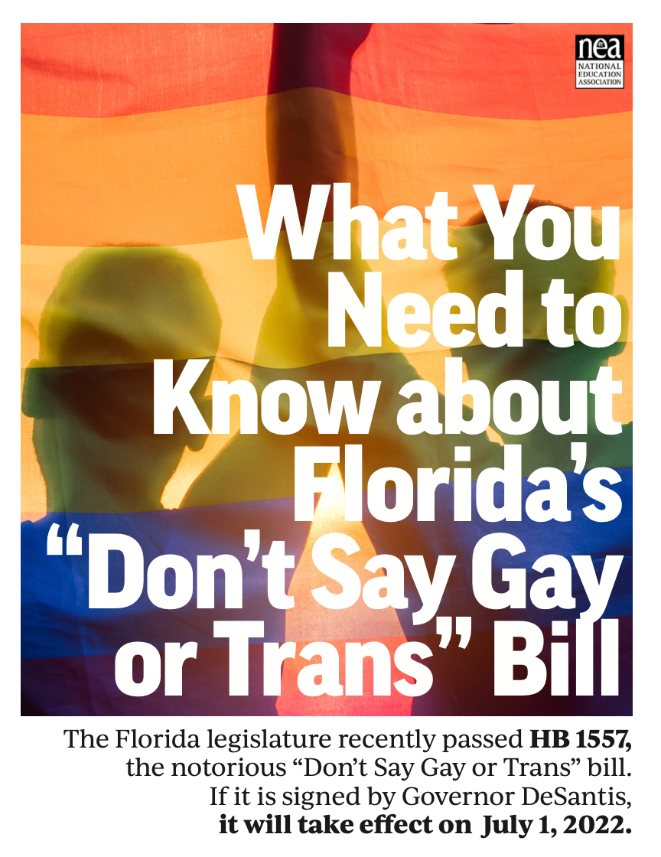




NEA RESOURCES
Legislative Trackers
Notes:
Bekah
The NEA has several resources and recommendations for legislative trackers. (See handout for full list and website links.)
https://www.icnl.org/usprotestlawtracker/
https://www.aclu.org/legislation-affecting-lgbtq-rights-across-country

Slide 81
Q & A
THANK YOU FOR YOUR PARTICIPATION!
Please place any questions in the chat, particularly those that may help us develop and focus our larger 3-day session.
Interested in learning more?
September 27-29, 2022
Location: TBD
81
Notes:
Bekah

Slide 82
EXTRA
SLIDES

Slide 83
SOCIAL EMOTIONAL LEARNING
“No public school district, charter school, or virtual charter school teacher, administrator, counselor, employee, or volunteer shall use any curricula with content related to social emotional learning in the training, instruction, or education of students…or face a penalty of 5% of the state aid for the previous year.”
Notes:
Let’s tie it to SOcial EMotional Learning or another pedagogical strategy…
Some conservative legislators have tied critical race theory to other types of curriculum and seek to further restrict what students learn about in the classroom. “Social-emotional learning” is one of the kinds of education that they oppose.
Oklahoma’s Sb 1442 (an excerpt is on the slide) is one bill that specifically targets this kind of education.
http://webserver1.lsb.state.ok.us/cf_pdf/2021-22%20int/SB/SB1442%20int.pdf
The sponsor of a similar bill, Oklahoma SB 1125, said, “diversity, equity and inclusion” training for teachers is a vehicle for leftist ideas. “It’s not core curriculum,” Bullard said. “DEI is diversity, equity, inclusion. Those are all buzzwords for the different leftist agendas that are out there. If your community is fine with that, that’s their choice but they need to know how much you’re spending on it and what they’re teaching.”

Slide 84
STATE & LOCAL LAWS ON THE RISE
In the absence of federal law that protects LGBTQ+ individuals, states are rushing to pass legislation.
State laws range from being affirming to harmful of LGBTQ+ individuals & their families.
Local School Boards have joined in passing policies that affirm or further marginalize/erase the history and lived experiences of LGBTQ+ and BIPOC students.
Notes:
Well funded political groups have launched a coordinated and strategic approach to overwhelm and see what legislation sticks regarding harmful legislation.
Local School boards & the public education system have become a focus for advancing anti-LGBTQ+ policies
While children of color make up the majority of U.S. public school students, policies that affirm their histories and lived experiences are not centered in local and state legislation.

Slide 85
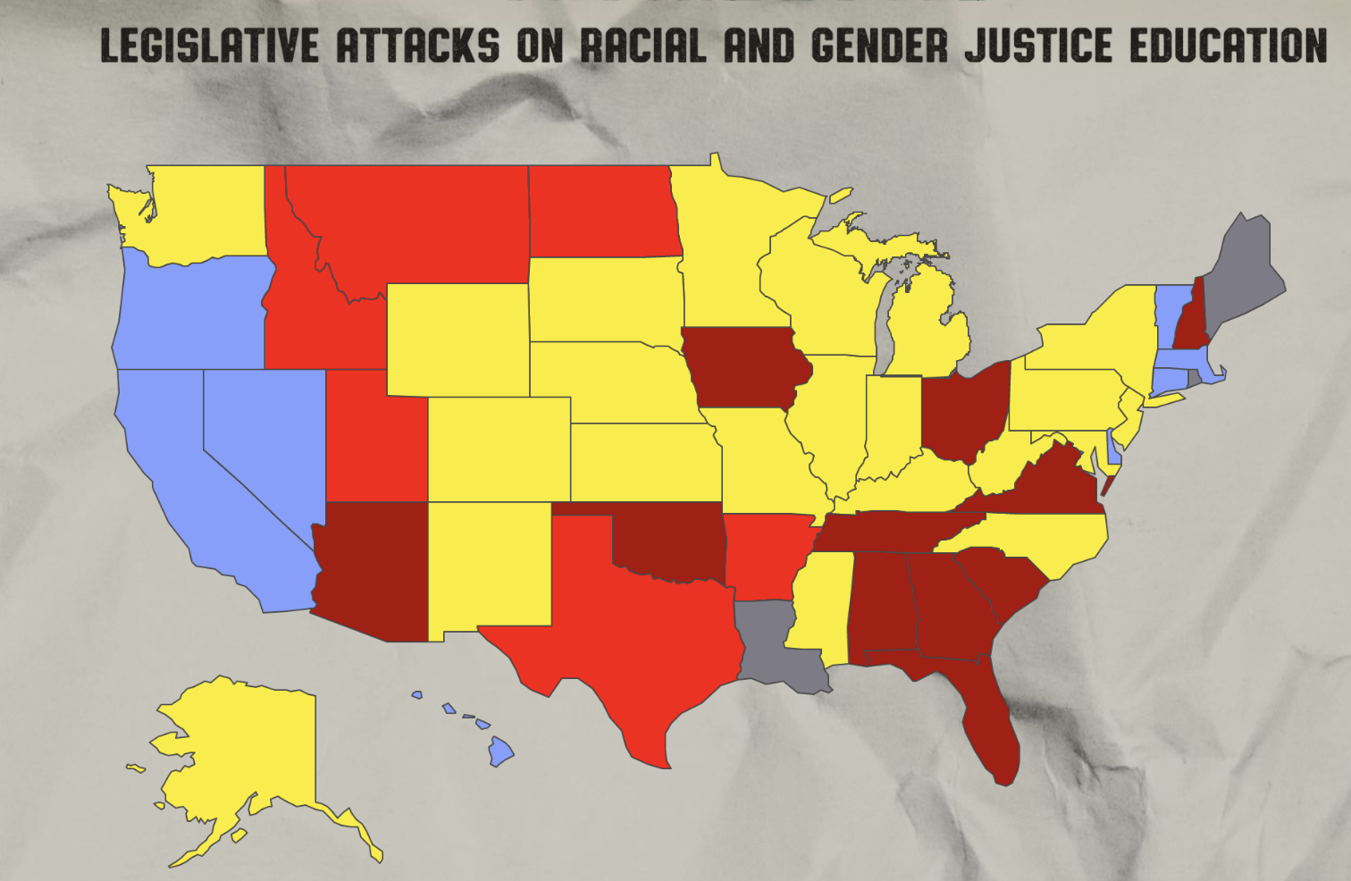

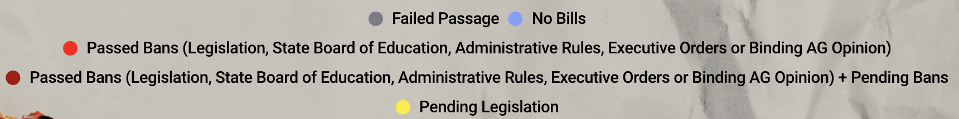
RACIAL & GENDER JUSTICE AT RISK
Notes:
This map from the African American Policy Forum shows just how urgent the need is to halt the passage of laws that put racial and gender justice at risk.
Take a look at this map. What do you notice?

Slide 86
How to Create Welcoming Workplaces for Trans & Transitioning Staff
Notes:
Now that we’ve discussed key LGBTQ+ terms, and what it means to transition, let’s look at how we can create welcoming workplaces for transgender and transitioning staff.

Slide 87
THE WORDS OF NEA MEMBERS
“Try to think of a time when you were discriminated against. Imagine what it must be like if the world wanted you gone because you are left handed or too tall, etc. Diversity is an essential part of nature and we all benefit when we realize that we are not clones of an imaginary perfect human. Empathy towards others is the key
to a peaceful planet.”
87
Notes:
This quote is from an NEA member with a message for non-LGBTQ+ educators.

Slide 88
THE WORDS OF NEA MEMBERS
“I’m almost entirely closeted at school because some individuals in my building have a record of making homophobic and transphobic statements. I do not feel comfortable being out in that environment.”

Slide 89
Top 5 Features of Inclusive LGBTQ+
Workplace Policies:
INCLUSIVE POLICIES
Protections against discrimination or harassment.
1
89
Notes:
The non-discrimination policy of the school district and the collective bargaining agreement include more expansive protections against discrimination based on sexual orientation and gender identity/expression.
For example, policy language should include protection against discrimination on the basis of “race, color, religion, national origin, ancestry, sex, age, marital status, immigration status, disability, sexual orientation, gender identity, gender expression, gender characteristics, gender non-conformity, genetic information, familial status, status as transgender or transitioning, or participation in any professional educational organization or union.”
Today, LGBTQ+ educators have legal grounds for further action. In the absence of these protections (for example, before the US Supreme Court’s Bostock ruling), LGBTQ+ individuals had a difficult time filing claims because (in many states) there was no policy violation to call out.

Slide 90
Top 5 Features of Inclusive LGBTQ+
Workplace Policies:
INCLUSIVE POLICIES
2
Domestic partner benefits.
90
Notes:
The school board policy and collective bargaining agreement cover domestic partner benefits for employees who are in same-sex relationships.
Many employers have done away with this coverage since the Marriage Equality Act of 2015 made same-sex marriages legal in all 50 states.
Increasingly, same-sex couples are required to marry to receive company benefits that can include sick leave, long-term care insurance, life insurance, and more. Most employers now offer comprehensive health, vision, and dental insurance to employees and their spouses or partners.

Slide 91
Top 5 Features of Inclusive LGBTQ+
Workplace Policies:
INCLUSIVE POLICIES
Paid family leave for same-sex couples and in cases of adoption.
3
91
Notes:
The same rights that are afforded to heterosexual couples should be afforded to same-sex couples. This includes time to bond with a new child, to care for a family member, or to treat your own serious health condition.
In workplace policies, one way to do this is to degender the language of benefits. For example, instead of saying, “Husband or Wife” using the term “Spouse” is more gender neutral. Likewise, replacing “Maternity or Mother” with “Parental or Birthing Parent” is more gender inclusive – people of many gender identities can give birth to children!

Slide 92
Top 5 Features of Inclusive LGBTQ+
Workplace Policies:
INCLUSIVE POLICIES
Transgender-inclusive health benefits for employees and dependents.
4
92
Notes:
The school board policy and the collective bargaining agreements should include a health care plan that is inclusive of transgender employees.
Trans inclusive healthcare benefits must cover gender affirming surgeries and hormone treatments for trans individuals. And, trans individuals must be able to receive leave time for these surgeries, and not have them considered elective (and therefore ineligible for medical leave). This coverage should also include medications, mental health screenings and counseling.

Slide 93
Top 5 Features of Inclusive LGBTQ+
Workplace Policies:
INCLUSIVE POLICIES
District or union committees or employee resource groups.
5
93
Notes:
The school district or local association may also include a social justice or diversity committee. If such committees exist, they should be inclusive of LGBTQ+ issues. The committees should also focus on the intersectionality of race, gender, and sexual orientation.

Slide 94
TRANSITIONING AT WORK
Support Can Include:
Transition Plan
  Communication
  Absences
  Name, title & pronouns
  Training for co-workers and/or students
Leave Time
  Name Change
  Gender Affirming Medical Procedures & Treatment
94
Notes:
Supporting transitioning educators at work can include a number of actions. Namely a Transition Plan. This is designed to support the employee and avoid tensions or uncertainties that could arise without being proactive.
Transition Plans address aspects of transitioning that an employee wants to raise and often include communication (if any) that will be made to staff, students, and parents, absences that may relate to the transition, any changes in name, title and pronouns and training that may be needed for co-workers and/or students.
Support also includes providing for leave time for name changes, gender affirming treatment, and more.
Sources:
Colorado Resource (https://docs.google.com/document/d/1Qk9VejvX7M8IbXw-swiZFd9fKx3UzGV3omib2K3j764/edit?usp=sharing)
NEA edjustice (https://neaedjustice.org/pridewins/)
NEA LGBTQ+ Resources (https://www.nea.org/resource-library/nea-lgbtq-resources)

Slide 95
SUPPORT LGBTQ+ EDUCATORS
Advocate for LGBTQ+ Inclusive Policies.
Identify where current policies can be strengthened
Champion changes that would affirm LGBTQ+ educators
Help others learn about the benefits of inclusive policies
95
Notes:
There are many steps you can take to advocate for stronger protections for LGBTQ+ employees.
A first step is to advocate for LGBTQ+ affirming policies. Become a champion for inclusion and help all staff receive fair and equitable treatment.
(Invite conversation) How could you advocate for affirming LGBTQ+ policies in your school or district?

Slide 96
SUPPORT LGBTQ+ EDUCATORS
Ensure policies support the Racial Justice in Education Framework
Acknowledge how bias and systemic racism can affect workplace experiences for BIPOC educators.
Advocate for policies that provide equitable access to mentoring, promotions, and more.
Encourage your school/district to measure the impact of policies designed to promote equity.
96
Notes:
Earlier, we discussed the Racial Justice in Education Framework and its components of Awareness, Capacity Building, and Action. As you support LGBTQ+ educators, keep this framework in mind.
How can our policies support LGBTQ+ educators and serve as a tool for racial justice? Here are some considerations. (Read slide.)

Slide 97
SUPPORT LGBTQ+ EDUCATORS
Learn about the various issues &
laws related to LGBTQ+ topics.
What is being debated in local, state and federal courts?
How could these laws affect you, your co-workers & students?
What actions are LGBTQ+ advocates asking allies to take?
How can local school boards support LGBTQ+ educators?
97
Notes:
The NEA and our partners are excellent sources of information to help you learn about various issues and laws related to LGBTQ+ topics.
Our “Additional Resources” handout can help you learn about various issues, laws, and advocacy organizations. (Insert Link)

Slide 98
SUPPORT LGBTQ+ EDUCATORS
Don’t Make Assumptions
Do not make assumptions about someone’s gender identity or sexual orientation
Do not make assumptions about people’s personal lives
Normalize asking for pronouns
98
Notes:
We can support LGBTQ+ educators by not making assumptions. (Read slide.)

Slide 99
THE WORDS OF NEA MEMBERS
“Please understand that LGBTQ+ educators are human beings just like everyone else. Being LGBTQ+ is just one part of their identity.”
99

Slide 100
SUPPORT LGBTQ+ EDUCATORS
Display Visible Symbols of Support
Include LGBTQ+ individuals with intersecting identities in displays, wall art and other visible methods.
Post “Safe Zone” stickers in your workspace.
Highlight messages of inclusion and zero-tolerance for racist, homophobic and transphobic language and behaviors in your work.
100
Notes:
Another way to support LGBTQ+ educators is to create a welcoming environment in your workspace. One way to do this is to (read the slide).

Slide 101
SUPPORT LGBTQ+ EDUCATORS
Take action with your local association.
Identify ways you can support local efforts for inclusion
Participate in trainings and other activities to educate yourself
Show LGBTQ+ allyship within your sphere of influence
101
Notes:
At the local level, connect with your association to support activities they’re already pursuing. And if they are not currently taking action, ask how you can help get things off the ground or take the lead. This is a great way to build support for LGBTQ+ issues and expand your knowledge about the issues.

Slide 102
CFU – BREAKOUT SESSION
What Would You Do?
Scenario #1: Winter Break Transition
Scenario #2: Gender Expression
Scenario #3: Pronouns & Personal Titles
102
Notes:
In small groups, invite participants to discuss what they would do in one of the following scenarios:
Scenario #1: A trans educator plans to begin their physical transition during the winter break but was told the school offered no assistance. What would you do?
Scenario #2: A member recently told you, “I'm a gay man and want to wear full makeup to further embrace my gender expression.” What would you do?
Scenario #3: A 4th grade non-binary educator would like to be addressed as Mx. and use them/they pronouns. Parents are worried that the educator is “grooming” children. What would you do?

Slide 103
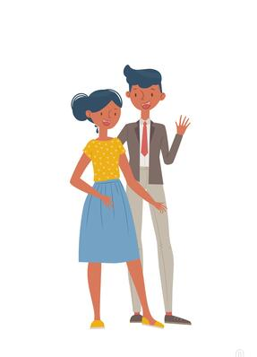
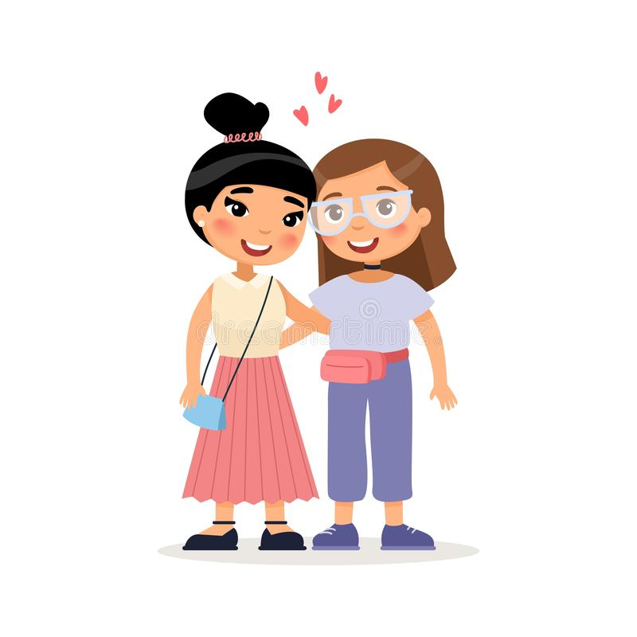

WHAT IS SEXUAL ORIENTATION?
Sexual orientation is who you are emotionally,
romantically, and/or physically attracted to.
Sexual orientation is not dependent on your gender.
103
Notes:
Sexual orientation is an important part of a person’s identity. It is not a decision that one makes, rather it is an awakening.
There are a variety of sexual orientations:
Heterosexual
Bisexual
Homosexual
Pansexual
Asexual
Even though sexual orientation is a private identity, it can be a source of public scorn and a basis for exclusionary practices and discrimination.

Slide 104
SEX VS. GENDER
SEX
Biological attributes that include physical features, chromosomes, internal and external reproductive organs, hormones, and anatomy.
GENDER
A person’s innermost, deeply held reality of self as male, female, both, in between or neither.
VS.
104
Notes:
Sex and Gender do NOT mean the same thing.
Our sex is determined by biological attributes such as chromosomes, hormones, reproductive organs, and other parts of our anatomy.
Gender is a person’s innermost, deeply held reality of self. It’s almost like being right-handed or left-handed. We don’t know why each person favors one hand over the other, but we all know that one just feels more correct for us. And, some people feel comfortable using either hand.
A person can have an inner reality of being male, female, both, neither, or somewhere in between.

Slide 105
GENDER
Gender
Identity
How you feel. Female, male, both, or neither.
Gender
Expression
The ways you show your gender identity.
Gender
Role
A social role based on a person’s sex.
105
Notes:
Gender, or gender identity, is that internal sense of self we just mentioned—the feeling of being male, female, both, neither, or somewhere in between.
Gender expression includes all the ways you show your gender to the world. For example, your hair and clothes, how you cross your legs, how you walk, and even your voice inflections. Some of these are innate, and some are learned from our cultural norms.
Gender roles are social constructs based on one’s sex or biological attributes. They can be very different from one culture to another. These roles can become so internalized that they create stereotypes or an implicit bias within us (e.g., assuming nurses are women, or mechanics are men).
Gender non-conforming simply means the person is breaking cultural or social rules about gender roles and/or expression.
There is a huge difference between not conforming to certain societal norms and expectations for one’s gender and having an internal identity that is not in alignment with one’s biological sex.
A Note About Phobias:
A phobia is a persistent, irrational and exaggerated fear of an object, person, activity, animal or situation. Homophobia is a fear of people who are gay and lesbian. Transphobia is a fear of people who are transgender. When someone’s identity challenges a person’s expectations or preconceived notions of male and female, they may go into a panic. The incongruence of what someone sees, and what they think creates fear and misunderstanding.
We say “i-dentity” because it’s about the individual and how they personally identify, not “you-dentity” because of how you want to determine someone else’s existence.

Slide 106

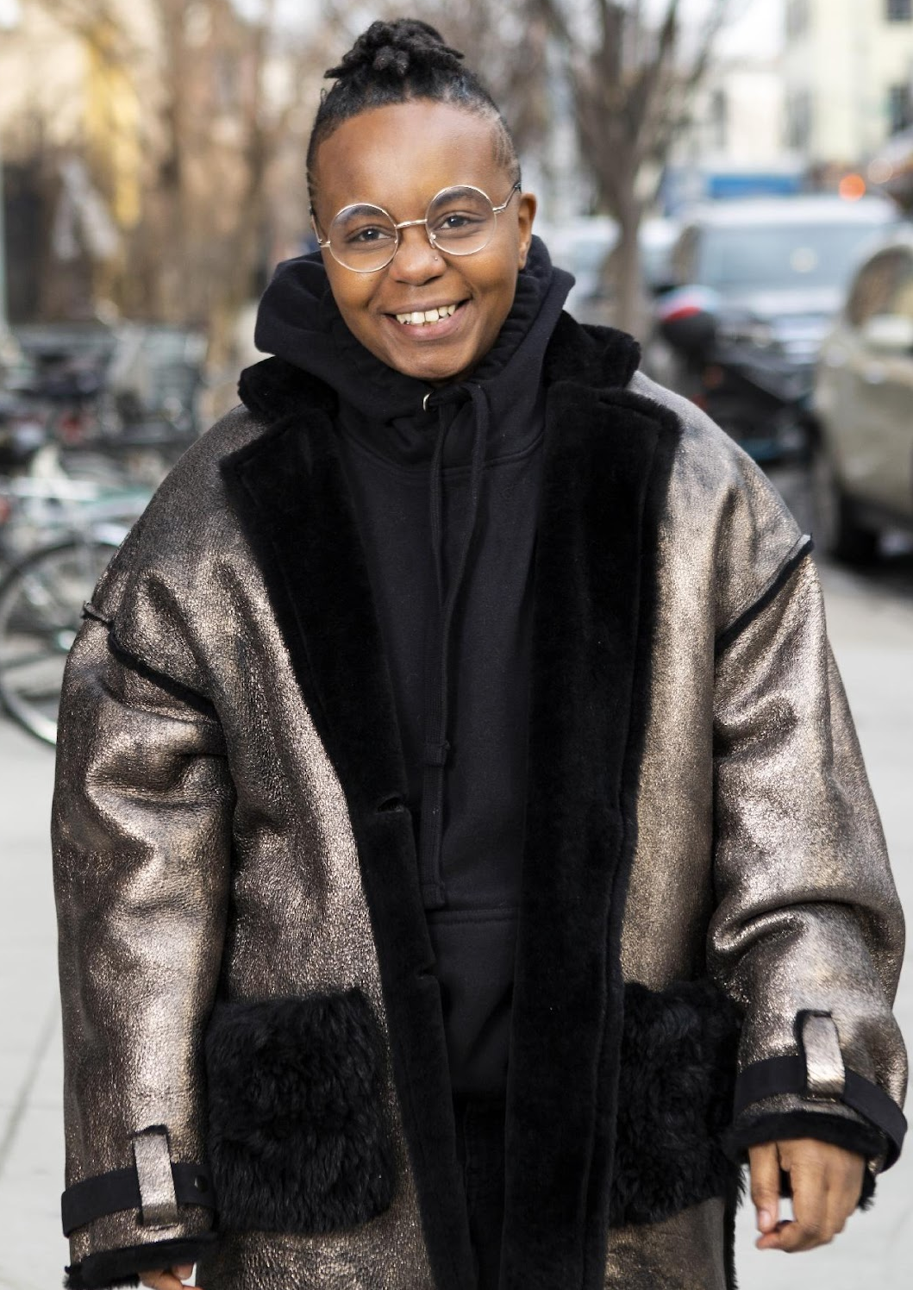

GENDER EXPRESSION
A transgender woman
in an office.
A transmasculine person in a winter coat.
A gender-fluid woman on a city sidewalk.
Photos courtesy of the Gender Spectrum Collection.
106
Notes:
Transgender, non-binary, and gender non-conforming individuals show their gender to the world in many ways. Just as cisgender people have different hairstyles, clothing choices, mannerisms, and more, the same is true for trans, non-binary, and gender-non-conforming people. There is no “one way” to look to be any gender.
These images are from the Gender Spectrum Collection – a group that works with trans and non-binary models. In the first image we see a transgender woman in an office. The second is a transmasculine person in a winter coat. Transmasculine is a term generally used for people who were born female at birth, but who identify with masculinity. As we can see in both of these two photos, they present within the gender binary of male and female.
In the last image, we see a gender-fluid woman. Gender fluid refers to a person who does not feel they have a fixed gender.

Slide 107
BINARY & NON-BINARY
Gender Identities
BINARY
NON-BINARY
MAN WOMAN
A person who does not identify exclusively as a woman or man. They may be both, somewhere in between, or outside the categories of woman and man.
107
Notes:
Binary and non-binary are two types of gender identities.
Gender is a social construct. What it means to be male and what it means to be female are concepts created by humans, and over time, those definitions and views became generally accepted by society at large. Most of us align with these long-standing definitions of male and female and feel comfortable saying so.
A non-binary person is someone who does not adhere to these gender expectations or stereotypes. The binary—being male or female—will feel very foreign to them.

Slide 108
BINARY & NON-BINARY
NON-BINARY
“It’s not that I don’t fit into being a man or woman.
I don’t see a difference.”
108
Notes:
For a non-binary person, their gender identity does not fit within the binary of male and female.
While we might see two separate colors, yellow and blue, a non-binary person may only see green. Someone who is agender (or who has no gender identity) might only see gray.
This is why non-binary is a gender identity and not a gender expression. Non-binary people are not attached to gender.

Slide 109
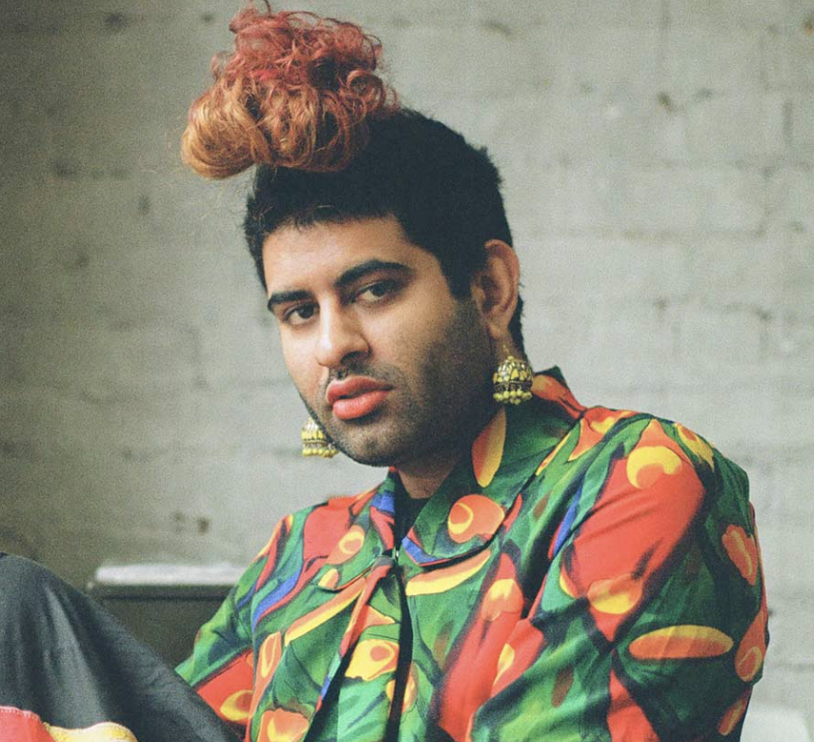
NON-BINARY VOICES
“Being non-binary isn’t just about being defined by my absence (I am not a man or a woman), but also by my abundance (I am far too expansive to be encapsulated by the gender binary). Being non-binary is about embracing my fluidity, my becoming, my journey without a fixed destination.”
Alok Vaid-Menon
(they/them)
109
Notes:
Here we see the words of Alok Vaid-Menon who uses the gender pronouns they/them. They are an internationally acclaimed gender non-conforming writer, performer, and public speaker. As a mixed-media artist, Alok’s work explores themes of trauma, belonging, and the human condition.
(Read the slide.)

Slide 110
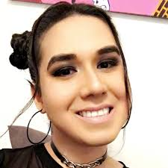
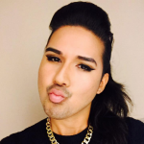
NON-BINARY VOICES
“Throughout my life, I have made so many stops all along the gender and sexuality spectrums. Each one felt like home until it didn’t. I’d stumble across a new shell and try it on. If it fit, I’d keep it, and leave my old one behind.
So I’ve been gay. I’ve been gender non-conforming. I’ve been queer. I’ve been genderqueer. And now I’m non-binary. And sometimes a demiwoman.”
Karari Olvera Orozco (they/she)
Activist, writer, co-founder and former editor-in-chief of xQsí Magazine, an online LGBTQ Latin@ Multimedia Publication.
110
Notes:
As we’ve said, gender can be fluid. Here, writer and activist Karari Olvera Orozco shares a bit of their story. (Read the slide.)
A demiwoman is someone who was assigned female at birth but does not fully identify with being a woman, socially or mentally.
If someone has two types of pronouns, like we see here with Karari, they may feel more comfortable with one over the other. So be sure to ask which one they are most comfortable with.

Slide 111
INTERSEX
Intersex is a general term used for a variety of conditions in which a person is born with a reproductive or sexual anatomy that doesn’t fit the typical definitions of female or male.
Intersex
XO
XXX
XXY
XYY
Male
XY
Female
XX
111
Notes:
Intersex conditions comprise more than 30 natural genetic variations. Historically, these variations have not been socially acceptable.
Proposed laws focused on the rights of transgender people regarding restroom usage, participation in sports, and even access to specific health care coverage, and have centered on genitals or proposed chromosome tests. These laws also affect the intersex community, who are often entirely ignored or left out of those conversations.
More people are intersex than we realize. In the past, this was often discovered in testing for the Olympic games, because some women were subjected to gender testing if they were thought to have a perceived physical advantage.
Scientists say there is no clear definition of male & female – that one’s sex includes more than just physical anatomy. It also includes hormone levels, chromosomes, and more.
The LGBTQ+ movement is now often referred to as LGBTQIA+ to include intersex people because of the similar issues facing each group around body autonomy and identity. (The “I” is for Intersex and the “A” for Asexual, which is a lack of sexual attraction.)

Slide 112
TRANS IDENTITIES
Trans woman
Trans girl
Someone assigned a male sex at birth who knows themselves to be a woman (or girl).
Trans man
Trans boy
Someone assigned a female sex at birth who knows themselves to be as a man (or boy).
Trans-feminine
Trans-masculine
Descriptive terms that transgender people use to explain where their gender expression lies.
112
Trans-feminine and trans-masculine: Descriptive terms that some people under the transgender umbrella will use to explain where their gender expression lies.
Notes:
Please note that “transgender” or “trans” are adjectives. They are terms that describe. A person is transgender, not “a transgender.”
A trans woman (or trans girl) is assigned a male sex at birth but knows themself to be a woman. Alternately, a trans man is assigned a female sex at birth but knows themself to be a man.
Someone who is transmasculine, identifies on the masculine side of the gender spectrum, but may not identify as a man. The same is true for transfeminine people. They may identify as more female, but not see themselves as a woman.

Slide 113

INTRODUCTIONS
Raise Your Hand If…
113
Notes:
(Presenter Note: This slide can be used or replaced with another type of group introduction.)
Let’s find out who’s in the room today. If your answer is yes, please raise your hand.
Do you teach at the elementary level?
Do you at the middle school level?
Do you teach at the high school level?
Have you been a teacher for less than 5 years?
Have you been a teacher for more than 20 years?
Raise your hand if you want to better support LGBTQ+ students.

Slide 114

EXPLAINING GENDER IDENTITY
Range of Gender Identities
114
Notes:
This video offers a simple way of looking at various gender identities (~3 mins).
Debrief the video with these three questions:
What is the gender binary? How many of you grew up thinking the only gender options were male or female?
What does it mean to be non-binary?
What is the difference between transgender and non-binary?

Slide 115
CHECK-IN
The
Gender
Unicorn
115
Notes:
Small Group Discussion: Review the Gender Unicorn Activity (insert link).

Slide 116
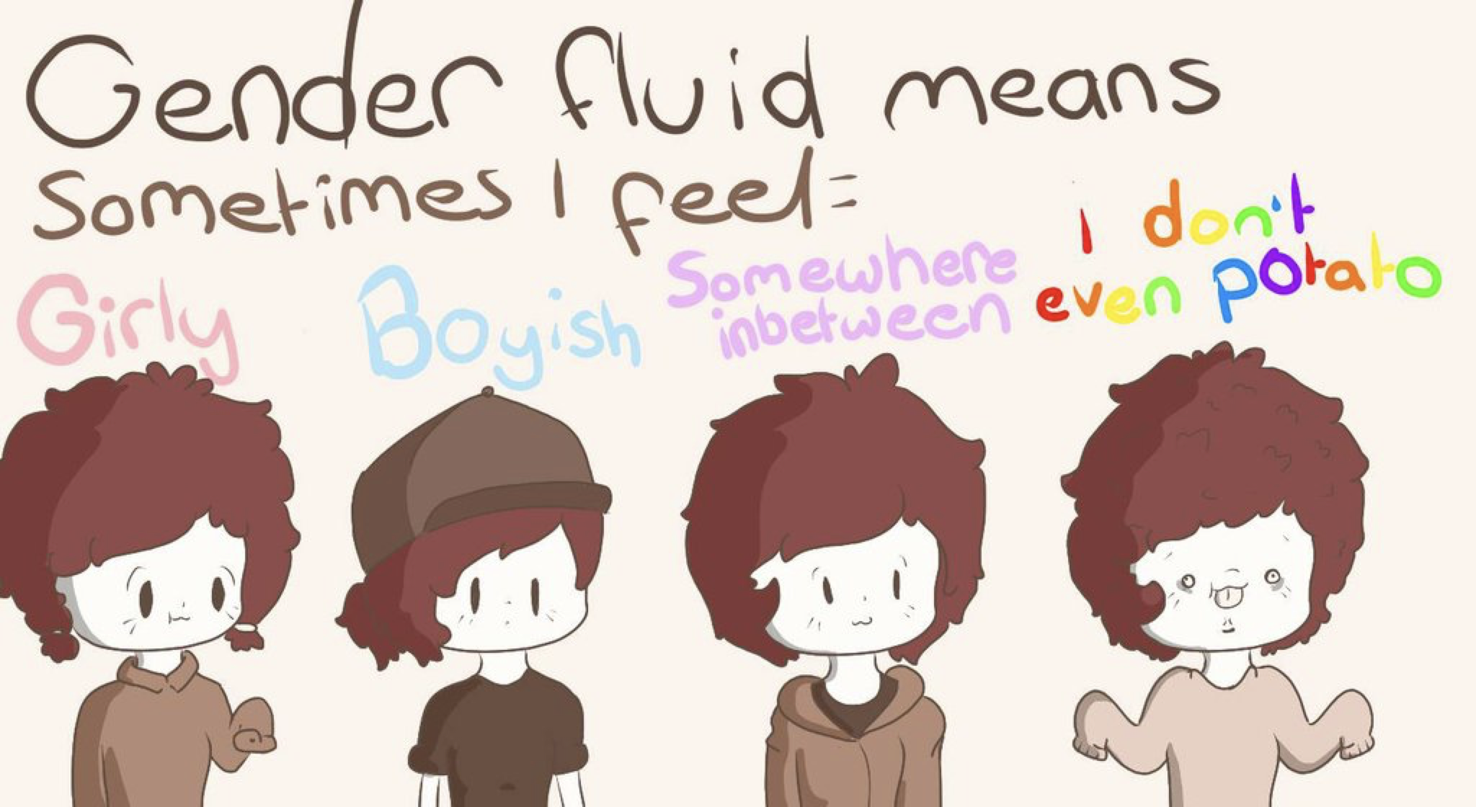
Other Gender Identities
ADDITIONAL TERMS
Gender Fluid Genderqueer Agender
116
Notes:
Gender fluid is exactly what it sounds like. Gender flows in a more masculine way at times and in a more feminine way at others, with no internal struggle between the two. That fluidity could happen over many years, or it may fluctuate during a week.
Genderqueer people are fluid in their gender and often their sexuality. People who consider themselves genderqueer will often say that no rules apply. They like what they like, who they like, and feel the best living outside of any boxes.
Older generations often regard the word “queer” as a derogatory term. It causes LGBTQ+ people of a certain age to feel pain and relive some tough times when they hear it. But younger generations have reclaimed the word and are using “queer” for themselves. They don’t want to be narrowly defined as gay, lesbian, bi, or trans. Because there is respect for the spectrums of gender and sexuality, “queer” feels more all encompassing for who they are.
Agender is the last term on this slide, and it describes someone who does not have a gender. Agender people can feel no connection to the concept of gender at all. They may feel genderless or gender neutral.

